Slide 1
REVIEW SEMINAR – I • VII SEMESTER • MAJOR PROJECT
HieraSync AI
Smart Academic Workflow & Event Management System
One role-aware workspace for tasks, approvals, events, notifications, analytics and AI assistance.
AT A GLANCE
17+ REST API modules (FastAPI)
13+ Web pages (React + TS)
10 Role-based user roles
2-stage HOD → Principal approvals
AI Risk engine + chat + reports
Department of Computer Science & Engineering (Artificial Intelligence & Machine Learning)
S. B. Jain Institute of Technology, Management & Research, Nagpur • Academic Year 2026–27
PRESENTED BY [Your Name] • Roll No: [__] • VII Sem, CSE (AI & ML)
GUIDED BY [Guide Name], [Designation], Dept. of CSE (AI & ML)
PROJECT REPOSITORY github.com / Parthwadekar40 / Hiera_Sync
Notes:
Good morning respected reviewers. I present HieraSync AI, our major project: a smart academic workflow and event management system built for our department. This Review Seminar-I covers our progress so far — the problem, design, technology and the modules already implemented and running.

Slide 2
FLOW OF PRESENTATION
Presentation Roadmap
02
01
Title
02
Introduction
03
Problem & Objectives
04
Literature Survey
05
System Design
06
Technology Used
07
Developed Modules
08
Advantages & Uses
09
References
10
Conclusion
Review Seminar – I reflects ACTUAL implementation progress — every module shown today is designed, coded and running in our repository.
HieraSync AI • Review Seminar – I CSE (AI & ML), SBJIT Nagpur
Notes:
I will walk through ten sections, from the problem to design, technology, working modules, advantages, references and conclusion.

Slide 3
1 · INTRODUCTION
Introduction — What is HieraSync?
03
▪ A full-stack web platform that centralizes departmental work — tasks, events, approvals, notifications, goals and reports — in one place.
▪ Role-aware by design: Principal → HOD → Faculty → Staff/Students, with 10 distinct roles and access rules.
▪ Built for CSE (AI & ML), SBJIT Nagpur, and generalizable to any department or institute.
▪ Real engineering scale: 17 REST API modules, 13+ UI pages, JWT security, scheduled reminders and an AI assistant.
▪ One-line value: it replaces registers, scattered WhatsApp threads and Excel sheets with a single accountable workspace.
Domain
Web-based Academic Workflow Automation + Applied AI (heuristic risk scoring, summarization, report generation).
Users
Principal, HOD, Faculty, TAs, Lab Assistants, Staff, Students & Student Representatives.
Deployment
Cloud-ready: React SPA + FastAPI services + Firebase (Firestore, Auth, Storage).
HieraSync AI • Review Seminar – I CSE (AI & ML), SBJIT Nagpur
Notes:
HieraSync is a role-aware web platform for our department. It brings tasks, approvals, events and analytics together, with AI assistance for prioritization and risk alerts.

Slide 4
1 · INTRODUCTION
Background & Motivation
04
Approvals get lost
Paper forms and chat messages have no trail — requests stall for days with no visibility.
No workload view
HODs cannot see who is overloaded; work distribution is guesswork.
Manual reporting
Monthly/NAAC reports are assembled by hand from Excel sheets — slow and error-prone.
Missed deadlines
No reminders, no risk signals — tasks slip until it is too late.
▪ Motivation: digitize the hierarchy itself — every request flows through the correct authority with timestamps, comments and status.
▪ Opportunity: cloud + AI can automate prioritization, reminders and delay-risk alerts at near-zero operational cost.
▪ Outcome: faster decisions, fair workload distribution and accreditation-ready digital records (NAAC/NBA documentation).
2025–26 evidence: a UNSW pilot cut admin workload 60% with AI agents • 2026 surveys: Asana AI leads risk detection but paywalls AI at $10.99+/user/mo — academic teams need a low-cost alternative.
HieraSync AI • Review Seminar – I CSE (AI & ML), SBJIT Nagpur
Notes:
Departments still run on paper and chat apps. That causes lost approvals, invisible workloads and painful manual reporting. HieraSync digitizes the hierarchy itself. Recent 2025-26 studies back this: AI agents cut admin workload by up to sixty percent in pilots.

Slide 5
2 · PROBLEM STATEMENT & OBJECTIVES
Problem Statement
05
“ Academic departments lack a unified, role-aware digital system to assign, track, approve and analyse teaching and administrative work — causing delays, opacity and overload. ”
Fragmented
communication
Tasks live across WhatsApp, mail and memory — nothing is searchable or tracked.
No accountability trail
Who approved what, and when? Paper leaves no audit log.
Approval bottleneck
Single-channel, manual HOD → Principal routing takes days.
Zero data insight
No analytics on load, delays or performance for decisions.
HieraSync AI • Review Seminar – I CSE (AI & ML), SBJIT Nagpur
Notes:
Our formal problem statement: departments lack a unified role-aware system for academic work. Four concrete pains follow from this — fragmentation, no audit trail, slow approvals and zero analytics.

Slide 6
2 · PROBLEM STATEMENT & OBJECTIVES
Objectives & Scope
06
1
O1 — Centralized role-based workspace Tasks, events, approvals, documents, goals and notifications in one secure portal.
Scope (Review-I)
Department-level web deployment: CSE (AI & ML). Web-first responsive UI; Firebase cloud backend; heuristic AI (no GPU servers).
2
O2 — Two-stage digital approvals Structured HOD → Principal workflow with comments, history and status tracking.
3
O3 — Automation of follow-ups Notification center, scheduled daily reminders and deadline alerts — no manual chasing.
Success criteria
All 5 objectives demonstrable live: login as each role → assign → approve → notify → analyse.
4
O4 — AI assistance Deadline-risk prediction, priority scoring, conversational assistant and auto-generated reports.
5
O5 — Analytics & one-click reports Dashboards, faculty performance views and exportable department summaries.
HieraSync AI • Review Seminar – I CSE (AI & ML), SBJIT Nagpur
Notes:
Five measurable objectives guide the build — workspace, approvals, automation, AI and analytics. Scope is department-level for Review-I, with institute scale-up planned.

Slide 7
3 · LITERATURE SURVEY
Existing Systems — Comparative Study
07
System / Category | Strengths | Limitations found
Manual registers, Excel, WhatsApp | Zero cost; familiar | No tracking or audit trail; data loss; zero analytics
Traditional college ERPs | Cover fees / attendance / records | Costly, rigid, weak faculty task-workflows; poor UX
AI PM suites 2026 (Asana, Monday, ClickUp, Notion AI) | Risk detection, summaries, workflow automation | AI paywalled $7–20/user/mo; corporate-generic: no academic hierarchy or dept. analytics
Google Workspace (Mail, Calendar, Drive) | Good collaboration | Scattered tools; no RBAC workflows or approval audit
Moodle / LMS platforms | Strong learning content | Student-centric; no faculty admin / approval workflows
Inference (incl. 2026 app surveys): nothing combines academic hierarchy + workflows + approvals + analytics + AI in one low-cost stack — the gap HieraSync targets.
HieraSync AI • Review Seminar – I CSE (AI & ML), SBJIT Nagpur
Notes:
We surveyed five categories. Each solves part of the problem, but none combines academic hierarchy, approvals, analytics and AI in one low-cost system. That is our gap.

Slide 8
3 · LITERATURE SURVEY
Research Papers & Identified Gaps
08
[1] IEEE Xplore — “A Detailed Analysis of College ERP Software Systems.” ERPs raise efficiency, but cost/complexity block adoption. → Our low-cost modular cloud stack.
[2] IJERT (2026) — Swain et al., modular web-based college ERP. Cuts admin labor; flexible expansion. → Our router-per-module design.
[3] Frontiers Educ. (2025) — Khairullah et al., AI in HEI academic + admin processes. AI scheduling, resource mgmt, decision support (Univ. of Murcia case). → Our risk engine + analytics.
[4] Frontiers Educ. (2025) — Buele et al., faculty perceptions of AI. AI without support strategies overloads staff. → Human-in-the-loop approvals: AI suggests, humans decide.
Also reviewed: AI-agents-in-HE study (60% admin cut, UNSW pilot) · IJARSCT Django ERP (RBAC design) · 2026 AI-PM app surveys (Asana / Monday / ClickUp / Notion).
GAPS → OUR ANSWER
✔ Prior work = student records & fees → we target faculty workflows
✔ AI paywalled $7–20/user/mo → our zero-cost heuristic engine
✔ Full automation risks overload → human-in-the-loop approvals
✔ Heavy on-premise ERPs → serverless Firebase, web-only
Full citations with links are listed in the References section (slide 23).
HieraSync AI • Review Seminar – I CSE (AI & ML), SBJIT Nagpur
Notes:
Recent 2025-26 research supports our direction: ERPs help but are costly; AI pilots cut admin workload up to sixty percent; but full automation without support can overload staff — so our novelty is faculty workflows plus human-in-the-loop approvals plus zero-cost AI risk scoring.

Slide 9
4 · SYSTEM DESIGN
Design Approach & Methodology
09
HOW WE BUILT IT▪ Agile, module-wise slices: each module = API router + UI page + Firestore model, demoed incrementally.
▪ 3-tier architecture: React SPA → FastAPI REST → Firebase backend-as-a-service.
▪ Security-first: Firebase Auth + JWT; role check dependency on every protected endpoint.
▪ Automation layer: APScheduler cron (daily 8 AM reminders) + notification engine.
KEY DESIGN DECISIONS▪ Firestore NoSQL — flexible workflow documents, serverless scaling, no DB ops.
▪ Router-per-module API — 17 independent routers; easy to extend without breakage.
▪ Heuristic AI first — deadline-risk scoring without GPU/LLM cost; LLM-ready chat hook.
▪ Audit-friendly — timestamps, comments and stage history on every approval.
HieraSync AI • Review Seminar – I CSE (AI & ML), SBJIT Nagpur
Notes:
We followed agile vertical slices. The design is a secure three-tier system with a router-per-module API and heuristic AI that needs no expensive infrastructure.

Slide 10
4 · SYSTEM DESIGN
System Architecture (3-Tier + Cloud)
10
TIER 1 — CLIENT (React 19 + TS + Vite)
• Dashboard, Tasks (Kanban), Calendar
• Approvals, Goals, Reports
• AI Chat + Notification Center
• AuthContext • Protected routes
• Tailwind + Framer Motion UI
TIER 2 — APPLICATION (FastAPI REST · /api/v1)
Routers: auth · users · departments · tasks
task-requests · approvals · events · goals
comments · attachments · notifications
analytics · reports · ai · files · search
settings · join
— JWT + RBAC middleware · CORS —
— APScheduler: daily 8 AM reminders —
TIER 3 — CLOUD DATA (Firebase)
• Cloud Firestore
(users, tasks, approvals…)
• Firebase Authentication
• Firebase Storage
(attachments)
• Email hooks
HTTPS · JSON
Admin SDK
Stateless REST • JWT in Authorization header • Role check on every request • Auto OpenAPI docs at /docs
HieraSync AI • Review Seminar – I CSE (AI & ML), SBJIT Nagpur
Notes:
Three tiers: a React single-page app, a FastAPI REST layer with seventeen routers and JWT role checks, and Firebase for data, auth and storage. A scheduler fires daily reminders.

Slide 11
4 · SYSTEM DESIGN
Data Flow Diagram — Level 0 (Context)
11
☐ FACULTY
Task updates, requests
☐ HOD
Assigns, reviews, reports
updates / requests
tasks / approvals
HieraSync AI
System (0)
☐ PRINCIPAL / ADMIN
Final approval, users
☐ CLOUD SERVICES
Store · Auth · Notify
decisions / config
persist / alerts
HieraSync AI • Review Seminar – I CSE (AI & ML), SBJIT Nagpur
Notes:
The context diagram shows HieraSync as one process with four external entities: faculty, HOD, principal-admin, and cloud services exchanging tasks, approvals and alerts.

Slide 12
4 · SYSTEM DESIGN
Data Flow Diagram — Level 1 (Detail)
12
P1
Users & Roles
login, RBAC
P2
Tasks & Events
assign, track
P3
Approvals
HOD→Principal
P4
Notify & Remind
alerts, cron
P5
AI & Reports
risk, analytics
D1 · Users
D2 · Tasks/Events
D3 · Approvals
D4 · Notify Log
P5 reads D1–D4
→ dashboards
Flow: Users authenticate (P1) → work is assigned & tracked (P2) → approvals move hierarchically (P3) → stakeholders are alerted (P4) → AI + analytics summarize (P5).
HieraSync AI • Review Seminar – I CSE (AI & ML), SBJIT Nagpur
Notes:
Level one decomposes the system into five processes and four data stores. Authentication feeds task tracking, which feeds approvals, notifications, and finally AI analytics.

Slide 13
4 · SYSTEM DESIGN
Use Case Diagram
13
◉ ADMIN
— HieraSync System Boundary —
Login &
RBAC
Manage
Employees
Create / Assign
Tasks
Update
Progress
◉ PRINCIPAL
Request
Task
Approve
(HOD)
Approve
(Principal)
Manage
Events
◉ HOD
View
Analytics
AI Chat &
Reports
Receive
Alerts
Goals &
Milestones
◉ FACULTY
HieraSync AI • Review Seminar – I CSE (AI & ML), SBJIT Nagpur
Notes:
Four actors interact with twelve use cases. Admin manages users, faculty executes tasks, HOD assigns and reviews, and the principal gives final approvals and views analytics.

Slide 14
4 · SYSTEM DESIGN
Database Design — Firestore Collections
14
▦ users
id · name · email
role (10 roles)
department_id
designation, status
▦ departments
id · name · code
hod_id
▦ tasks
id · title · assignee
priority · status
progress · deadline
risk_score · goal_id
▦ approvals
id · title · requester
stage, hod_comment
principal_comment
status
▦ events
id · title · date
type · person
location
▦ notifications
id · user_id · title
type · is_read
▦ goals
id · title · category
target_date
+ milestones[]
▦ comments /
attachments
subcollections
of tasks:
mentions, files
Relations: departments 1—N users • users 1—N tasks • tasks 1—N comments / attachments • goals 1—N milestones • approvals link requester → HOD → Principal
HieraSync AI • Review Seminar – I CSE (AI & ML), SBJIT Nagpur
Notes:
Firestore holds eight collections. Departments own users, users own tasks, tasks carry comments and attachments, and approvals chain requester to HOD to principal.

Slide 15
4 · SYSTEM DESIGN
Core Workflow — Approval Flowchart
15
START: Request raised
Stage machine
PENDING → APPROVED_HOD →
APPROVED_PRINCIPAL
(or REJECTED at any stage)
• Comments at each stage
• Timestamps + history
• Task-requests auto-create
tasks on approval
HOD reviews request
REJECTED ✕ + reason → notify
HOD
approves?
NO
YES
Forward to Principal
Actors
Faculty / Staff raise →
HOD reviews →
Principal decides
Principal
approves?
REJECTED ✕ + reason → notify
NO
YES
APPROVED ✓ • notify all • log history
HieraSync AI • Review Seminar – I CSE (AI & ML), SBJIT Nagpur
Notes:
Every request passes a two-stage state machine: pending, HOD-approved, then principal-approved — or rejected with a recorded reason. Each transition notifies stakeholders.

Slide 16
5 · TECHNOLOGY USED
Technology Stack & Justification
16
Layer | Technology | Why this choice
Frontend | React 19 + TypeScript + Vite | Actions/Suspense, type safety, instant HMR builds
Styling / UX | Tailwind CSS v4, Framer Motion, lucide-react | Responsive, animated, consistent design system
Calendar / Charts / DnD | FullCalendar, Recharts, dnd-kit | Production-grade calendar, analytics & Kanban
Backend API | FastAPI (Python), Pydantic v2 | Async, validated, auto OpenAPI docs at /docs
Auth | Firebase Auth + JWT (python-jose) | Secure, stateless, role-checked sessions
Database | Cloud Firestore (NoSQL) | Serverless scale, flexible docs, zero DB ops
Storage / Scheduler | Firebase Storage, APScheduler | File attachments; daily 8 AM reminder cron
Tooling: Git + GitHub • npm + pip • VS Code • Postman / OpenAPI for API testing • Vercel / Cloud Run-ready deploy targets
HieraSync AI • Review Seminar – I CSE (AI & ML), SBJIT Nagpur
Notes:
Our stack is modern and pragmatic: React with TypeScript, FastAPI for a documented REST API, and Firebase as a serverless backend — minimizing ops cost while staying extensible.

Slide 17
6 · DEVELOPED MODULES
Modules Developed — Status at Review-I
17
# | Module | Key capability delivered | Status
M1 | Auth & RBAC | Login/register, JWT, 10 roles, protected routes | ✔ Done 100%
M2 | Employee Mgmt | Faculty CRUD, profiles, department mapping | ✔ Done 95%
M3 | Task Management | Kanban, subtasks, priorities, progress, risk badges | ✔ Done 95%
M4 | Events & Calendar | FullCalendar views, types, reminders | ✔ Done 90%
M5 | Approval Workflow | HOD→Principal stages, comments, history | ✔ Done 90%
M6 | Notifications | Center, unread counts, scheduler + email hooks | ◐ 85%
M7 | AI Assistant | Chat, dashboard summary, report-gen, risk engine | ◐ 80%
M8 | Analytics & Reports | Stats, activity log, faculty performance, export | ◐ 85%
M9 | Goals / Requests / Social | Milestones, task-requests, comments, attachments | ✔ Done 90%
HieraSync AI • Review Seminar – I CSE (AI & ML), SBJIT Nagpur
Notes:
Nine modules are implemented. Six are essentially complete; AI, notifications and analytics are at eighty-plus percent and under active polish.

Slide 18
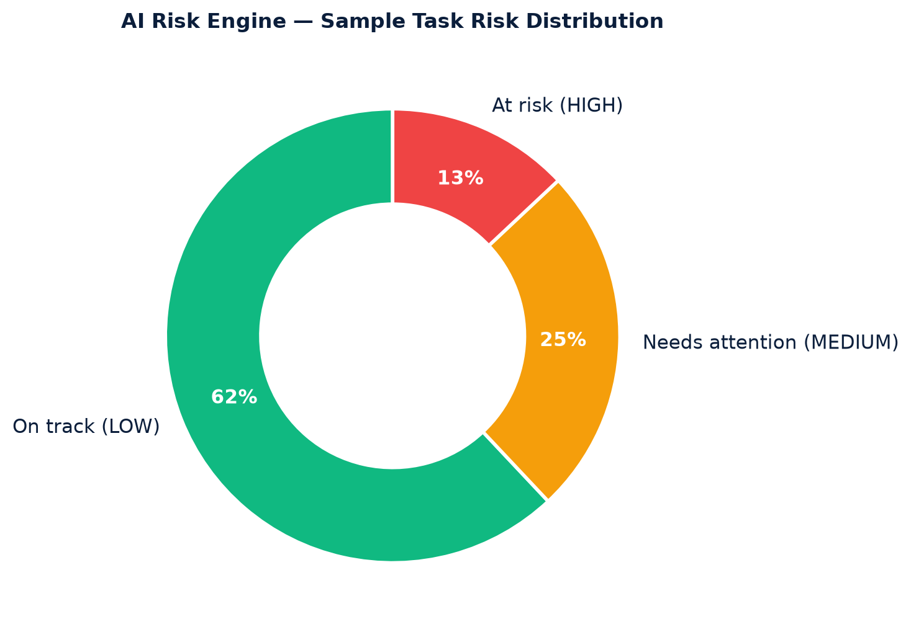
6 · DEVELOPED MODULES
Deep-Dive A — Tasks + AI Risk Engine
18
TASK MANAGEMENT▪ Kanban board with drag-and-drop (dnd-kit).
▪ Priorities, deadlines, subtasks, progress %.
▪ Goal linking + approval-required tasks.
▪ Comments with @mentions; file attachments.
▪ HOD vs Faculty dashboards with distinct views.
AI RISK ENGINE (HEURISTIC)▪ Risk score 0–100 from deadline gap, progress lag, workload.
▪ Levels LOW / MEDIUM / HIGH + human-readable risk factors.
▪ Endpoints: /dashboard-summary, /chat, /generate-report.
▪ HOD action items: who needs help, what is late.
▪ No GPU/LLM cost — deterministic & explainable.
Sample output: 62% tasks on track,
25% need attention, 13% at risk
→ HOD sees this before delay happens.
HieraSync AI • Review Seminar – I CSE (AI & ML), SBJIT Nagpur
Notes:
Tasks support Kanban, subtasks and attachments. On top sits our heuristic risk engine scoring every task zero to one hundred with explainable factors — no costly LLM needed.

Slide 19
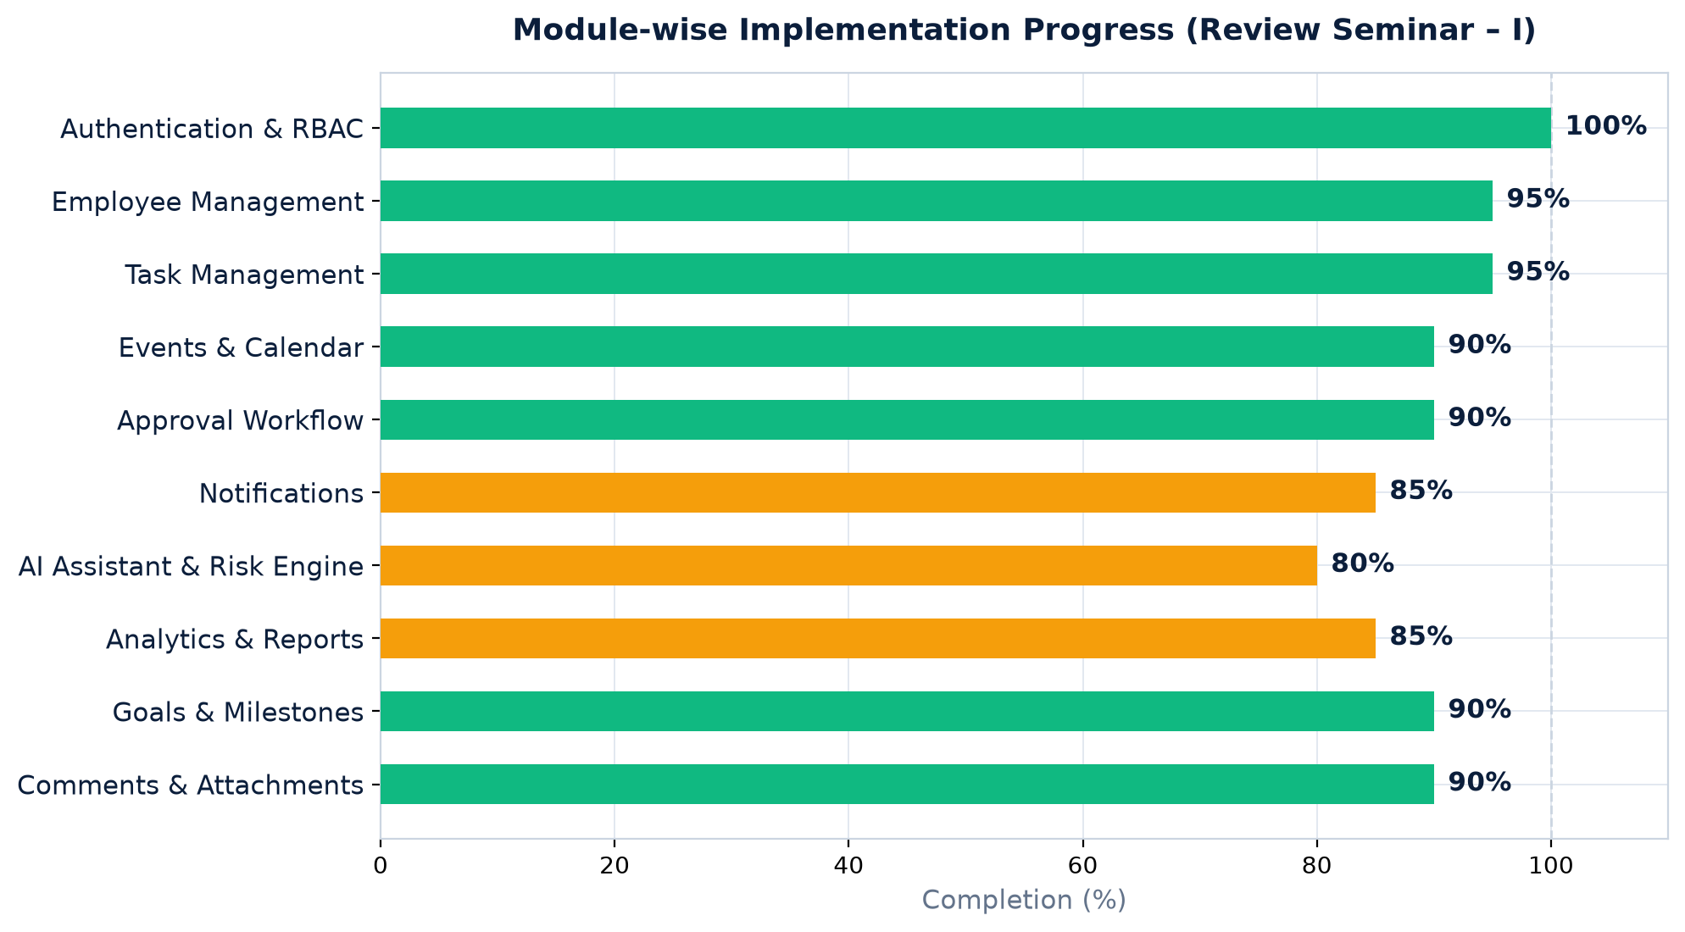
6 · DEVELOPED MODULES
Deep-Dive B — Approvals, Analytics, Alerts
19
✓ Approvals
• HOD → Principal stages
• Comments & decision history
• Pending / approved / rejected views
• Task-requests convert to tasks
◐ Analytics & Reports
• Dashboard stats + activity log
• Faculty performance table
• Completion & on-time metrics
• One-click report export
◐ Notifications
• In-app center + unread badge
• Task / approval / event alerts
• Daily 8 AM scheduler cron
• Email hook ready
HieraSync AI • Review Seminar – I CSE (AI & ML), SBJIT Nagpur
Notes:
Approvals, analytics and notifications close the loop: decisions are tracked, performance is measured, and nobody misses an update thanks to scheduled reminders.

Slide 20
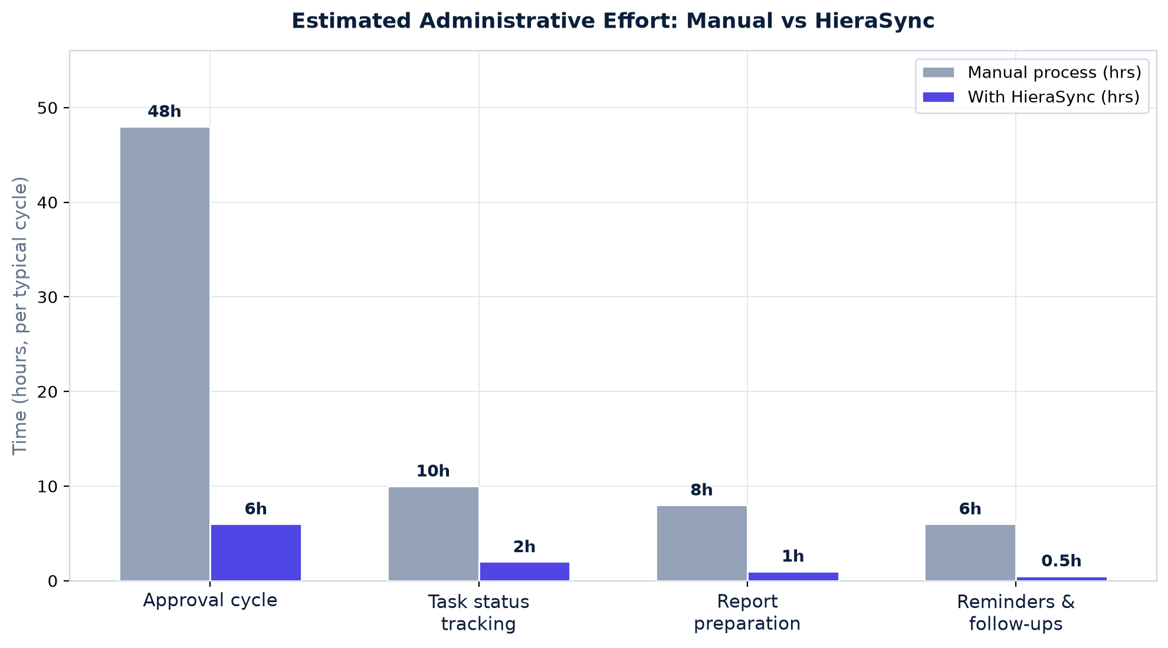
7 · ADVANTAGES & APPLICATIONS
Advantages
20
▪ Single source of truth: one workspace replaces registers, chats and sheets.
▪ Faster decisions: approval cycles shrink from days to hours (est.).
▪ Full accountability: who did/approved what, with timestamps.
▪ Proactive, not reactive: reminders + AI delay-risk alerts.
▪ Data-driven leadership: workload balance + NAAC-ready reports.
▪ Low cost & secure: serverless Firebase, zero per-seat AI fees (vs $7–20/user/mo suites); JWT + per-request role checks.
Estimated admin effort per cycle drops ~80–90% across approvals, tracking and reporting.
HieraSync AI • Review Seminar – I CSE (AI & ML), SBJIT Nagpur
Notes:
The payoff: one accountable workspace, far faster approvals, proactive alerts, leadership dashboards — at serverless cost with strong access control.

Slide 21
7 · ADVANTAGES & APPLICATIONS
Applications & Future Scope
21
WHERE IT APPLIES▪ Department task & event governance (any branch).
▪ Leave, purchase & resource approvals.
▪ Accreditation (NAAC/NBA) documentation.
▪ Faculty appraisal & workload inputs.
▪ Student clubs, labs & multi-department roll-out.
FUTURE SCOPE▪ Mobile app / PWA + push notifications.
▪ ML-based delay prediction on history.
▪ Timetable & attendance integration.
▪ Email/SMS gateway; offline mode.
▪ Multi-college SaaS + institute console.
HieraSync AI • Review Seminar – I CSE (AI & ML), SBJIT Nagpur
Notes:
Beyond our department, the system fits any academic unit and accreditation workflows. Planned extensions include mobile support, ML prediction and multi-college scale.

Slide 22
REVIEW SEMINAR – I
Progress Status & Plan Ahead
22
✔ COMPLETED (IN REPO TODAY)✔ Full-stack scaffold: React SPA + FastAPI + Firebase wired.
✔ 17 API routers live; 13+ pages with RBAC guards.
✔ Approvals, tasks, events, scheduler, AI heuristics.
◐ IN PROGRESS◐ AI chat polish + richer report formats.
◐ UI polish, validations & test coverage.
◐ Cloud deployment + user acceptance testing.
Phase | Milestone | Target | Status
Review – I | Core platform + 9 modules demonstrable | Sept 2026 | ✔ ~90% done
Hardening | Testing, AI tuning, deployment | Oct 2026 | ◐ Planned
Review – II | Deployed pilot + docs + feedback fixes | Nov 2026 | ○ Next
Final | Final demo, report & publication | Dec 2026 | ○ Next
HieraSync AI • Review Seminar – I CSE (AI & ML), SBJIT Nagpur
Notes:
As of today, about ninety percent of core scope is implemented and visible in our repository. Hardening and deployment lead to Review Two, then final demonstration.

Slide 23
8 · REFERENCES
References
23
[1] “A Detailed Analysis of College ERP Software Systems,” IEEE Xplore, doc. 10743425. https://ieeexplore.ieee.org/document/10743425/
[2] S. Swain et al., “College ERP Management System,” IJERT, vol. 15, no. 04, Apr. 2026, DOI: 10.5281/zenodo.19731754.
[3] S. Tripathi et al., “College ERP System,” IJCRT, paper IJCRT1812344. https://www.ijcrt.org/papers/IJCRT1812344.pdf
[4] R. Salunke et al., “ERP Management System” (Django, RBAC), IJARSCT. https://www.ijarsct.co.in/Paper25814.pdf
[5] S. A. Khairullah et al., “Implementing AI in academic and administrative processes…,” Front. Educ., 2025. https://www.frontiersin.org/journals/education/articles/10.3389/feduc.2025.1548104/full
[6] “The Future of AI Agents in Higher Education,” ResearchGate, 2025. https://www.researchgate.net/publication/394249334
[7] “Automating Higher Education Administrative Processes with AI-Powered Workflows,” ResearchGate. https://www.researchgate.net/publication/399184231
[8] J. Buele et al., “Transformations in academic work and faculty perceptions of AI,” Front. Educ., 2025. https://www.frontiersin.org/journals/education/articles/10.3389/feduc.2025.1603763/full
[9] “8 Best AI for Project Management in 2026 (Compared by a PM),” Dupple, 2026. https://dupple.com/learn/best-ai-for-project-management
[10] FastAPI, Firebase, React & Vite official docs; Project repo: https://github.com/Parthwadekar40/Hiera_Sync
HieraSync AI • Review Seminar – I CSE (AI & ML), SBJIT Nagpur
Notes:
Our references combine three peer-reviewed works on college ERP systems with official documentation of our stack and our own public repository.

Slide 24
9 · CONCLUSION
Conclusion
24
▪ We built a unified, role-aware platform covering the department's real workflows end-to-end.
▪ Approvals are digitized & auditable; follow-ups are automated; nothing falls through cracks.
▪ AI adds foresight: risk scores and summaries help HODs act before delays.
▪ All 5 objectives are demonstrable live — the system runs from our repository today.
“ HieraSync turns departmental chaos into a calm, transparent workflow. ”
HieraSync AI • Review Seminar – I CSE (AI & ML), SBJIT Nagpur
Notes:
In conclusion, HieraSync delivers every objective: unified workspace, auditable approvals, automation, AI foresight and analytics — all running live for demonstration.

Slide 25
Thank You!
Open for Live Demonstration & Questions
HieraSync AI • Smart Academic Workflow & Event Management System
github.com / Parthwadekar40 / Hiera_Sync
[Your Name] • Guided by [Guide Name] • CSE (AI & ML), SBJIT Nagpur
Backup slides 26–30 follow for Q&A
Notes:
Thank the panel, offer a live demo: login as HOD, create a task, approve a request, show AI risk and analytics. Invite questions.

Slide 26
APPENDIX · BACKUP FOR Q&A
Appendix A — Sequence Diagram (Approval Flow)
26
Faculty
Browser
FastAPI
Server
Firestore
DB
HOD / Principal
App
1 POST /approvals {title, …}
2 save: status = PENDING
3 ack
4 201 Created
5 PUT /{id}/approve (HOD)
6 stage = APPROVED_HOD
7 notify: HOD ✓, faculty ✓
8 PUT /{id}/approve (Principal)
9 status = APPROVED_PRINCIPAL
10 notify all + activity log
Synchronous REST/JSON • every mutating call carries JWT + role check • failures return 4xx with no state change
HieraSync AI • Review Seminar – I CSE (AI & ML), SBJIT Nagpur
Notes:
Backup slide. The sequence shows a request flowing from the faculty browser to FastAPI to Firestore, then HOD and principal approvals, each persisting stage changes and fanning out notifications.

Slide 27
APPENDIX · BACKUP FOR Q&A
Appendix B — Task Lifecycle & Risk Formula
27
TODO
RISK FORMULA · calculate_task_risk() · tasks.py
Completed / Awaiting Approval → R = 0 (LOW)
Otherwise: R = clamp(D + G + P + W, 5, 95)
D = 90 overdue · 50 if ≤2d · 30 if ≤5d
G = 25 if progress < 50% and ≤3 days left
P = 15 if priority High · W = 20 if load > 3
HIGH if R > 70 · MEDIUM if R > 40 · LOW else
e.g. 2d left · 30% done · High · load 5
→ 50+25+15+20 = 110 → capped 95 → HIGH ✓
IN_PROGRESS
deadline passes
OVERDUE
auto-flagged when
deadline passes;
returns to flow on update
IN_REVIEW
COMPLETED
HieraSync AI • Review Seminar – I CSE (AI & ML), SBJIT Nagpur
Notes:
Backup slide. Tasks move through four states with an overdue branch. The risk formula is exactly as implemented: deadline pressure plus progress gap plus priority plus workload, clamped and banded into three levels.

Slide 28
APPENDIX · BACKUP FOR Q&A
Appendix C — Testing & Results (Review-I)
28
ID | Test scenario | Expected result | Status
T1 | Valid HOD login | JWT issued, dashboard loads | ✔ Pass
T2 | Invalid password | 401 error, stays on login | ✔ Pass
T3 | Faculty opens HOD-only page | Blocked / redirected | ✔ Pass
T4 | HOD assigns task | Appears in faculty Kanban + alert | ✔ Pass
T5 | Faculty updates progress | % saved, activity logged | ✔ Pass
T6 | HOD → Principal approval | Stage advances, comments stored | ✔ Pass
T7 | Overdue task scored | HIGH badge + factor strings | ✔ Pass
T8 | Daily 8 AM scheduler run | Deadline reminders created | ✔ Pass
T9 | Report export | Department summary downloads | ◐ Partial
Method: manual functional testing via auto OpenAPI docs (/docs) + per-role UI walkthroughs • Automated suite + UAT in hardening phase (Oct)
HieraSync AI • Review Seminar – I CSE (AI & ML), SBJIT Nagpur
Notes:
Backup slide. Nine functional test cases cover login, role guards, tasks, approvals, risk scoring, scheduler and export. Run each live before the seminar and keep this table honest.

Slide 29
APPENDIX · BACKUP FOR Q&A
Appendix D — Feature Matrix vs Alternatives
29
Capability | Manual / Excel | College ERP | Asana-class 2026 | HieraSync
Academic role hierarchy | ✖ | ◐ | ✖ | ✔
HOD → Principal e-approvals | ✖ | ◐ | ✖ | ✔
AI delay-risk alerts | ✖ | ✖ | ◐ paid | ✔ free
Department analytics | ✖ | ◐ | ◐ generic | ✔ academic
Zero per-seat AI cost | ✔ | ✖ | ✖ | ✔
Tasks + events unified | ✖ | ◐ | ◐ | ✔
Full audit trail | ✖ | ✔ | ✔ | ✔
Open & customizable | — | ✖ | ✖ | ✔
✔ full • ◐ partial • ✖ missing → Only HieraSync combines hierarchy + approvals + free AI risk + academic analytics
HieraSync AI • Review Seminar – I CSE (AI & ML), SBJIT Nagpur
Notes:
Backup slide. Use this when asked what is novel: no alternative covers academic hierarchy, two-stage approvals, free AI risk alerts and department analytics together.

Slide 30
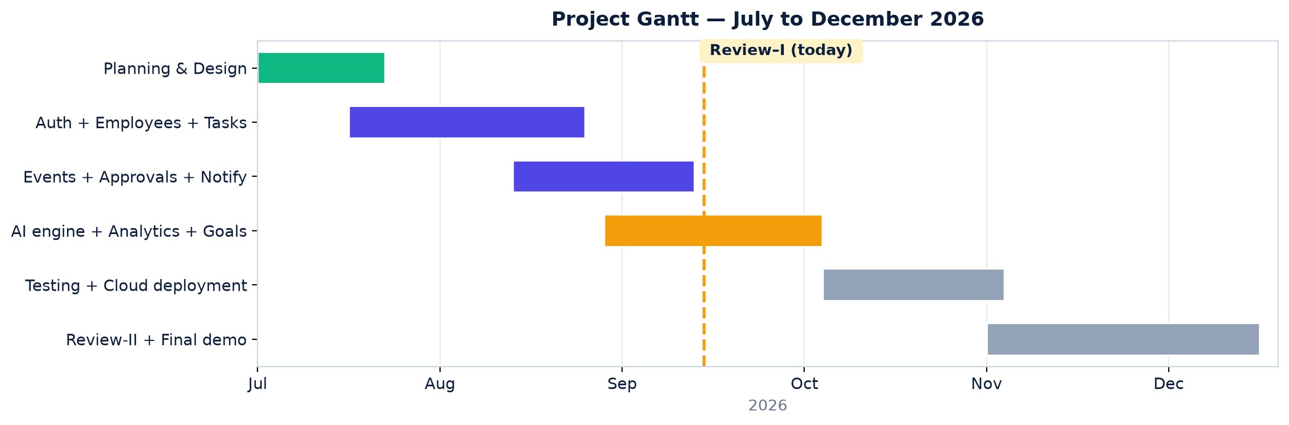
APPENDIX · BACKUP FOR Q&A
Appendix E — Project Timeline (Gantt)
30
TARGET DEPLOYMENT: Browser → Vercel / Firebase Hosting (SPA) → Cloud Run (FastAPI) → Firestore + Auth + Storage • env-based config • HTTPS everywhere
HieraSync AI • Review Seminar – I CSE (AI & ML), SBJIT Nagpur
Notes:
Backup slide. The Gantt shows design to final demo across July to December, with Review One marked today, plus the target cloud deployment chain.

