Slide 1
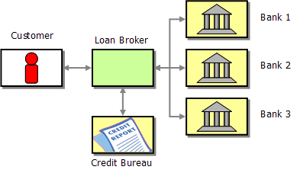
AWS Loan broker: Logical View

Slide 2
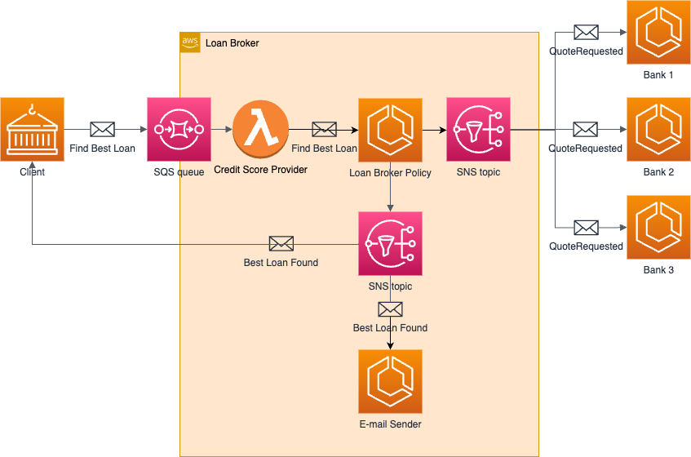
AWS Loan broker: Process View

