Slide 1
Enterprise Development
with NServiceBus
Authored by: Udi Dahan

Slide 2
Topics Covered
NServiceBus Basics
Architectural Implications
Business Processes
Scalability & Monitoring
Designing distributed systems

Slide 3
Course Programme
Day 1
One-way messaging
Queues
Request / Response
Exceptions & faults
Web Apps
WS Integration
Day 2
SOA Intro
SOA & Events
Publish / Subscribe
CQRS

Slide 4
Course Programme
Day 3
Sagas
Timeouts
Unit testing
Day 4
Scaling & Monitoring
Multi Site operations
Group exercise

Slide 5
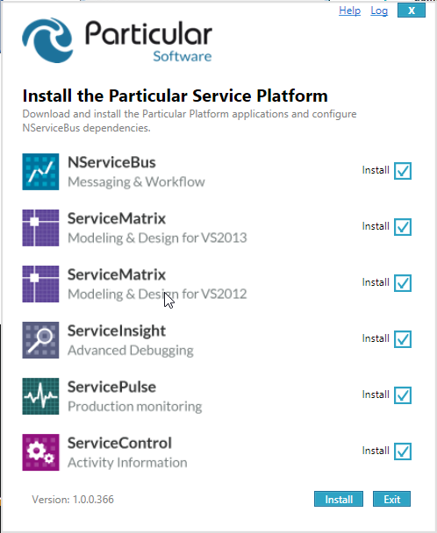
Hello Distributed World
Downloading NServiceBus
Using NServiceBus with Visual Studio
NuGet
Logging
Notes:
Mention how logging picks up log4net or NLog, and you should just use NServiceBus.Logging namespace, which provides internalized log4net implementation.

Slide 6
Exercises 1, 2
Exercise 1:
Hello Distributed World
Getting ready
Hosting NServiceBus
Exercise 2:
Logging

Slide 7
One-Way Messaging

Slide 8
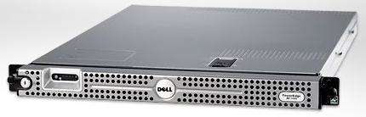

Messaging & Queues
Server
Logically one-way:
All information transferred in
the message
Client

Slide 9
How to: Define a message
public class MyMessage : IMessage { }
Or:
public interface IMyMessage : IMessage { }
Or:
public interface IMyMessage { }
configuration.Conventions() .DefiningMessagesAs(t=>MyOwnConvention(t))
Add properties like a regular class/interface
Keep messages in their own assembly/project
Use conventions whenever possible

Slide 10
How to: Instantiate a message
var m = new MyMessage();
Notes:
If you are using interfaces for messages then you should use the options on the next slide

Slide 11
How to: Send a message
Bus.Send(messageObject);
Can instantiate and send together
Useful for interfaces:
Bus.Send<IMyMessage>(m =>
{
m.Prop1 = v1; m.Prop2 = v2;
});
Notes:
NSB creates a proxy class for message interfaces and instantiates that when you ask to create an instance of an interface. Send has lambda expression overload which allows to set the message properties.

Slide 12
How to: specify destination
Bus.Send(string destination, object msg);
Requires that application manages routing
Configure destination for message type:
In <UnicastBusConfig>, under <MessageEndpointMappings>
<add Assembly=“assembly” endpoint=“destination”>
Or:
<add Assembly=“asm” Namespace=“ns” endpoint=“dest”>
<add Assembly=“asm” Type=“fqn” endpoint=“dest”>
Notes:
Even if it is possible to specify a message destination in code it is highly suggested to specify message destinations at application-configuration level to maintain a high level of flexibility.

Slide 13
How to: specify destination
QueueName@ServerName
Or
Just QueueName for the same machine
Notes:
Broker based transports don’t need the server part. May need to quickly draw on whiteboard to quickly explain difference between bus and broker, depending on audience.

Slide 14
How to: handle a message
Write a class that implements IHandleMessages<T> where T is message type
public class H1 : IHandleMessages<MyMessage>
{
public void Handle(MyMessage message)
{
}
}

Slide 15
Exercises 3 - 6
Exercise 3:
Unobtrusive mode, message conventions
Exercise 4:
Customization of serializer
Exercise 5:
Routing
Exercise 6:
Message processing

Slide 16
Fallacies of distributed computing
The network is reliable
Latency isn’t a problem
Bandwidth isn’t a problem
The network is secure
The topology won’t change
The administrator will know what to do
Transport cost isn’t a problem
The network is homogeneous
Can’t assume WHEN the message will arrive,
IF AT ALL

Slide 17
Differences from RPC
RPC is easy to code
After invoking a web service
Next line of code assumes we’ve got a response
RPC problems
Can’t reason about the time between one line of code and another
Messaging makes this all explicit

Slide 18
Fallacy: The network is reliable
Reasons thing fail
Switch goes up in smoke
Power out
Someone trips over the network cord
New/Different security settings (Firewalls, XP SP2)
This means:
Messages/Data can get lost when sent over the wire
What do you do when that happens?
What if you don’t even know when it happens?

Slide 19
Messaging & Queues
Server
MSMQ
Outgoing Incoming
Store & Forward writes to disk
Resilient in the face of failures
MSMQ
Outgoing Incoming
Client

Slide 20
Dangers of Store & Forward
If target is offline for an extended period of time messages can fill up the disk
Can cause a server to crash
Especially problematic in B2B integration
Example:
1 MB / message, 100 messages/sec = 6GB / minute
Solution – discard messages after a while
Notes:
MSMQ also limits the size of messages to about 4MB.
Mention DataBus which simplifies the transmission of larger messages – specifically those containing “attachments” like files or images.

Slide 21
How to: Specify time to discard
Use the TimeToBeReceivedAttribute:
[TimeToBeReceived(“00:01:00”)] // one minute
public class MyMessage : IMessage { }
Unobtrusive:
configuration.Conventions() .DefiningTimeToBeReceivedAs(…)

Slide 22
Exercise 7
Conventions configuration for expiry
Centralized conventions

Slide 23
Fault Tolerance
Notes:
Batman Begins clip mentioned in Learning NServiceBus Chapter 3: http://www.youtube.com/watch?v=LstIgtkEe50

Slide 24
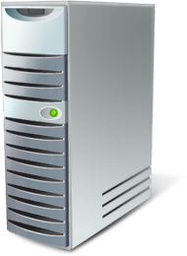

Fault Tolerance
[HTTP] $$ Order
DB
App
Tx
Call 1 of 3
Call 2 of 3
Rollback
Where’s the order!?

Slide 25
Exceptions
Reasons exceptions happen:
Deadlock in the database
Database is down
Message deserialization fails
Retrying can resolve transient exceptions
<TransportConfig MaxRetries=“5” />
Second Level Retries (SLR)
Messages that always fail are moved to an error queue
<MessageForwardingInCaseOfFaultConfig ErrorQueue="error"/>
Transient
Permanent
Deserialization exception: message moved to error queue right away
Notes:
Database down not necessarily == PANIC .... Could be failing over to a failover partner and will be back up in ~90 seconds
ActiveMq: Uses it’s own SLR mechanism

Slide 26
Messaging and Consistency
Rollback
Tx
$$ Order
Q
Receive
Rollback
App
Call 1 of 3
DB
Call 2 of 3
The order is back in the queue

Slide 27
Consistency
configuration.Transactions() Enable();
OR
IConfigureThisEndpoint, AsA_Server

Slide 28
Exercise 8
Exceptions
First-Level and Second-Level Retries

Slide 29
Authorization, Impersonation, Auditing

Slide 30
Headers
Bus.OutgoingHeaders[“user”] = “udi”;
Affects all messages sent
Bus.SetHeader(msg, “key”, “value”);
Headers attached only to specific message
For server processing, headers cleared when a new message arrives
Notes:
OutgoingHeaders affects after setting all messages sent. The example above sets the user to udi. This practically means that for the endpoint setting the outgoing headers the user header will always be «udi». Makes not much sense for MVC applications.

Slide 31
Message Processing Pipeline
Multiple handlers can process the same message
Useful for having validation handlers separate from handlers that perform business logic
Implement IHandleMessages<IMessage> or IHandleMessages<object> to handle all types of messages
Useful for things like authentication and authorization
Notes:
This may be a good place to start talking about the IT/Ops service.
Might want to mention that there are other ways to do this that will guarantee first order – UnitOfWork/Mutators for example.

Slide 32
Set Pipeline Order
configuration
.LoadMessageHandlers(
First<A>.Then<B>().AndThen<C>() );
OR
Inherit from ISpecifyMessageHandlerOrdering
order.SpecifyFirst<A>();
OR
order.Specify(First<A>.Then<B>().AndThen<C>());
Notes:
SpecifyFirst: The given type will be activated before all others, terminal syntax. Not fluent
Specify: Fluent syntax

Slide 33
How to: reference IBus in handler
public class H1 : IHandleMessages<MyMessage>
{
public IBus Bus { get; set; }
public void Handle(MyMessage message)
{
// use Bus to do something
}
}
Notes:
Mention that constructor injection is also possible

Slide 34
How to: stop the pipeline
public class Auth : IHandleMessages<IMessage>
{
public IBus Bus { get; set; }
public void Handle(IMessage message)
{
if ( /* some logic */ )
Bus.DoNotContinueDispatchingCurrentMessageToHandlers();
}
}

Slide 35
How to: get additional meta data
public class H1 : IHandleMessages<MyMessage>
{
public IBus Bus { get; set; }
public void Handle(MyMessage message)
{
Console.WriteLine(“Received “ +
Bus.CurrentMessageContext.Id + “ from “ +
Bus.CurrentMessageContext.ReplyToAddress);
// Bus.CurrentMessageContext.Headers (dictionary of strings)
}
}

Slide 36
Message Auditing
Can forward messages received to another queue
In config:
<AuditConfig
QueueName=“AuditQueue@AuditServer”>
Notes:
With broker based transports you don’t specify the server machine name. Auditing will only happen for incoming messages.
This is on by default for V4 going forward to enable the Management Service, ServiceInsight, ServicePulse, etc.
You can also use registry keys to set it globally on all machines in your datacenter.

Slide 37
Exercise 9
Authorization
Message Headers

Slide 38
Infrastructure Extension

Slide 39
Dependency Injection
NServiceBus makes heavy use of IoC
Uses a container, and exposes its own registration API:
configuration.RegisterComponents(c => c.ConfigureComponent<T>(
DependencyLifecycle lifecycle)
.ConfigureProperty(o =>
o.Property, someValue));
Notes:
Currently, Autofac is the default container. The default container is ILMerged and internalized. This may change in later versions to separate framework IoC concerns from user IoC concerns and simplify customer container integration.
In order to make the container pluggable, we had to provide our own API instead of using one of the existing ones.

Slide 40
Dependency Injection
Locator pattern is no longer supported
Configure.Instance.Builder.Build<T>();
Supports constructor or property setter injection
Constructor or setter injection is usually better
Notes:
Can use the Build<T>() in a framework piece that, for whatever reason, can’t receive dependency injection support, but shouldn’t really do this from mainstream code.

Slide 41
Unit of work management
Called once per message
Called before and after all handlers
A way to perform things like session management
Implement IManageUnitsOfWork
Needs to be registered in the container explicitly
Should be registered as instance per call
Notes:
More than one unit of work can be active at the same time. Will be called in sequence

Slide 42
Message Mutators
Implement IMessageMutator to mutate individual messages
Useful for things like validation, encryption
Implement IMutateTransportMessages to mutate transport messages
Useful for things like compression
Both on incoming and outgoing messages
Needs to be registered in the container explicitly
Notes:
http://particular.net/articles/nservicebus-message-mutators-sample
IMutateOutgoingMessages, IMutateIncomingMessages, IMutateIncomingTransportMessages, IMutateOutgoingTransportMessages

Slide 43
Exercise 10
Dependency Injection

Slide 44
Encryption

Slide 45
Encryption
Use the WireEncryptedString type for the message properties you want encrypted
public class MyMessage
{
public string UnencryptedProperty { get; set; }
public WireEncryptedString Encrypted { get; set; }
}
Get the value using the .Value property
Unobtrusive:
configuration.Conventions() .DefiningEncryptedPropertiesAs(…)
Notes:
Primarily used for sensitive data (like credit card numbers) we don’t want administrators to accidentally see – like when looking in the error queue.

Slide 46
Encryption Service
Pluggable IEncryptionService
Default implementation is the RijndaelEncryptionService
Based on a shared key
Enabled by calling configuration.RijndaelEncryptionService();
Notes:
Rijndael is also known as AES (Advanced Encryption Standard) is a symmetric algorithm, considered better than its predecessor DES.
AES is the first publicly accessible and open cipher approved by the NSA for top secret information.

Slide 47
Encryption and Topology
Same-site / LAN
Full message encryption unnecessary
Cross-site / WAN
Full message encryption may be required
Configure the Gateway to communicate using HTTPS

Slide 48
Exercise 11
Encryption
Custom convention for encrypted properties

Slide 49
Adjusting runtime behaviour

Slide 50
Profiles
Change endpoint behavior without recompiling
Built-in profiles
Environment profiles:
Lite | Integration | Production
Feature profiles (moved out of the core):
MultiSite | Distributor | Master | etc
Activated by the command line:
.\NServiceBus.Host.exe nservicebus.production nservicebus.multisite
Notes:
Is a host only feature
Setup on install when running the endpoint as a windows service
Environment related profiles
NServiceBus comes with 3 built-in profiles who’s main goal is to adjust the behavioral of the host depending on the environment where the endpoint is running. You can of course create your own profiles, more on that can be found here. The 3 environmental profiles are:
Lite This profile is suitable for running on your development machine possible inside visual studio. This profile configures all the persistence like sagas, subscriptions, timeouts etc to be InMemory which is easy setup but probably not what you want for production. Lite also turns the TimeoutManager and Gateway on by default. Installers are always invoked when running the lite profile. Logging is done to the console.
Integration The integration profile is suitable for running your endpoint in an integration and QA environments. Storage is persistent using queues or RavenDB. Features like TimeoutManager and Gateway are now turned off be default. Installers are still being invoked to make deployment easier to automate. Logging is still being output to the console by default.
Production This is the default profile that is used if no explicit profile is defined. This profile sets your endpoint up for production use. This means that all storage is durable and suitable for scale out. Installers are not invoked since your endpoint will probably be installed as a windows service and not running with elevated privileges. Installers are only run when you install the host or you are running inside Visual Studio in Debug mode. Logging is done to a logfile in the runtime directory since again you’re most likely running as a windows service. Performance counters are installed by default.
Feature related profiles
The feature related profiles that comes out of the box are:
MultiSite Turns the the gateway on. Now in new nuget package
Master Makes the endpoint a “master node endpoint”. This means that it will run the Gateway for multisite interaction, Timeout manager and the Distributor. It will also start a worker that will enlist with the Distributor. The Master profile can’t be combined with the Worker or Distributor profiles. Now in new nuget package
Worker Makes the current endpoint enlist as a worker with its distributor running on the master node. Can’t be combined with the Master or Distributor profile. Now in new nuget package
Distributor Starts the endpoint as a distributor only. This means that the endpoint won’t do any actual work and only distribute the load among its enlisted workers. Now in new nuget package
Can’t be combined with the Master and Worker profiles.
PerformanceCounters Turns the NServiceBus specific performance counters on. Performance counters are installed by default when running in Production profile.

Slide 51
Defining your own profiles
Defined by implementing IProfile
Add behavior by implementing:
IHandleProfile<T>
Can also add behavior to existing profiles
Implement IHandleProfile<ExistingProfile>
Notes:
Activates on the command line just like built in ones
Users can add handlers for built in profiles as well

Slide 52
Convention over Configuration

Slide 53
Endpoint name
Is the base for all the conventions
Must be logically unique
Conventions
Endpoint input queue
TimeoutManager input queue
Name of Raven database
Distributor input, control and storage queues
Subscription storage
Gateway input queue
Notes:
In future versions the endpoint name will no longer be derived from the root namespace. You must set it manually on the BusConfiguration. Suggest you already do that.
V5 has a Bug in the Endpoint Name algorithm when running under OWIN pipeline.

Slide 54
Defining the endpoint name
Ways to define the name
Namespace of the endpoint configuration class
[EndpointName(“X”)] attribute
/serviceName:”X” | /endpointName:”X”
Or define your own convention
configuration.EndpointName(“X”);

Slide 55
Customization

Slide 56
Extending the Fluent DSL
Write an extension method for the NServiceBus.Configure class:
public static class MyExtensions
{
public static BusConfiguration Something(this BusConfiguration c)
{ // register something in the container
c.Configurer.RegisterComponents( r => r.ConfigureComponent<SaySomething>(…);
}
}

Slide 57
Accessing Configuration Sections
public static class MyExtensions
{
public static BusConfiguration Something(this BusConfiguration c)
{
var section = c.GetSettings() .GetConfigSection<MySection>();
configuration.RegisterComponents(r => r .ConfigureComponent<SaySomething>(…) .ConfigureProperty(p => p.Prop, section.Value)); }
}

Slide 58
Diverting App.config
Only holds for config sections accessed via configuration.GetSettings().GetConfigSection<T>
configuration
.CustomConfigurationSource(new MySource());
public class MySource : IConfigurationSource
{
public T GetConfiguration<T>() where T : class, new()
{
// override everything
}
}
Notes:
Why might you want to do this? You could take the all the routing info found in the UnicastBusConfig sections of all endpoints and put that in a central DB; take encryption keys and get them from the web service exposed by a security management system.
Could also implement your own configuration sections and they would get the same power of diverting from app.config to a different source.
http://docs.particular.net/NServiceBus/customizing-nservicebus-configuration

Slide 59
Diverting individual sections
Use IProvideConfiguration to control individual sections
class MySource : IProvideConfiguration<SomeSection>
{
public SomeSection GetConfiguration()
{
return new SomeSection
{
Setting = “”
};
}
}

Slide 60
Russian dolls
Pipeline of NServiceBus can be bent to your will, implement IBehavior<IncomingContext|OutgoingContext>
public class IncomingBehavior : IBehavior<IncomingContext>
{
public void Invoke(IncomingContext context, Action next)
{
next();
}
}

Slide 61
Russian dolls
Register (before or after) the behavior in the pipeline with a RegisterStep
public class IncomingBehaviorStep : RegisterStep
{
public IncomingBehaviorStep() : base(“Id", typeof (IncomingBehavior), “Description")
{
InsertBefore(WellKnownStep.ExecuteUnitOfWork);
}
}

Slide 62
Russian dolls
Register the step in the container
public class IncomingBehaviorStepRegistration
: INeedInitialization
{
public void Customize(BusConfiguration configuration)
{
configuration.Pipeline .Register<IncomingBehaviorStep>();
}
}

Slide 63
Exercise 12
Override Configuration
Notes:
For the fast ones: Write a pipeline extension which allows to filter which messages are audited.

Slide 64
Custom Hosting

Slide 65
Custom Hosting
Can host NServiceBus in your own process
References required:
NServiceBus.dll
NServiceBus.Core.dll
NuGet: install-package NServiceBus
Don’t need to reference NServiceBus.Host.exe

Slide 66
Hosting in a Web Application
Set up the bus in the Global.asax:
Using the “Application_Start” built-in method;
Set up the bus in a separate assembly:
Defining a public static class decorated with the “PreApplicationStartMethod”:
The attribute is defined in “System.Web” assembly;
Your class will be called at application startup time by the asp.net infrastructure;

Slide 67
Fluent Initialization DSL
var configuration = new BusConfiguration();
configuration.UsePersistence<RavenDBPersistence>();
configuration.UseTransport<MsmqTransport>();
Bus.Create(configuration).Start();
Notes:
Order of initialization is no longer important
.XmlSerializer() removed, replaced with Configure.Serialization.Xml() but is not required.

Slide 68
Send only endpoints
Useful for endpoints that only sends messages
Configured by calling Bus.CreateSendOnly(configuration)
Doesn’t need settings for
Input queue
Error queue
Worker threads, Retries
Notes:
SendOnly endpoints should be used in WebApplication for example. Because in web applications the app pool can be recycled at any time. So you shouldn’t have any handlers in those cases. If you need message handling divide into Frontend and Backend services.

Slide 69
Exercise 13
Web Application Hosting
Notes:
conf.EnableInstallers("Username");

Slide 70
Request / Response

Slide 71
Request / Response
Server
MSMQ
Outgoing Incoming
Client can’t assume when a response will arrive, if at all
Equivalent to 2 one-way messages
MSMQ
Outgoing Incoming
Client

Slide 72
Request / Response
Message is sent from the server to the client’s queue
If the client is offline, message sits in the server machine’s outgoing queue
Client is not blocked until response arrives
If two requests were sent, responses may arrive out of order

Slide 73
Warning! This is NOT RPC
Do NOT try to implement regular request/response patterns on top of messaging
The client should be designed so that it can continue operating if a response never comes

Slide 74
Fallacy: Latency isn’t a problem
Latency is the time it takes a single call to cross the network
Reasonably small for a LAN, not so small for a WAN, and significant over the internet
~ 1000 times slower than in-memory access
If a remote object has 10 properties and you access them one by one, you pay 10 round-trips crossing the network 20 times

Slide 75
Fallacy: Latency isn’t a problem
Solutions:
Don’t cross the network if you don’t have to
Inter-object chit-chat shouldn’t cross the network
If you have to cross the network,
take all the data you might need with you
Messaging makes no assumptions about latency

Slide 76
How to return data
Bus.Reply(messages);
Remember: You don’t know when this will arrive
Bus.Return(int errorCode);
Embeds the errorCode in a control message
Prefer to define an enumeration:
Bus.Return(ErrorCodes.NoSuchUser);

Slide 77
Handling responses client-side
Can handle like any regular message:
Have a class implement IHandleMessages<Response>
Can register a callback when sending request:
Bus.Send(request).Register(asyncCallback, state)
Callback only fires on first response
Then is cleaned up to prevent memory leaks
Doesn’t survive restarts – not suitable for server-side
Useful for feedback on a command (success/failure)
Notes:
The asyncCallback.AsyncState is of the type CompletionResult, which contains an ErrorCode property (exposing what the server passed in to Bus.Return).
CompletionResult also has a Messages property (which gives you the messages the server passed in to Bus.Reply).
NServiceBus intentionally makes this a little ugly to discourage request/response style interactions.
Remember to use AsyncController as your base class for sending messages from MVC
New overloads provide a TPL task which can be awaited.

Slide 78
Client Startup
Servers shouldn’t throw away messages - ever
Clients may not care what’s in their queue at startup – preferring not to waste resources
configuration.PurgeOnStartup(true);

Slide 79
Exercise 14
Full Duplex Request / Response
Notes:
Exposing synchronous WCF/Web services can be done similarly, using the *Begin *End pattern, or you can block the thread yourself using WaitHandle’s WaitOne method (sometimes used in smart clients where you want to give the user a blocking experience).

Slide 80
Unit Testing

Slide 81
Unit Testing Message Handlers
NServiceBus.Testing.dll
Provides the ability to set expectations around how message handlers handle messages
Expect: Send, Reply, Publish, etc…

Slide 82
Exercise 15
Unit Test

Slide 83
Exceptions, Consistency, Integration

Slide 84

Invoking web services from handlers
Rollback
$$ Order
H1
H2
H3
H4
Not Rolled back
[HTTP] Invoke
DB
WS
Deadlock

Slide 85

Integrating messaging & WS
The right way
The message won’t be sent if there’s a failure
$$ Order
Msg
H1
H2
H3
H4
DB
[HTTP] Invoke
WS
Messaging
Gateway
Commit

Slide 86
Messaging to WS Integration
When calling external web services from a messaging endpoint, if they’re down, regular retry logic kicks in.
Messaging
Gateway
HTTP
Web Service
?
HTTP Timeout Exception & Retry
Notes:
Talk about idempotency so that duplicate calls due to retries will be OK – use of the message ID as a correlation ID in the web service

Slide 87
Web Services & Integration
Request/response synchronous web service most broadly known
Makes sense to expose this kind of endpoint
Throttle it – not a scalable solution
Direct users to a different integration *protocol*
Request
Response
Notes:
Demonstrate sample: WcfIntegration (NServiceBus Main Repo Integration Tests)

Slide 88
Web Integration Protocols
Increasing T dynamically pushes back on load
Request
Ticket - come back in T
http://acme.com/responses/guid
Send message with guid
T
Request (http://acme.com/responses/guid )
Check cache
Response ready?
Response / come back in T2
Responses can be served by different machines

Slide 89
Exceptions & Request / Response
As opposed to RPC, an exception doesn’t return to the endpoint which sent the request
If there’s a problem with the system, users don’t need to call the helpdesk – administrators can see that there’s a problem from the error queue.
Consider responding to the user via email

Slide 90
Multiple Responses
Can call Bus.Reply multiple times
Useful for “streaming” back a lot of data
Can respond with multiple message types too
Each handler in the pipeline can reply differently
Get all customers
Better user experience
Customers (1-100)
Customers (101-200)
Caps server-side
memory use
Customers (201-300)
Notes:
By removing the requirement of a single response, we remove the need to have a single top-level object collect all data to return – this reduces the coupling in our business logic and service layer. Example from retail:
Request: ScanItem
Responses: Price, Promotions, Additional Info Required (shipping address for large items), etc

Slide 91
Streaming Responses and CQRS
When the endpoint is transactional, messages are not sent until processing is complete
Query endpoints do not require transactional fault-tolerance, and MUST not be transactional in order to stream back responses

Slide 92
Exercise 16, 17
Exercise 16:
Multiple Responses
Exercise 17:
Streaming

Slide 93
Administration & Monitoring

Slide 94
Installing your endpoint
NServiceBus.Host.exe -install
Installs the host as a windows service
Add -sideBySide if you want to run in parallel while upgrading
Executes the installers
NServiceBus.Host.exe -uninstall
Uninstalls the service
It recommended to install/uninstall on each deploy
Notes:
Commands are dash-prefixed in V4, previously were slash-prefixed (i.e. /install became –install)

Slide 95
Installers
Used by NServiceBus to install runtime dependencies like queues, databases etc
Implement INeedToInstallSomething to create your own installer
Used for endpoint related dependencies

Slide 96
Error Queues
1 error queue usually enough for the whole system
Administrators should monitor the error queue
First indication that something is wrong
Like database going down
Especially after installing a new version of the system side by side with the old version

Slide 97
Error Queues & Administration
Deserialization exceptions can be caused by incompatible versions running side-by-side
After fixing and redeploying, messages from error queue can be retried:
ServicePulse or ServiceInsight
Can return single or all messages
Notes:
QueueExplorer, Powershell…

Slide 98

Monitoring
Use performance counters exposed by the queuing system to monitor number of messages waiting in queue
But various parts of the system process different loads, and have varying computing power
Age of oldest message equalizes everything
Time is the key

Slide 99
Critical Time Performance Counter
Can use WMI to pull into existing monitoring apps
Measure against business-defined SLA
Calculate “Time to exceed SLA”
A
B
% SLA
% SLA
T
T
Notes:
Although component B has a lower % SLA value, administrators should be more concerned about it as it will likely violate the SLA sooner than A.
Demonstrate. How to demo can be seen here: http://support.nservicebus.com/customer/portal/articles/859446-monitoring-nservicebus-endpoints

Slide 100
SOA Introduction

Slide 101
SOA: Definition
A service is the technical authority for a specific business capability

Slide 102
Common SOA Practice
UI
BL
DAL
UI
BL
DAL
Services
DB
DB

Slide 103
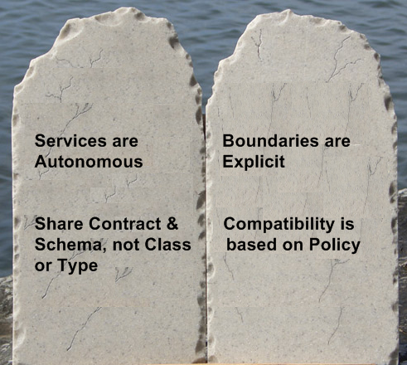
Tenets of Service Orientation

Slide 104

Layers & Coupling
Tight Coupling
Loose Coupling
UI
BL
DAL
Sales
Pricing
CRM
DB
Referential Integrity
Re-introduces Coupling
Notes:
But do you really need referential integrity? What if you didn’t delete data, and modeled the business lifecycle of data instead?
Products no longer for sale, though previous orders can continue processing, inventory liquidated, etc.

Slide 105
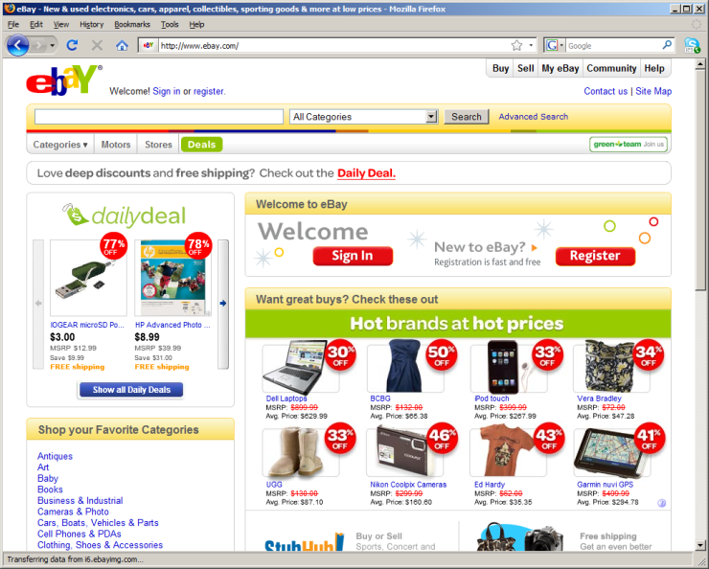
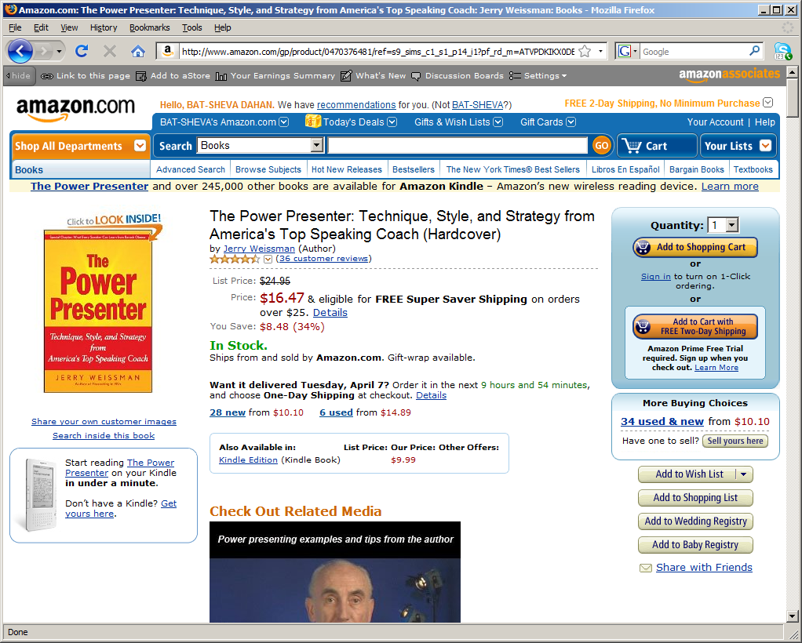
Composite Challenges
EBay & Amazon
One page showing data from multiple sources
EBay: Browser-side
Amazon: Server-side

Slide 106
Browser-side Composition
Each URI handled by a different service
Layout.CSS
Layout.JS
<link rel=“/welcome/”>
<link rel=“/dailydeal/”>
<link rel=“/hotbrands/”>
<link rel=“/categories/”>

Slide 107
Server-Side Composition (SEO friendly)
ASP MVC3 Razor
Builds a single response
Layout
<div id=“Layout.Top”>
Product Catalog
<div id=“Catalog.Name”>
Price
<div id=“Pricing.Price”>
Inventory
<div id=“Inventory.InStock”>

Slide 108
Command Query Segregation Principle

Slide 109
Where to use it?
Only within
an SOA service

Slide 110

Not the only alternative to N-Tier
Cache
UI
WS
DB
Map from DTOs & WS to view model
Map from DTOs and WS to domain objects
Use ORM to map from tables to domain objects

Slide 111
In non-collaborative business domains
Client
Data Storage
Notes:
Data storage doesn’t necessarily need to be relational – consider document or graph databases as well.
Remember, a service doesn’t necessarily handle all the data on a given screen.

Slide 112



Collaboration
Get data
Get data
User is looking
at stale data
Change data
Change data
Optimistic concurrency
not good enough
Notes:
First-one-wins optimistic concurrency not suitable in highly collaborative domains – causes too many things to fail. Last-one-wins concurrency causes users to overwrite each others’ changes.

Slide 113
Queries – showing data to the user
Can be implemented in simple 2-Tier fashion
Use ADO.NET to get a DataTable, bind to the UI
No 2-way Data Binding
Denormalized, pre-calculated
1 View == Table
UI
Persistent
View Model
SELECT * FROM t1 WHERE ID = @ID

Slide 114
View Model & Preliminary Validation
Used to decide if commands should be sent
Yes – this is business logic. Get over it
Client side controllers are supposed to do logic
Checking for uniqueness
Other examples:
Is product still for sale?

Slide 115
Commands – accepting user input
Implemented as simple fire & forget mode
User should assume that the command succeeded
Therefore validation should occur before sending the command
Race conditions still need to be dealt with

Slide 116
Command Processing Layers
Input from User
Rules
Persistence
Validation
DB

Slide 117
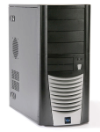

Command Processing Tiers
Transaction
Get current
state
Command
Input
Server
Persist
Validation
Rules /
Domain
Validation

Slide 118
Command Feedback
Success & failure can be communicated back using email (or something similar)
Can also invest in AJAX widgets which pop up “toasts” to notify users
Or just implicitly assume success
Stackoverflow: leaving a comment on a question
Notes:
What should happen if the question was deleted a second before (or after) the user left their comment? Do we even need to let the user know?

Slide 119
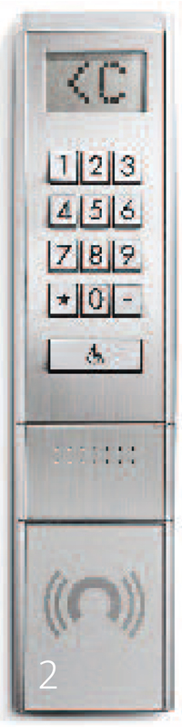
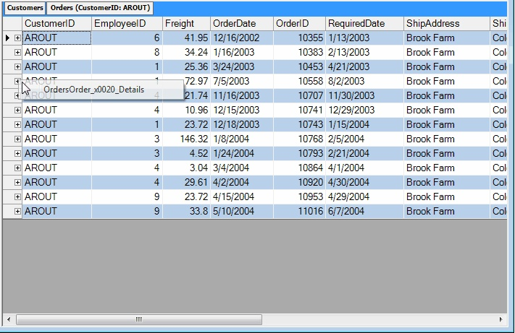
Rethinking the UI
Design the user-system interaction such that the user doesn’t need immediate feedback on their actions
Stay away from editable grids
Notes:
New elevator UI for maximizing throughput. Instead of just an Up/Down UI, asks users for which floor they want to go to, and then tells them which elevator to get into (A,B,C,D,etc). This allows the system to bunch people who want to go to floors close to each other into the same elevator, leading to higher overall utilization.

Slide 120
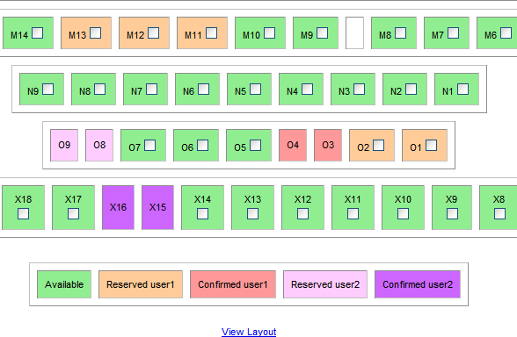
Not Capturing User Intent
Notes:
System behaves the same way if a user selects 4 seats together or at each corner.
System should be “biased” towards common user behavior.

Slide 121
Capturing user intent
Group reservation
Small group sitting together
Large group – several small groups
Enter number of people
Enter preferred seat type – indicates cost
System emails back when reservation is filled

Slide 122
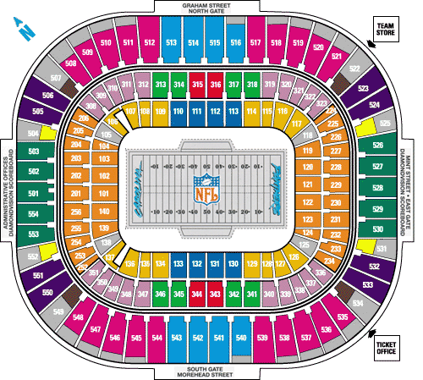
Scalability benefits
No need to show actual status!

Slide 123
Putting it all together
Data from commands immediately overlaid on queries
Queries
View Model
Client
Queries
View Model
Updater
Commands
Publish
Input
WS
Rules / Domain
Validation
DB
Notes:
When adding an item to a shopping cart, client doesn’t need to wait for response from server – can show updated order total based on previous total and price of item from view model.

Slide 124
Rules / Domain Components
What are they for?
In addition to doing what the command said to do, doing other things
E.g. When a customer withdraws money from their account, if the account is overdrawn, send them an email recommending a loan.
The focus is NOT on persistence
The view model provides for most data needs

Slide 125

Domain Models
“If you have complicated and everchanging business rules…”
“If you have simple not-null checks and a couple of sums to calculate, a Transaction Script is a better bet”
p119 Patterns of Enterprise Application Architecture
Notes:
“Customer has a first name” isn’t complicated/everchanging, so it shouldn’t be handled by a domain model.
“A customer can have many orders” isn’t complicated or everchanging either – nor are many cross entity relationships.

Slide 126
Remember
Use CQRS only within
an SOA service

Slide 127
SOA & Events

Slide 128

Loosely Coupled Synchronization
Place Order
Sales
Save Discount Locally
Save Pricing Locally
Subscribe to Product Pricing Updated
Subscribe to Customer Status Updated
Publish
Product Pricing Updated
Publish
Customer Status Updated
CRM
Pricing
Publish Order Accepted
Notes:
Detail to the class that the «Customer Status Updated» is just a sample and not a generic event that can be used to tell that something (not really known) is changed in the Customer. Events should be really specific, such as «Customer Shipping Address Changed»

Slide 129
Business Component: Definition
A service is divided internally into Business Components (BC)
A Business Component is a sub-division of the business capability, not relevant outside the context of the service

Slide 130
Business Components: Example
Business Components in Shipping Service
Perishable
Non-perishable
Business Components in Sales Service
Regular Customers
Strategic Partners
Notes:
Sales service doesn’t care that Shipping uses different kinds of trucks based on product type.

Slide 131
Business Component Structure
A business component:
Has its own database
Logically independent
No foreign keys to any other BCs
Physical separation provides greatest autonomy
Can subscribe to events from other services
Logically owns the code, config, DB schema as well as message schema for those it publishes

Slide 132
Autonomous Component: Definition
An Autonomous Component (AC) is a logical unit of deployment, containing all code and config needed to handle a single message type within a given business component.
When installed on a given machine, that physical instance is called an
Autonomous Component Instance (ACI)

Slide 133
Service Structure
Service
Business Component A
Business Component B
M1
AC
M4
AC
CQRS
CQRS
M2
AC
M3
AC
Client Server
Client Server
DB
DB

Slide 134
Publish/Subscribe

Slide 135
Advertise / Subscribe / Publish
Messages represent logical events
Technically, there’s no difference.
Publisher advertises these events
Subscribers express interest in an event
When a publisher publishes an event, a message arrives in the queues of subscribed parties
Notes:
Subscribe/Publish can be thought of as Request/Response between client and server where the Request is a request to subscribe to a given event, and the Response is really a stream of responses/events that is sent back (to all subscribers).

Slide 136
Subscriber
Publisher
Subscribe
Subscriber
Subscriber
Subscriber
Subscriber
Notes:
This model only applies when store & forward messaging is used. Broker based transport manage subscriptions on the broker (or clustered broker)

Slide 137
Subscriber
Publisher
abcdefgh
Subscriber
abcdefgh
Subscriber
abcdefgh
Subscriber
abcdefgh
abcdefgh
Subscriber
Notes:
It’s important not to confuse network-level broadcast behavior with pub/sub. The focus with pub/sub is on modeling logical publishers and subscribers. Each one of these can be scaled out, in which case only a single node should process an event for a given logical subscriber.

Slide 138
Advantages
Extensible
Adding subscribers without bringing anything down
Robust
publishers & subscribers can operate independently of each other
Easy to patch, upgrade, and administer

Slide 139
Advertise
NServiceBus is not involved in this step
May be as simple as a wiki
Hosts the schema as well as where to go to subscribe
Configure like regular messaging:
In <UnicastBusConfig>, under <MessageEndpointMappings>
<add Assembly=“schema assembly”
endpoint=“subscribe-here@Publisher”>

Slide 140
Automatic Subscriptions
Write a handler for the event
NServiceBus will contact the configured publisher at startup to subscribe to that message
Unless:
configuration.DisableFeature<AutoSubscribe>();

Slide 141
Manual Subscription Management
Bus.Subscribe<T>();
Bus.Unsubscribe<T>();
Still requires a handler for the given message
Consider unsubscribing clients when they shut down

Slide 142
Subscription Storage
Publisher-side storage of who is interested in what
Can be stored in MSMQ (not scale-out friendly)
configuration.UsePersistence<MsmqPersistence>();
Configured:
<MsmqSubscriptionStorageConfig Queue=“” />
Can be stored in a database
RavenDB is the default
configuration.UsePersistence<RavenDBPersistence>();
NHibernate is still supported but in a separate assembly
NServicebus.Configure.With().DbSubscriptionStorage();
Notes:
On broker based transports the subscriptions are usually managed on the broker on not in a seperate subscription store.

Slide 143
Publishing Events
Similar to sending a message:
Bus.Publish(msg);
Or:
Bus.Publish<IMyEvent>( (m) =>
{ m.Prop1 = val1; m.Prop2 = val2; } );
Consider having your events inherit from IEvent or define convention configuration.Conventions() .DefiningEventsAs(t =>…)

Slide 144
Advertise / Subscribe / Publish
WIKI
M1 → Q@Publisher
Subscription Message
Publisher
Subscriber
Q
Q
Store
M1
Bus.Publish<M1>();

Slide 145
Publisher Scale-Out
Subscription Message
Publisher
Subscriber
Q
Q
M1
DB
Publisher
Q
Bus.Publish<M1>();

Slide 146
Bus Architectural Style – not a Broker
Event sources and sinks communicate via channels in the bus
Source place events (messages) in channels, sinks are notified about message availability
Source
Sink
Bus
Sink
Source

Slide 147
Bus Characteristics
Bus is not necessarily physically separate
Channels are both physical and logical
Bus is simpler than most Brokers
No routing or service fail over
No single point of failure

Slide 148
Exercise 18
Publish / Subscribe

Slide 149
Web, Pub/Sub, Caching

Slide 150
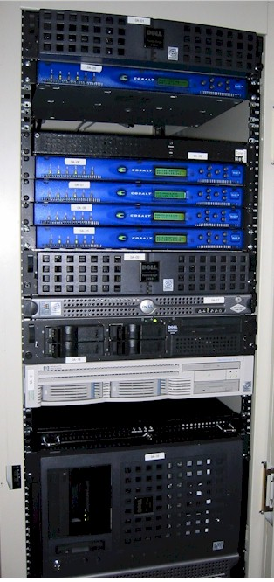


Web Apps
HTTP request/response with browsers
Should avoid request/response with backend
Easier said than done

Slide 151
Web Apps, Pub/Sub, and Caching
Web app front end subscribes to events
Caches data from events in the web tier
Serves data from the cache to browsers
Publish
GET
Data
Cache

Slide 152
Changing data
User submits changes to data
Send message and show user “thank you” page
Successful processing causes publish/cache update
Email (?)
POST
Fire & forget msg
“Thank you”
Publish
Update
Cache
Email
Notes:
This is another kind of Command/Query Separation, just that the queries are served off of the cache rather than the DB.

Slide 153
Scaling-out and Multi-Site Messaging

Slide 154
Master nodes and worker nodes
Master node provides infrastructure capabilities
Distributor, RavenDB, TimeoutManager, etc
Needs to be highly available
Worker nodes – process messages delivered from the master node
Enables scale out with minimal configuration

Slide 155
Scaling a Autonomous Component
AC
Master node
M1
ACI
M1
Distributor
Ready
Worker node
ACI
ACI
Ready
Worker node
ACI
Worker node

Slide 156
Configuring an ACI as the master
Use the Master profile
Must be running on the master node
Runs the distributor in-process
Enlists it self as a worker
If you want to run the distributor by itself, use the Distributor profile

Slide 157
Configuring an ACI as a worker
Use the Worker profile
Must know the master node
<MasterNodeConfig Node=“MyCluster"/>
Sends timeout/gateway requests to the master
Connects to RavenDB on the master for shared subscriptions and sagas

Slide 158
Distributor – Group Exercise
Use the scale out sample from the download
Run only the Orders.Handler project
Have one machine be a masternode
NServiceBus.Production NServiceBus.Master
Configure the other machines to be workers
NServiceBus.Production NServiceBus.Worker
<MasterNodeConfig Node=”smt68"/>
Notes:
Msmq.Samples

Slide 159
Cross-site communication
When your sites are logically different
Headquarter vs Stores
For High Availability (HA) scenarios infrastructure solutions should be used
Prefer explicit message types for your cross-site communication
public class EndOfDaySalesReport : IMessage
{
public List<Purchase> Purchases{ get;set; }
}
Notes:
http://andreasohlund.net/2011/12/01/introduction-to-the-nservicebus-gateway/

Slide 160
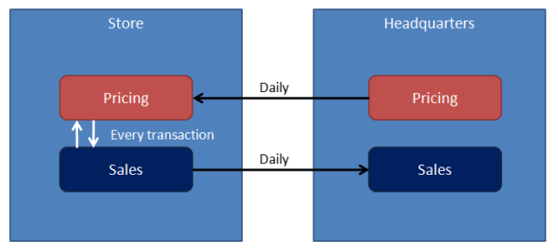
Logically significant sites

Slide 161
The Gateway
Runs in-process with your endpoint
Enabled by the MultiSite profile
Use the gateway by calling
Builtin channels are Http/Https
Create you own by implementing IChannel
Handles de-duplication for you
Bus.SendToSites(endOfDayReport,
new[]{“Headquarter”})

Slide 162
Sagas

Slide 163
Saga: Definition
A saga is pattern for implementing long-lived transaction by using a series of shorter transactions
Sagas hold relevant state needed to process multiple messages in a “saga entity”
Sagas are initiated by a message

Slide 164
Saga: Declaration
public class MySaga : Saga<MySagaData>, IAmStartedByMessages<M1>, IHandleMessages<M2>
{
public void Handle(M1 message) {}
public void Handle(M2 message) {}
}
Methods are like regular message handling logic

Slide 165
SagaEntity: Declaration
public class MySagaData : IContainSagaData
{
public Guid Id { get; set; }
public string Originator { get; set; }
public string OriginalMessageId { get; set; }
}
Must have these properties
Easier to inherit ContainSagaData
This was a bad idea prior to V4 due to NHibernate saga storage implementation
Notes:
Good time to talk about differences in Saga storage and locking implications
New NHibernate implementation flattens ContainSagaData and doesn’t create multiple tables. NSB Issue #1085
Of course RavenDB works flawlessly

Slide 166
Sagas and Services
Sales
Billing
Order Accepted
Order Billed
Events may arrive
out of order
Shipping
Process only when both events have arrived
Notes:
ShippingSaga should be IAmStartedByMessages<OrderAccepted> AND IAmStartedByMessages<OrderBilled>
As we have seen messages that are expected to hit a existing saga isn’t quite so common that you might think. I would go as far as to say that the only message can’t start a saga is a message sent or initiated by the saga instance it self, this is either timeouts set by the saga or messages being received as a reaction of a message sent by the saga it self. (request/response interactions)
So go back and review your sagas, there are probably a few places where you need to start using IAmStartedByMessages!

Slide 167
Starting Sagas
Sagas can be started by multiple messages
Implement IAmStartedByMessages<> for each
First messages should start saga, following messages should be processed by the same one

Slide 168
Finding Sagas
Saga can declare how to find it using messages:
public class MySaga : Saga<MySagaData>,
IAmStartedByMessages<M1>,
IAmStartedByMessages<M2>
{
public override void ConfigureHowToFindSaga()
{
ConfigureMapping<M1>(m => m.SomeId)
.ToSaga(s => s.MyId);
ConfigureMapping<M2>(m => m.SomeId)
.ToSaga(s => s.MyId);
}
}

Slide 169
Finding Sagas
For greater flexibility:
class MySagaFinder : IFindSagas<MySagaData>.Using<M1>
{
public MySagaData FindBy(M1 message)
{
//Go to DB and find it using any/all data from message
}
}
Notes:
Also IHandleSagaNotFound

Slide 170
Ending a saga
MarkAsComplete();
Can call this from any method
Causes the saga to be deleted
Any data that you want retained should be sent on (or published) via a message
Notes:
Sagas should not modify master data directly – instead, have them send a message to another endpoint which does those changes.

Slide 171
Timeouts

Slide 172

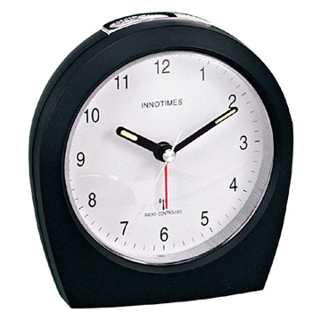

Sagas and Integration
Messaging
WS
Shipping
FedEx proxy
?
?
HTTP Timeout Exception & Retry
Logical Timeout
UPS proxy
Remember: when handling a response from a partner,
if you want to reply to your client, use Saga.ReplyToOriginator(msg);
Notes:
Fed Ex is our preferred shipping provider, but if they don’t answer in a timely manner, we’ll turn to other shipping providers like UPS
What happens if we shutdown part of the system, the fedex proxy is still running, succeeds and we restart shipping while the timeout is over?

Slide 173
Sagas and Integration
public class ShippingSaga : Saga<ShippingSagaData>, IAmStartedByMessages<M1>, IHandleMessages<FedExResponse>,
IHandleTimeouts<FedexTimedOut>
{
public void Handle(M1 msg)
{
Data.Order = msg.Order;
Bus.Send<ShipToFedEx>(m => m.Order = msg.Order);
RequestTimeout<FedexTimedOut>(
TimeSpan.FromMinutes(5));
}
public void Handle(FedExResponse msg)
{
this.MarkAsComplete();
}
public void Timeout(FedexTimedOut state)
{
Bus.Send<ShipToUps>(m => m.Data = Data.Order);
}
}

Slide 174
Custom timeout state
public class FedexTimedOut
{
public string SomeState{get;set;}
}
public void Timeout(FedexTimedOut state)
{
if(state.SomeState)
…
}
Notes:
Important to note here is that the Timeout Data doesn’t have to be a message type. It can be any poco.

Slide 175
Timeout Management
Runs in process with your endpoint by default
Enabled by default
Easily replaced with your own implementation
Maintains timeout data in RavenDB

Slide 176
Timeout Configuration
Convention based configuration
Input queue: {endpointname}.timeouts@{masternode}
Override using:
<UnicastBusConfig
TimeoutManagerAddress=“timeouts@myserver"/>

Slide 177
Unit testing

Slide 178
Unit Testing Sagas
Test.Saga<MySaga>(sagaId)
.WhenReceivesMessageFrom(clientEndpoint)
.ExpectReplyToOrginator<M1>( /* check data */ )
.ExpectPublish<M2>( /* check data */ )
.ExpectSend<M3>( /* check data */ )
.When( saga => saga.Handle(firstMessage) );
Check Data:
m => return (m.Data == Something)

Slide 179
Unit Testing Saga Timeouts
MyTimeoutState state;
Saga.WhenReceivesMessageFrom(clientEndpoint)
.ExpectTimeoutToBeSetAt<MyTimeoutState>(…)
.When( saga => saga.Handle(firstMessage) );
Saga.Expect…
.When( saga => saga.Timeout(state) );

Slide 180
Exercise: Sagas
Implement and unit test the shipping saga described

Slide 181
Business Activity Monitoring

Slide 182
BAM & Monitoring
Business Activity Monitoring
High-level “what’s going on” from a business view
Monitoring
Lower-level “what’s going on” from a technical view
Important to be able to tie one to the other

Slide 183
When Events Don’t Happen In Time
Sales
Billing
Order Accepted
Order Billed
?
BAM
Logical Timeout
Often makes use of sagas

Slide 184
How big of a timeout?
The service’s SLA specifies time
BAM bases timeout choices on that SLA

Slide 185
Dashboards
BAM can show:
How many cross-service processes are in progress
How many did we do yesterday, last week, etc
Statistics around completion time
Trends
In real time
Useful for administrators to see problematic trends
Zoom in on an AC of problem service

Slide 186
SOA, BAM, and Centralization
There is no central authority which orchestrates autonomous services
Business Activity Monitoring provides a central point of visibility on what’s going on

Slide 187
SOA, CQRS, and Sagas
All together now

Slide 188
Race Conditions – the secret sauce
Race conditions may indicate a collaborative domain – fertile ground for CQRS
May even make you think your service boundaries are wrong

Slide 189
Real World Requirements
Do not allow users to cancel shipped orders
Don’t ship cancelled orders
As we shrink the time between actions, a race condition presents itself

Slide 190
Service Boundary Issues
Cancelling an order is in the Sales service
Shipping an order is in the Shipping service
Requirements seem to imply need for consistency/transactions between services

Slide 191
Implementation is simple with 3-Tier
public class Order
{
public void Cancel()
{
if (status != OrderStatusEnum.Shipped)
//cancel
}
public void Ship()
{
if (status != OrderStatusEnum.Cancelled)
//ship
}
}

Slide 192
Remember
In CQRS, commands don’t fail
Race conditions don’t exist in business
A microsecond either way shouldn’t change business objectives

Slide 193
Find underlying business objectives
Rules:
Cannot cancel shipped orders
Because shipping costs money
That money would be lost if the customer cancelled
Because we refund the customers money
Don’t ship cancelled orders
Why?
So?
Why?
Refund Policies
Notes:
Use the “explain it to me like I was 5 years old” business analysis technique.

Slide 194
Analyze
No
When an order is cancelled,
does the refund need to be given
immediately?
Can we give a partial refund?
Yes
Notes:
So, no real race condition – we have the time and space to run business logic later.

Slide 195

Dig Deeper
What does a customer have to do
in order to get a refund?
Return the products
Most orders cancelled soon after they were made – buyer’s remorse
Implement a saga for buyer’s remorse in the Sales service

Slide 196
Consider Service Boundaries
Order Accepted
Order Cancelled
Products Returned
Customer Charged
Refund Policy
Sales
Shipping
Billing
Implement a saga for the refund policy in Billing
Notes:
Products returned in 30 days – full refund (less shipping and handling)
Products returned in 60 days – 50% refund (less shipping and handling)
Later than 60 days – no refund

Slide 197
Summary and Q&A
NServiceBus is *one piece* of the puzzle
Points you in the right direction
Creating friction if you’re going the wrong direction
Keep in mind the importance of the UI
Q&A …

Slide 198

So long, and thanks for all the fish

Slide 199

www.particular.net
https://groups.google.com/forum/#!forum/particularsoftware
http://stackoverflow.com/questions/tagged/nservicebus

