Slide 1
Saga Master Class
NSBCON Dallas 2015

Slide 2
Agenda
Intro to sagas
TBD

Slide 3
Prerequisites
Visual studio 2015
MSMQ
SQL Server
Including Management tools
Optional
Latest Particular Platform
Coquin Queue Explorer

Slide 4
Saga definition
A saga is pattern for implementing long-lived transaction by using a series of shorter transactions
In short: Sagas == message driven state machines

Slide 5
Handling messages
Just like normal message handlers
class MySaga: IHandleMessages<MyMessage>

Slide 6
Starting sagas
class MySaga: IAmStartedByMessages<MyStartMessage>
Tells NServiceBus that it’s ok to start a new saga
IAmStartedByMessages extends IHandleMessages
So no need to implement IHandleMessages

Slide 7
Storing state
class MySaga: Saga< MySaga.State>
The state class should inherit from ContainSagaData
To allow NServiceBus to add metadata
Prefer a nested class
Custom state must be a property
class State: ContainSagaData{
public string MyState{ get; set;}
}
Access state via this.Data.MyStateProperty
Notes:
The [Unique] attribute is left out on purpose, we’ll handle this later in the course

Slide 8
Correlating messages to saga instances
Decide on a property to correlate on
Usually some kind of entity id like OrderId, CustomerId etc
Setup a mapping for each message
Connects message property to saga property
override void ConfigureHowToFindSaga(SagaPropertyMapper<State> mapper)
{
mapper.ConfigureMapping<OrderPlaced>(msg => msg.OrderId)
.ToSaga(state => state.OrderId);
}
Make sure to set the saga property when starting the saga
this.Data.Orderid = message.OrderId

Slide 9
Requesting timeouts
Timeouts are reminders for the saga it self
Just a plain message
this.RequestTimeout<MyTimeout>(TimeSpan.FromSeconds(60))
Handle them by implementing IHandleTimeouts<MyTimeout>
public void Timeout(MyTimeout timeoutState)
{
}

Slide 10
Sending messages
You get access to the bus via the saga base class
this.Bus.Send(new MyMessage())
this.Bus.Publish(new MyEvent())

Slide 11
Sample domain
TODO: Create a picture
Shop
Sales
Billing
Shipping
Customer care

Slide 12
Exercise 1 – Order Policy saga
State changes
StartOrder (Command)
PlaceOrder (Command)
CancelOrder (Command)
OrderAbandoned (Event)
Business rules:
An order is abandoned if not cancelled or placed within 20 seconds
Events should be emitted for each relevant state change

Slide 13
Walkthrough
Exercise 1

Slide 14
Event driven architectures
Where sagas rule…

Slide 15

Loosely Coupled Synchronization
Place Order
Sales
Save Discount Locally
Save Pricing Locally
Subscribe to Product Pricing Updated
Subscribe to Customer Status Updated
Publish
Product Pricing Updated
Publish
Customer Status Updated
CRM
Pricing
Publish Order Accepted

Slide 16

Sagas and Services
Sales
Billing
Order Accepted
Order Billed
Events may arrive
out of order
Shipping
Process only when both events have arrived

Slide 17
Starting Sagas – The truth
Sagas can be started by multiple messages
Implement IAmStartedByMessages<T> for each
First messages should start saga, following messages should be processed by the same one

Slide 18
Exercise 2 – Shipping policy saga
Include the Billing and Shipping projects
Create a event handler in Billing that emits the `OrderBilled` Event
Create a Shipping saga that
Starts a ship order sub process when the order has been accepted and billed
For now just make the sub process a message handler

Slide 19
Walkthrough
Exercise 2
Notes:
Bring one of the pairs up to demo (volunteer)

Slide 20
NServiceBus Basics
Retries

Slide 21
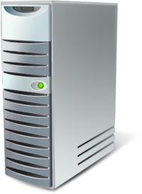

Fault Tolerance
[HTTP] $$ Order
DB
App
Tx
Call 1 of 3
Call 2 of 3
Rollback
Where’s the order!?

Slide 22
Exceptions
Reasons exceptions happen:
Deadlock in the database
Database is down
Message deserialization fails
Retrying can resolve transient exceptions
<TransportConfig MaxRetries=“5” />
Second Level Retries (SLR)
Messages that always fail are moved to an error queue
<MessageForwardingInCaseOfFaultConfig ErrorQueue="error"/>
Transient
Permanent
Deserialization exception: message moved to error queue right away
Notes:
Database down not necessarily == PANIC .... Could be failing over to a failover partner and will be back up in ~90 seconds
ActiveMq: Uses it’s own SLR mechanism

Slide 23
Messaging and Consistency
Rollback
Tx
$$ Order
Q
Receive
Rollback
App
Call 1 of 3
DB
Call 2 of 3
The order is back in the queue

Slide 24
Sagas and concurrency
Storage matters
Notes:
You are exposed to concurrency when concurrency SETTINGS >1
will the default in v6

Slide 25
Sagas started concurrently
Make sure to add the [Unique] attribute to the correlated property
ALTER TABLE [dbo].[ShippingPolicy] ADD UNIQUE NONCLUSTERED
([OrderId] ASC) ON [PRIMARY]
GO
Notes:
This is the exercise they just coded

Slide 26
Concurrently updating existing sagas
Strategy is specific to each storage
NHibernate used
Optimistic concurrency with a where clause
Checks all properties
Can cause large sql statements
Decimal properties can cause failures due to truncation
TDB – Daniel: Bytearray timestamp trick?
Consider using a row version property to avoid the above issues
[RowVersion]
public virtual int Version{ get; set; }
Notes:
exec sp_executesql N'UPDATE ShippingPolicy SET Billed = @p0 WHERE Id = @p1 AND Originator = @p2 AND OriginalMessageId = @p3 AND OrderId = @p4 AND Placed = @p5 AND Billed = @p6',N'@p0 bit,@p1 uniqueidentifier,@p2 nvarchar(4000),@p3 nvarchar(4000),@p4 nvarchar(4000),@p5 bit,@p6 bit',@p0=1,@p1='870D112B-44D1-4206-A4DB-A55B015DA80A',@p2=N'Sales@ANDREAS2015',@p3=N'baf9b6bb-a0da-41b9-8a81-a55b015d7a05',@p4=N'a23a2438-3af6-4c0a-a108-7f8e72d12083',@p5=1,@p6=0
After rowversion trick:
exec sp_executesql N'UPDATE ShippingPolicy SET Version = @p0, OrderId = @p1, Placed = @p2, Billed = @p3, Originator = @p4, OriginalMessageId = @p5 WHERE Id = @p6 AND Version = @p7',N'@p0 int,@p1 nvarchar(4000),@p2 bit,@p3 bit,@p4 nvarchar(4000),@p5 nvarchar(4000),@p6 uniqueidentifier,@p7 int',@p0=2,@p1=N'86427be3-59a5-453d-9c75-aab2a4b466be',@p2=1,@p3=1,@p4=N'Sales@ANDREAS2015',@p5=N'b5e51adb-9d18-40b9-bcea-a55c01356c38',@p6='3FAD8522-46EE-4C0E-B18D-A55C01356DA4',@p7=1

Slide 27
Optimizing for concurrency - NHibernate
Upgrade locks (this essentially becomes pessimistic locking)
Ok since its just locking a single saga instance
All messages updates saga state (usually
RavenDB has no concept of locking
Notes:
exec sp_executesql N'SELECT this_.Id as Id0_0_, this_.Originator as Originator0_0_, this_.OriginalMessageId as Original3_0_0_, this_.OrderId as OrderId1_0_, this_.SentToFedex as SentToFe2_1_0_ FROM ShipOrderPolicy this_ with (updlock, rowlock) WHERE this_.OrderId = @p0',N'@p0 nvarchar(4000)',@p0=N'ac9598f9-79cc-4d1c-bea2-32d8b73675b4'

Slide 28
Exercise 3 – Concurrency
Make sure that the billing endpoint is stopped
Place a new order
Start the Shipping endpoint after the Billing event has arrived
Note that the shipping endpoint is configured to run multi threaded
Notice the concurrency exception
In the logfile in /bin/debug
Or in sqlprofiler
FLR Retries handles it

Slide 29
Walkthrough
Exercise 3

Slide 30
Storage mechanics
TBD draw the diagram

Slide 31
Sagas and integration

Slide 32
Auto correlation
Avoid the need for mapping reponses
Caveat: Does not work btw sagas

Slide 33
Custom timeout state
public class FedexTimedOut
{
public string SomeState{get;set;}
}
public void Timeout(FedexTimedOut state)
{
if(state.SomeState)
…
}
Notes:
Important to note here is that the Timeout Data doesn’t have to be a message type. It can be any poco.
Why is there no virtual since the TM persister will serialize it to a string format

Slide 34
NServiceBus Basics
Dealing with non transactional resources

Slide 35
Invoking web services from handlers
Rollback
$$ Order
H1
H2
H3
H4
Not Rolled back
[HTTP] Invoke
DB
WS
Deadlock

Slide 36

Integrating messaging & WS
The right way
The message won’t be sent if there’s a failure
$$ Order
Msg
H1
H2
H3
H4
DB
[HTTP] Invoke
WS
Messaging
Gateway
Commit

Slide 37
Messaging to WS Integration
When calling external web services from a messaging endpoint, if they’re down, regular retry logic kicks in.
Messaging
Gateway
HTTP
Web Service
?
HTTP Timeout Exception & Retry
Notes:
Talk about idempotency so that duplicate calls due to retries will be OK – use of the message ID as a correlation ID in the web service

Slide 38

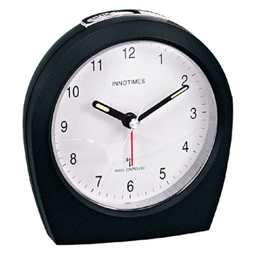

Shipping orders
Messaging
WS
Shipping
FedEx gateway
?
?
HTTP Timeout Exception & Retry
Logical Timeout
UPS gateway
Remember: when handling a response from a partner,
if you want to reply to your client, use Saga.ReplyToOriginator(msg);
Notes:
Fed Ex is our preferred shipping provider, but if they don’t answer in a timely manner, we’ll turn to other shipping providers like UPS
What happens if we shutdown part of the system, the fedex proxy is still running, succeeds and we restart shipping while the timeout is over?

Slide 39
Exercise 4 – Shipping integration
TBD - Daniel

Slide 40
Sagas not found

Slide 41
What happens if fedex do returns?
Messaging
WS
Shipping
FedEx gateway
?
?
HTTP Timeout Exception & Retry
Logical Timeout

Slide 42
Walkthrough
Exercise 4

Slide 43
Web Services & Integration
Request/response synchronous web service most broadly known
Makes sense to expose this kind of endpoint
Throttle it – not a scalable solution
Direct users to a different integration *protocol*
Request
Response
Notes:
Demonstrate sample: WcfIntegration (NServiceBus Main Repo Integration Tests)

Slide 44
Web Integration Protocols
Increasing T dynamically pushes back on load
Request
Ticket - come back in T
http://acme.com/responses/guid
Send message with guid
T
Request (http://acme.com/responses/guid )
Check cache
Response ready?
Response / come back in T2
Responses can be served by different machines

Slide 45
Observer vs Command saga
Notes:
Observer sagas live fro ever
Command sagas complete when done

Slide 46
System
A
B
C
Request
Response
Notes:
Klassisches Integration Beispiel

Slide 47
Process
Queue
Request
Send requests to 3 other partners
Save requests state
Response 2
Update state
Store
Other Request
Check if done
Response 3
Update state
Other Request
Check if done
Response 1
Update state + resolve
Done!
Enqueue Response or publish event
Notes:
Prozesshandling wie es aussehen könnte

Slide 48
Legacy App
Adapters
RPC
Sagas
msg
msg
Logic
WS
3rd party WS
Notes:
Fast wie Onion oder Hexagonale Architektur. Layering von Prozessmanagers/Sagas
Die Buildingblocks zu verwenden ist einfach, schwierig ist den Prozess und die Schritte zu identifizieren.
Mit Legacy Systemen ein Prozessmanager für den Flow, ein Adapter für die Integration
Orchestration is not a thing by itself.
Divide up workflows/orchestrations along service boundaries
Events are published at the end of the sub-flow in a service
Events trigger a sub-flow in other services
Sagas can be used for CEP/ESP:
complex event processing, event-stream proc.

Slide 49
Sagas and batch jobs

Slide 50

The Batch Job

Slide 51

The scheduled task
Batch
Notes:
Now we call them Scheduled tasks

Slide 52
foreach(var customer in customers)
{
var orderTotal = customer.Orders
.Where(o=> o.OrderDate < 365.DaysAgo)
.Sum(order => order.OrderValue);
customer.Prefered = orderTotal > 5000;
}
Notes:
Domainmodel
Select n+1
Fetching strategies
Lets run them during the night

Slide 53

What if there is no night?

Slide 54
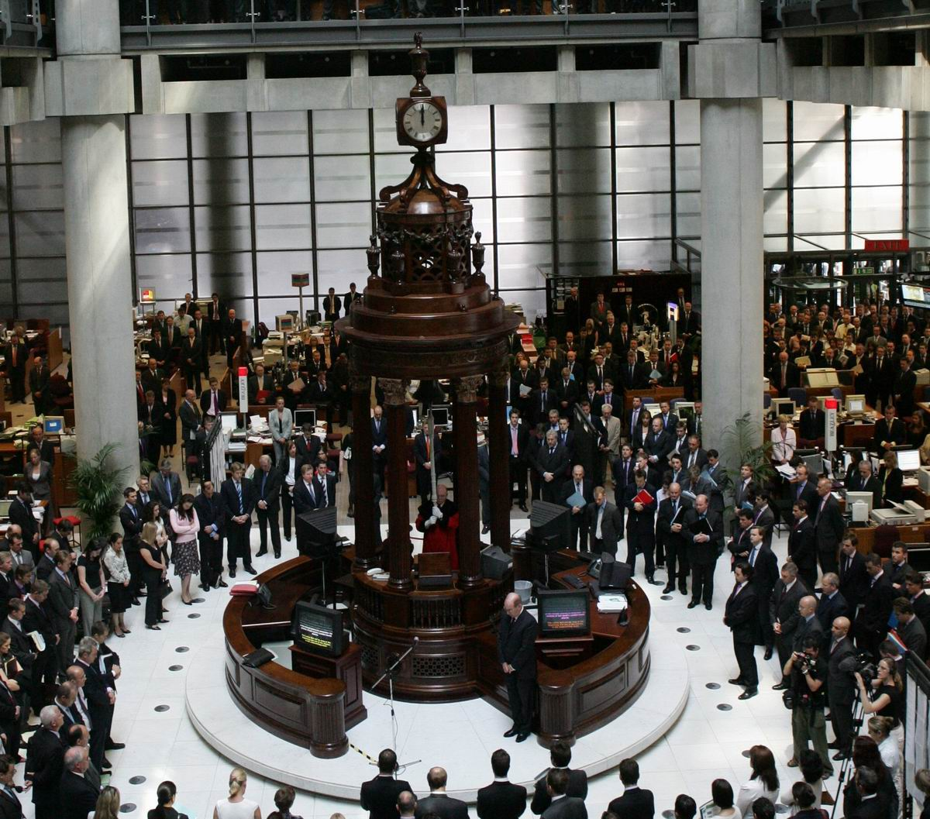
Businesses are getting
more ”real time”
Notes:
The opposite of real time

Slide 55
foreach(var customer in customers)
{
var orderTotal = customer.Orders
.Where(o=> o.OrderDate < 365.DaysAgo)
.Sum(order => order.OrderValue);
customer.Prefered = orderTotal > 5000;
}
Notes:
What happens if the user buys twice the same day?
Asking the business can be tricky

Slide 56
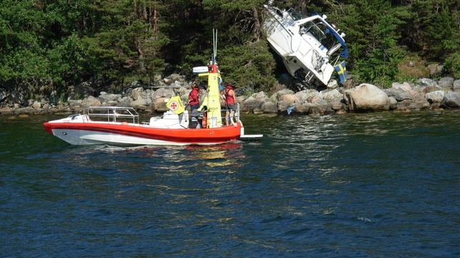
But they told me
that it was ok?
Notes:
We have trained the business to think in batches

Slide 57

We traditionally focus
on the past

Slide 58
2011
2012
Now
100 $
300 $
250 $

Slide 59

Can we predict the
future?

Slide 60

They will know if you ask them

Slide 61
2011
2012
- 300 $
- 100 $
100 $
300 $

Slide 62

Note to self
Notes:
Memento (2000)
Guy Pearce

Slide 63
Exercise 5 – Preferred customers
TBD - Daniel

Slide 64
Walkthrough
Exercise 5

Slide 65
Rescheduling of timeouts

Slide 66
Put some code here

Slide 67
Sagas are your domain model

Slide 68
Race Conditions – the secret sauce
Race conditions may indicate a collaborative domain – fertile ground for CQRS
May even make you think your service boundaries are wrong

Slide 69
Real World Requirements
Do not allow users to cancel shipped orders
Don’t ship cancelled orders
As we shrink the time between actions, a race condition presents itself

Slide 70
Service Boundary Issues
Cancelling an order is in the Sales service
Shipping an order is in the Shipping service
Requirements seem to imply need for consistency/transactions between services

Slide 71
Implementation is simple with 3-Tier
public class Order
{
public void Cancel()
{
if (status != OrderStatusEnum.Shipped)
//cancel
}
public void Ship()
{
if (status != OrderStatusEnum.Cancelled)
//ship
}
}

Slide 72
Remember
In CQRS, commands don’t fail
Race conditions don’t exist in business
A microsecond either way shouldn’t change business objectives

Slide 73
Find underlying business objectives
Rules:
Cannot cancel shipped orders
Because shipping costs money
That money would be lost if the customer cancelled
Because we refund the customers money
Don’t ship cancelled orders
Why?
So?
Why?
Refund Policies
Notes:
Use the “explain it to me like I was 5 years old” business analysis technique.

Slide 74
Analyze
No
When an order is cancelled,
does the refund need to be given
immediately?
Can we give a partial refund?
Yes
Notes:
So, no real race condition – we have the time and space to run business logic later.

Slide 75

Dig Deeper
What does a customer have to do
in order to get a refund?
Return the products
Most orders cancelled soon after they were made – buyer’s remorse
Implement a saga for buyer’s remorse in the Sales service

Slide 76
Consider Service Boundaries
Order Accepted
Order Cancelled
Products Returned
Customer Charged
Refund Policy
Sales
Shipping
Billing
Implement a saga for the refund policy in Billing
Notes:
Products returned in 30 days – full refund (less shipping and handling)
Products returned in 60 days – 50% refund (less shipping and handling)
Later than 60 days – no refund

Slide 77
Exercise 6 – Buyers remorse
TBD

Slide 78
Walkthrough
Exercise 6

Slide 79
Upcoming saga changes in v6
Notes:
Upgrade the sales endpoint to v6 and remove:
Unique
Set of the corr prop
Show that it blows if no IAmStartedByExists
Show that a mapping is required for each I am started bys (double check this)

Slide 80
Less sharp edges
TBD andreas

