Slide 1
Saga Master Class
NSBCON Dallas 2015

Slide 2
Agenda
Intro to sagas
TBD

Slide 3
Prerequisites
Visual studio 2015
MSMQ
SQL Server
Including Management tools
Optional
Particular Platform
Cogin Queue Explorer

Slide 4
Saga definition
A saga is pattern for implementing long-lived transaction by using a series of shorter transactions
Sagas == message driven state machines
Notes:
The database guys from the 80’ies needed to break up long business process into shorter parts to avoid massive locking

Slide 5
Handling messages
Just like normal message handlers
class MySaga: IHandleMessages<MyMessage>

Slide 6
Starting sagas
class MySaga: IAmStartedByMessages<MyStartMessage>
Tells NServiceBus that it’s ok to start a new saga
IAmStartedByMessages extends IHandleMessages
So no need to implement IHandleMessages

Slide 7
Storing state
class MySaga: Saga< MySaga.State>
The state class should inherit from ContainSagaData
To allow NServiceBus to add metadata
Prefer a nested class
Custom state must be a property
class State: ContainSagaData {
public string MyState{ get; set;}
}
Access state via this.Data.MyStateProperty
Notes:
The [Unique] attribute is left out on purpose, we’ll handle this later in the course
Talk about how the data should be as flat and simple as possible. Don’t just take your messages and toss them in!
Talk about benefits of base class, that it hides the properties that should never be touched. Ask if anyone has been burned by this in earlier versions where Nhibernate would split into 2 tables. (Fixed in V4, I think)

Slide 8
Correlating messages to saga instances
Decide on a property to correlate on
Usually some kind of entity id like OrderId, CustomerId etc
Setup a mapping for each message
Connects message property to saga property
override void ConfigureHowToFindSaga(SagaPropertyMapper<State> mapper)
{
mapper.ConfigureMapping<OrderPlaced>(msg => msg.OrderId)
.ToSaga(state => state.OrderId);
}
Make sure to set the saga property when starting the saga
this.Data.Orderid = message.OrderId

Slide 9
Requesting timeouts
Timeouts are reminders for the saga it self
Just a plain message
this.RequestTimeout<MyTimeout>(TimeSpan.FromSeconds(60))
Handle them by implementing IHandleTimeouts<MyTimeout>
public void Timeout(MyTimeout timeoutState)
{
}
Notes:
Mention that TimeoutManager is required. You can’t disable it for perf and then expect it to work!

Slide 10
Sending messages
You get access to the bus via the saga base class
this.Bus.Send(new MyMessage())
this.Bus.Publish(new MyEvent())
Notes:
Mention that it’s a common gotcha to convert from a Handler to a Saga and that you’ll get in trouble if you don’t remove your own IBus.

Slide 11
Sample domain
Shop
Sales
CustomerCare
Billing
Shipping
Composite UI

Slide 12
Sample domain
Shop
Sales
CustomerCare
Billing
Shipping
Composite UI
Notes:
This is the goal. In the first exercise we will only be dealing with the “UI” and the Sales service.

Slide 13
Exercise 1 – Order Policy saga
State changes
StartOrder (Command)
PlaceOrder (Command)
CancelOrder (Command)
OrderAbandoned (Event)
Business rules:
An order is abandoned if not cancelled or placed within 20 seconds
Events should be emitted for each relevant state change

Slide 14
Walkthrough
Exercise 1

Slide 15
Event driven architectures
Where sagas rule…

Slide 16

Loosely Coupled Synchronization
Place Order
Sales
Save Discount Locally
Save Pricing Locally
Subscribe to Product Pricing Updated
Subscribe to Customer Status Updated
Publish
Product Pricing Updated
Publish
Customer Status Updated
CRM
Pricing
Publish Order Accepted

Slide 17

Sagas and Services
Sales
Billing
Order Accepted
Order Billed
Events may arrive
out of order
Shipping
Process only when both events have arrived

Slide 18
Starting Sagas – The truth
Sagas can be started by multiple messages
Implement IAmStartedByMessages<T> for each
First messages should start saga, following messages should be processed by the same one

Slide 19
Exercise 2 – Shipping policy saga
Include the Billing and Shipping projects
Create a event handler in Billing that emits the `OrderBilled` Event
Create a Shipping saga that
Starts a ship order sub process when the order has been accepted and billed
For now just make the sub process a message handler

Slide 20
Walkthrough
Exercise 2
Notes:
Bring one of the pairs up to demo (volunteer)

Slide 21
NServiceBus Basics
Retries

Slide 22
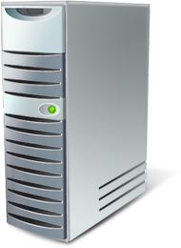

Fault Tolerance
[HTTP] $$ Order
DB
App
Tx
Call 1 of 3
Call 2 of 3
Rollback
Where’s the order!?

Slide 23
Exceptions
Reasons exceptions happen:
Deadlock in the database
Database is down
Message deserialization fails
Retrying can resolve transient exceptions
<TransportConfig MaxRetries=“5” />
Second Level Retries (SLR)
Messages that always fail are moved to an error queue
<MessageForwardingInCaseOfFaultConfig ErrorQueue="error"/>
Transient
Permanent
Deserialization exception: message moved to error queue right away
Notes:
Database down not necessarily == PANIC .... Could be failing over to a failover partner and will be back up in ~90 seconds
ActiveMq: Uses it’s own SLR mechanism

Slide 24
Messaging and Consistency
Rollback
Tx
$$ Order
Q
Receive
Rollback
App
Call 1 of 3
DB
Call 2 of 3
The order is back in the queue

Slide 25
Sagas and concurrency
Storage matters
Notes:
You are exposed to concurrency when concurrency SETTINGS >1
will the default in v6

Slide 26
Sagas started concurrently
Make sure to add the [Unique] attribute to the correlated property
ALTER TABLE [dbo].[ShippingPolicy] ADD UNIQUE NONCLUSTERED
([OrderId] ASC) ON [PRIMARY]
GO
Notes:
This is the exercise they just coded

Slide 27
Concurrently updating existing sagas
Strategy is specific to each storage
NHibernate used
Optimistic concurrency with a where clause
Checks all properties
Can cause large sql statements
Decimal properties can cause failures due to truncation
Consider using a row version property to avoid the above issues
[RowVersion]
public virtual int Version{ get; set; }
Notes:
exec sp_executesql N'UPDATE ShippingPolicy SET Billed = @p0 WHERE Id = @p1 AND Originator = @p2 AND OriginalMessageId = @p3 AND OrderId = @p4 AND Placed = @p5 AND Billed = @p6',N'@p0 bit,@p1 uniqueidentifier,@p2 nvarchar(4000),@p3 nvarchar(4000),@p4 nvarchar(4000),@p5 bit,@p6 bit',@p0=1,@p1='870D112B-44D1-4206-A4DB-A55B015DA80A',@p2=N'Sales@ANDREAS2015',@p3=N'baf9b6bb-a0da-41b9-8a81-a55b015d7a05',@p4=N'a23a2438-3af6-4c0a-a108-7f8e72d12083',@p5=1,@p6=0
After rowversion trick:
exec sp_executesql N'UPDATE ShippingPolicy SET Version = @p0, OrderId = @p1, Placed = @p2, Billed = @p3, Originator = @p4, OriginalMessageId = @p5 WHERE Id = @p6 AND Version = @p7',N'@p0 int,@p1 nvarchar(4000),@p2 bit,@p3 bit,@p4 nvarchar(4000),@p5 nvarchar(4000),@p6 uniqueidentifier,@p7 int',@p0=2,@p1=N'86427be3-59a5-453d-9c75-aab2a4b466be',@p2=1,@p3=1,@p4=N'Sales@ANDREAS2015',@p5=N'b5e51adb-9d18-40b9-bcea-a55c01356c38',@p6='3FAD8522-46EE-4C0E-B18D-A55C01356DA4',@p7=1

Slide 28
Concurrently updating existing sagas
public virtual byte[] Version { get; set; } public class StateMapping : ClassMapping<ShippingPolicy.State> { public StateMapping() { Version(x => x.Version, m => { m.UnsavedValue(null); m.Type(new BinaryBlobType()); m.Column(c => { c.SqlType("timestamp"); c.NotNullable(false);
});
m.Generated(VersionGeneration.Always);
});

Slide 29
Optimizing for concurrency - NHibernate
Upgrade locks (this essentially becomes pessimistic locking)
Ok since its just locking a single saga instance
All messages updates saga state (usually)
Control locking with the [LockMode.{Mode}] attribute on saga data class
Notes:
exec sp_executesql N'SELECT this_.Id as Id0_0_, this_.Originator as Originator0_0_, this_.OriginalMessageId as Original3_0_0_, this_.OrderId as OrderId1_0_, this_.SentToFedex as SentToFe2_1_0_ FROM ShipOrderPolicy this_ with (updlock, rowlock) WHERE this_.OrderId = @p0',N'@p0 nvarchar(4000)',@p0=N'ac9598f9-79cc-4d1c-bea2-32d8b73675b4'

Slide 30
Exercise 3 – Concurrency
Make sure that the billing endpoint is stopped
Place a new order
Start the Shipping endpoint after the Billing event has arrived
Note that the shipping endpoint is configured to run multi threaded
Notice the concurrency exception
In the logfile in /bin/debug
Or in sqlprofiler
FLR Retries handles it

Slide 31
Walkthrough
Exercise 3

Slide 32
Storage mechanics

Slide 33
Bus
Create Saga For Message
Start Saga Message
Saga
Dispatch Message
Send Saga Messages
Saga Persister
Save Saga
DB
Persist
Notes:
Wichtig: Saga erhält Korrelationsschlüssel, jede Nachricht die von einer Saga weg geht beinhaltet diesen

Slide 34
Saga Message
Bus
Get Saga by Message.SagaId
Saga Persister
4.Return Saga
Dispatch Message
Saga
2.New
3.Fill
Complete
Saga Complete
Timeouts are regular messages
1.Get
Delete
Can occur on multiple machines concurrently
DB
Notes:
Verarbeitung kann auf mehreren Prozessen / Maschinen gleichzeitig erfolgen
Saga-Eindeutigkeit muss definiert werden, Infrastruktur handhabt dann das Rollback
Sonst läuft der Systemzustand aus dem Ruder!
Schwierigkeit: Sagas zu modellieren (Einzelschritte etc.), Viel Kommunikation mit dem BA notwendig., auch für Legacysysteme geeignet

Slide 35
Sagas and integration

Slide 36
Auto correlation
Avoid the need for mapping responses
Caveat: Does not work between sagas

Slide 37
Auto correlation
public class ExampleSaga : Saga<SampleData>
: IAmStartedByMessages<StartMessage>
: IHandleMessages<Response>
{
public override void ConfigureHowToFindSagas(SagaMapper<SampleData> mapper)
{
mapper.ConfigureMapping<StartMessage>(msg => msg.Property)
.ToSaga(saga => saga.Property);
// Mapping for Response not needed!
}
}
public class RequestHandler : IHandleMessages<Request>
{
public void Handle(Request message)
{
Bus.Reply(new Response());
}
}

Slide 38
Custom timeout state
public void Timeout(FedexTimedOut state)
{
if(state.SomeState)
…
}
public class FedexTimedOut
{
public string SomeState{get;set;}
}
Notes:
Important to note here is that the Timeout Data doesn’t have to be a message type. It can be any poco.
Why is there no virtual since the TM persister will serialize it to a string format (JSON)

Slide 39
NServiceBus Basics
Dealing with non-transactional resources

Slide 40
Invoking web services from handlers
Rollback
$$ Order
H1
H2
H3
H4
Not Rolled back
[HTTP] Invoke
DB
WS
Deadlock

Slide 41

Integrating messaging & WS
The right way
The message won’t be sent if there’s a failure
$$ Order
Msg
H1
H2
H3
H4
DB
[HTTP] Invoke
WS
Messaging
Gateway
Commit

Slide 42
Messaging to WS Integration
When calling external web services from a messaging endpoint, if they’re down, regular retry logic kicks in.
Messaging
Gateway
HTTP
Web Service
?
HTTP Timeout Exception & Retry
Notes:
Talk about idempotency so that duplicate calls due to retries will be OK – use of the message ID as a correlation ID in the web service

Slide 43

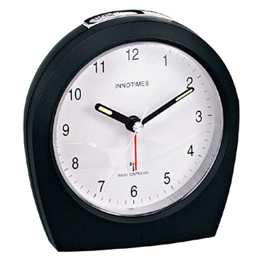

Shipping orders
Messaging
WS
Shipping
FedEx gateway
?
?
HTTP Timeout Exception & Retry
Logical Timeout
UPS gateway
Remember: when handling a response from a partner,
if you want to reply to your client, use Saga.ReplyToOriginator(msg);
Notes:
Fed Ex is our preferred shipping provider, but if they don’t answer in a timely manner, we’ll turn to other shipping providers like UPS
What happens if we shutdown part of the system, the fedex proxy is still running, succeeds and we restart shipping while the timeout is over?

Slide 44
Legacy App
Adapters
RPC
Sagas
msg
msg
Logic
WS
3rd party WS
Notes:
Similar to Onion or Hexagonal architecture. We have rings of prozess managers/sagas
When you integrate with Legacy Systems you usually have one process manager for the overall flow and one adapter for each integration point
Orchestration is not a thing by itself.
Divide up workflows/orchestrations along service boundaries
Events are published at the end of the sub-flow in a service
Events trigger a sub-flow in other services
Sagas can be used for CEP/ESP:
complex event processing, event-stream proc.

Slide 45
Exercise 4 – Shipping integration
Create a ShipOrder Policy
Create a Fedex.Gateway
Create a Ups.Gateway
Use the provided Fedex.Simulator GET http://localhost:8888/fedex/shipit

Slide 46
Walkthrough
Exercise 4

Slide 47
Sagas not found

Slide 48
What happens if Fedex returns later?
public class MySaga: IHandleSagaNotFound
{
public void Handle(object message)
{
var fedExResponse = message as FedExResponse;
if (fedExResponse != null)
{
//take some action
}
}
}

Slide 49
Web Services & Integration
Request/response synchronous web service most broadly known
Makes sense to expose this kind of endpoint
Throttle it – not a scalable solution
Direct users to a different integration *protocol*
Request
Response
Notes:
Demonstrate sample: WcfIntegration (NServiceBus Main Repo Integration Tests)

Slide 50
Web Integration Protocols
Increasing T dynamically pushes back on load
Request
Ticket - come back in T
http://acme.com/responses/guid
Send message with guid
T
Request (http://acme.com/responses/guid )
Check cache
Response ready?
Response / come back in T2
Responses can be served by different machines

Slide 51
Observer vs Commander saga
Notes:
Observer sagas live fro ever
Command sagas complete when done

Slide 52
System
A
B
C
Request
Response
Notes:
Klassisches Integration Beispiel

Slide 53
System
A
B
C
Event 1
Event 2
Event 3
Reaction
Notes:
Klassisches Integration Beispiel

Slide 54
Process
Queue
Request
Send requests to 3 other partners
Save requests state
Response 2
Update state
Store
Other Request
Check if done
Response 3
Update state
Other Request
Check if done
Response 1
Update state + resolve
Done!
Enqueue Response or publish event
Notes:
Prozesshandling wie es aussehen könnte

Slide 55
Sagas and batch jobs

Slide 56

The Batch Job

Slide 57

The scheduled task
Batch
Notes:
Now we call them Scheduled tasks

Slide 58
foreach(var customer in customers)
{
var orderTotal = customer.Orders
.Where(o=> o.OrderDate < 365.DaysAgo)
.Sum(order => order.OrderValue);
customer.Prefered = orderTotal > 5000;
}
Notes:
Domainmodel
Select n+1
Fetching strategies
Lets run them during the night

Slide 59

What if there is no night?

Slide 60
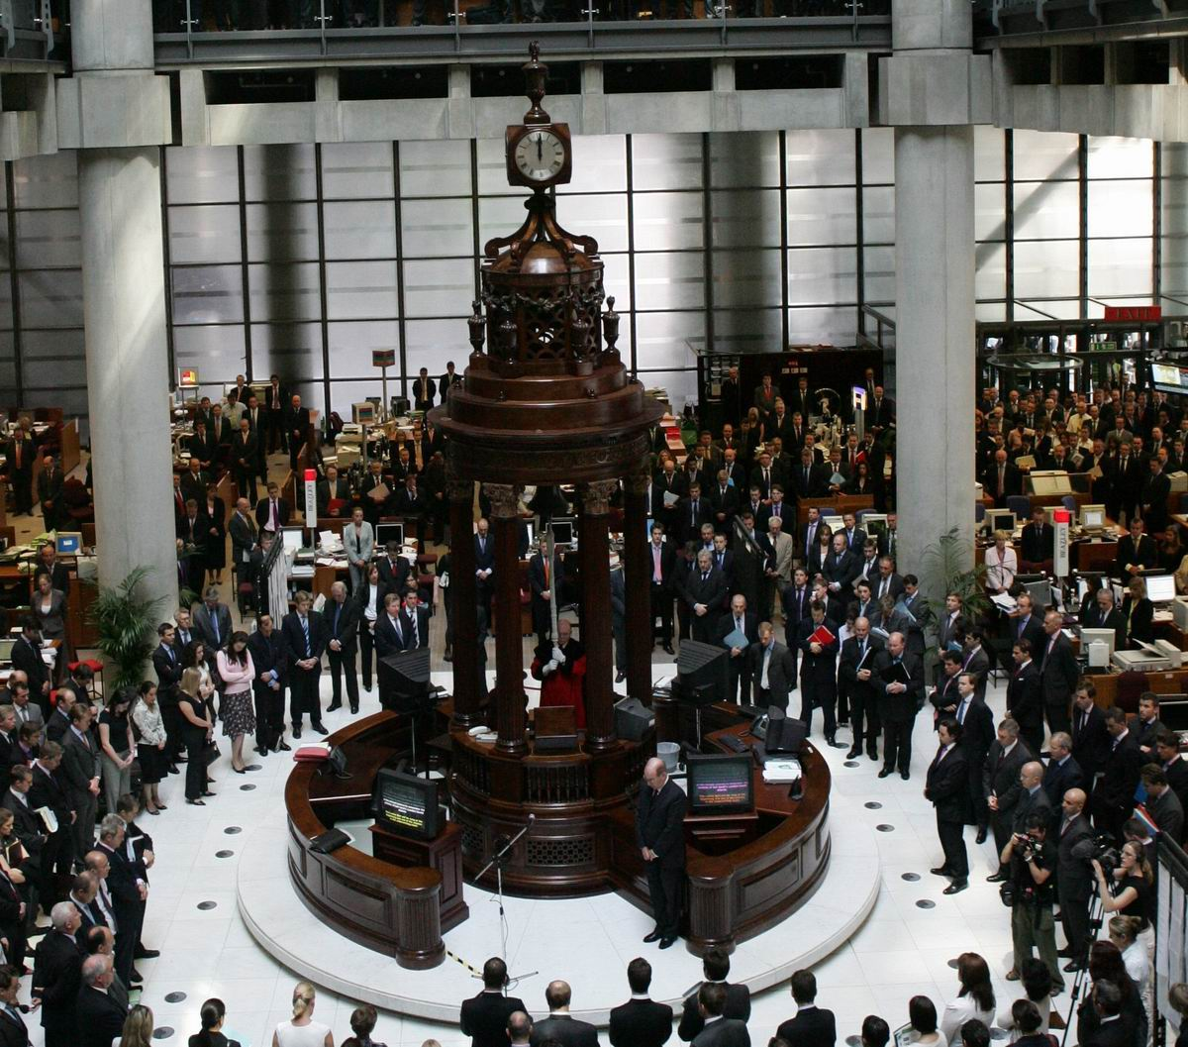
Businesses are getting
more ”real time”
Notes:
The opposite of real time

Slide 61
foreach(var customer in customers)
{
var orderTotal = customer.Orders
.Where(o=> o.OrderDate < 365.DaysAgo)
.Sum(order => order.OrderValue);
customer.Prefered = orderTotal > 5000;
}
Notes:
What happens if the user buys twice the same day?
Asking the business can be tricky

Slide 62
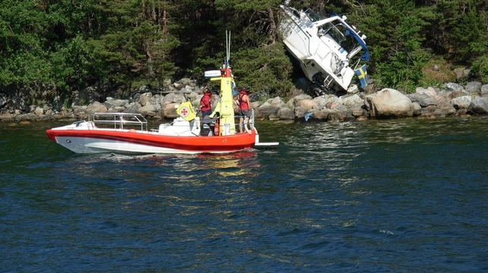
But they told me
that it was ok?
Notes:
We have trained the business to think in batches

Slide 63

We traditionally focus
on the past

Slide 64
2011
2012
Now
100 $
300 $
250 $

Slide 65

Can we predict the
future?

Slide 66

They will know if you ask them

Slide 67
2011
2012
- 300 $
- 100 $
100 $
300 $

Slide 68
Exercise 5 – Preferred customers
Create a CustomerCare service
Build the preferred customer policy
Emit CustomerMadePrefered and CustomerDemoted events
Calculate customer discounts based on the above events
Console.WriteLine is good enough
Business rules
Orders in the last 20 seconds counts towards the running total
Customers with a running total above $5000 are considered preferred
Use `placeorder {amount}` in the shop application to test

Slide 69
Walkthrough
Exercise 5

Slide 70
Rescheduling of timeouts

Slide 71
Change timeouts in storage
UPDATE TimeoutEntity
SET Time = DATEADD(day,10,Time)
WHERE id IN
(
SELECT t.Id
FROM TimeoutEntity t
OUTER APPLY dbo.parseJSON(t.Headers) as parsed
WHERE parsed.StringValue LIKE '%Contracts.OrderPlaced%'
)
Notes:
parseJson is a custom func

Slide 72
Sagas are your domain model

Slide 73
Race Conditions – the secret sauce
Race conditions may indicate a collaborative domain
May need to think about different patterns (e.g. CQRS)
May even make you think your service boundaries are wrong

Slide 74
Real World Requirements
Do not allow users to cancel shipped orders
Don’t ship cancelled orders
As we shrink the time between actions, a race condition presents itself

Slide 75
Service Boundary Issues
Cancelling an order is in the Sales service
Shipping an order is in the Shipping service
Requirements seem to imply need for consistency/transactions between services

Slide 76
Implementation is simple with 3-Tier
public class Order
{
public void Cancel()
{
if (status != OrderStatusEnum.Shipped)
//cancel
}
public void Ship()
{
if (status != OrderStatusEnum.Cancelled)
//ship
}
}

Slide 77
A few pointers
Commands should not fail (most of the time)
Race conditions don’t exist in business
A microsecond either way shouldn’t change business objectives

Slide 78
Find underlying business objectives
Rules:
Cannot cancel shipped orders
Because shipping costs money
That money would be lost if the customer cancelled
Because we refund the customers money
Don’t ship cancelled orders
Why?
So?
Why?
Refund Policies
Notes:
Use the “explain it to me like I was 5 years old” business analysis technique.

Slide 79
Analyze
No
When an order is cancelled,
does the refund need to be given
immediately?
Can we give a partial refund?
Yes
Notes:
So, no real race condition – we have the time and space to run business logic later.

Slide 80

Dig Deeper
What does a customer have to do
in order to get a refund?
Return the products
Most orders cancelled soon after they were made – buyer’s remorse
Implement a saga for buyer’s remorse in the Sales service

Slide 81
Consider Service Boundaries
Order Accepted
Order Cancelled
Products Returned
Customer Charged
Refund Policy
Sales
Shipping
Billing
We could implement a saga for the refund policy in Billing
Notes:
Products returned in 30 days – full refund (less shipping and handling)
Products returned in 60 days – 50% refund (less shipping and handling)
Later than 60 days – no refund

Slide 82
Exercise 6 – Buyers remorse
Implement the buyers remorse saga in sales
Emit a OrderAccepted event in addition to OrderPlaced
Adjust other sagas to use this new event where appropriate
Business rules
Buyers remorse timeout is 10 seconds
Notes:
If they get done early, they could do the refund policy in Billing

Slide 83
Walkthrough
Exercise 6

Slide 84
Upcoming saga changes in v6
Notes:
Upgrade the sales endpoint to v6 and remove:
Unique
Set of the corr prop
Show that it blows if no IAmStartedByExists
Show that a mapping is required for each I am started bys (double check this)

Slide 85
Less sharp edges
TBD andreas

