Slide 1
Presentation
on
[Air Quality Monitoring System]
Presented
by
Nitin Sharma – 2410992551
Partiyush Thakur– 2410992555
Tushar Sharma– 2410992573
Aditya Sehrawat– 2410992505
Department of Electronics and Communication Engineering
Department of Electronics and Communication Engineering

Slide 2
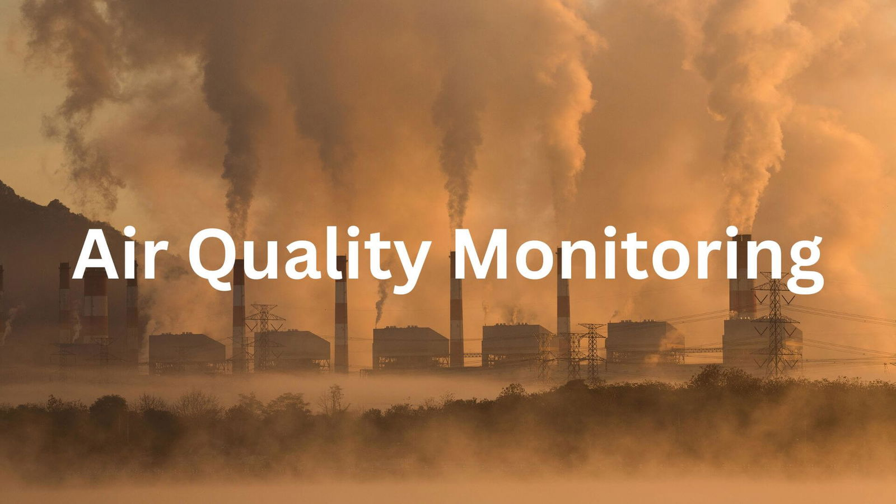
Introduction
Air pollution has become one of the most critical environmental issues affecting human health. To understand the pollution around us, a continuous monitoring system is needed. This project focuses on creating an Air Quality Monitoring System using IoT, which measures environmental parameters like air quality, temperature, and humidity, sends data to the cloud, and displays it on a professional dashboard website.Our goal is to build a smart, real-time, cloud-connected solution that helps users monitor air conditions instantly — anytime, anywhere.
2

Slide 3
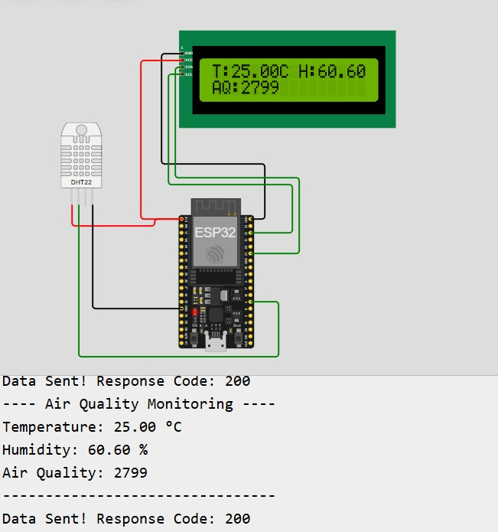
Project Overview
This project is a software-based IoT simulation that captures live environmental data using sensors and transmits it to the ThingSpeak cloud platform. From there, the values are displayed on a custom-designed, colorful web dashboard showing:Air Quality (Good / Moderate / Bad)TemperatureHumidityLive graphLive numeric readingsHistorical data trendsThe system also includes a buzzer alert that triggers when air quality becomes dangerous (AQI > 200).This model demonstrates how IoT can be used for smart environment monitoring, which is essential for smart cities.

Slide 4
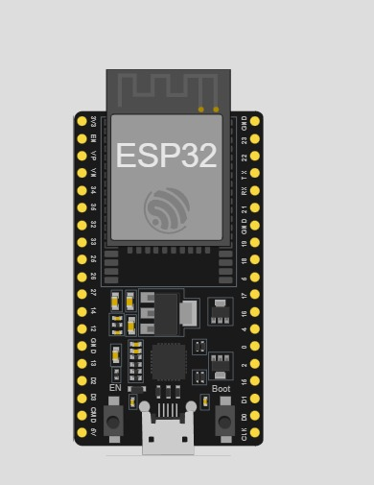
Components Used (Controllers)
ESP32 Microcontroller (Simulated in Wokwi)
Acts as the brain of the system
Has built-in Wi-Fi capability
Reads sensor values
Sends the data to the cloud using HTTP requests
Controls output devices like the buzzer

Slide 5
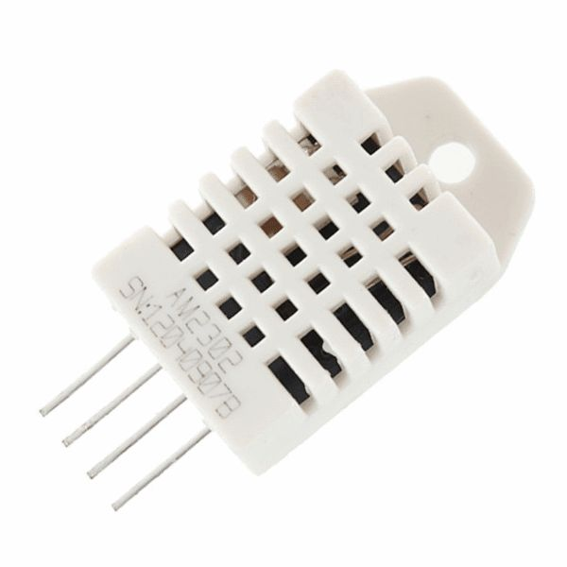
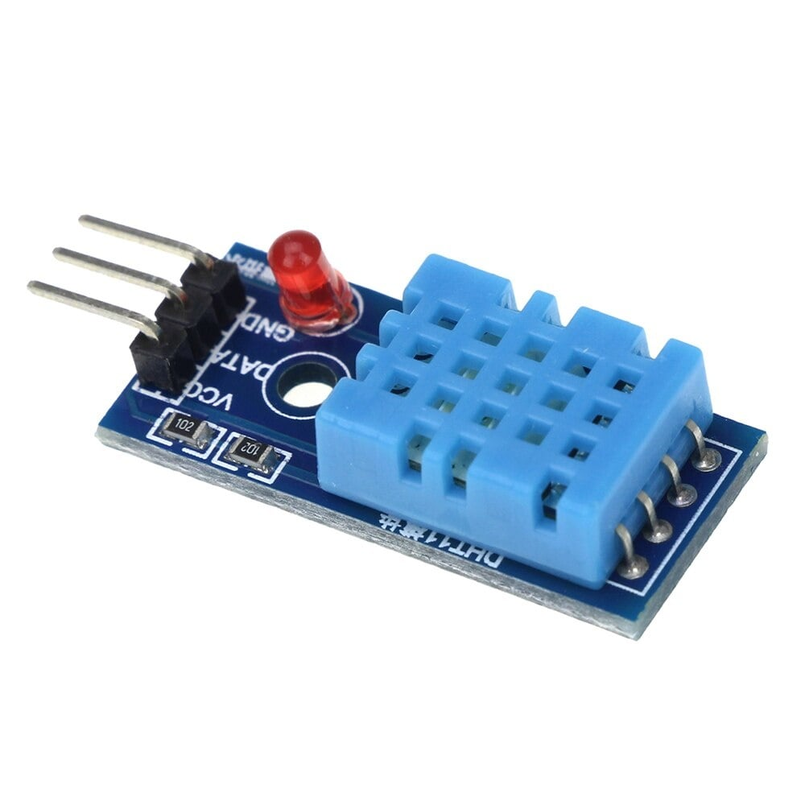
Components Used(Sensors & Output Devices)
MQ135 Air Quality Sensor
Measures gases like CO₂, NH₃, NOx, smokeGives an air quality value
Used to classify air quality (Good / Moderate / Bad)
DHT11 Sensor
Measures temperature
Measures humidity
Simple and accurate for beginner IoT projects
Buzzer
Turns ON when air quality becomes dangerous
Acts as an alert/warning system

Slide 6
Working Principle
The system operates in a continuous cycle where sensors first collect environmental data: the MQ135 sensor measures air quality, while the DHT11 sensor records temperature and humidity. The ESP32 reads these sensor values through its analog and digital inputs and processes the collected data. Using its built-in Wi-Fi module, the ESP32 connects to the network and uploads the data to ThingSpeak via HTTP GET/POST requests, where the values are stored in separate fields and updated in real time. The website then fetches this data using the ThingSpeak Read API and displays it on the dashboard with dynamic graphs, gauges, and cards. A buzzer alert system is also integrated—if the air quality value exceeds 200, the buzzer automatically turns ON; otherwise, it remains OFF. This entire process repeats every few seconds to ensure continuous monitoring.

Slide 7
IoT and Cloud Integration
The core of this project is the integration of Internet of Things (IoT) and cloud technology. IoT enables sensors to transmit data automatically without any manual intervention. The ESP32 sends the collected temperature, humidity, and air quality data to the ThingSpeak cloud, where it is stored in separate fields. The cloud platform then generates live charts, performs data analysis, and provides JSON output for external applications. Our custom website retrieves this JSON data in real time and displays live sensor values, dynamic graphs, air quality status, and related icons and images on the dashboard.

Slide 8
Results
After testing and integrating all modules:
Real-time sensor values are displayed correctly
Data is successfully uploaded to ThingSpeak
Website shows dynamic Air Quality, Temperature, Humidity
Live graph updates frequently
Air Quality status color changes automatically
Buzzer alarm works perfectly for dangerous AQI
Dashboard looks professional, clean, and modern
This proves the system is fully functional and accurate for environmental monitoring.

Slide 9
Conclusion
This project demonstrates how IoT can be effectively used to build a real-time environmental monitoring system. By integrating sensors, an ESP32 microcontroller, cloud storage, and a custom web interface, we developed a smart solution capable of continuously tracking air quality and weather parameters. The system is scalable, accurate, cost-effective, and suitable for applications in homes, schools, industries, and smart cities. It also offers scope for future enhancements such as AI-based prediction models, a mobile application, GPS integration, and an expanded multi-sensor network.

Slide 10






10

