Slide 1
Project Presenter: Alden Partridge
Scope: District 57, Java
Data: representative name, political party, counties in charge of, home address, Columbia address, home phone number, Columbia phone number, and committee assignments
Code Organization:
PA1: code reuse from Ryan Capron
PA2: code reuse from Ryan Capron
PA3: Base layer
PA4: Built on layer
PA5: Built on top again
PA6: Updating csv made into own method, fixed an issue with program 4, used Ryan’s code to get the information directly from the website
No one that I am aware of used my code.

Slide 2
Experience implementing: some challenge at first, reused code for program 1 and 2 because Ryan’s worked better
Experience testing: once the programming was done, testing was pretty easy

Slide 3
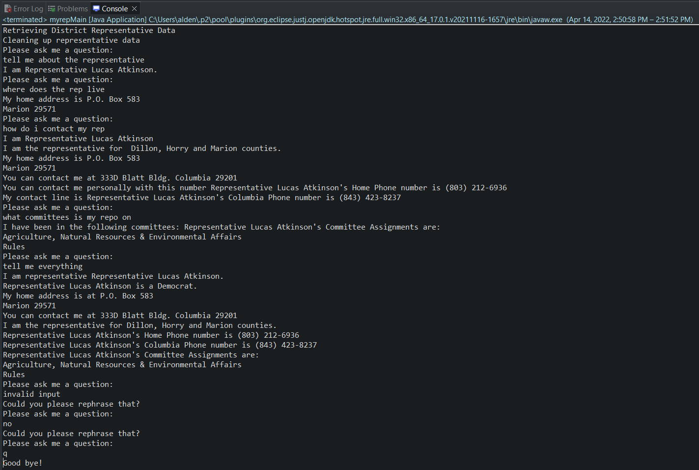
Queries Snapshot

