Slide 1

IS 737
Team 6: Credit Card Default

Slide 2
Agenda
Project Overview
Data background
Exploratory Data Analysis (EDA)
Handling Imbalanced Datasets
Model Outcomes
Model Comparison
Summary

Slide 3
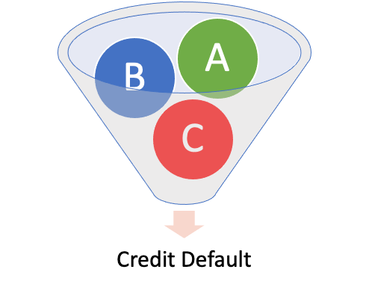
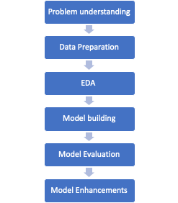

Project Overview
What type of customers are more likely to default?
Data
Process
Outcomes
Developed a predictive model to identify customers at risk of default
Help the product team create and deploy early intervention strategies
Influence approval rates and credit limits for low performing segments
Notes:
They have provided historical data with various customer attributes and an indicator telling us what customers are likely to default on their loans.

Slide 4
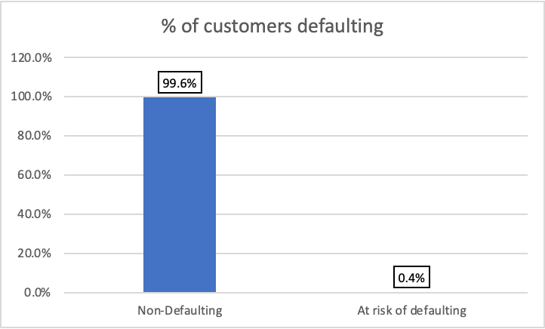
Exploratory Data Analysis
Customer Feature*
On average, .36% of customers are at risk of defaulting on their credit card loans
less likely
vs. average
More likely
Female
Gender
Male
Realty Agents
Job Title
Low Skilled Labors
Civil Marriage
Marriage
Single
2+ children
Children Count
1 children
Academic Degree
Education
Lower Secondary
13+ years
Tenure
<2 years
$225k-$270k
Income
<$112k
36-41 years old
Age
51-67 years old

Slide 5
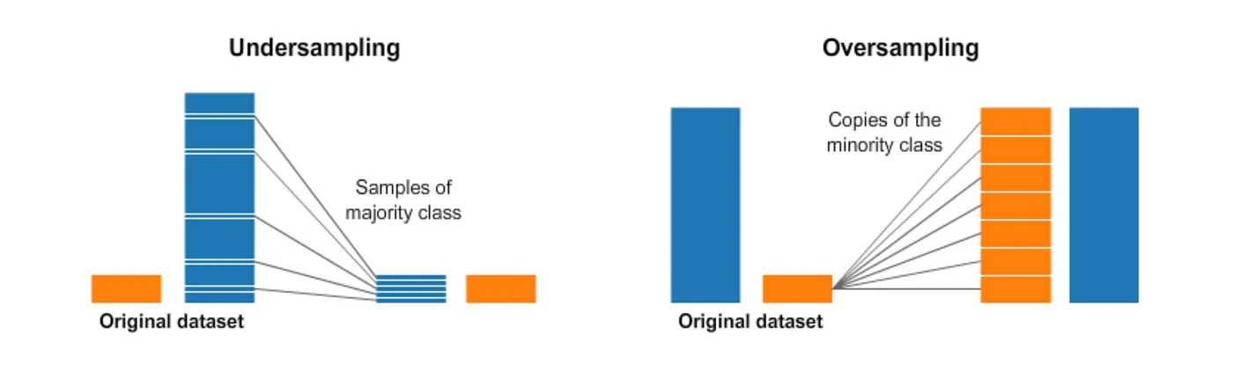
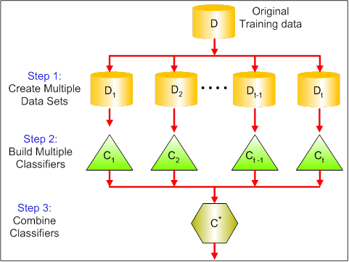
Techniques used to tackle Imbalanced Dataset
Under sampling is a technique where we try to balance the majority and minority classes by decreasing the count of majority class
Cost Sensitive learning is a technique where the weights to the errors are added to majority class and minority class depending on sample size and then best fit is measured by minimizing the error
Under Sampling
Cost Sensitive Learning
Imbalanced Data
Over Sampling
Ensemble Models
ML Models are one of the post processing techniques used to tackle imbalanced dataset where the multiple models are trained with different data from the imbalanced data and final prediction is taken as majority model prediction
Over sampling is a technique where we increase the samples of minority class by duplicating existing minority samples

Slide 6
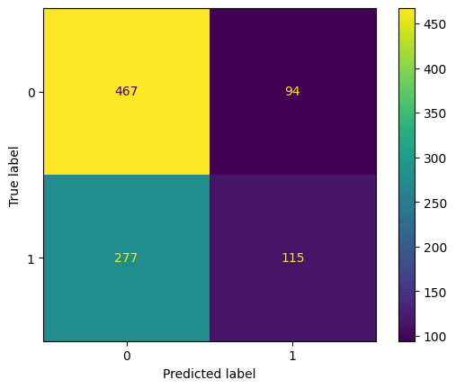
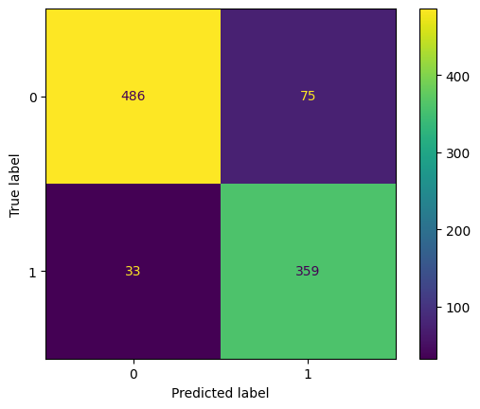
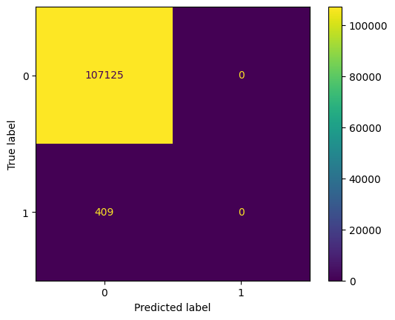
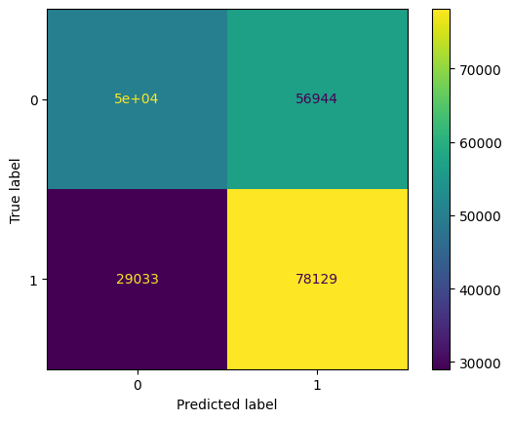
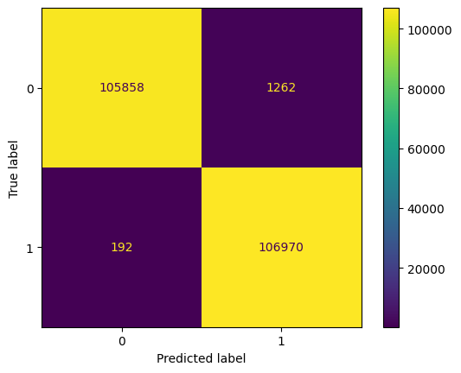
Confusion Matrix (Pre vs Post imbalance dataset solution)
Undersampling - Balanced Data
Logistic Regression
Decision Tree
Imbalance Dataset
Accuracy : 61.07%
Recall : 0.29
Precision:0.55
ROC AUC: 0.56
F1 Score: 0.38
Accuracy : 88.66%
Recall : 0.91
Precision:0.82
ROC AUC: 0.89
F1 Score: 0.86
Oversampling - Balanced Data
Accuracy : 99.6756
Recall : 0.00
Precision:0.0
ROC AUC: 0.50
F1 Score: 0.00
Logistic Regression
Decision Tree
Accuracy : 59.8%
Recall : 0.72
Precision:0.57
ROC AUC: 0.59
F1 Score: 0.64
Accuracy : 99.3%
Recall : 0.998
Precision:0.988
ROC AUC: 0.993
F1 Score: 0.993

Slide 7
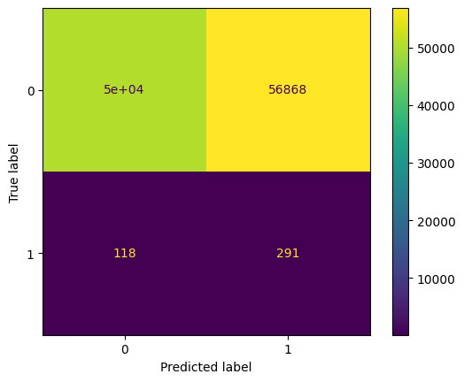



Continued…
Cost Sensitive Learning
Logistic Regression
Decision Tree
Imbalance Dataset
Accuracy : 47.0%
Recall : 0.711
Precision:0.005
ROC AUC: 0.59
F1 Score: 0.01
Accuracy : 99.30%
Recall : 0.388
Precision:0.241
ROC AUC: 0.69
F1 Score: 0.298
Using ensemble methods
Random Forest Classifier
Bagging Classifier
Accuracy : 99.6756
Recall : 0.00
Precision:0.0
ROC AUC: 0.50
F1 Score: 0.00
Accuracy : 99.6%
Recall : 0.31
Precision:0.48
ROC AUC: 0.65
F1 Score: 0.38
Accuracy : 99.6%
Recall : 0.32
Precision:0.47
ROC AUC: 0.65
F1 Score: 0.38

Slide 8
Model Comparison
Metrics / Models | Logistic Regression | KNN | Decision Tree | XGBoost | Bagging | Random Forest
Accuracy | 0.63 | 0.81 | 0.89 | 0.90 | 0.91 | 0.93
F1-score | 0.45 | 0.80 | 0.86 | 0.92 | 0.92 | 0.91
Precision | 0.65 | 0.83 | 0.92 | 0.88 | 0.91 | 0.93
Recall | 0.35 | 0.83 | 0.63 | 0.91 | 0.92 | 0.94

Slide 9
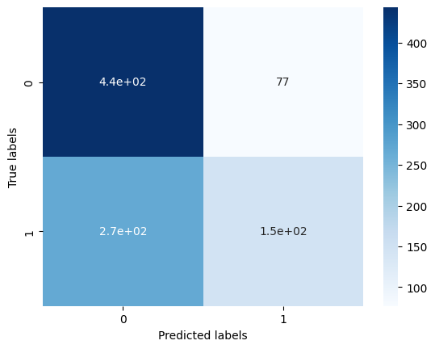
Confusion Matrix - Logistic Regression

Slide 10
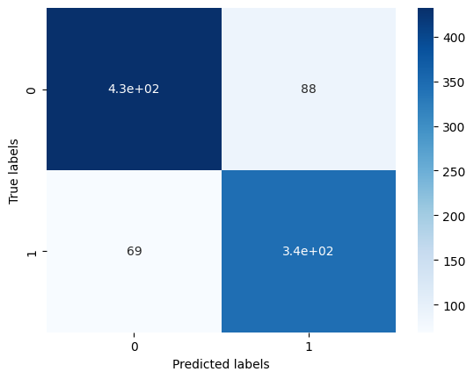
Confusion Matrix - KNN Classifier

Slide 11

Confusion Matrix - Decision Tree

Slide 12
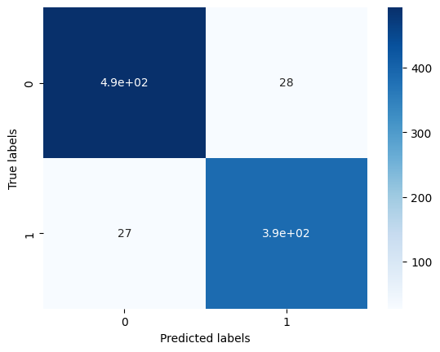
Confusion Matrix - Random Forest

Slide 13

Confusion Matrix - XG Boost

Slide 14

Confusion Matrix - Bagging

Slide 15
Summary / Lessons Learned/ Next steps
Spend time understanding data definition
High accuracy =/ good model
Imbalanced dataset predicting 0s outweighting 1s
Explore various techniques and pick whatever works best for what you’re trying to predict
Validate accuracy by looking at precision, error rates, f-1 score, ROC AUC
Next steps:
Iterate feature selection, feature engineering and continue to explore more imbalanced dataset managing techniques to optimize our model

Slide 16
Review Imbalance Dataset code

Slide 17
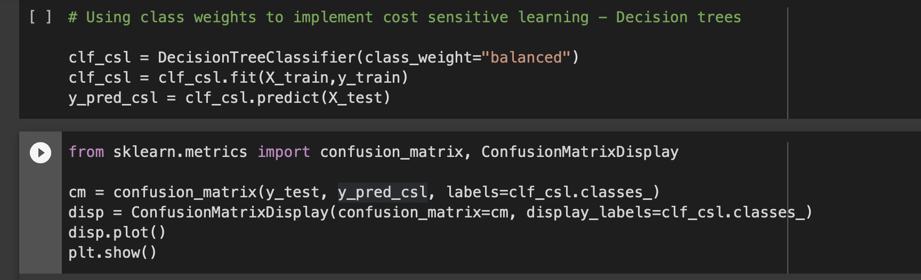
Cost-Sensitivity Imbalanced Dataset Code

Slide 18
Appendix

Slide 19
Issue: Imbalance Datasets
(Target class has an uneven distribution of observations)
Why is this problem ?
Imbalance datasets which results in non prediction of minority class even though it results in higher accuracy. So, it’s important to tackle this problem to get better prediction of minority class even though it results in lower accuracy
Potential Solutions:
There are both pre data processing techniques and post data processing techniques to handle this issue with imbalance data
What worked for us ?
We implemented multiple techniques that can help us in predicting minority class more effectively such as over sampling, under sampling, cost sensitive learning, ensemble methods(Random Forest) etc out of which both ensemble methods and cost sensitive learning gave us better results considering other important factors like ROC curve, F1 score, accuracy, recall etc.
How did it impact our models ?
Oversampling and undersampling techniques resulted in very low accuracy even though the prediction of minority class improved relative to imbalance data but cost sensitive learning and ensemble model technique gave good prediction on minority class as well as good accuracy
Notes:
Expand this a little more

Slide 20
Data background
No missing values
Abnormal values
Dealing with outliers
Converting categorical to dummy variables
Distribution of variables
Feature selection
Tuning parameters

