Slide 1
Modified ResNet Architecture for Single Image Deraining
Quang Luan Dang Tran - dangtran@bu.edu
Haniel Edward Jacob - hanielj@bu.edu
Parth Gajanan Ghayal - parthg@bu.edu

Slide 2
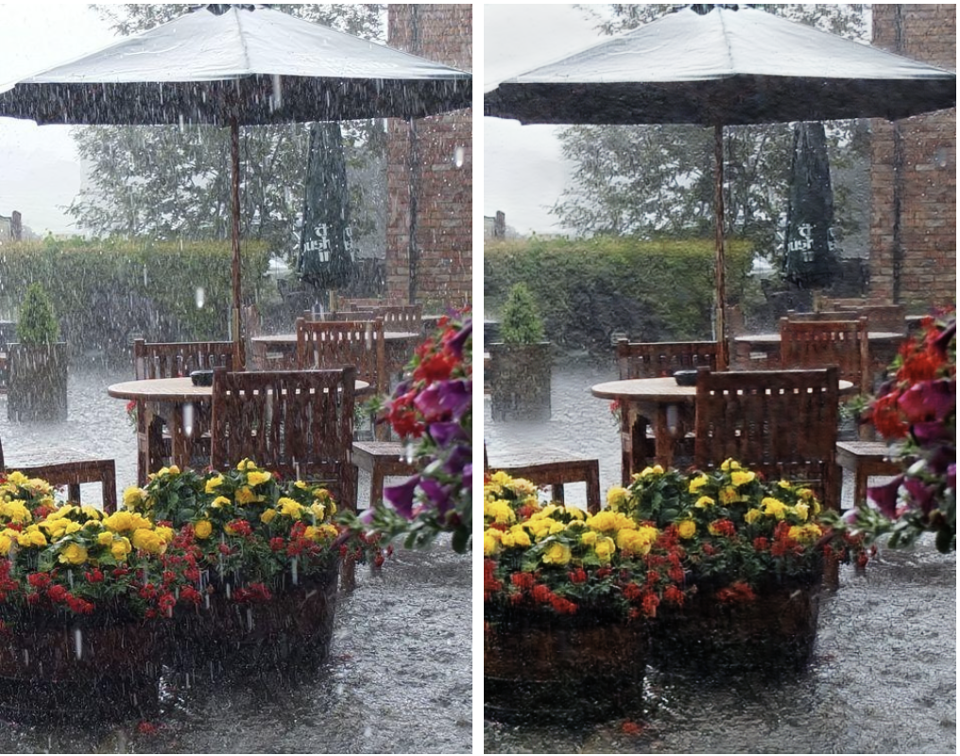
Introduction
The objective of our project was to develop a technique for effectively eliminating rain streaks and accumulations.
The training dataset consisted of 89 image scenes with one clean image and around 300 rainy images per scene.
We used a modified Resnet architecture to generate clean images from the rainy images.

Slide 3
Dataset and Functions
Dataset: pairs of rainy images and ground-truth image in different scenarios
Loss Functions:
l1: absolute difference
MS-SSIM: Multi-Scale Structural Similarity Index
Robust Loss: feature space comparison

Slide 4
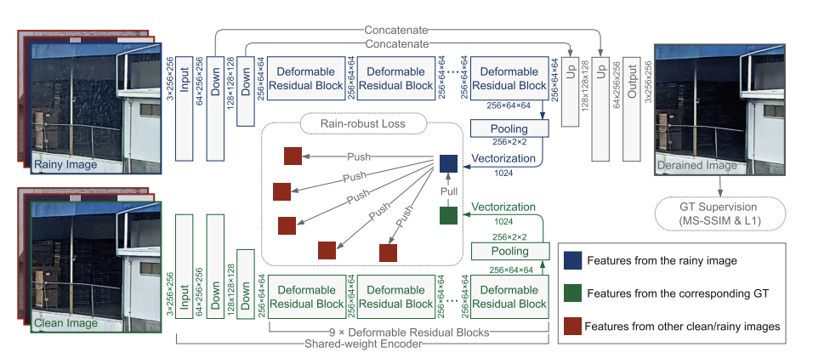
Model

Slide 5
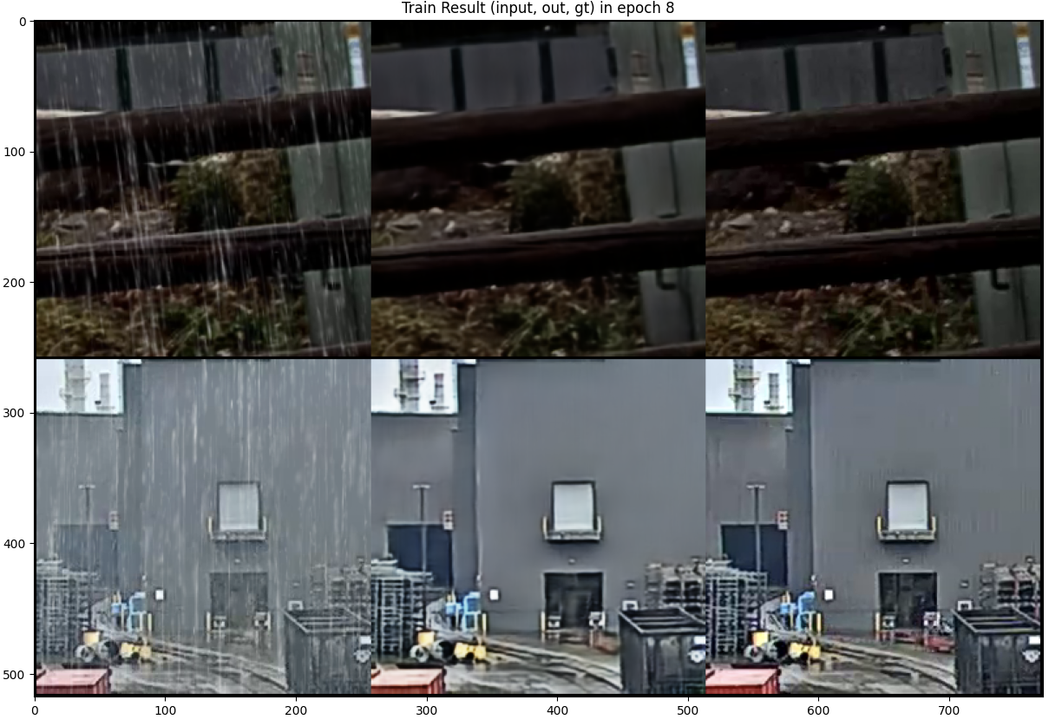
Results
We experimented with various techniques such as adjusting the learning rate, adding data augmentation, and modifying the model architecture.
During the final testing phase, we achieved a PSNR score of 23.344

Slide 6
Conclusion
Our modified ResNet architecture for single image deraining can accurately remove rain from images while maintaining important spatial details and context information.
The model is able to successfully detect rain and its pattern in the input image, and the predicted output image is very close to the ground-truth (clean) image with minimal information loss during the training process.
By using the Mish activation function along with a higher number of epochs for training we were able to increase the PSNR score of the model.
Future Work and applications.

