Slide 1
Scalar Wave Equations and Numerical Solutions In Black Hole Spacetimes ​
A Brief Look​
​
By Adam Kiddle

Slide 2
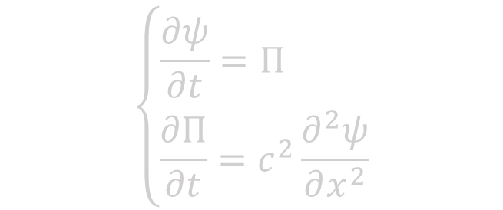
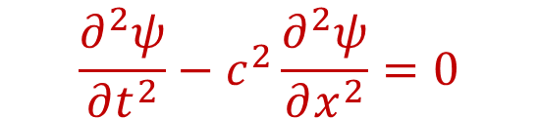
Hyperbolic PDE - A reminder
Model hyperbolic equation: The 1D wave equation
$$\frac{∂^{2}ψ}{∂t^{2}}−c^{2}\frac{∂^{2}ψ}{∂x^{2}}=0$$
Second order in time, second order in space
Can introduce a new variable $Π$ to turn this into two equations
$$\left\{\begin{matrix}\frac{∂ψ}{∂t}=Π \\ \frac{∂Π}{∂t}=c^{2}\frac{∂^{2}ψ}{∂x^{2}}\end{matrix}\right.$$
Both first order in time – simpler to solve numerically!

Slide 3
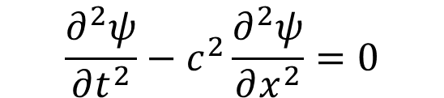
Hyperbolic PDE - A reminder
Model hyperbolic equation: The 1D wave equation
$$\frac{∂^{2}ψ}{∂t^{2}}−c^{2}\frac{∂^{2}ψ}{∂x^{2}}=0$$
Second order in time, second order in space
Can introduce a new variable $Π$ to turn this into two equations
$$\left\{\begin{matrix}\frac{∂ψ}{∂t}=Π \\ \frac{∂Π}{∂t}=c^{2}\frac{∂^{2}ψ}{∂x^{2}}\end{matrix}\right.$$
Both first order in time – simpler to solve numerically!

Slide 4
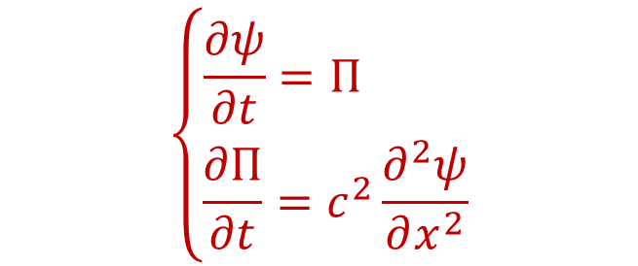
Hyperbolic PDE - A reminder
Model hyperbolic equation: The 1D wave equation
$$\frac{∂^{2}ψ}{∂t^{2}}−c^{2}\frac{∂^{2}ψ}{∂x^{2}}=0$$
Second order in time, second order in space
Can introduce a new variable $Π$ to turn this into two equations
$$\left\{\begin{matrix}\frac{∂ψ}{∂t}=Π \\ \frac{∂Π}{∂t}=c^{2}\frac{∂^{2}ψ}{∂x^{2}}\end{matrix}\right.$$
Both first order in time – simpler to solve numerically!

Slide 5
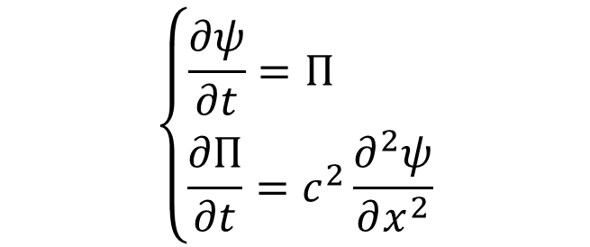
Hyperbolic PDE - A reminder
Model hyperbolic equation: The 1D wave equation
$$\frac{∂^{2}ψ}{∂t^{2}}−c^{2}\frac{∂^{2}ψ}{∂x^{2}}=0$$
Second order in time, second order in space
Can introduce a new variable $Π$ to turn this into two equations
$$\left\{\begin{matrix}\frac{∂ψ}{∂t}=Π \\ \frac{∂Π}{∂t}=c^{2}\frac{∂^{2}ψ}{∂x^{2}}\end{matrix}\right.$$
Both first order in time – simpler to solve numerically!

Slide 6
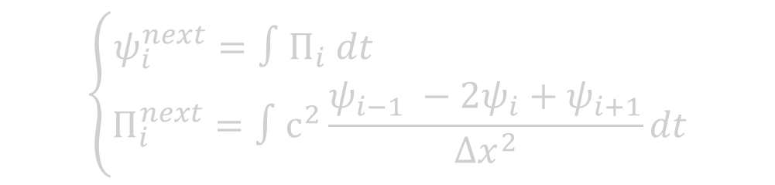

Finite difference
Taking second order derivatives across space at fixed time intervals:
$$\frac{∂^{2}ψ_{i}}{∂x^{2}}{\left.​\right|}_{t}≈\frac{ψ_{i−1} −2ψ_{i}+ψ_{i+1}}{Δx^{2}}$$
A solution can be integrated integrated forward in time (with e.g. RK4):
$$\left\{\begin{matrix}ψ_{i}^{next}=∫Π_{i} dt \\ Π_{i}^{next}=∫c^{2}\frac{ψ_{i−1} −2ψ_{i}+ψ_{i+1}}{Δx^{2}}dt\end{matrix}\right.$$

Slide 7
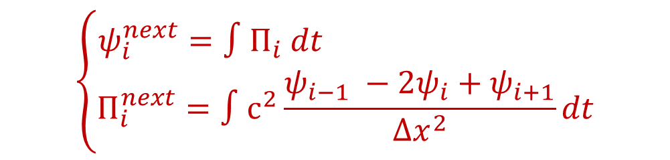

Finite difference
Taking second order derivatives across space at fixed time intervals:
$$\frac{∂^{2}ψ_{i}}{∂x^{2}}{\left.​\right|}_{t}≈\frac{ψ_{i−1} −2ψ_{i}+ψ_{i+1}}{Δx^{2}}$$
A solution can be integrated integrated forward in time (with e.g. RK4):
$$\left\{\begin{matrix}ψ_{i}^{next}=∫Π_{i} dt \\ Π_{i}^{next}=∫c^{2}\frac{ψ_{i−1} −2ψ_{i}+ψ_{i+1}}{Δx^{2}}dt\end{matrix}\right.$$

Slide 8
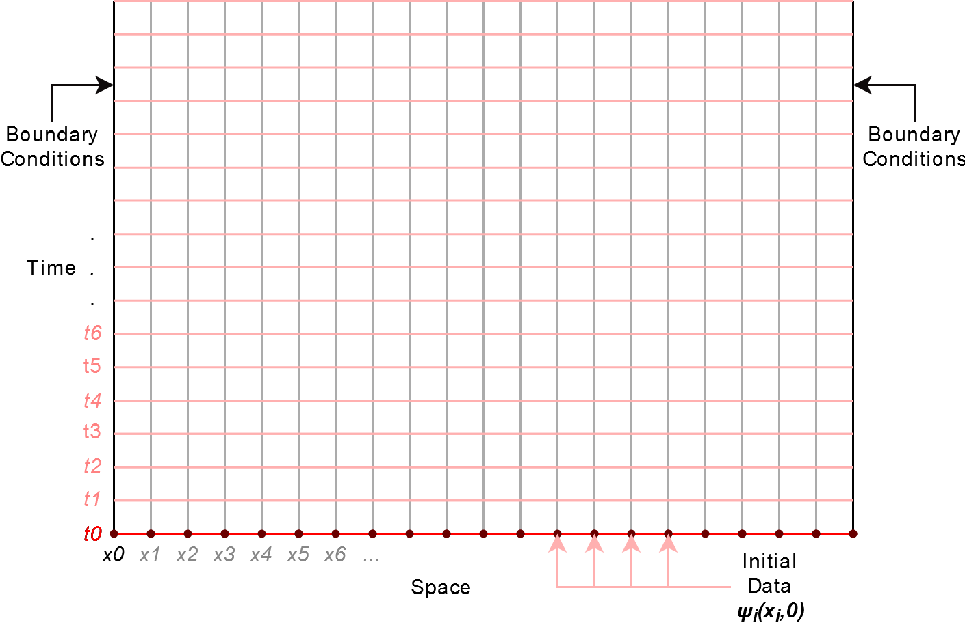

Slide 9
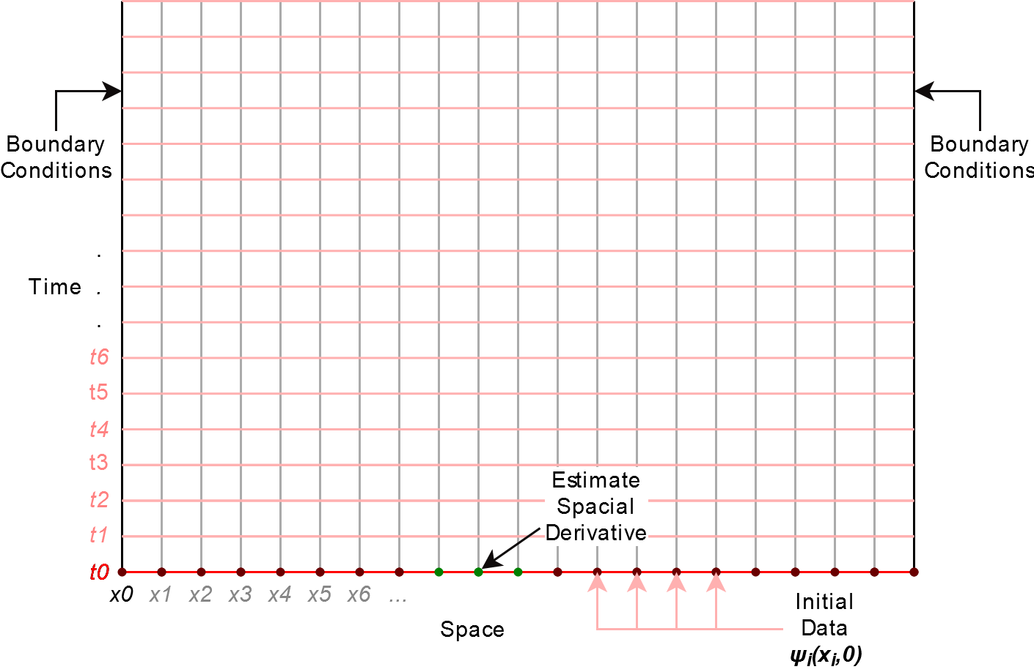

Slide 10
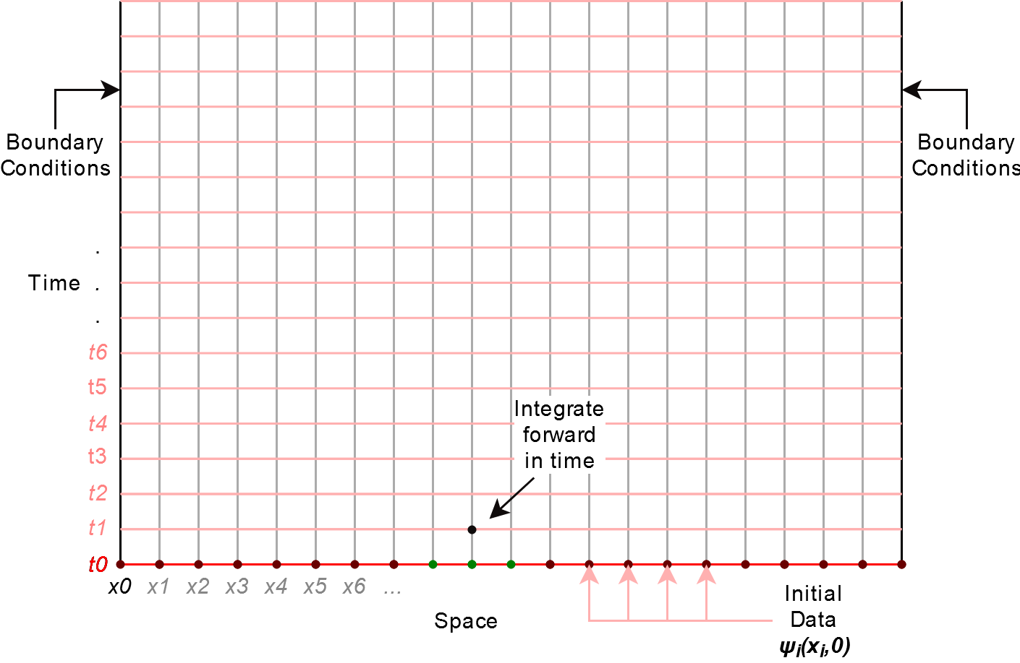

Slide 11
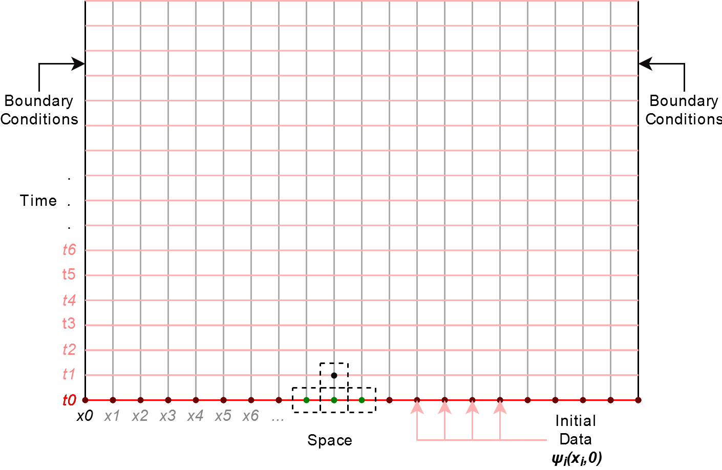

Slide 12
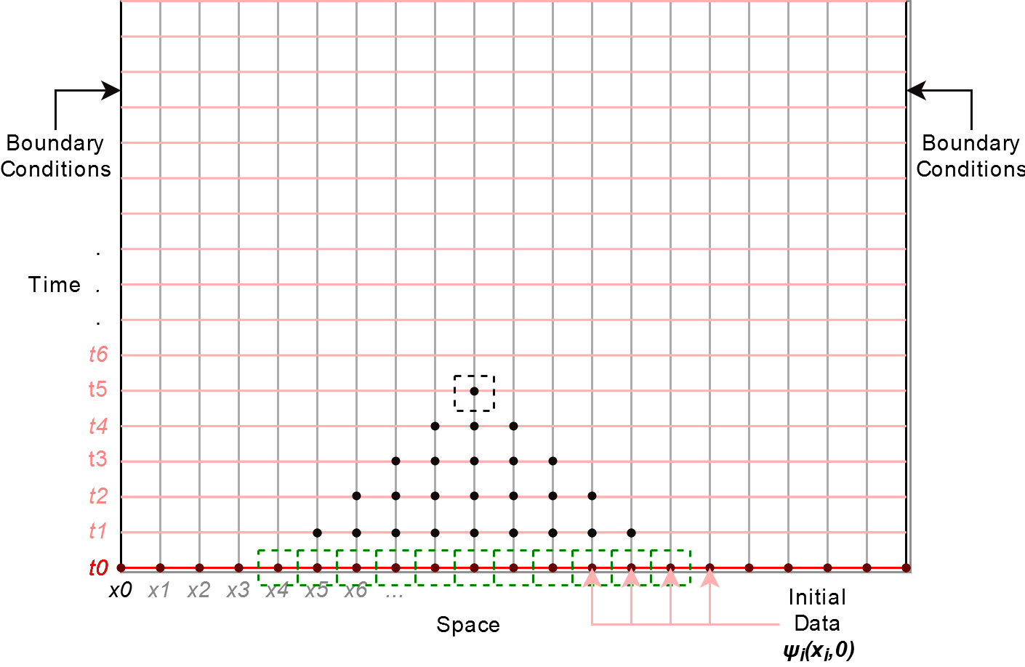

Slide 13
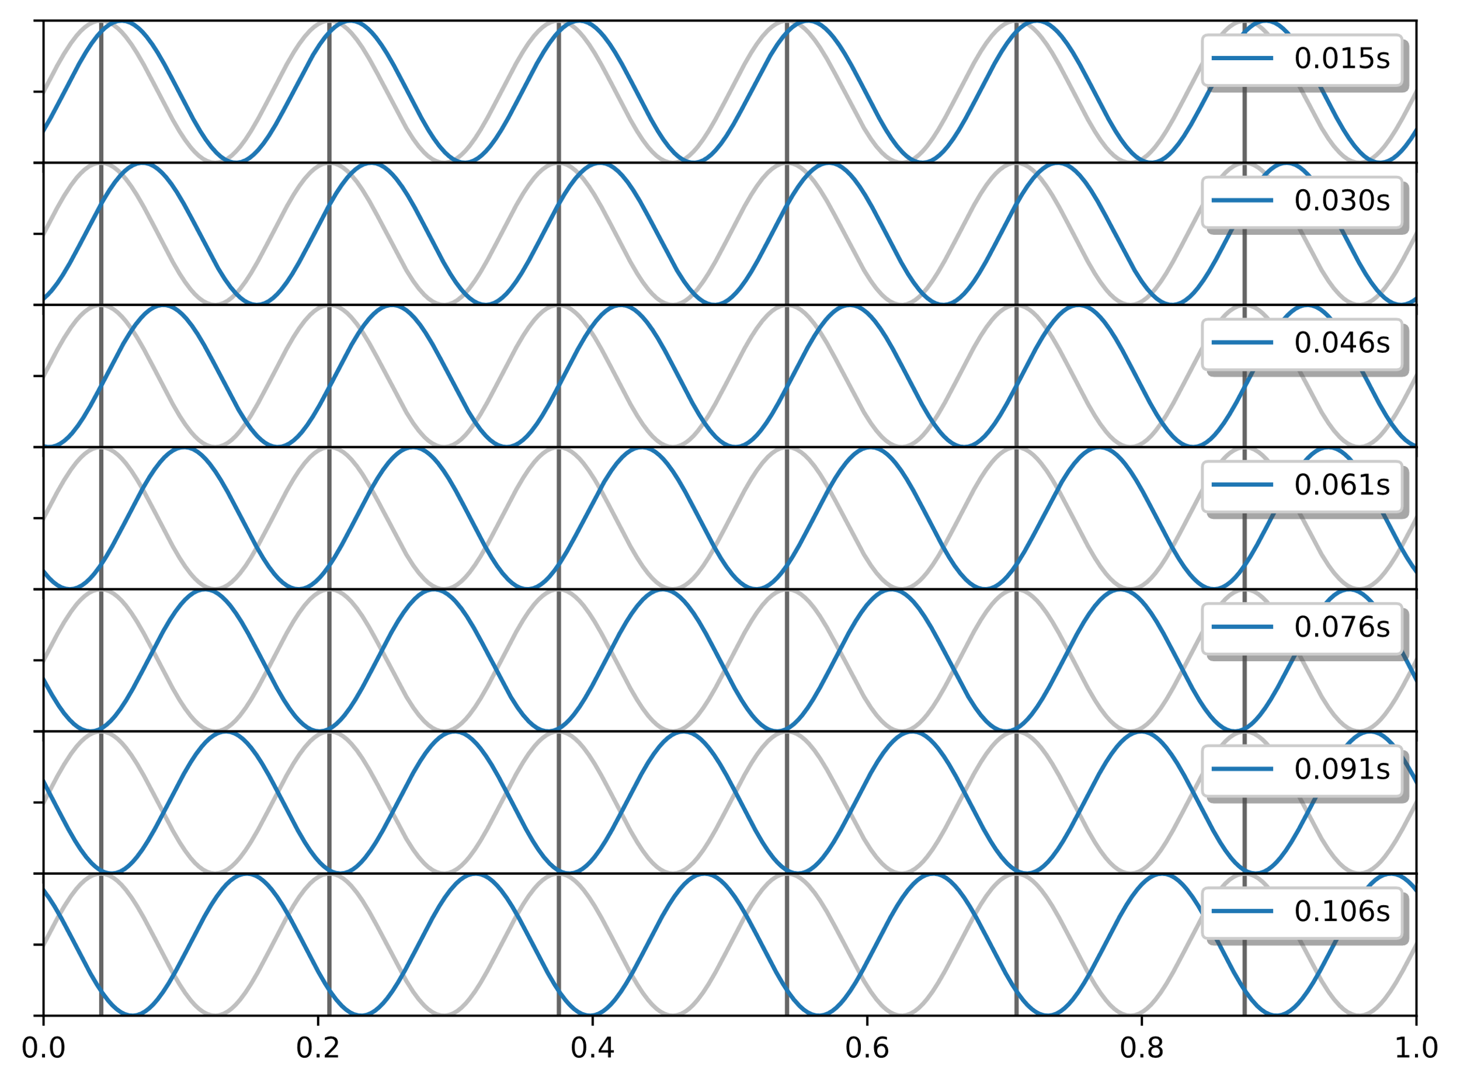
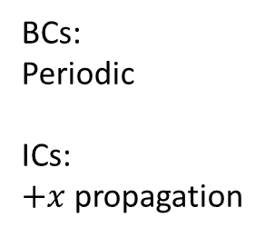
BCs:
Periodic
ICs:
$+x$ propagation

Slide 14
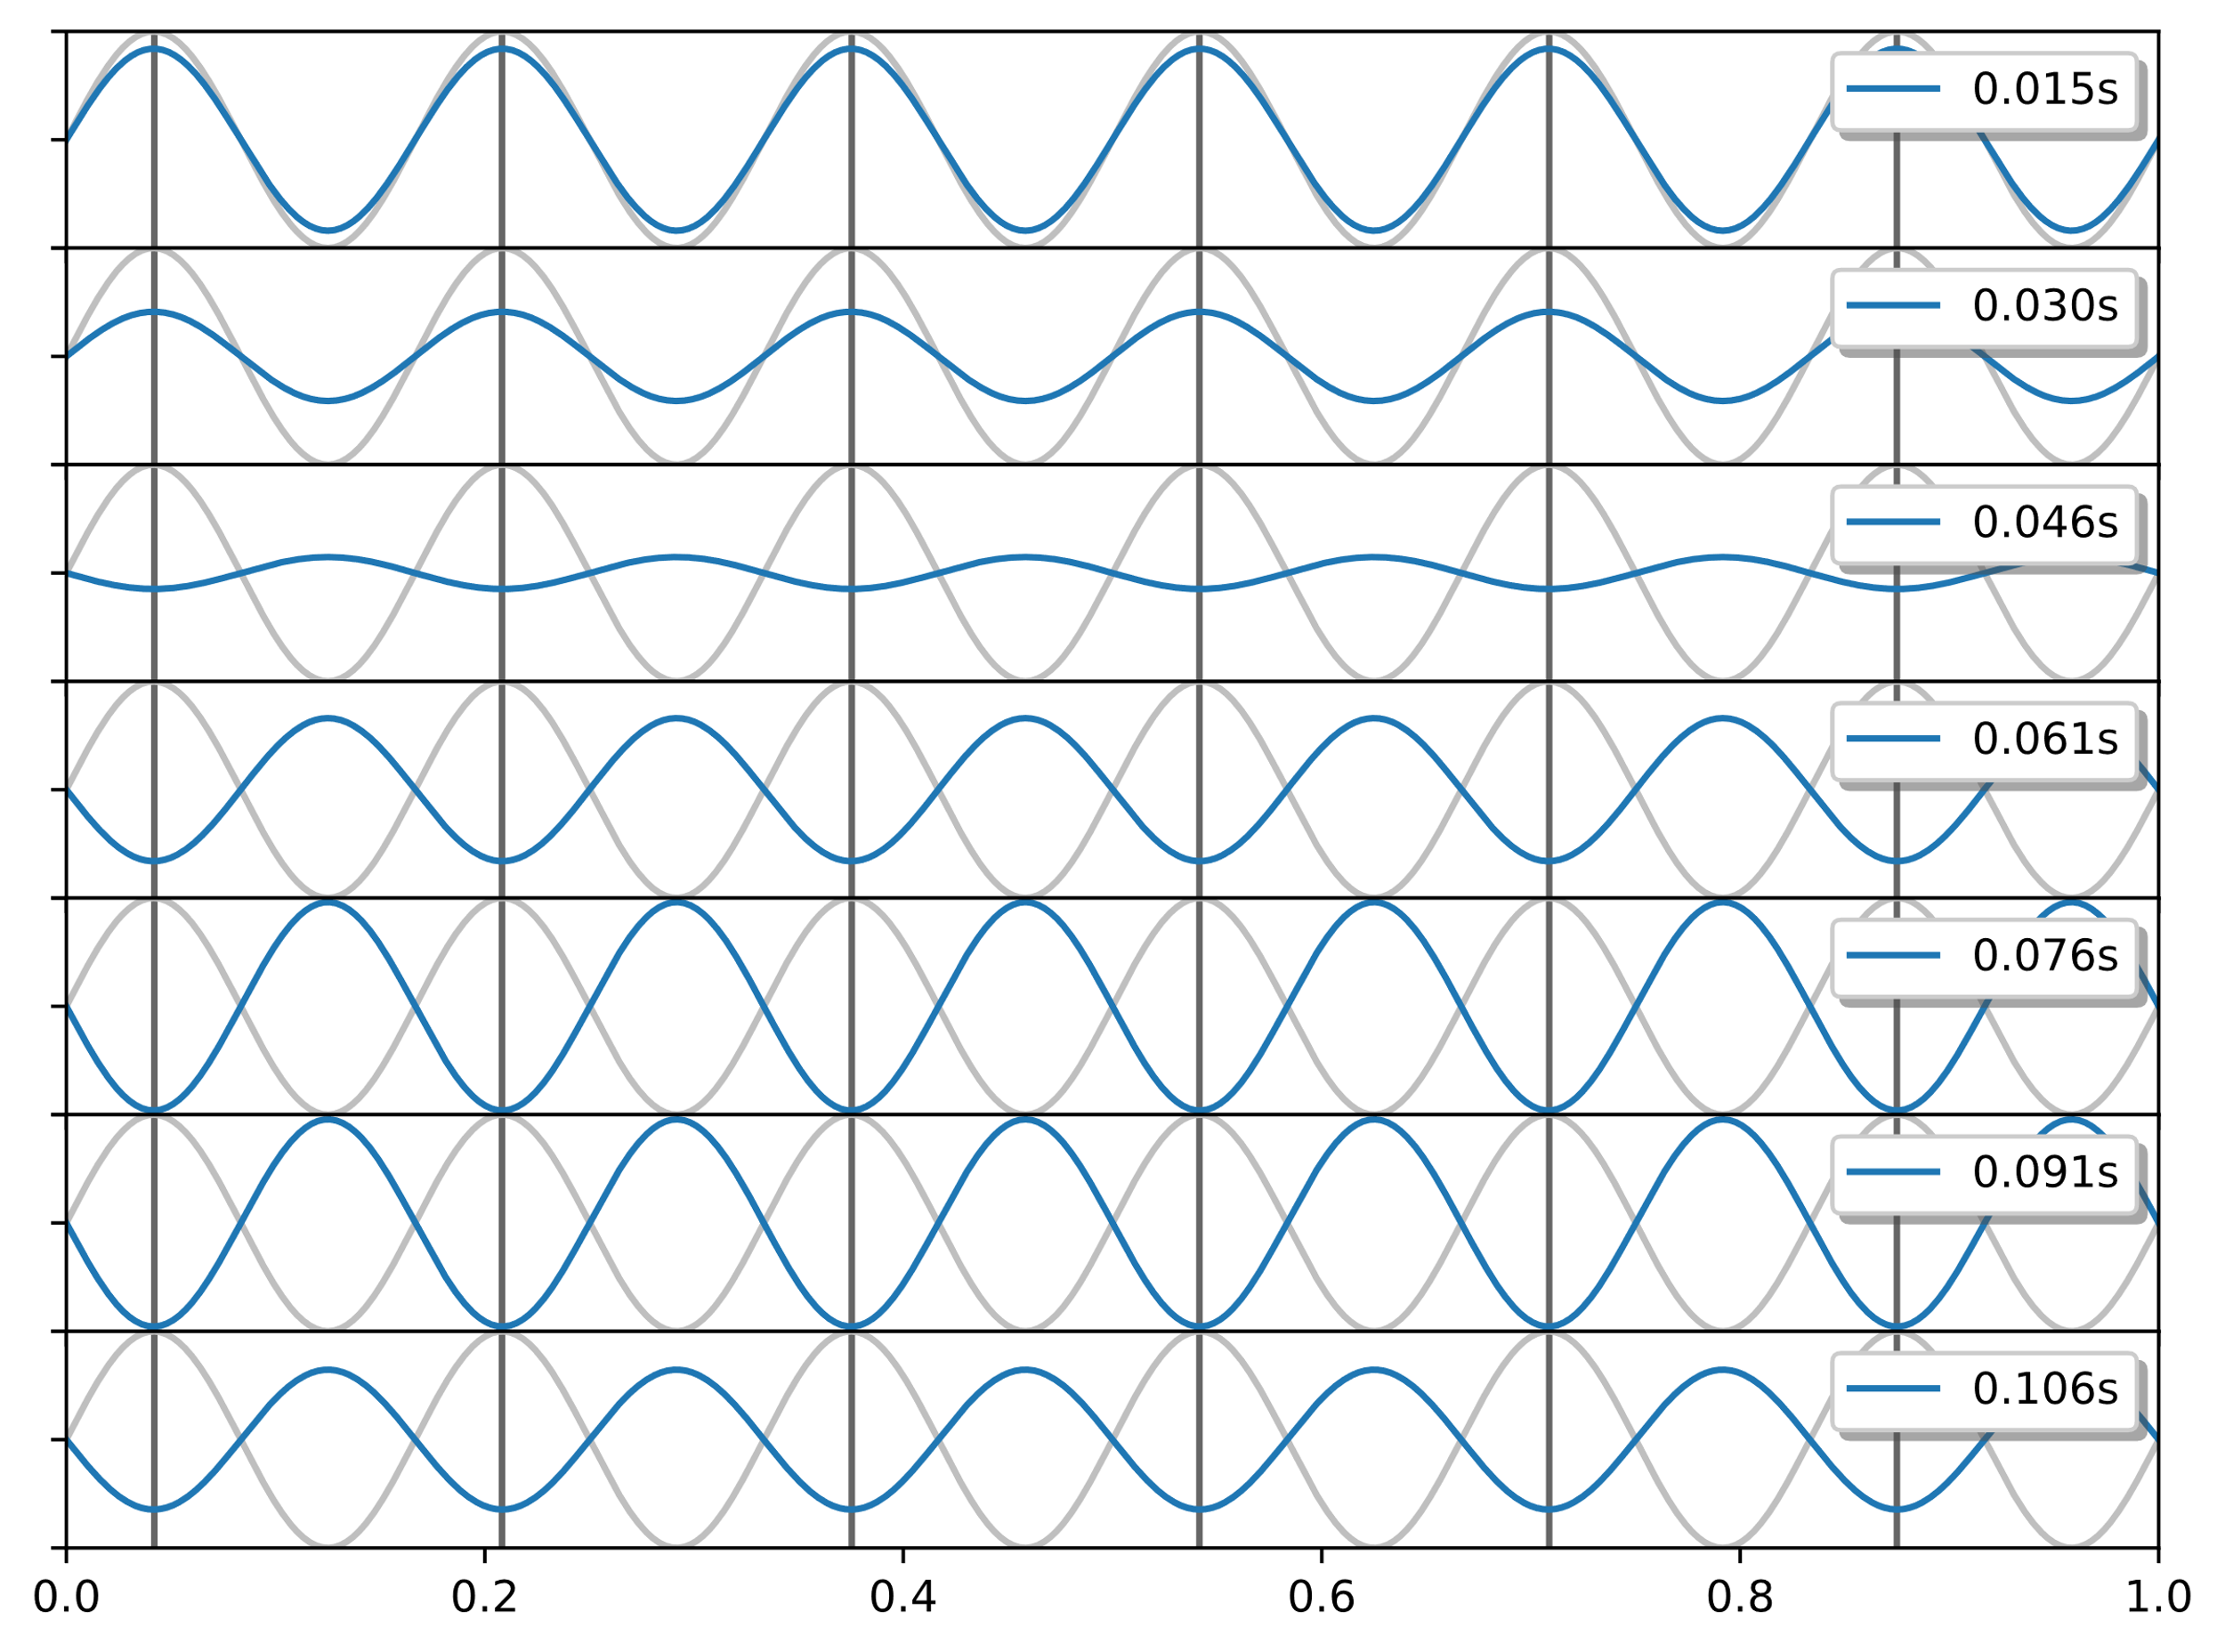
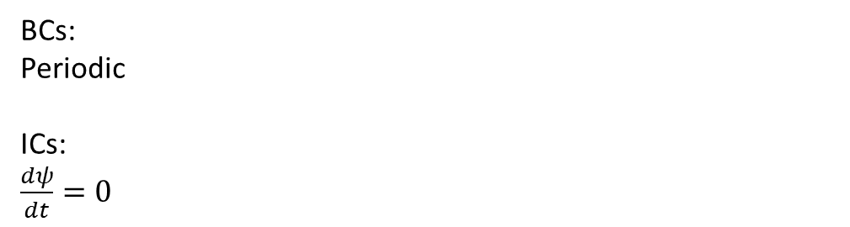
BCs:
Periodic
ICs:
$\frac{dψ}{dt}=0$

Slide 16
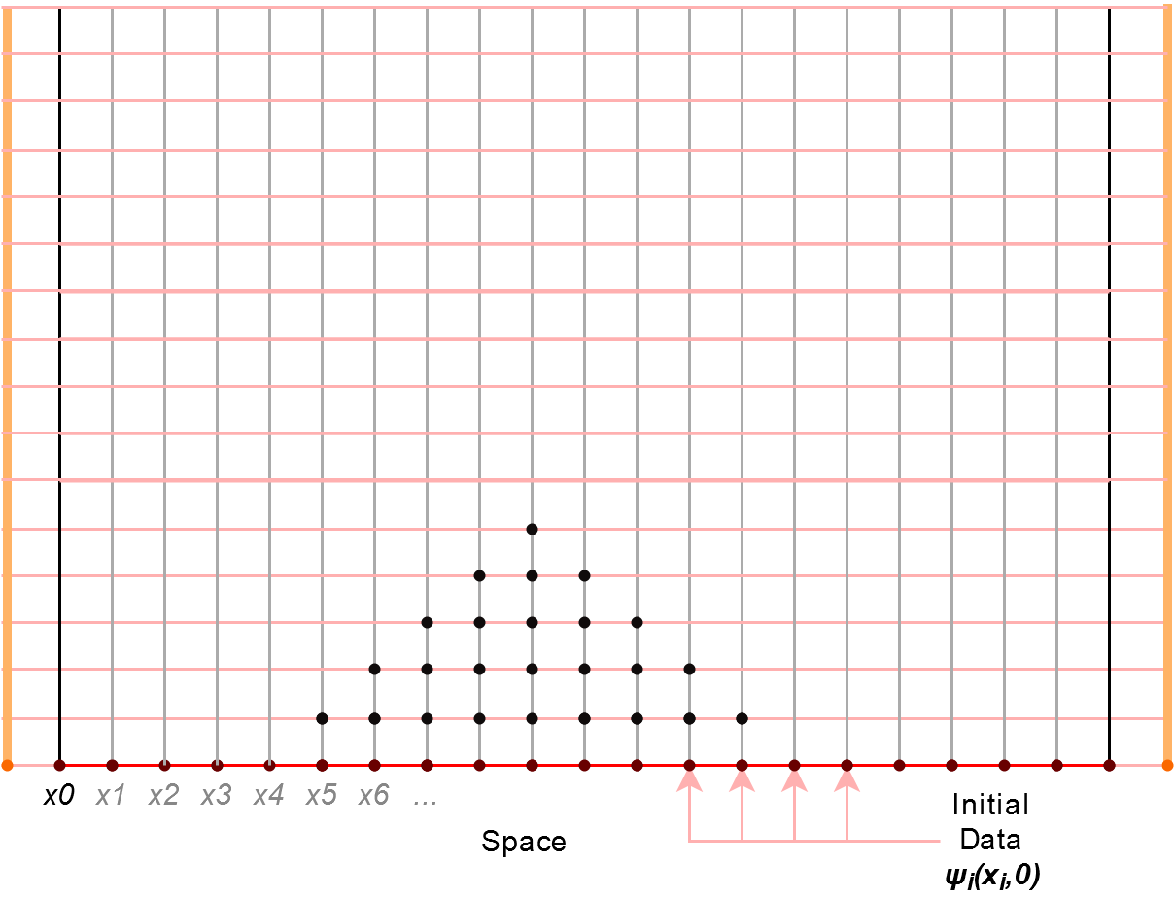

Slide 17
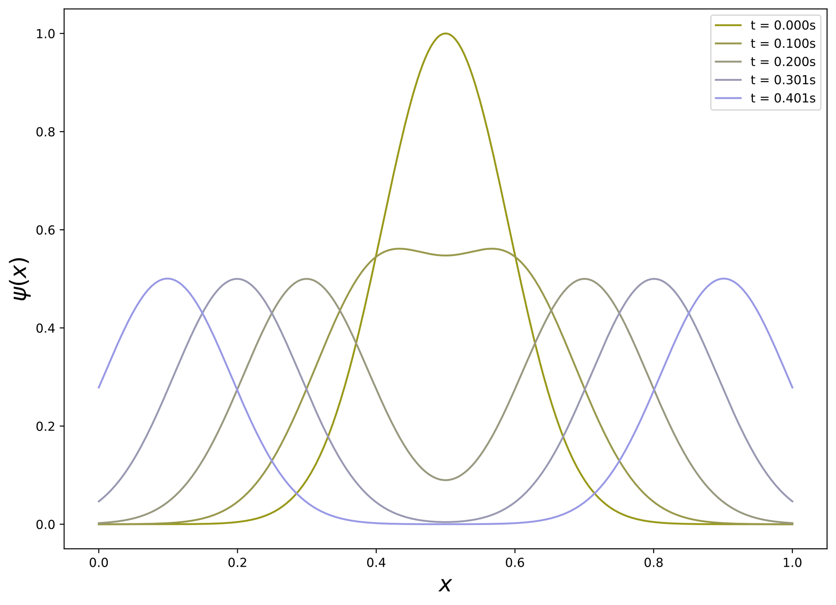
Dissipative Propagation: Gaussian Peak

Slide 18
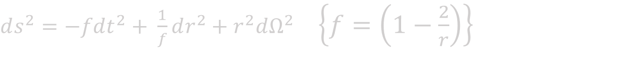
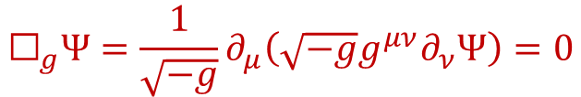
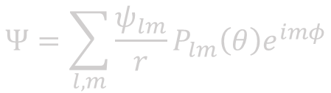
General Wave Equation
For general 4-dimensional spacetime, the scalar wave equation is:
$${\text{☐}}_{g}Ψ=\frac{1}{\sqrt{−g}}∂_{μ}\left(\sqrt{−g}g^{μν}∂_{ν}Ψ\right)=0$$
Take the Schwarzschild metric in Schwarzschild coordinates (c, M = 1):
$ds^{2}=−fdt^{2}+ \frac{1}{f}dr^{2}+r^{2}dΩ^{2}$ $\left\{f=\left(1−\frac{2}{r}\right)\right\}$
Expand solution into scalar harmonics:
$$Ψ=\sum_{l,m}{\frac{ψ_{lm}}{r}P_{lm}\left(θ\right)e^{imφ}}$$

Slide 19
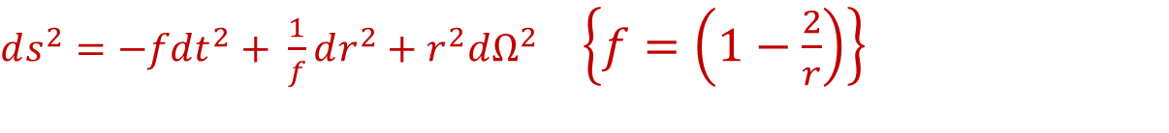
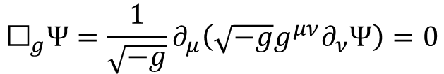
General Wave Equation
For general 4-dimensional spacetime, the scalar wave equation is:
$${\text{☐}}_{g}Ψ=\frac{1}{\sqrt{−g}}∂_{μ}\left(\sqrt{−g}g^{μν}∂_{ν}Ψ\right)=0$$
Take the Schwarzschild metric in Schwarzschild coordinates (c, M = 1):
$ds^{2}=−fdt^{2}+ \frac{1}{f}dr^{2}+r^{2}dΩ^{2}$ $\left\{f=\left(1−\frac{2}{r}\right)\right\}$
Expand solution into scalar harmonics:
$$Ψ=\sum_{l,m}{\frac{ψ_{lm}}{r}P_{lm}\left(θ\right)e^{imφ}}$$

Slide 20
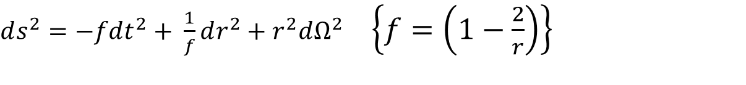
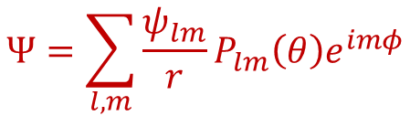
General Wave Equation
For general 4-dimensional spacetime, the scalar wave equation is:
$${\text{☐}}_{g}Ψ=\frac{1}{\sqrt{−g}}∂_{μ}\left(\sqrt{−g}g^{μν}∂_{ν}Ψ\right)=0$$
Take the Schwarzschild metric in Schwarzschild coordinates (c, M = 1):
$ds^{2}=−fdt^{2}+ \frac{1}{f}dr^{2}+r^{2}dΩ^{2}$ $\left\{f=\left(1−\frac{2}{r}\right)\right\}$
Expand solution into scalar harmonics:
$$Ψ=\sum_{l,m}{\frac{ψ_{lm}}{r}P_{lm}\left(θ\right)e^{imφ}}$$

Slide 21
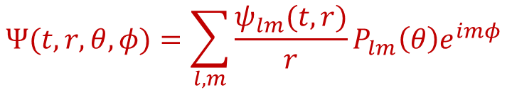
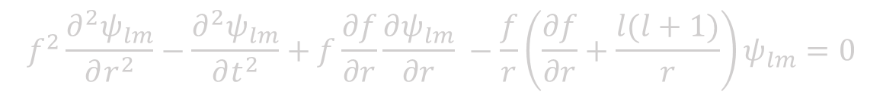

General Wave Equation
Expand solution into scalar harmonics:
$$Ψ(t,r,θ,φ)=\sum_{l,m}{\frac{ψ_{lm}(t,r)}{r}P_{lm}\left(θ\right)e^{imφ}}$$
Put this solution into the wave equation to obtain a PDE for any given mode $ψ_{lm}(r,t)$:
$$f^{2}\frac{∂^{2}ψ_{lm}}{∂r^{2}}−\frac{∂^{2}ψ_{lm}}{∂t^{2}}+f\frac{∂f}{∂r}\frac{∂ψ_{lm}}{∂r} −\frac{f}{r}\left(\frac{∂f}{∂r}+\frac{l(l+1)}{r}\right)ψ_{lm}=0$$
Using a new radial coordinate $r^{∗}$ which satisfies $f= \frac{dr}{{dr}^{∗}}:$
$$\frac{∂^{2}ψ_{lm}}{∂{r^{∗}}^{2}}−\frac{∂^{2}ψ_{lm}}{∂t^{2}}−\frac{f}{r}\left(\frac{∂f}{∂r}+\frac{l(l+1)}{r}\right)ψ_{lm}=0$$

Slide 22
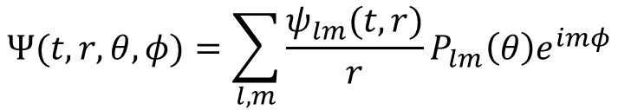
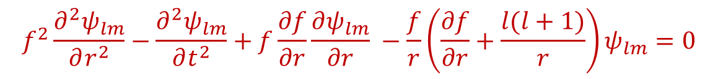
General Wave Equation
Expand solution into scalar harmonics:
$$Ψ(t,r,θ,φ)=\sum_{l,m}{\frac{ψ_{lm}(t,r)}{r}P_{lm}\left(θ\right)e^{imφ}}$$
Put this solution into the wave equation to obtain a PDE for any given mode $ψ_{lm}(r,t)$:
$$f^{2}\frac{∂^{2}ψ_{lm}}{∂r^{2}}−\frac{∂^{2}ψ_{lm}}{∂t^{2}}+f\frac{∂f}{∂r}\frac{∂ψ_{lm}}{∂r} −\frac{f}{r}\left(\frac{∂f}{∂r}+\frac{l(l+1)}{r}\right)ψ_{lm}=0$$
Using a new radial coordinate $r^{∗}$ which satisfies $f= \frac{dr}{{dr}^{∗}}:$
$$\frac{∂^{2}ψ_{lm}}{∂{r^{∗}}^{2}}−\frac{∂^{2}ψ_{lm}}{∂t^{2}}−\frac{f}{r}\left(\frac{∂f}{∂r}+\frac{l(l+1)}{r}\right)ψ_{lm}=0$$

Slide 23
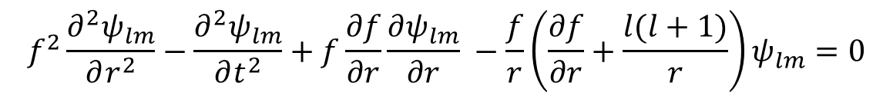

General Wave Equation
Expand solution into scalar harmonics:
$$Ψ(t,r,θ,φ)=\sum_{l,m}{\frac{ψ_{lm}(t,r)}{r}P_{lm}\left(θ\right)e^{imφ}}$$
Put this solution into the wave equation to obtain a PDE for any given mode $ψ_{lm}(r,t)$:
$$f^{2}\frac{∂^{2}ψ_{lm}}{∂r^{2}}−\frac{∂^{2}ψ_{lm}}{∂t^{2}}+f\frac{∂f}{∂r}\frac{∂ψ_{lm}}{∂r} −\frac{f}{r}\left(\frac{∂f}{∂r}+\frac{l(l+1)}{r}\right)ψ_{lm}=0$$
Using a new radial coordinate $r^{∗}$ which satisfies $f= \frac{dr}{{dr}^{∗}}:$
$$\frac{∂^{2}ψ_{lm}}{∂{r^{∗}}^{2}}−\frac{∂^{2}ψ_{lm}}{∂t^{2}}−\frac{f}{r}\left(\frac{∂f}{∂r}+\frac{l(l+1)}{r}\right)ψ_{lm}=0$$

Slide 24
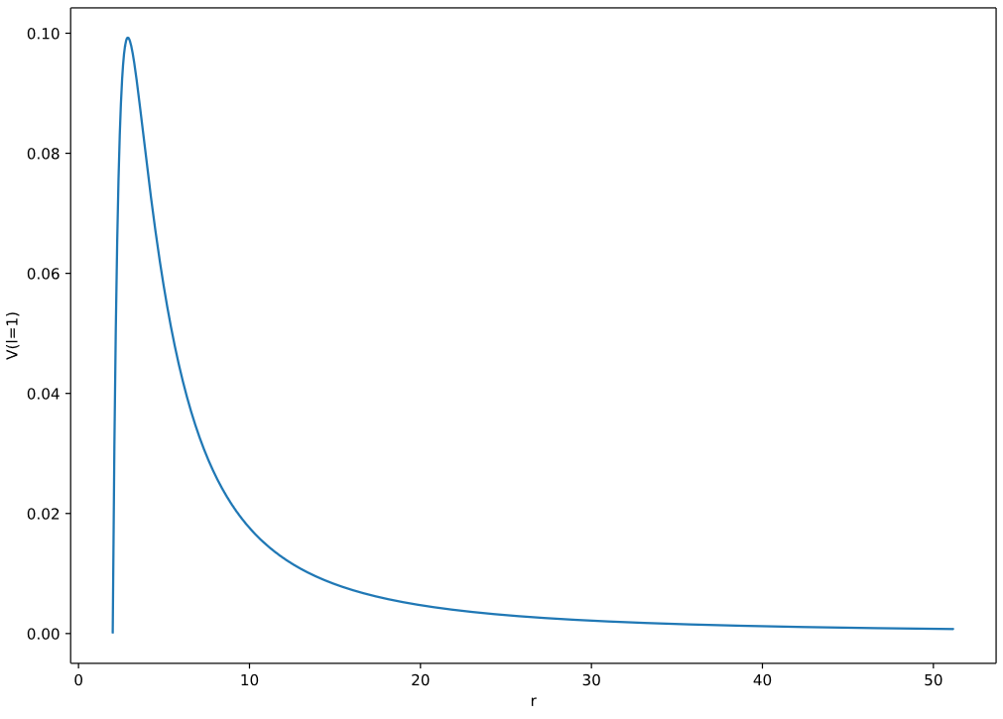

Slide 25
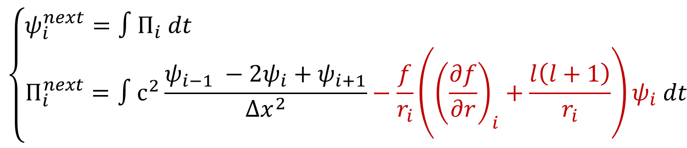
Finite difference
Taking second order derivatives across space at fixed time intervals:
$$\frac{∂^{2}ψ_{i}}{∂x^{2}}{\left.​\right|}_{t}≈\frac{ψ_{i−1} −2ψ_{i}+ψ_{i+1}}{Δx^{2}}$$
A solution can be integrated integrated forward in time (with e.g. RK4):
$$\left\{\begin{matrix}ψ_{i}^{next}=∫Π_{i} dt \\ Π_{i}^{next}=∫c^{2}\frac{ψ_{i−1} −2ψ_{i}+ψ_{i+1}}{Δx^{2}}−\frac{f}{r_{i}}\left({\left(\frac{∂f}{∂r}\right)}_{i}+\frac{l\left(l+1\right)}{r_{i}}\right)ψ_{i} dt\end{matrix}\right.$$

Slide 26

Boundaries?
Dissipative at $r^{∗}= ±∞$
(No waves come out the horizon, nor come in from infinity)

Slide 27
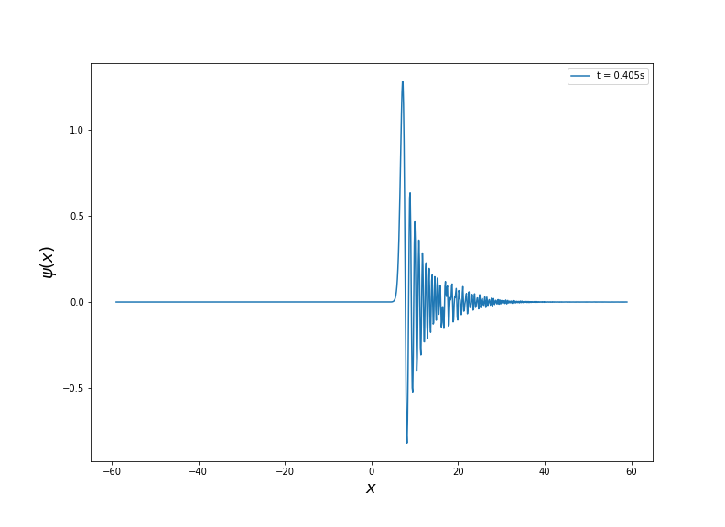

Slide 28
