Slide 1
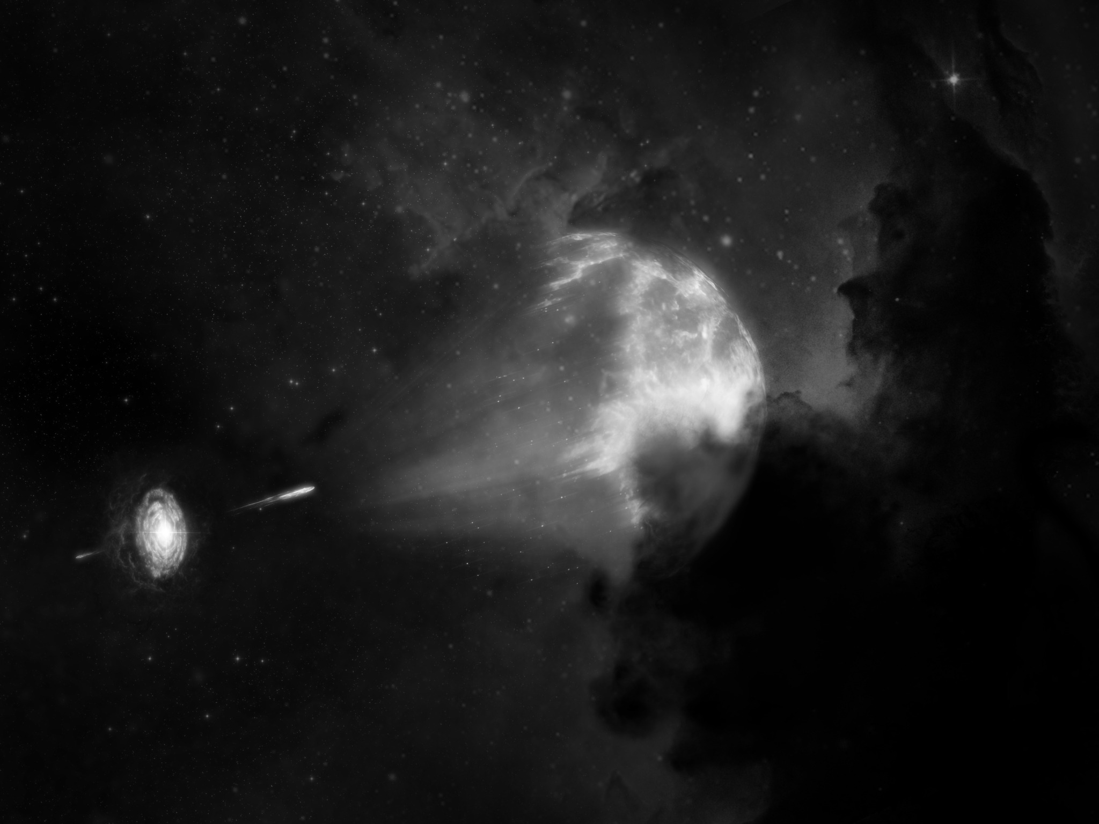
GRB Afterglow Modeling
Vsevolod Nedora
Bremen, Group Retreat
30 September 2024

Slide 2
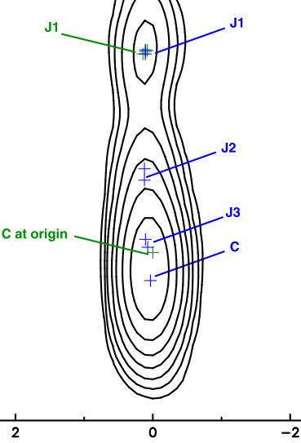

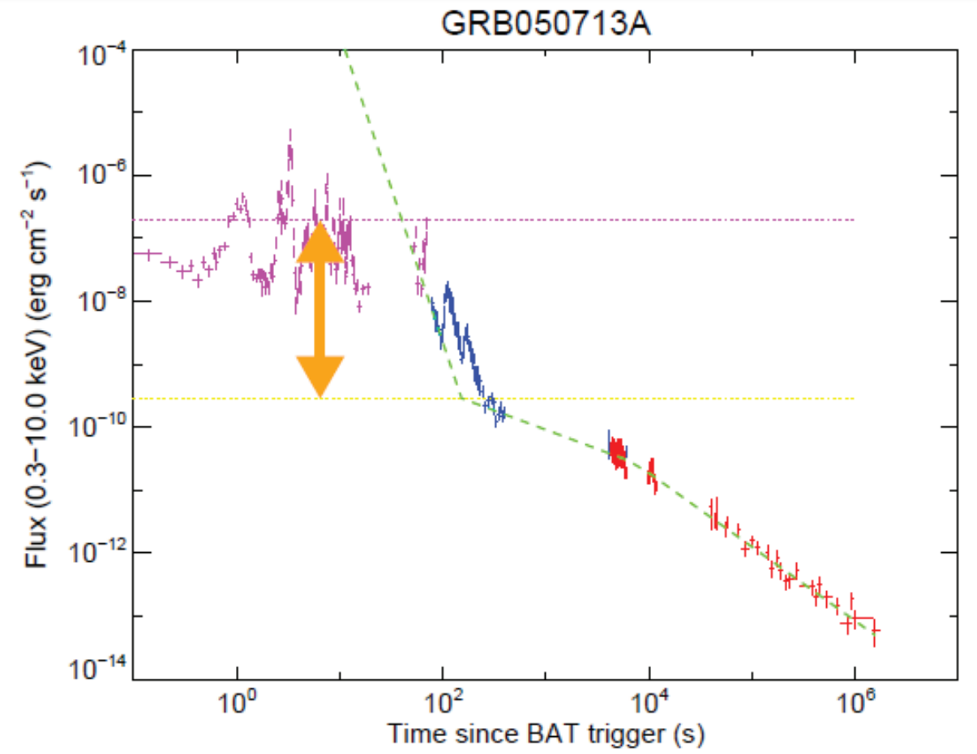
Observables
Light curves, spectra, and sky maps
Sky map – intensity distribution projected onto a plane orthogonal to the line of sight
(observed usually in radio band)
Prompt emission (oscillatory, early) produced by internal shocks or magnetic reconnection inside the jet;
synchrotron, SSC, thermal emission
Afterglow (smooth, late)
produced by external shocks (forward/reverse);
synchrotron emission (based on spectra)
Prompt
Afterglow

Slide 3
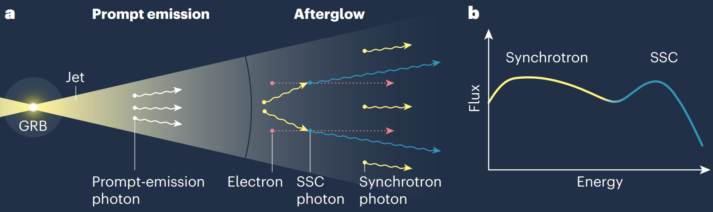
Mechanism
Synchrotron radiation from shocks in jet head
Jet head has Forward and Reverse shocks (collisionless shocks)
Magnetic field amplification and particle acceleration at shocks
Synchrotron and inverse Compton emission from shock downstream
Afterglow depends on shock microphysics and jet dynamics
Blastwave
RS
FS

Slide 4
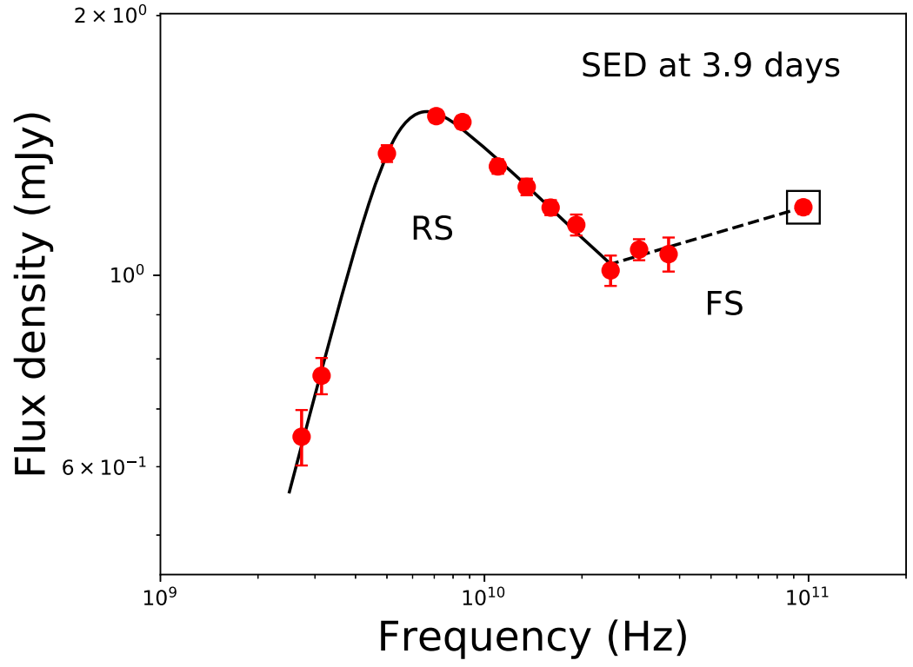
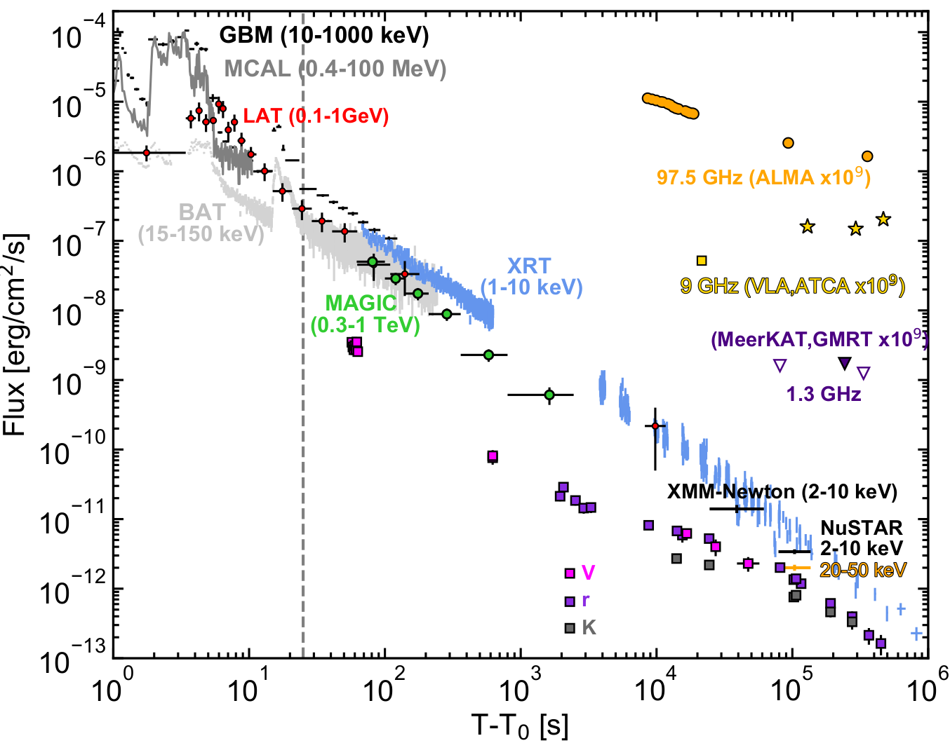
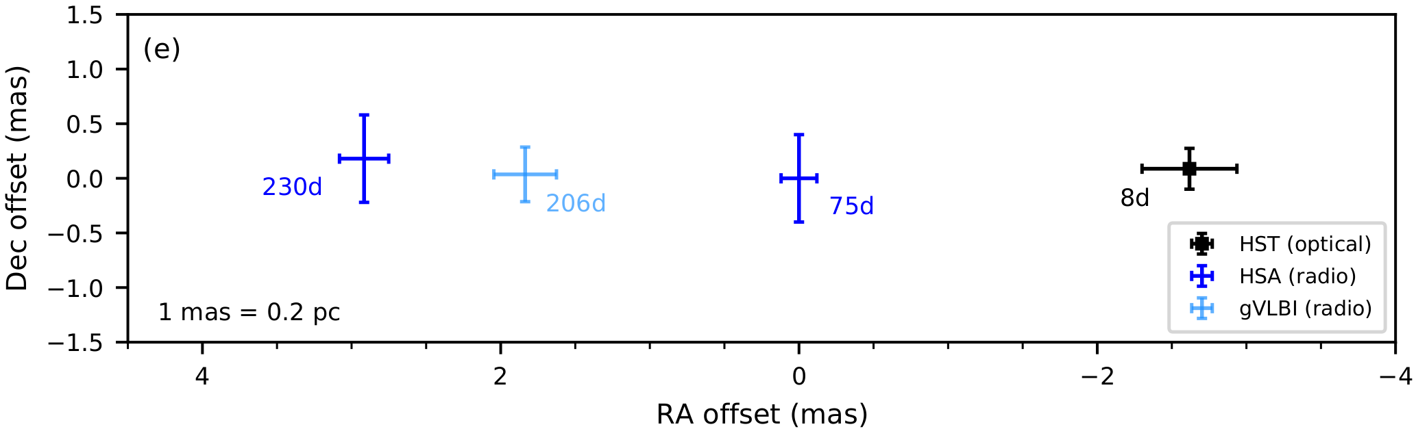
Afterglow examples
FS & RS emission; VHE emission; sky map properties
Synchrotron, power-law spectrum from forward (reverse) shocks
GeV emission from inverse Compton scattering
Radio sky maps showing jetted outflow moving off-axis
Jet properties
Microphysics
Geometry
Progenitor
GRB 190114C
GRB 181201A
GRB 170817A

Slide 5
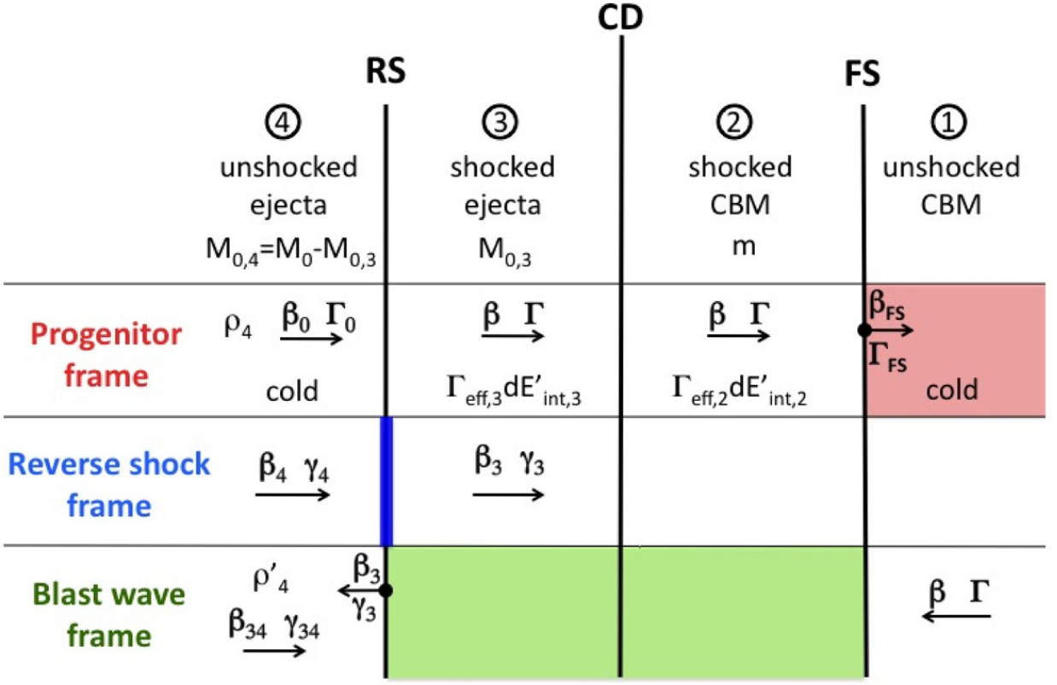

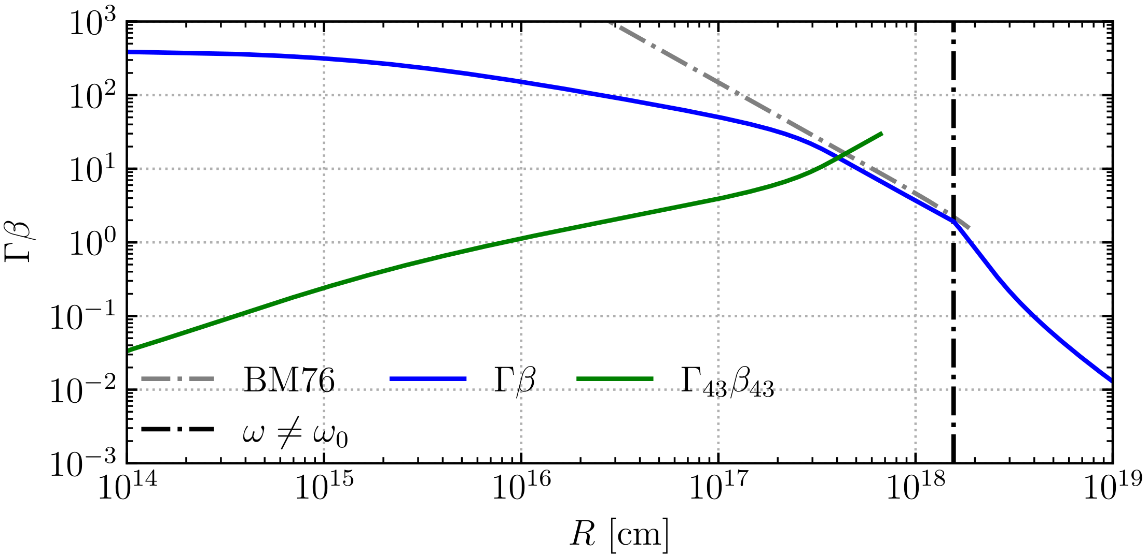
Model Dynamics
Energy conservation; thin-shell approximation; sem-analytic
Total blast wave energy
Numerics:
Adaptive step-size
Explicit ODE solver
DOP8(53)
Energy conservation equation
Nava+13

Slide 6

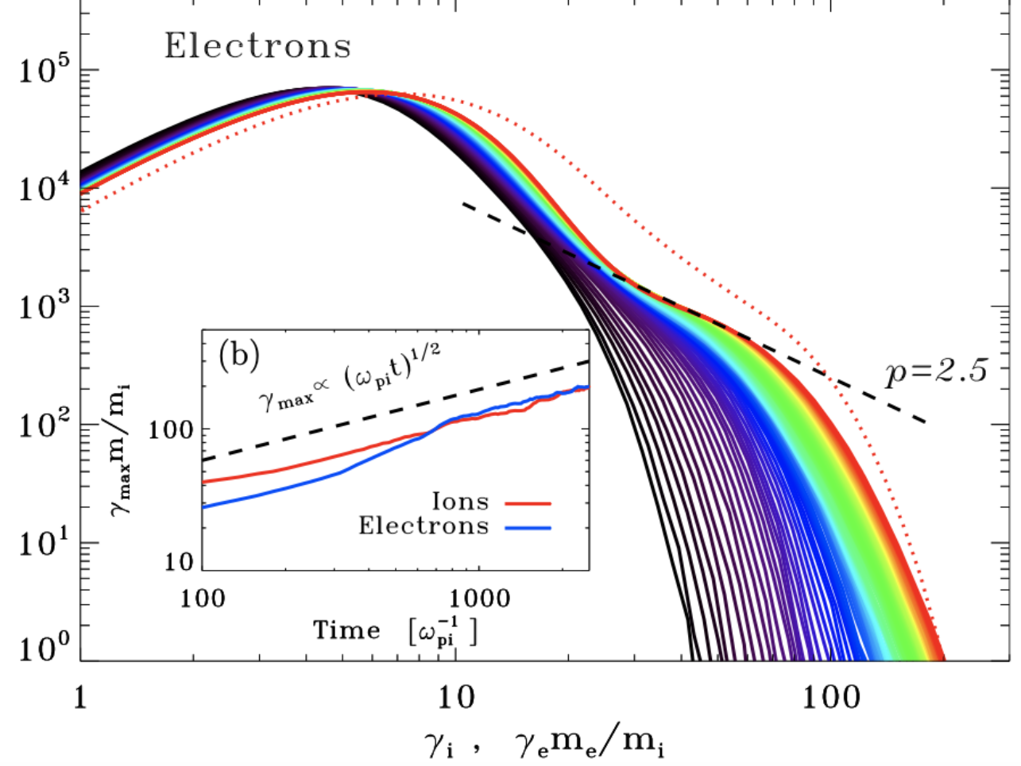

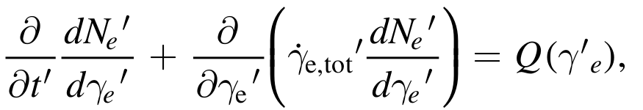
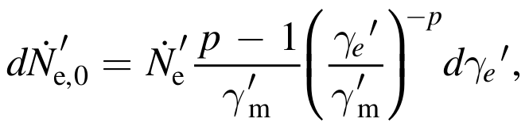
Model Microphysics
Collisionless shocks; power-law electron distribution; cooling
Energy Density
Magnetic Field
Injection spectrum
Electron distribution evolution
Electron injection
Numerics:
Fully-implicit PDE solver; unconditionally stable, particle number preserving Chang-Cooper scheme
Sub-stepping to respect CFL condition instead of directly following CFL timesteps

Slide 7
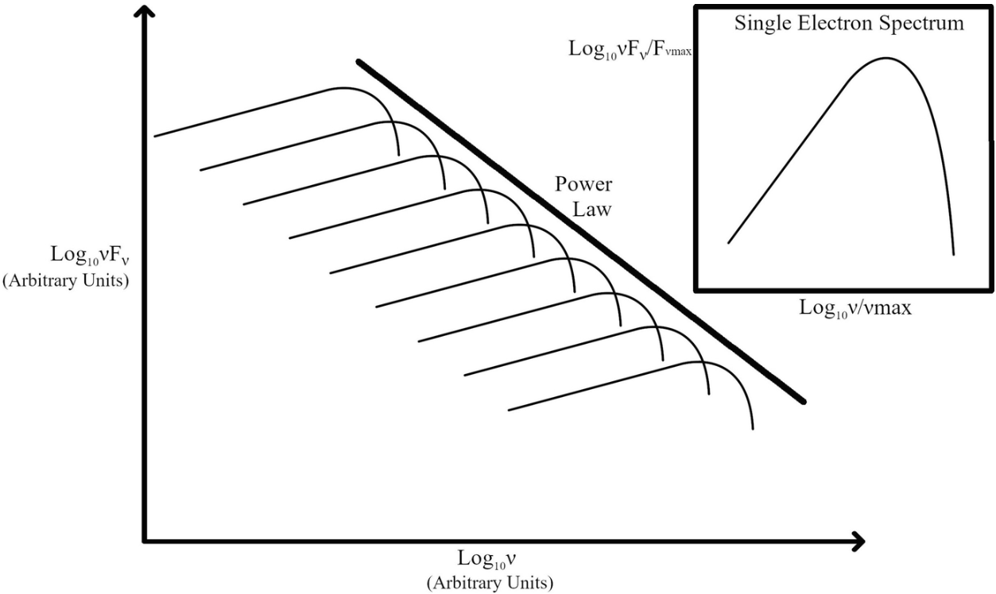
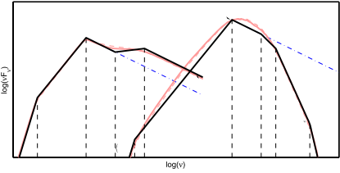
Modeling Radiation
Synchrotron emission & absorption; SSC emission; PP & EBL losses
Synchrotron emission: convolving single electron emissivity with electron distribution
Synchrotron self-absorption (SSA): convolving derivative of the distribution with emissivity
Synchrotron self-Compton (SSC): convolving scattering kernel with photon density spectrum.
Klein-Nishina corrections reduce VHE
Pair-production and external background light (EBL) absorption further reduce VHE
Synchrotron
SSC
Nakar+12
SSA
Klein-Nishina supression

Slide 8
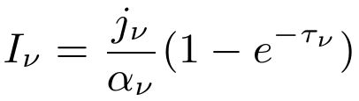
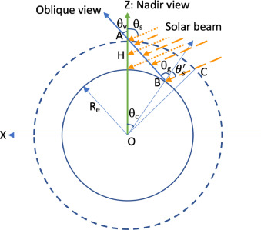


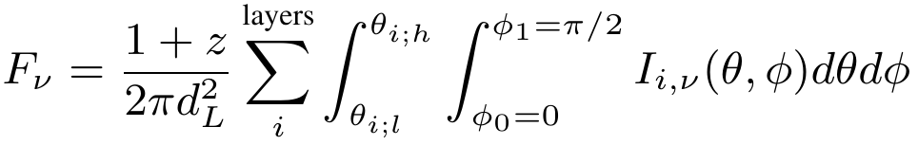
GRB afterglow modeling
GRB ejecta lateral structure; relativistic effects; EATS integration
Radiation intensity (observer frame)
Observer
Thickness of the emitting region depends on the observer
Emitting
region
Equal-arrival time surface integration
Numerics:
Adaptive quadrature for flux density evaluation and iterative algorithm for sky map resolving integration

Slide 9
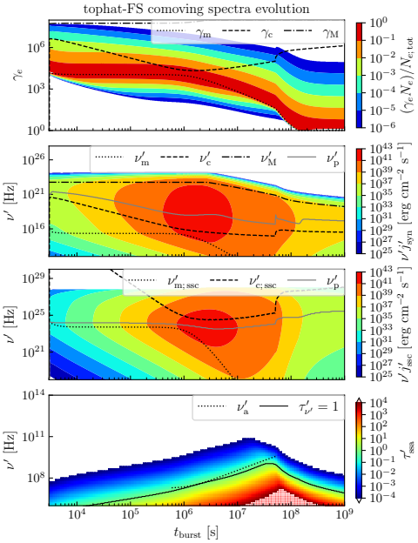
Afterglow
Modeling results
Comoving spectra evolution
Electron spectrum: Cooling of injected electrons; evolution of injection spectrum
Synchrotron emission: peaks at the onset of deceleration
SSC spectrum follows the synchrotron one – echo at higher frequencies
SSA affects primarely lower frequencies; and most prominent at late deceleration stages.

Slide 10
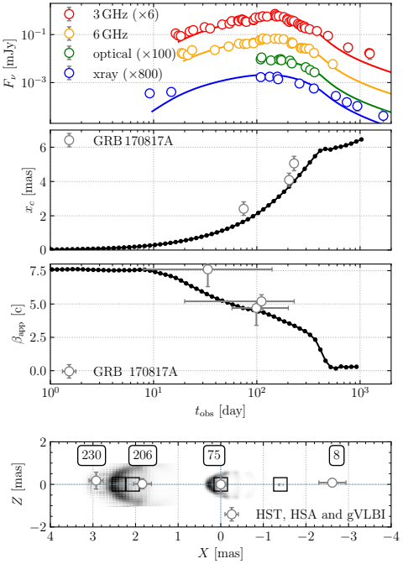
GRB 170817A
Modeling Example
Comparison with observables
Jet structure: Gaussian jet with 20 angular layers (blastwaves)
Synchrotron only; no VHE detected
Observed off-axis (~20 deg.) shows slow rising early light curve
Sky map related quantities: flux centroid motion constraint geometry and energetics
Numerically expensive runs prohibit Bayesian parameter inference

Slide 11
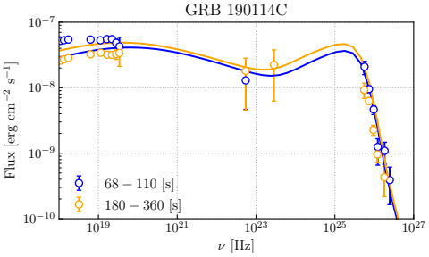
VHE afterglow modeling example
GRB 190114C VHE spectra from SSC mechanism
Grid-search analysis (20k runs)
Top-hat jet observed on-axis
VHE is produced by SSC but is shaped by EBL absorption
Model parameters of best-fitting model are close to the literature values
Synchrotron
SSC
EBL supression

Slide 12
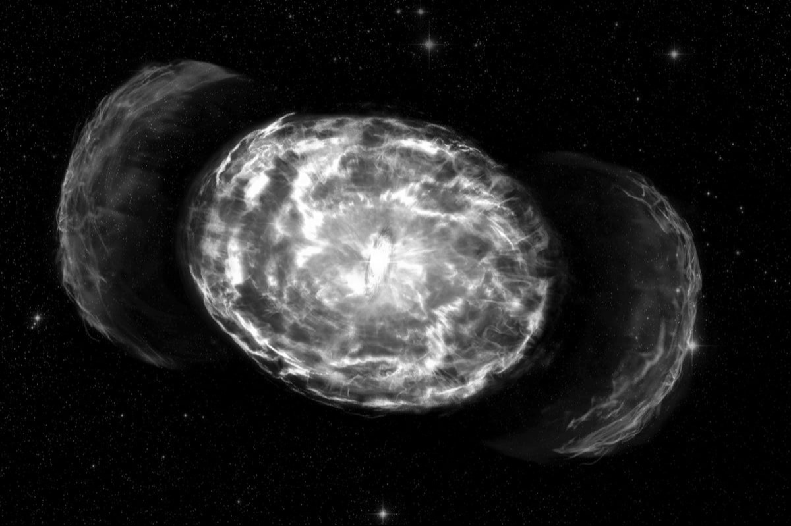
Kilonova Afterglow Modeling

Slide 13
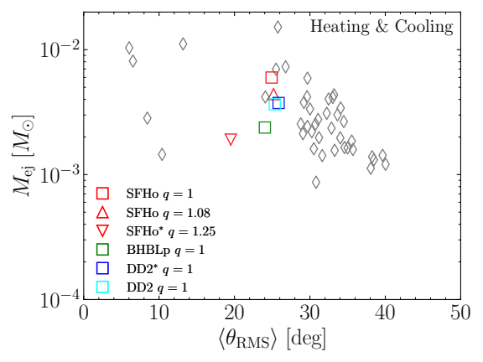
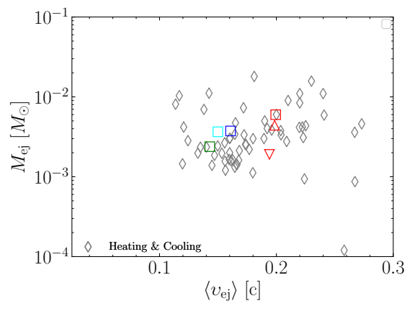
Kilonova Ejecta
Dynamical ejecta from binary neutron star merger simulations
5 BNS merger simulations: high resolution; M1 neutrino transport; MHD effects
Goal: analyze origin of the ejecta fast tail; statistics of the ejecta kinetic energy distribution and kilonova afterglow light curves

Slide 14
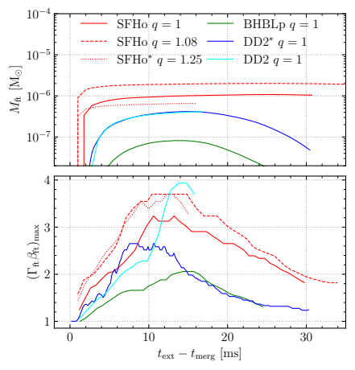
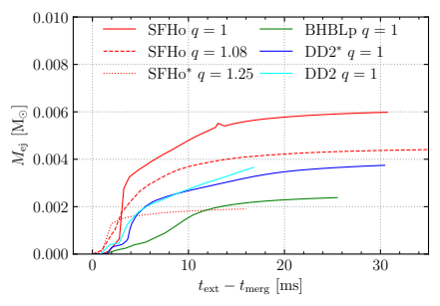
Ejecta Extraction Time
Ejecta properties depend on when they are extracted
Fast tail
Mass and maximum momentum saturate before the end of dynamical phase – possibly due to interactions with atmosphere
Total dynamical ejecta mass

Slide 15
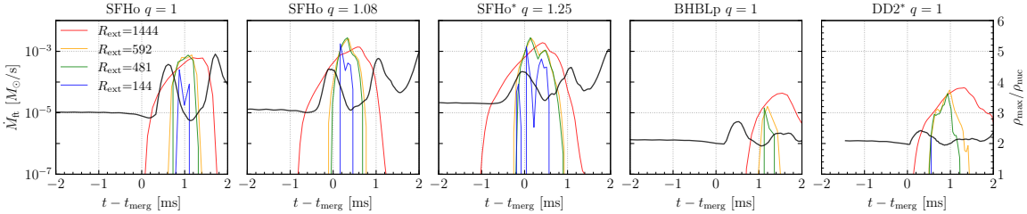
Fast Tail Origin
Comparing mass flux through with maximum density
Mass flux of the fast tail seem to coincide with the core bounce, traced by the maximum density evolution
Other mechanisms, however may contributed (see double peaked structure of the mass flux)

Slide 16
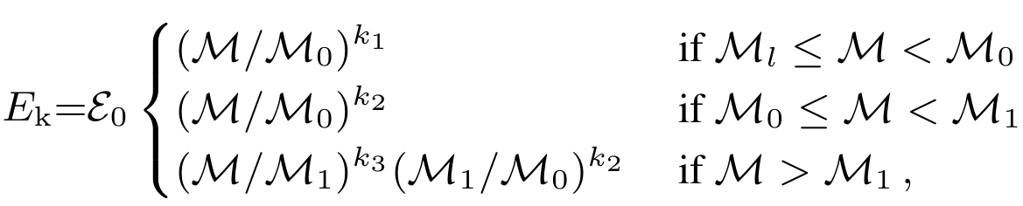
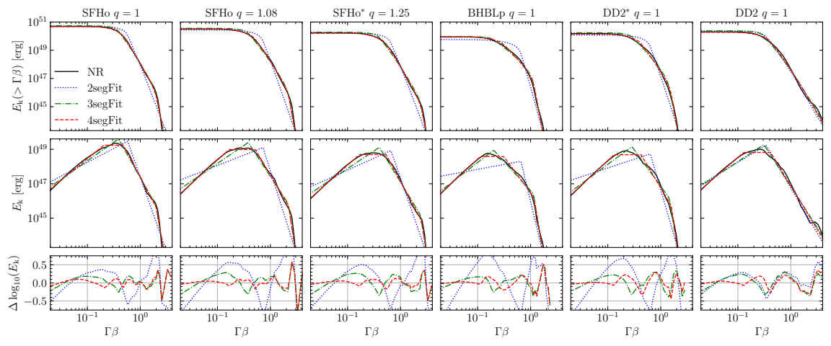
Ejecta kinetic
energy
Fitting formula:
s

Slide 17
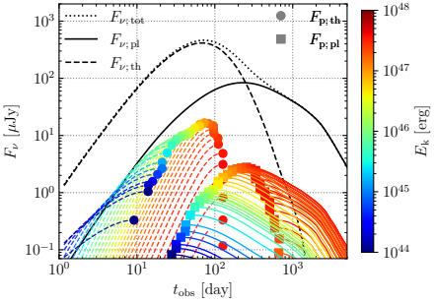
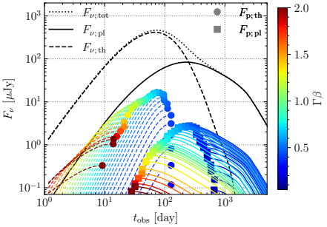
Afterglow Light Curves
Which part of the ejecta generates what part of the light curve
Light curve peak is produced by moderately fast and moderately energetic ejecta
Early rising part comes from low-energy, very fast ejecta tail
Late afterglow comes from high-energy, slow ejecta

Slide 18
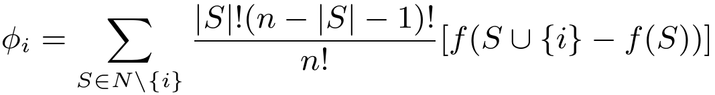
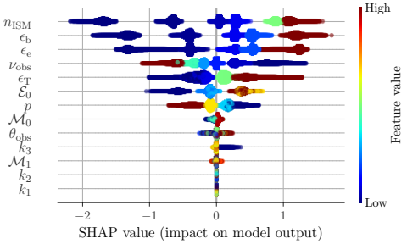
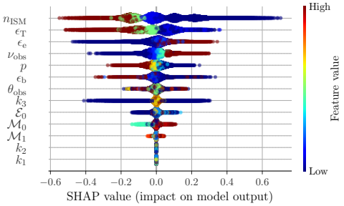
Afterglow Statistics
Which model parameter is the most important
Surrogate machine learning model (XGBoost) trained on large grid of simulations
Feature importance using
Shapley values:
Most important features: ISM density and microphysics (not ejecta parameters)
Light Curve Peak Flux
Light Curve Peak Time

Slide 19
Thank you for your attention

Slide 20

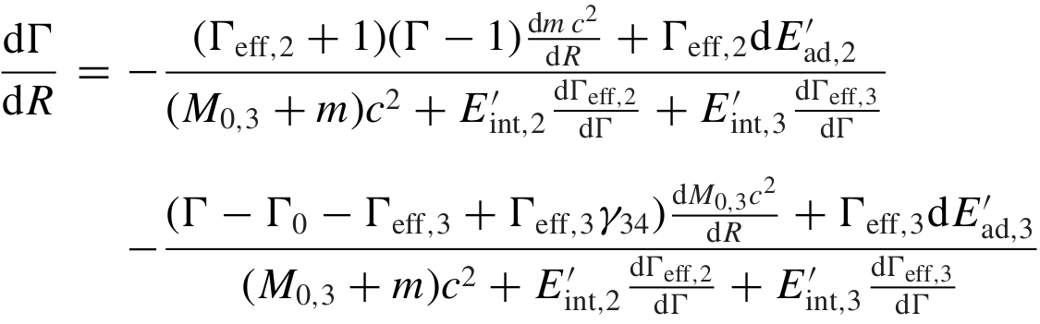
Building Afterglow Model: FS & RS dynamics
Total blast wave energy
Energy conservation equation
Evolution equation: after some algebra...
Adaptive ODE solve used

Slide 21
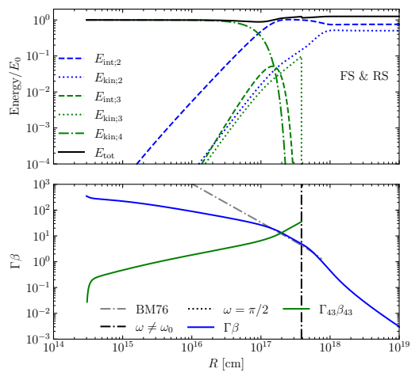
Building Afterglow Model: FS & RSexample
Energy;
Reverse shock shocks ejecta
Total energy ~ conserved
Dynamics
Initial deceleration when RS is crossing ejecta
Short standard deceleration
(BM solution)
Lateral spreading
Non-relativistic regime

Slide 22
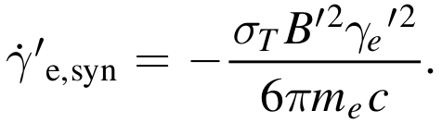
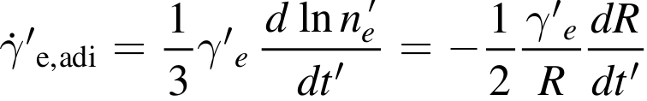
Building Afterglow: Electron Distribution
Electron distribution evolution
Electron injection
Electron energy loss
Assumed
injection
distribution
Synchrotron cooling
Adiabatic cooling

Slide 23
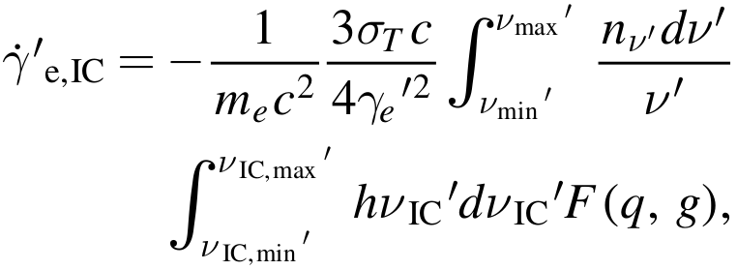
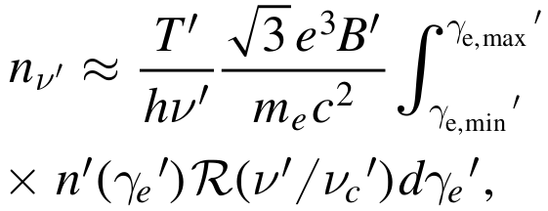



Building Afterglow: SSC cooling
Electrons lose energy by up-scattering (syn) photons
Connects the electron population with existing radiation field
SSC cooling
Seed photon density
Escape time
SSC scattering cross-section

Slide 24
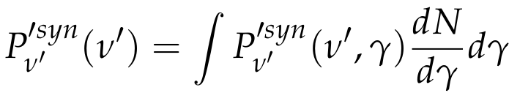
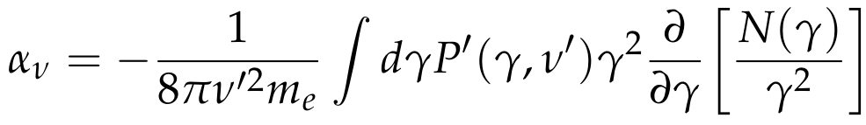
Building Afterglow: Synchrotron Emission
Convolving the emission of a single electron gyrating around magnetic field lines with electron distribution function
Synchrotron emission power
Emission power by a single electron
Synchrotron self-absorption (SSA)

Slide 25
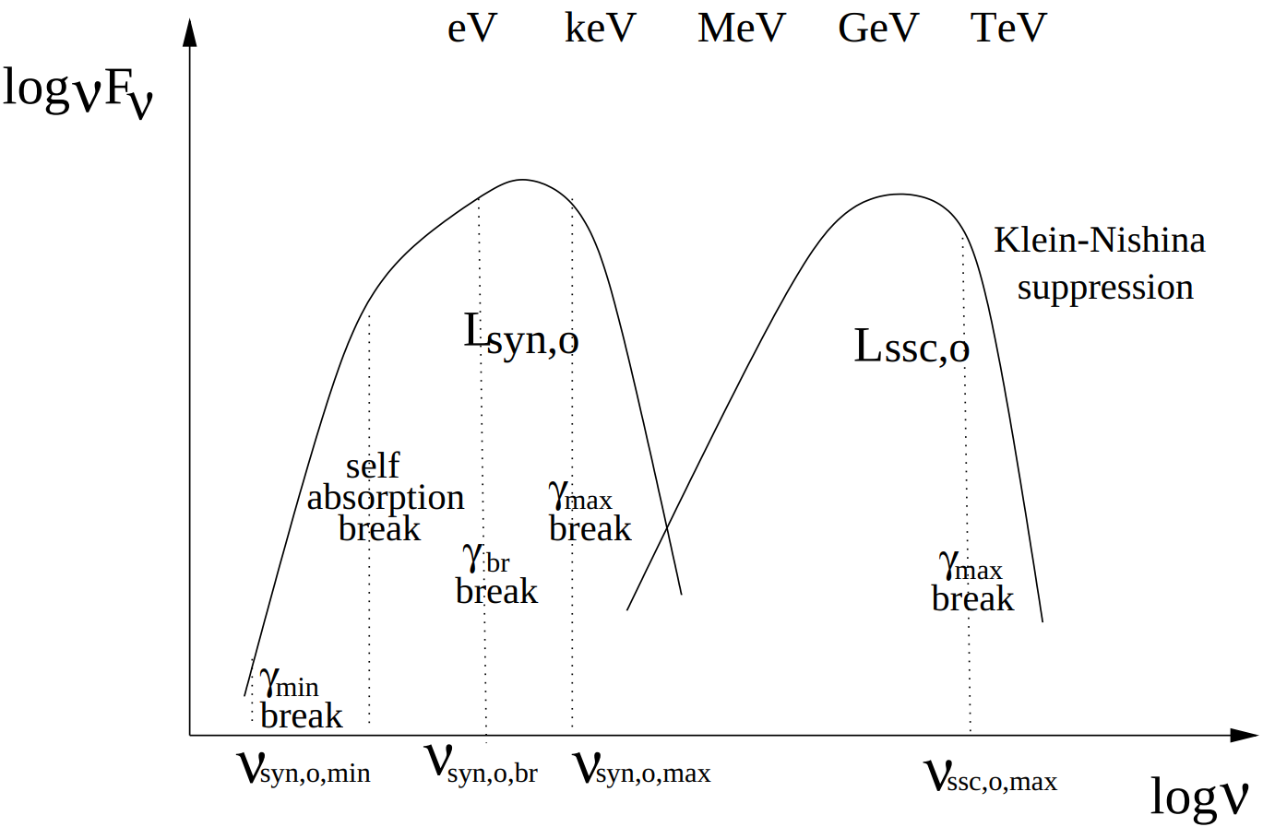
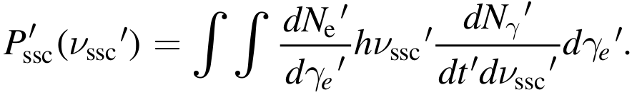
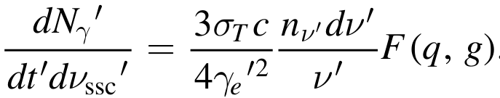
Building Afterglow: SSC emission
SSC emission power

Slide 26
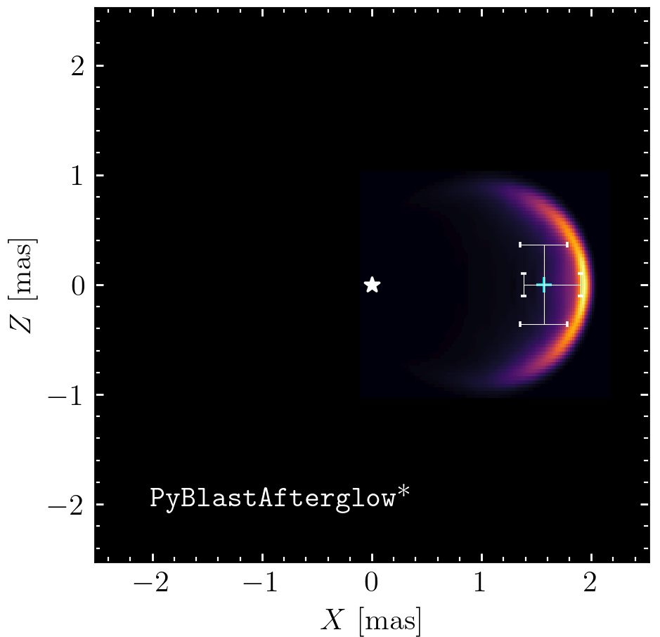
Example: sky map
Flux centroid
Sky map – intensity distribution projected onto a plane orthogonal to the line of sight.
Properties:
- Centroid position
- Size
Shows:
- geometry of the ejecta
- jet inclination angle
Origin
dx
Image size (FWHM)

