Slide 1


Modeling Gamma-Ray Burst
Afterglows
Methods of PyBlastAfterglow

Slide 2
Structure
General picture and basic properties
Examples of observations
Building an afterglow model
  Dynamics
  Microphysics and radiation
  Observables
Comparison with other models
Building a surrogate model

Slide 3
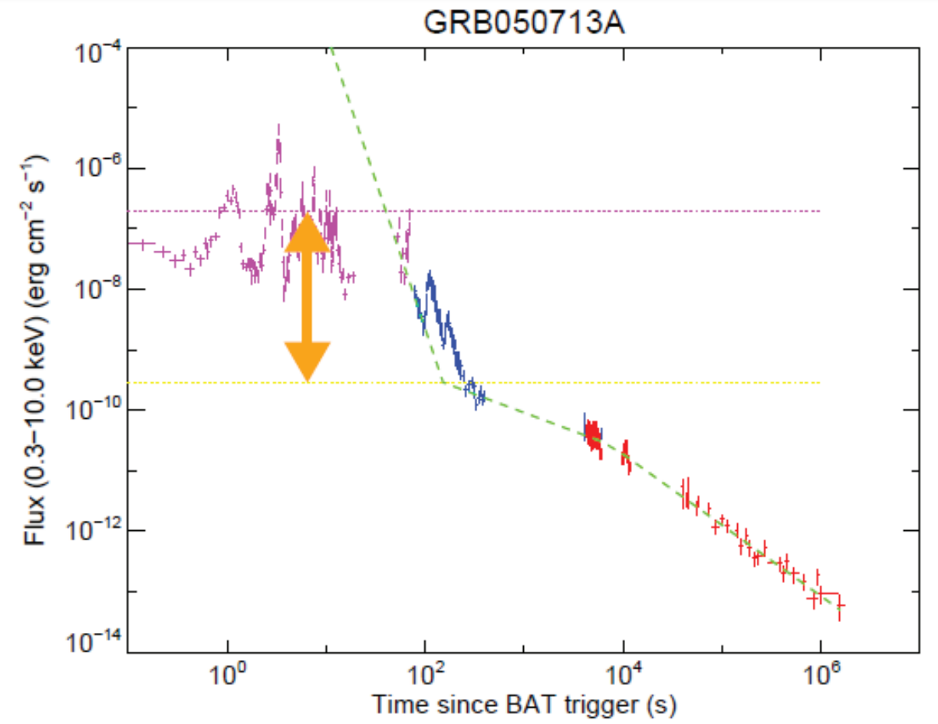
Introduction
Gamma-Ray Bursts
Prompt emission (oscillatory, early) Internal shocks or magnetic reconnection
Convert fraction of jet energy to radiation
Afterglow (smooth, late)
External shocks (forward/reverse)
Synchrotron emission (based on spectra)
Prompt
Afterglow
Kazanas+15
Jet → Internal dissipation (prompt emission) → Dissipation at external shocks (afterglow)

Slide 4
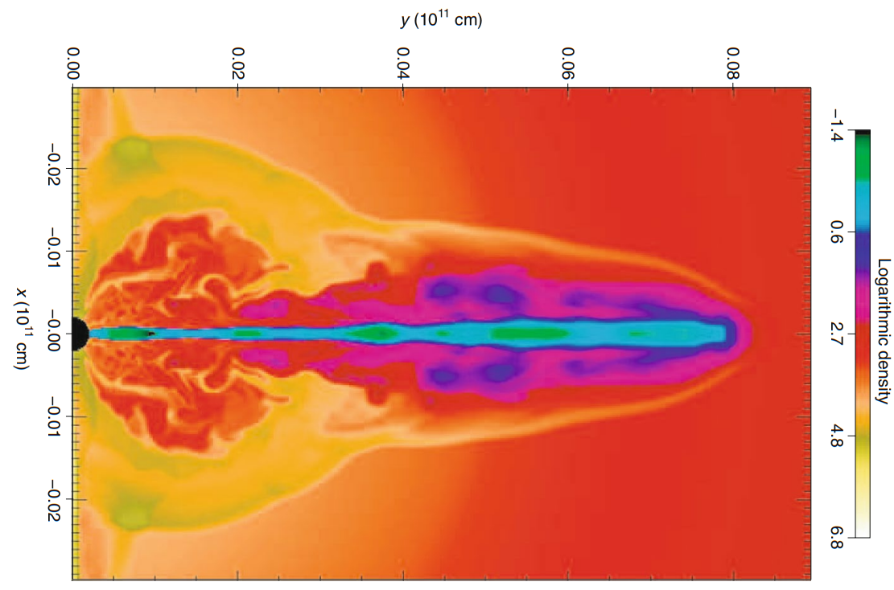
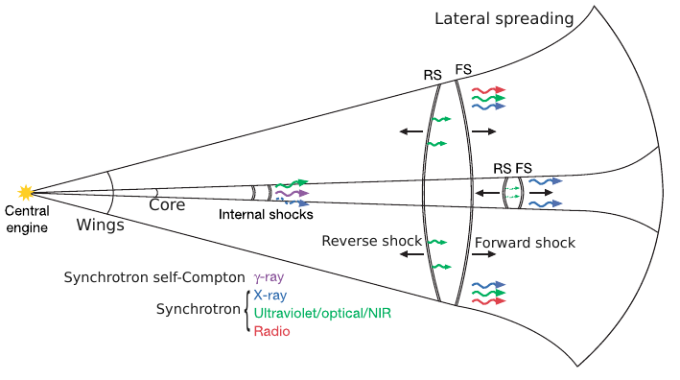
General Picture: Jet
Schematic picture:
  Ejecta structure
  Lateral spreading
Marios Karouzos
Simulation
Engine:
disk accretion
- burst energy
- ejecta structure
- ejecta composition

Slide 5
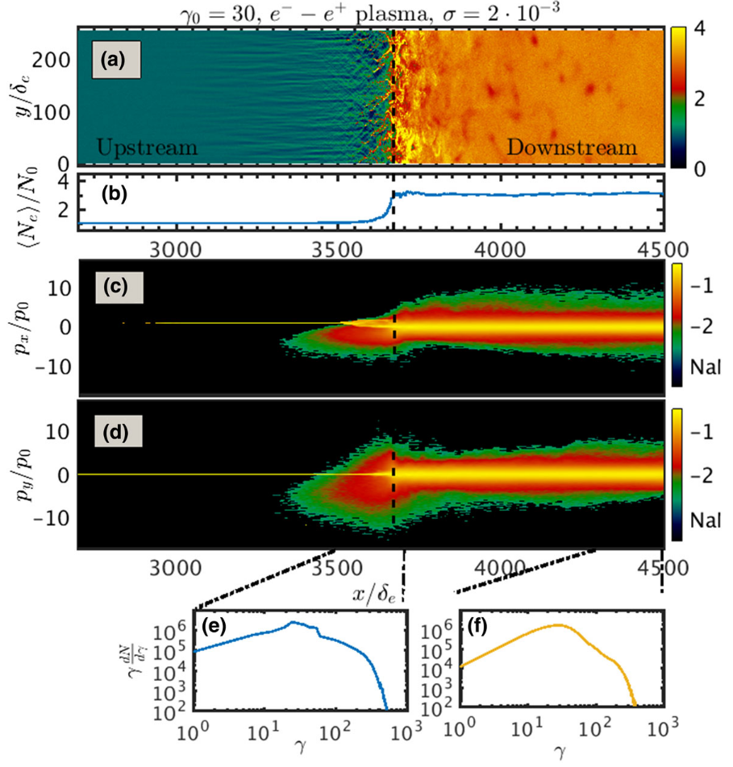
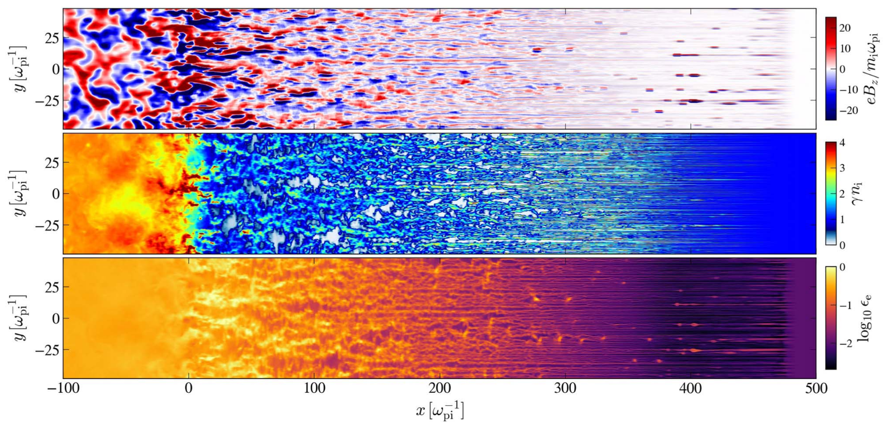
General Picture: Shocks
Simulation Vanthieghem+22
Collisionless shocks
(few gyro-radii scale)
MHD instabilities
magnetic field amplification
Particle acceleration
fermi first order acceleration →
thermal core + power-law tail)
}
Synchrotron
Radiation
Power law
Thermal
Review by Marcowith+20

Slide 6
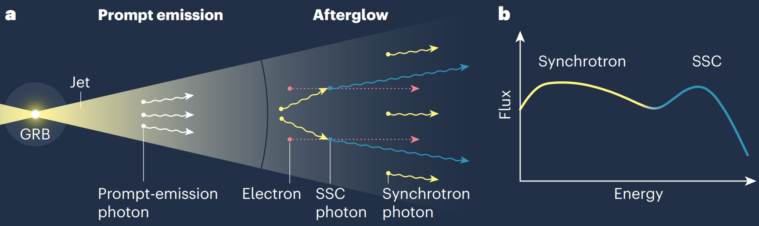
General Picture: Summary
From Bing Theodore Zhang (Zhang+19)
Photosphere
Power law
Jet structure: (energy/velocity angular dependency)
Ejecta dynamics: coasting; deceleration; spreading
Collisionless shocks: magnetic field amplification & article acceleration: Fermi first order acceleration; Power-law tail + thermal core

Slide 7
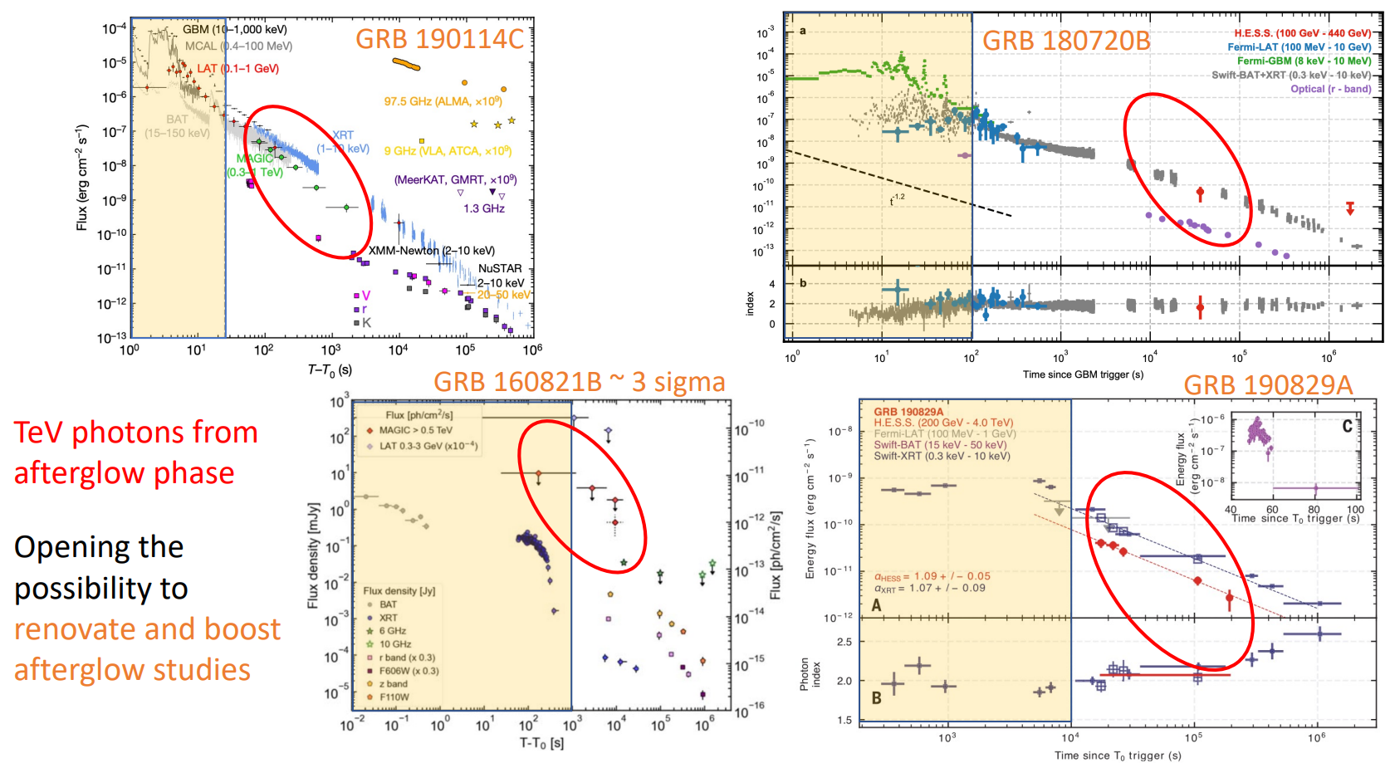
Examples: Very High Energy Afterglow

Slide 8
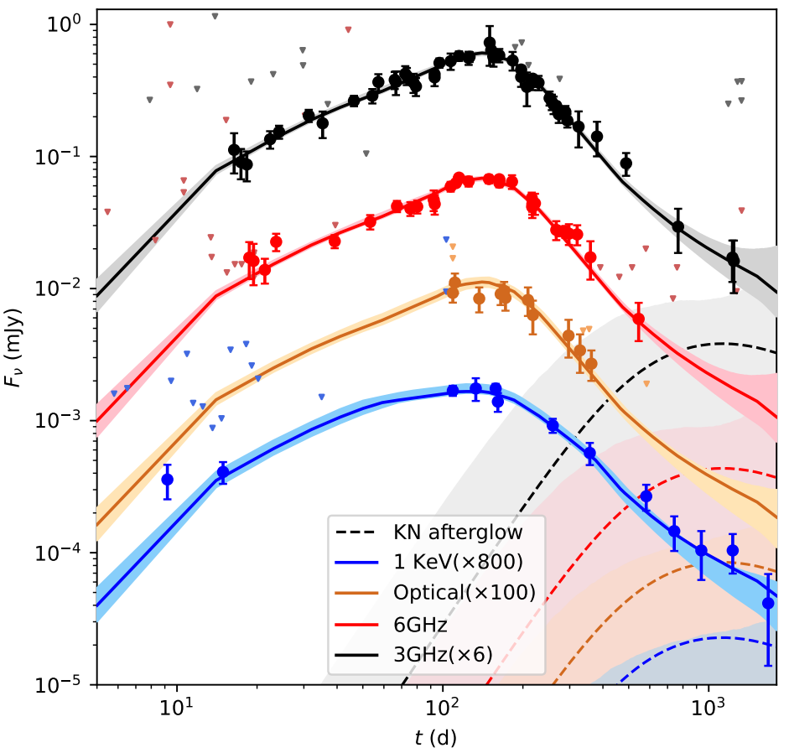
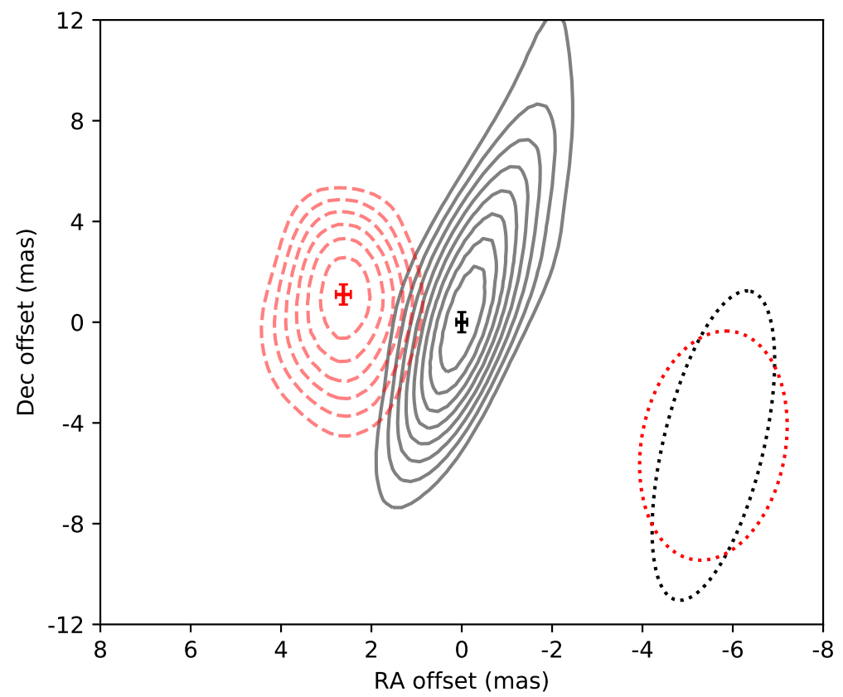
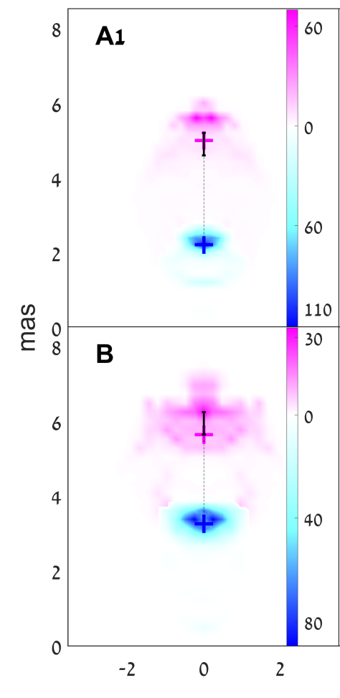
Examples: Structure & Radio Images
GRB 170817A off-axis & structured (2208.09121)
- Refreshed shock (2005.12426)
Synchrotron (semi-analytical)
Flux centroid motion (1806.09693)
Slow rise

Slide 9
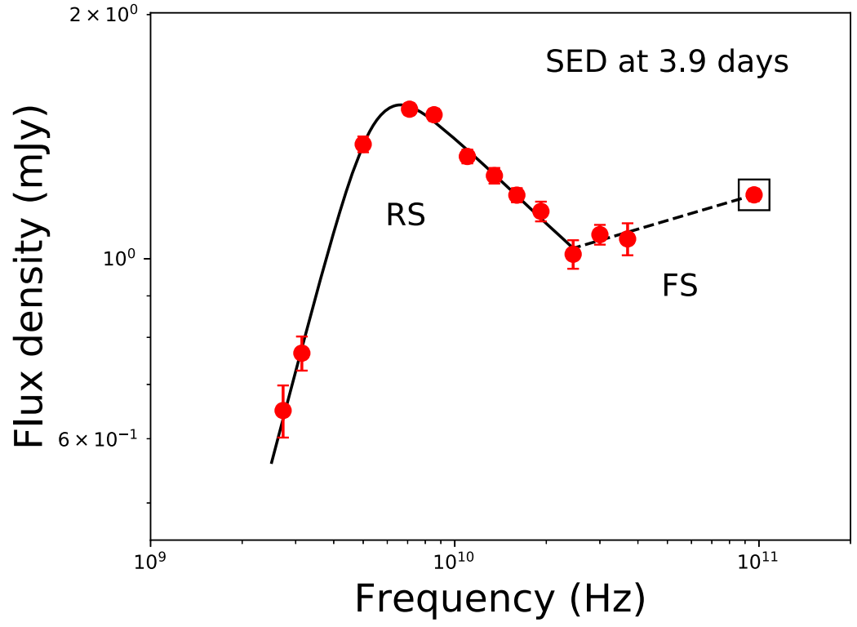
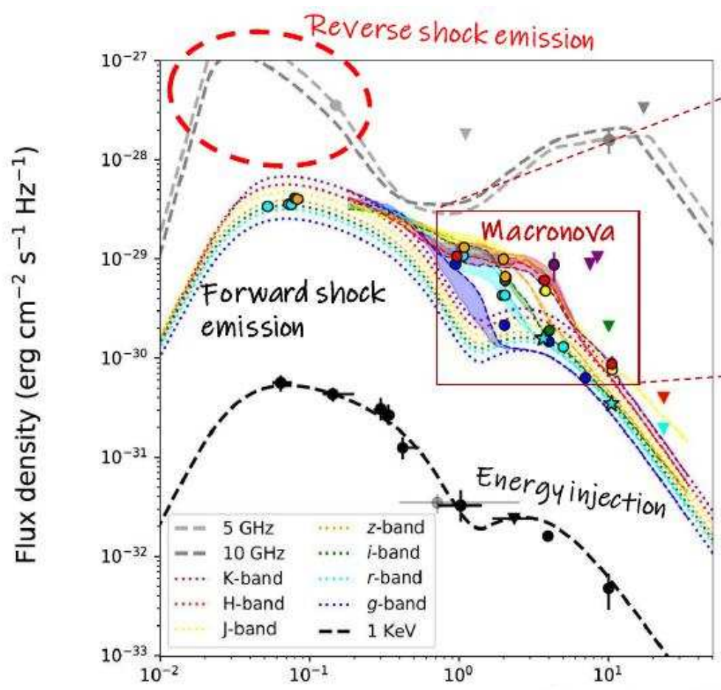
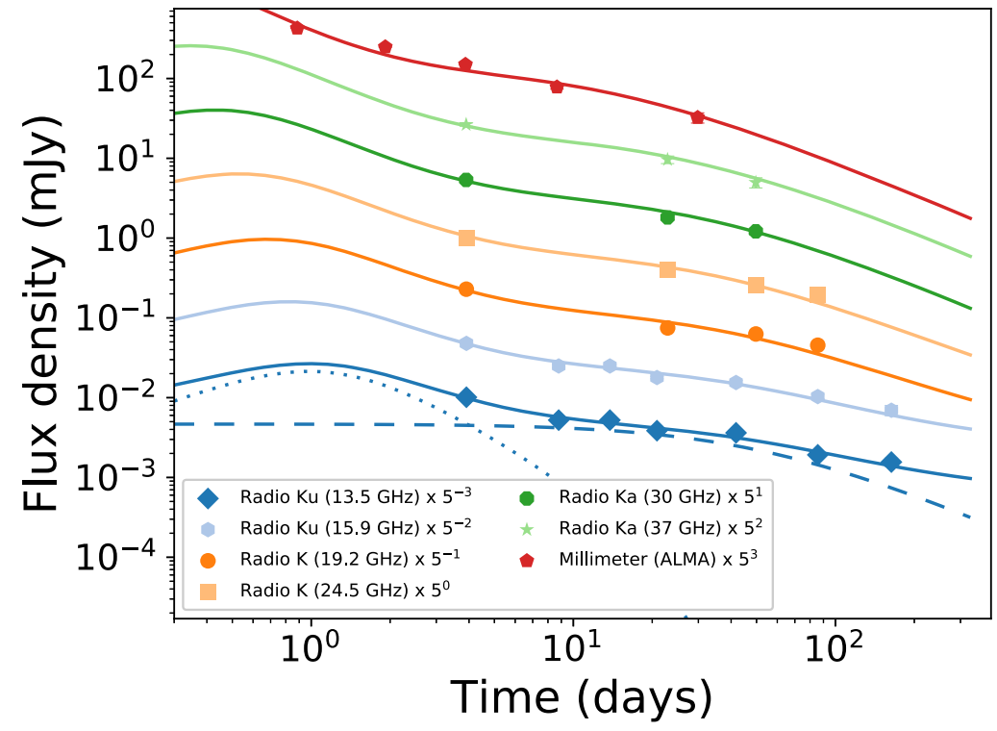
Examples: Reverse Shock
GRB 181201A reverse shock (Laskar+19)
GRB 160821B reverse shock
& kilonova & energy injection (Lamb+20)
FS & RS

Slide 10
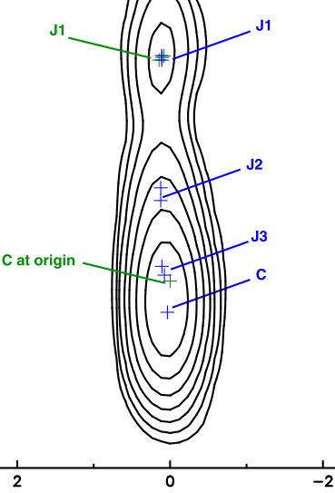
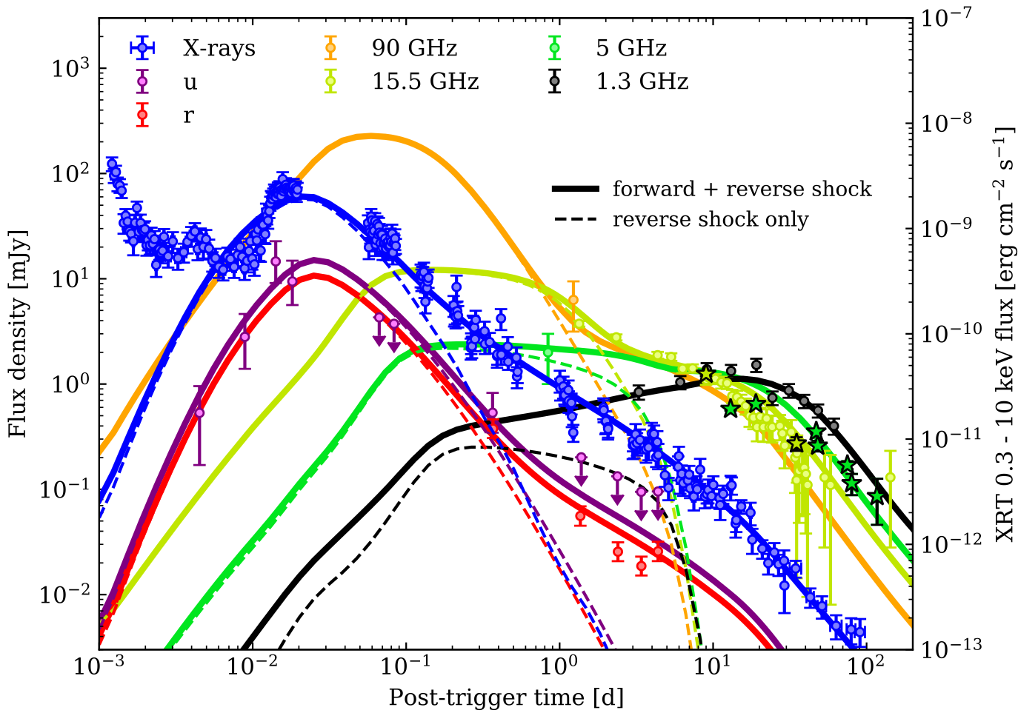
Examples: RS & SSC & Radio Images
GRB 190829A (Salafia+22)

Slide 11
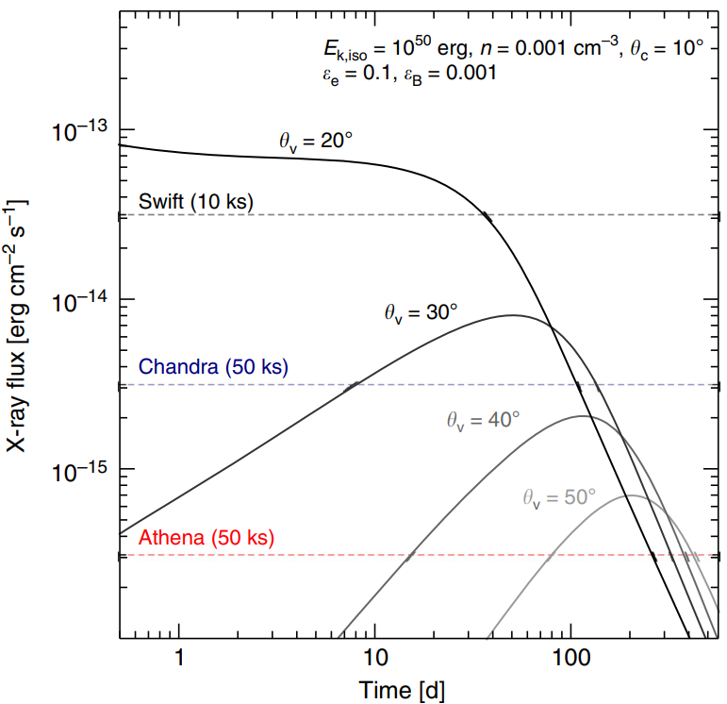
Observational Examples: Summary
Prompt → Afterglow
Ejecta dynamics & geometry:
coasting; deceleration; spreading (jet break)
Spectrum evolution:
electron distribution evolution;
synchrotron + synchrotron self-Compton;
Relativistic effects & EATS:
Beaming; Doppler shift
Observer angle dependency
Review by Marcowith+20

Slide 12
Ingredients for an Afterglow Model
Dynamics: semi-analytic for computational reasons;
  semi-analytic, energy conserving blast wave with FS and RS
  independent layers representing different angular layers of the jet
Electron distribution needs to be evolved (heating / cooling)
Radiation: Synchrotron and SSC radiation (comoving spectra)
Observables: Equal arrival time surface integration for spectra and sky maps (because of relativistic effects)

Slide 13

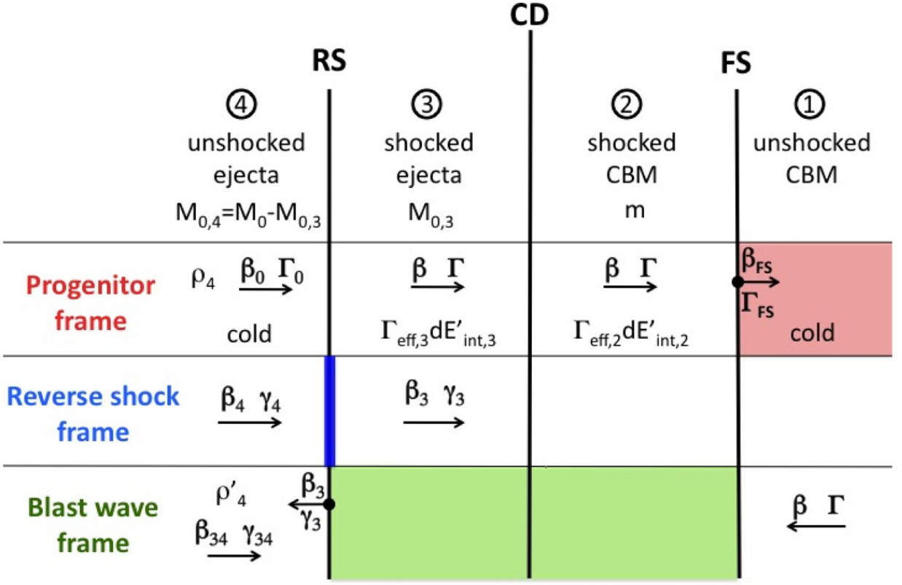

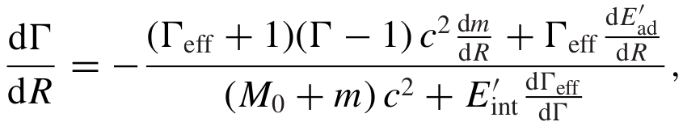
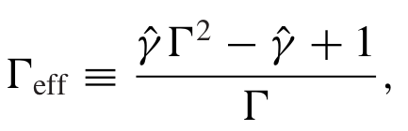
Building Afterglow Model: FS only example
Total blast wave energy (assume ejecta is already shocked)
z
Schematic picture of a Blast wave
(Nava+13)
Energy conservation equation
To be continued...
Evolution equation: after some algebra...
Where
Final set of ODEs we solve numerically

Slide 14
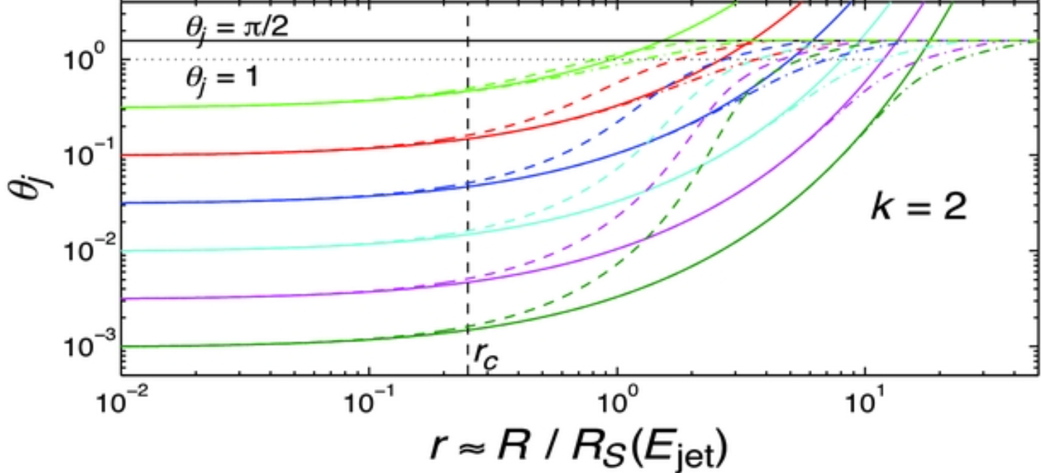
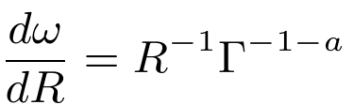
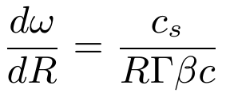
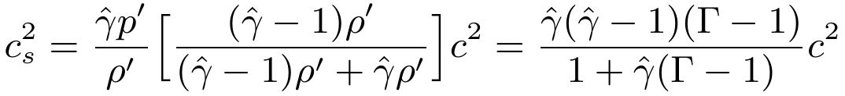
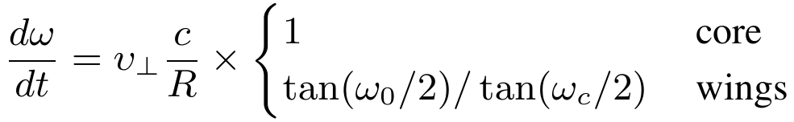
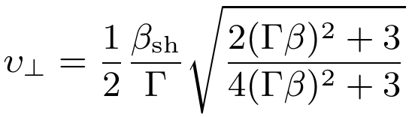
Building Afterglow Model: lateral spreading
Required 2D HD simulations. Using approximants. Many options...
Calibrated with early HD simulation (Granot+12)
Sound-speed based formulation (Huang+00)
Structured-jet aware formulation (Ryan+20)

Slide 15
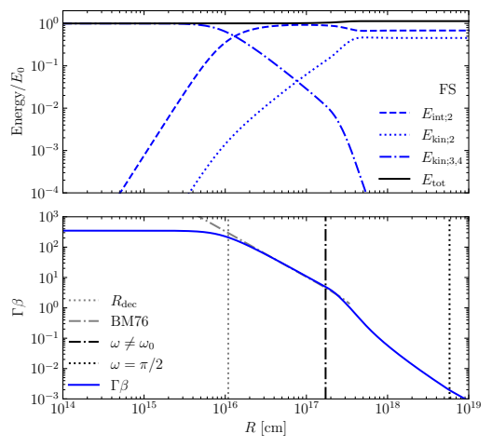
Building Afterglow Model: FS only example
Energy:
kinetic → internal energy
total energy is conserved c
Dynamics:
free coasting (constant momentum)
deceleration (BM solution)
lateral spreading
non-relativistic stage (ST solution)

Slide 16
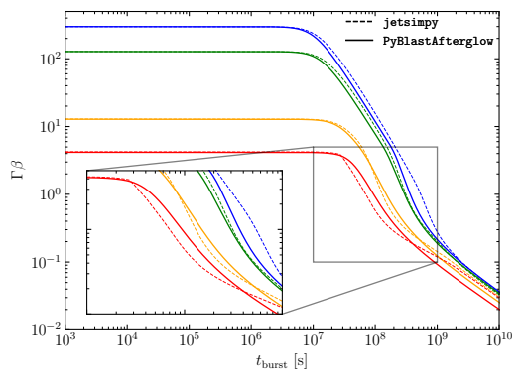
Building Afterglow Model: Comparison
Dynamics with lateral spreading against 2D thin-shell hydrodynamics model Structure and Spreading
calibration to BM can be added
spreading prescription
can be improved

Slide 17
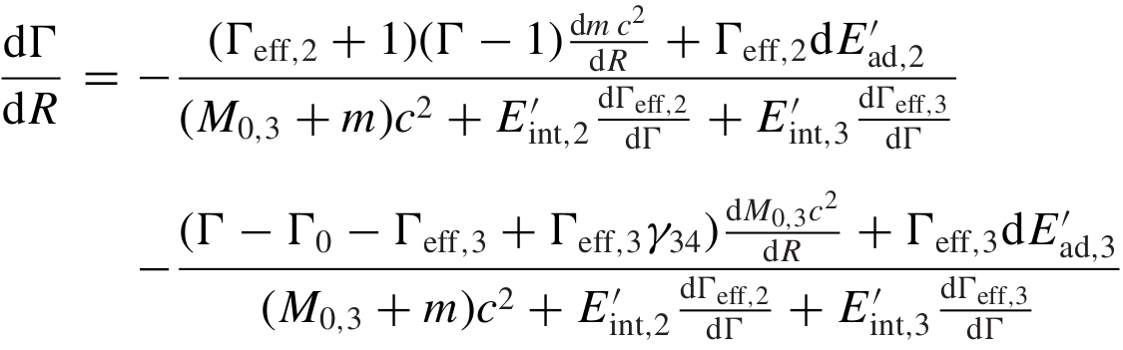
Building Afterglow Model: FS & RS dynamics
Total blast wave energy
Energy conservation equation
Evolution equation: after some algebra...
Adaptive ODE solve used

Slide 18
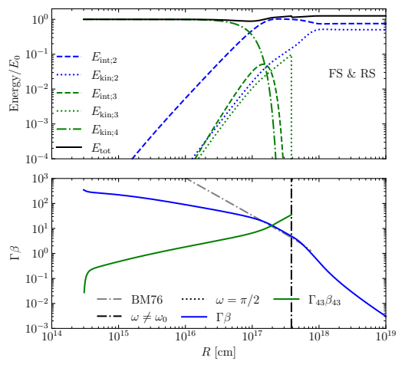
Building Afterglow Model: FS & RSexample
Energy;
Reverse shock shocks ejecta
Total energy ~ conserved
Dynamics
Initial deceleration when RS is crossing ejecta
Short standard deceleration
(BM solution)
Lateral spreading
Non-relativistic regime

Slide 19

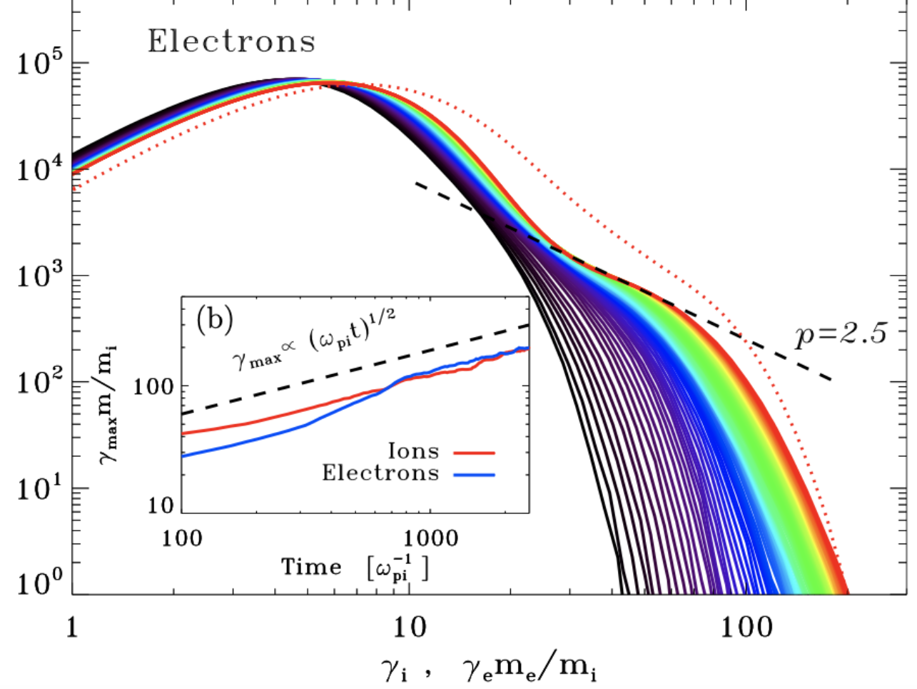

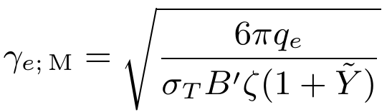
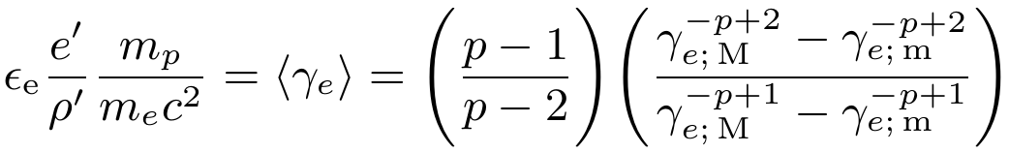
Building Afterglow: Shock Microphysics
Energy Density
Magnetic Field
Injection spectrum
Free parameter
Spectral limits
Compton parameter
M
Microphysics parameter
m
Free parameter
Solving for minimum

Slide 20
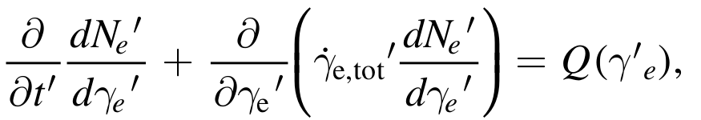
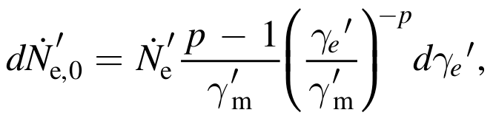
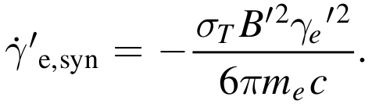
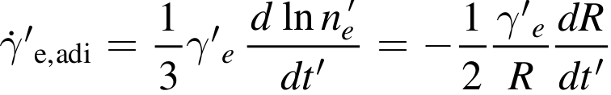
Building Afterglow: Electron Distribution
Electron distribution evolution
Electron injection
Electron energy loss
Assumed
injection
distribution
Synchrotron cooling
Adiabatic cooling

Slide 21
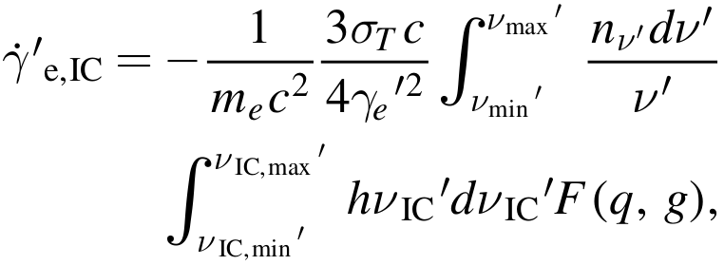
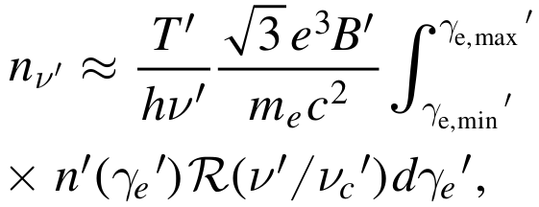



Building Afterglow: SSC cooling
Electrons lose energy by up-scattering (syn) photons
Connects the electron population with existing radiation field
SSC cooling
Seed photon density
Escape time
SSC scattering cross-section

Slide 22
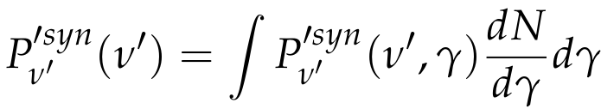
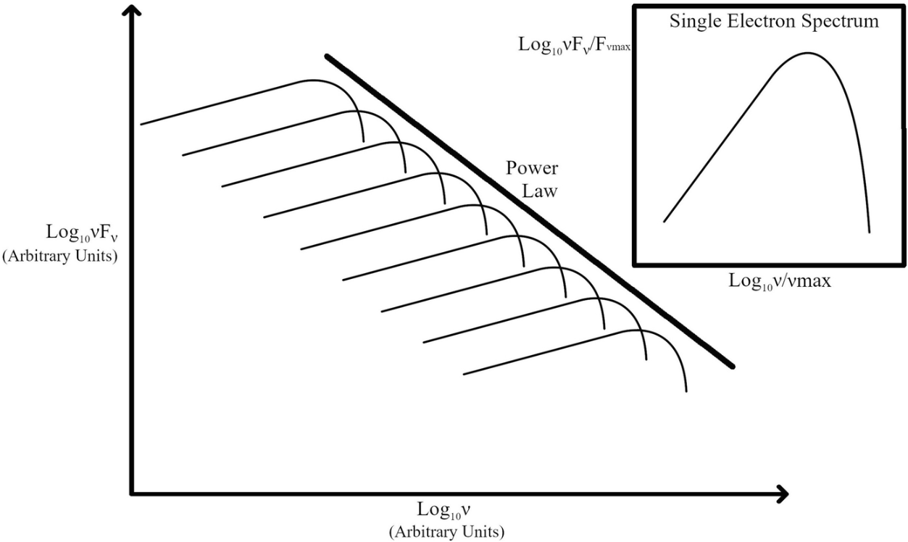
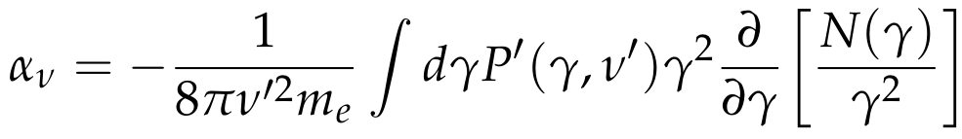
Building Afterglow: Synchrotron Emission
Convolving the emission of a single electron gyrating around magnetic field lines with electron distribution function
Synchrotron emission power
Emission power by a single electron
Synchrotron self-absorption (SSA)

Slide 23
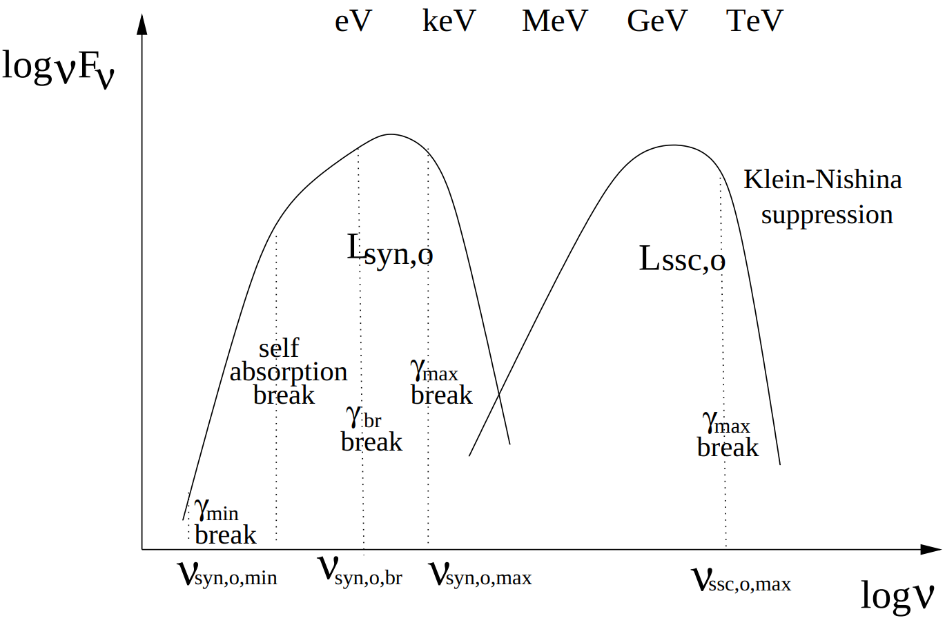
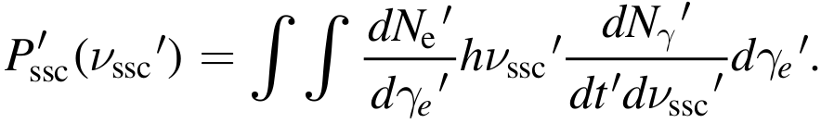
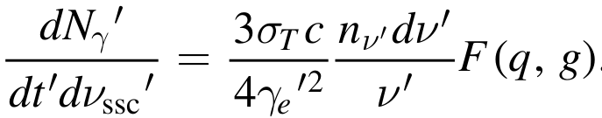
Building Afterglow: SSC emission
SSC emission power

Slide 24
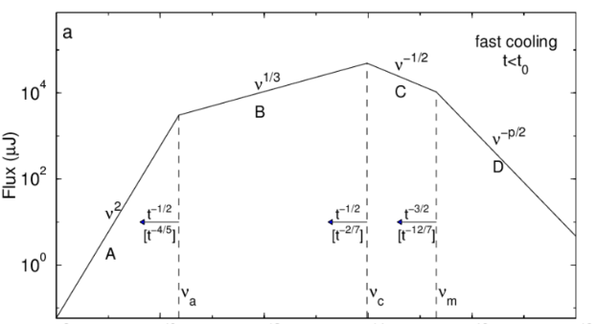
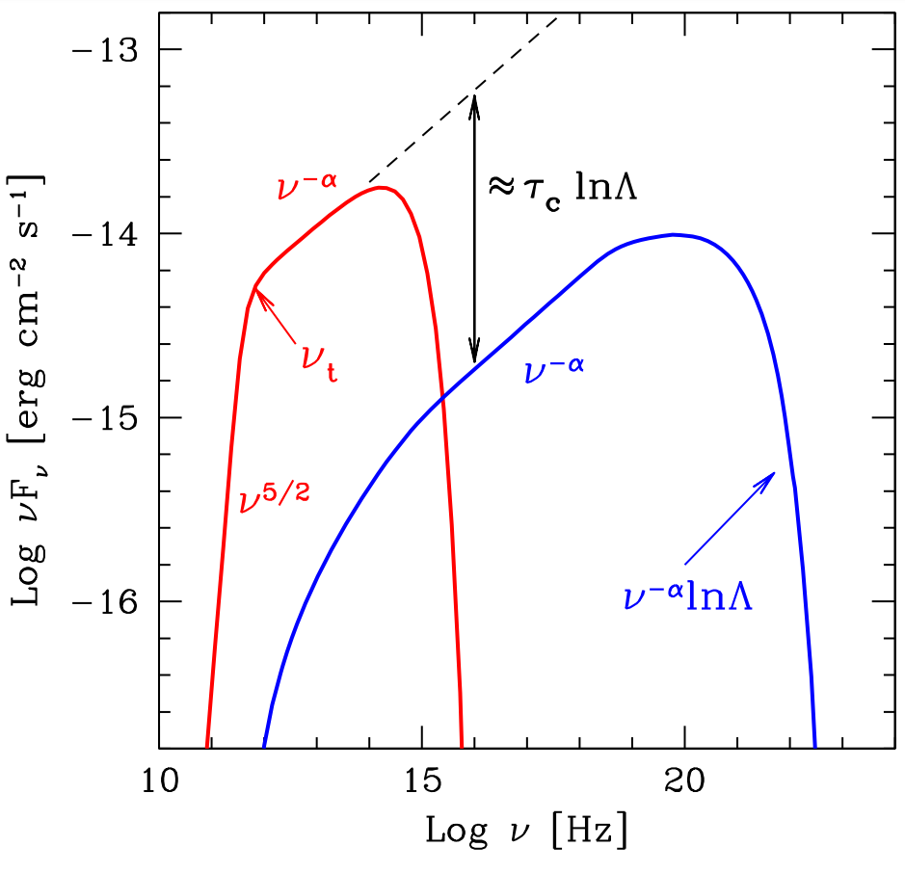
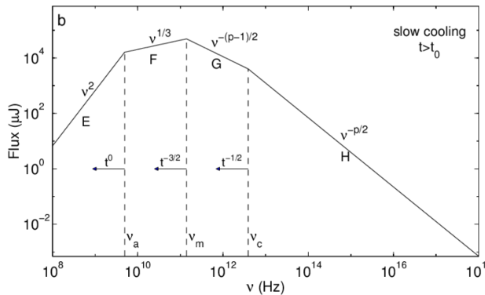
Building Afterglow: Comoving Spectrum
Synchrotron
SSC

Slide 25
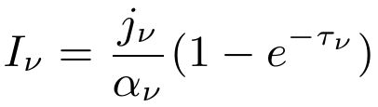

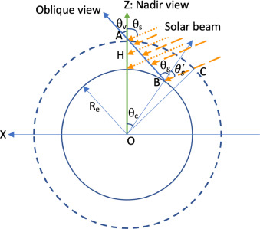

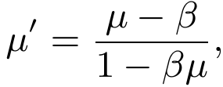

Building Afterglow: Intensity and Flux Density
From comoving emissivities to observed radiation flux density
Radiation intensity (observer frame)
Thickness of the emitting region depends on the observer
Observer
Light aberration
Equal-arrival time surface integration

Slide 26

Comparison with afterglowpyl; jetsimpy
On-axis afterglow
Shallow slope due to structure
Off-axis afterglow
Comparison:
Gaussian Jet
Forward Shock only
Synchrotron only

Slide 27

Example: sky map
Flux centroid
Sky map – intensity distribution projected onto a plane ortogonal to the line of sight.
Properties:
- Centroid position
- Size
Shows:
- geometry of the ejecta
- jet inclination angle
Origin
dx
Image size (FWHM)

Slide 28

Comparison with jetsimpy
Comparison:
Gaussian Jet
Forward Shock only
Synchrotron only

Slide 29

Building a Surrogate Model: Dataset
Building train dataset
(with afterglowpy)
- Set of time-dependent
Spectra (images)
~20 Gb for ~6400 spectra
Parameters:
"n_ism", "theta_obs",
"Eiso_c", "Gamma0c",
"theta_c", "theta_w",
"p_fs",
"eps_e_fs", "eps_b_fs"

Slide 30

Building a Surrogate Model: Architecture
Neural networds; generative model; conditional variational autoencoder (cVAE)
Kameoka+18

Slide 31

Building a Surrogate Model: Training
Training model on a 1000 spectra : Starting Epoch

Slide 32

Building a Surrogate Model: Training
Training model on a 1000 spectra : Last Epoch

Slide 33
Summary
GRB afterglow model:
Ejecta structure (jet structure)
Blastwave dynamics with collisionless shocks; coasting; spreading
Comoving electron distribution evolution
Comoving radiation (synchrotron & SSC) calculation
Integrating over EATS to obtain observables (spectra, sky maps)
Main work areas:
  Finishing the code (SSC; test cases; stability)
  Finilizing surrate model
  Integrating with NMMMA

