Slide 1


Modeling Gamma-Ray Burst
Afterglows
Vsevolod Nedora

Slide 2
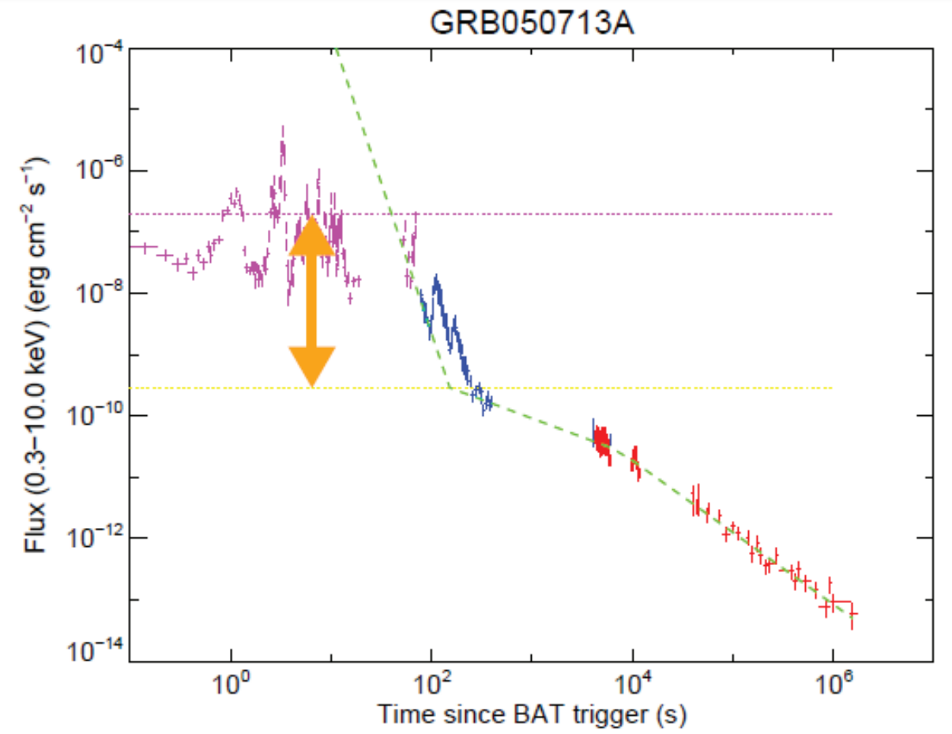
Introduction
Gamma-Ray Bursts
Prompt emission
(oscillatory, early)
Internal shocks or magnetic reconnection
Convert fraction of jet energy to radiation
Afterglow
(smooth, late)
External shocks (forward/reverse)
Synchrotron emission (based on spectra)
Prompt
Afterglow
Kazanas+15

Slide 3
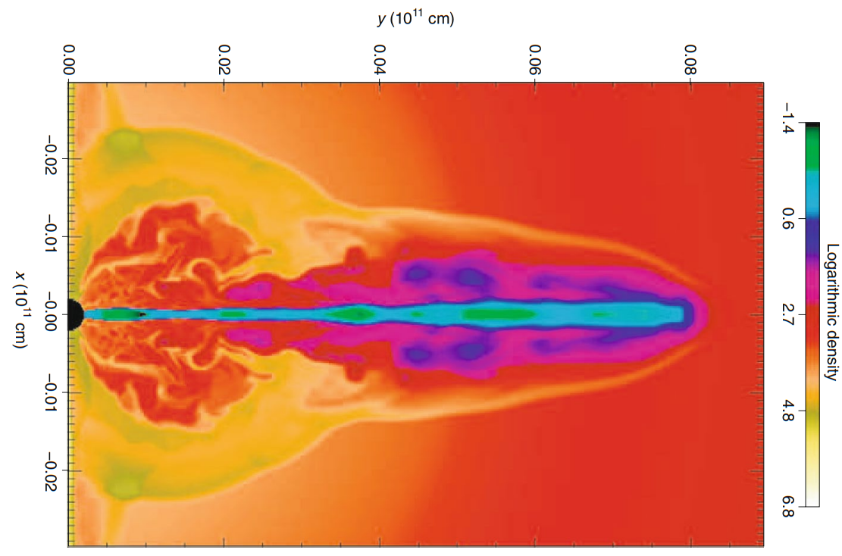
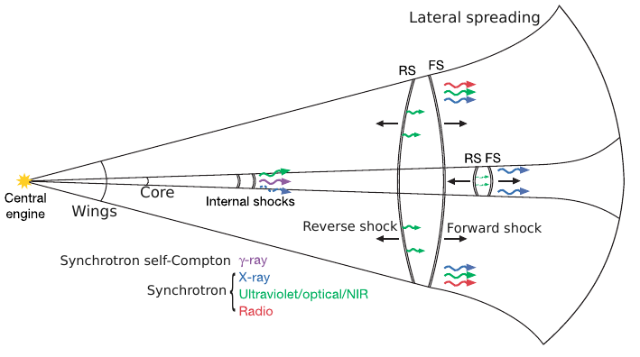
General Picture: Origin of GRBs
Marios Karouzos
Simulation
Schematic picture:
  Ejecta structure
  Lateral spreading
Prompt emission
Engine:
disk accretion
- burst energy
- ejecta structure
- ejecta composition

Slide 4
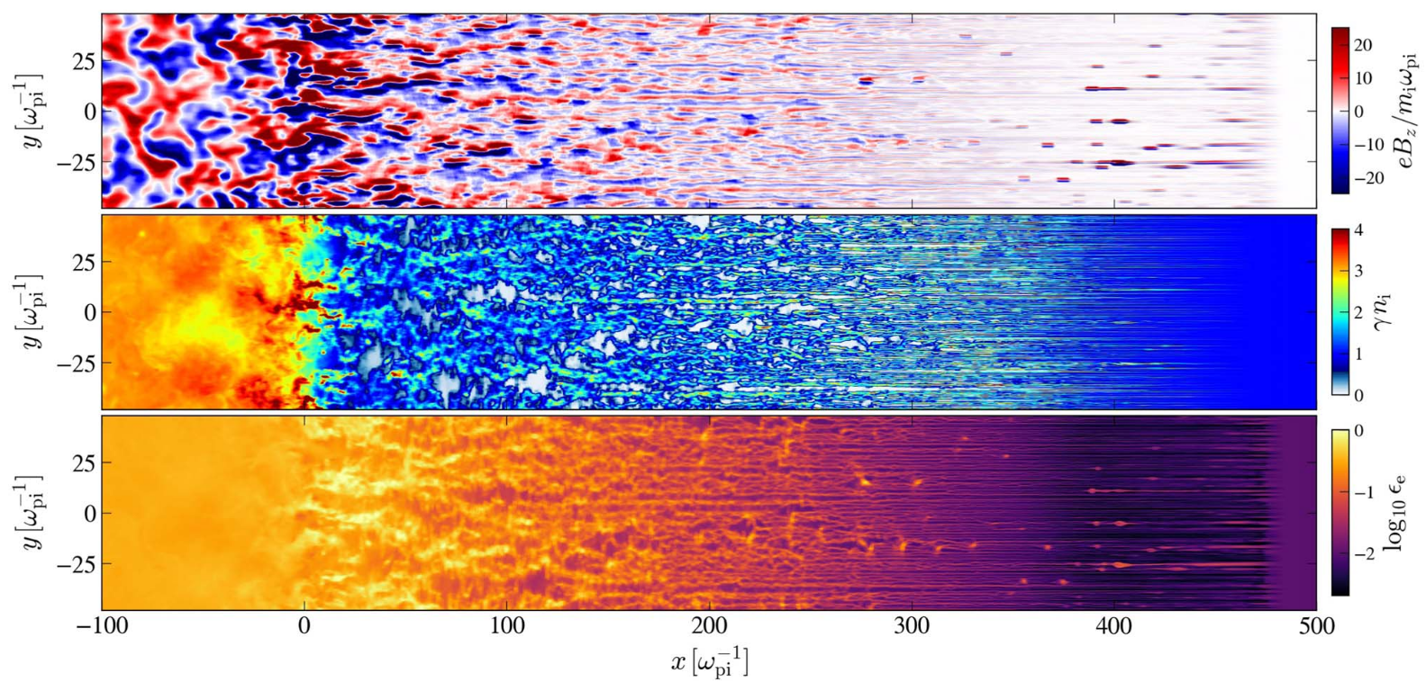
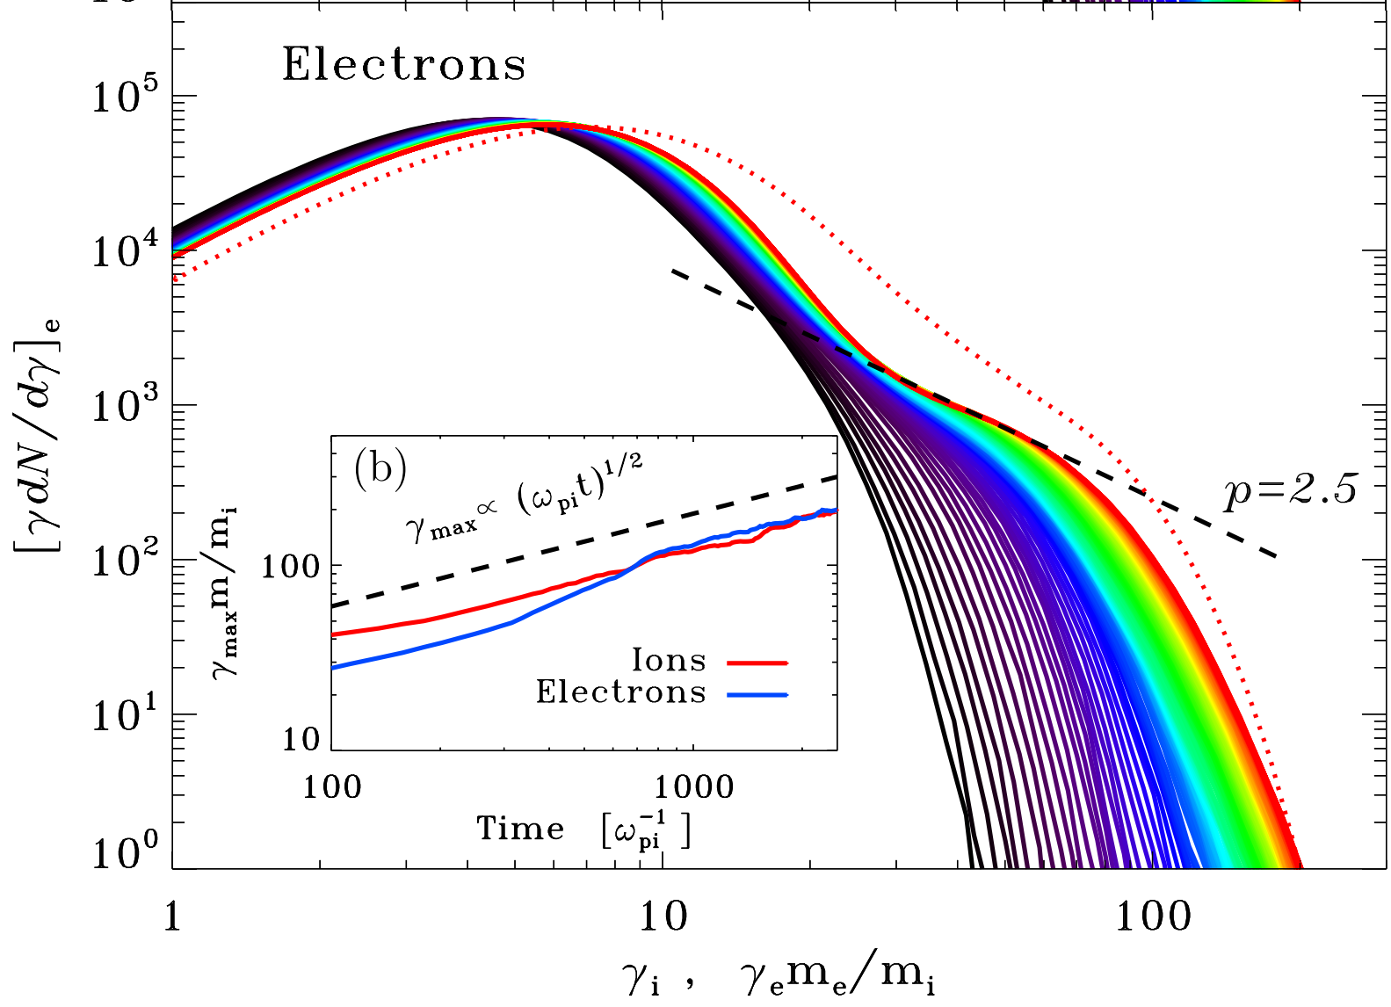
General Picture: Colisionless Shocks
Collisionless shocks
- mediated by electromagnetic processes
- few gyro-radii scale
At shocks:
- magnetic field amplification
- particle acceleration
fermi first order acceleration →
thermal core + power-law tail)
Vanthieghem+22
Sironi+13
}
Synchrotron
Radiation

Slide 5
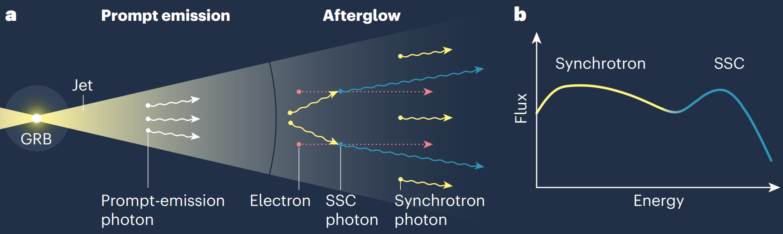
General Picture: Summary
From Bing Theodore Zhang (Zhang+19)
Power law
Jet structure: (energy/velocity angular dependency)
Ejecta dynamics: coasting; deceleration; spreading
Collisionless shocks: magnetic field amplification & article acceleration:
Synchrotron emission (self-absorption, inverse-Compton...)

Slide 6
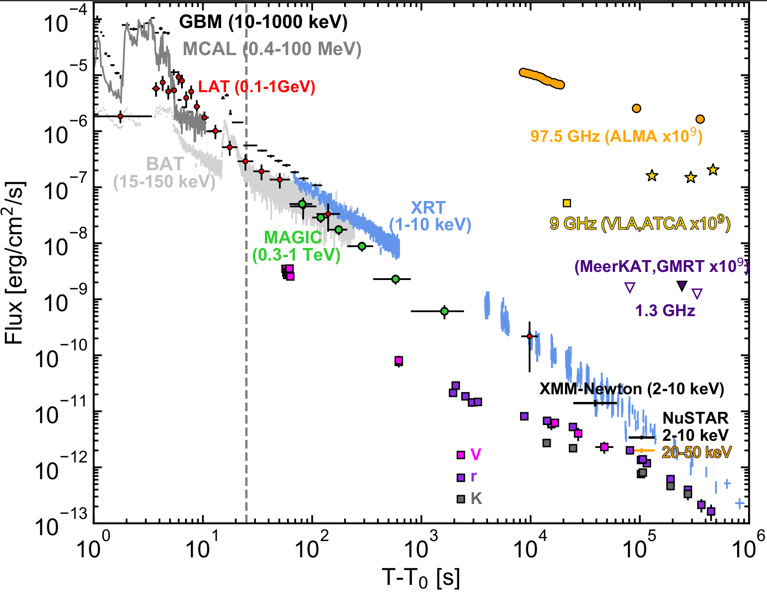
Examples: Very High Energy Afterglow
GRB 190114C (Acciari+20, MAGIC Collaboration)
TeV photons had distinct spectrum
Leading explanation: SSC
(KN regime & g-g absorption)
Other examples of VHE:
_ GRB 180720B
- GRB 221009A
Other possible sources of VHE
Proton synchrotron
Synchrotron self-Compton
External inverse Compton

Slide 7
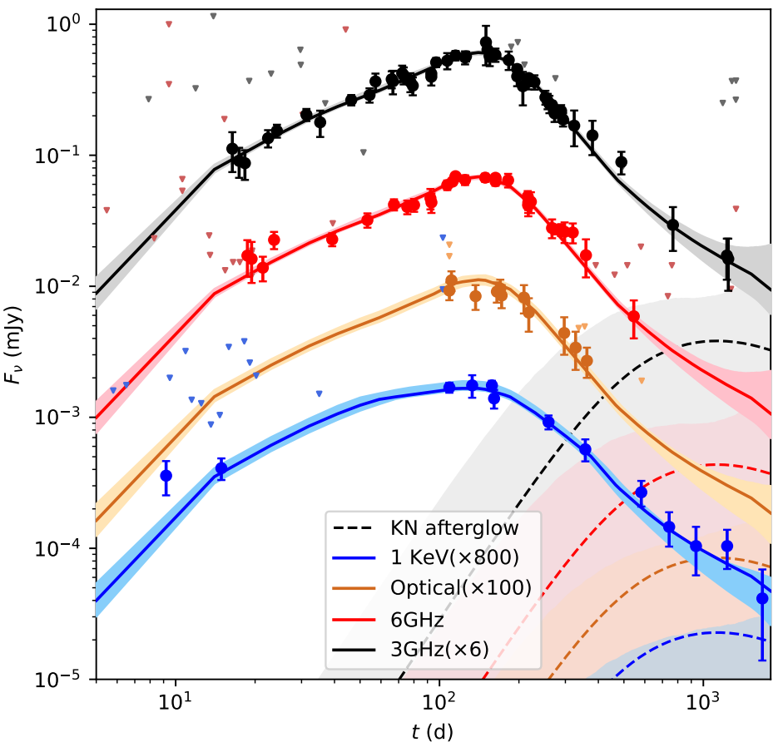
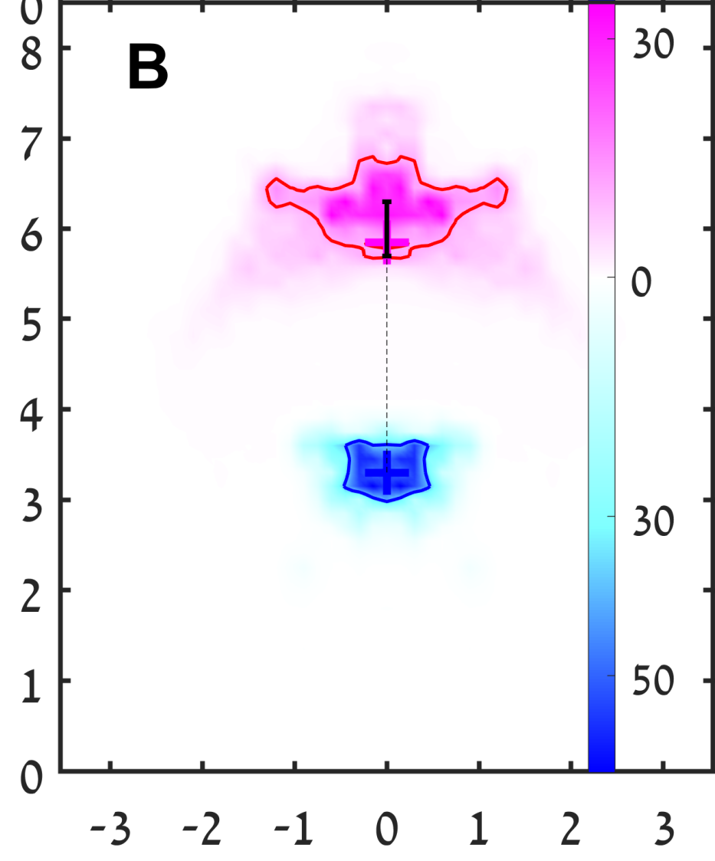
Examples: Structure & Radio Images
GRB 170817A showed
slow rise (not an off-axis tophat GRB)
Leading explanation:
- structured jet observed off-axis
Shallow decay: lateral spreading
VLA observed
radio image
(centroid motion
gives
additional
constrains)
Slow rise
230 d.
75d.
Flux density
Wang+22
Mooley+18

Slide 8
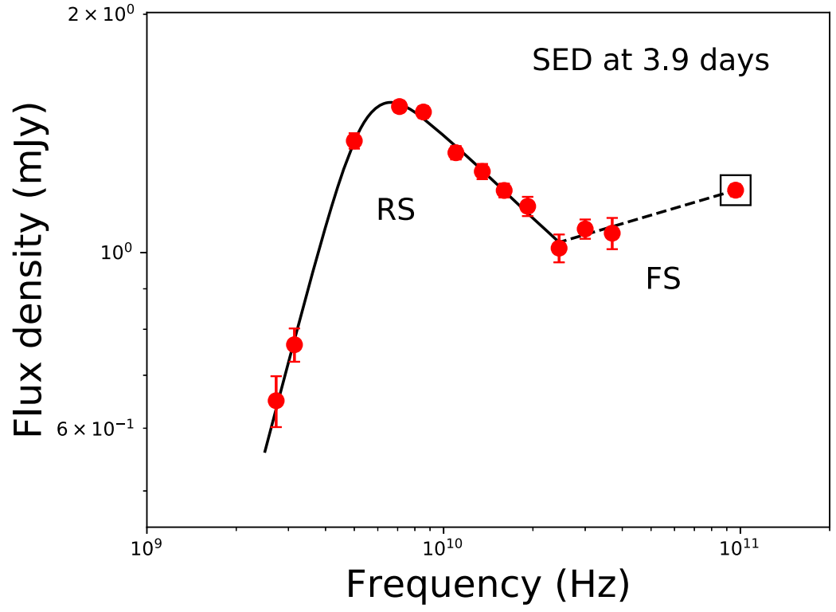
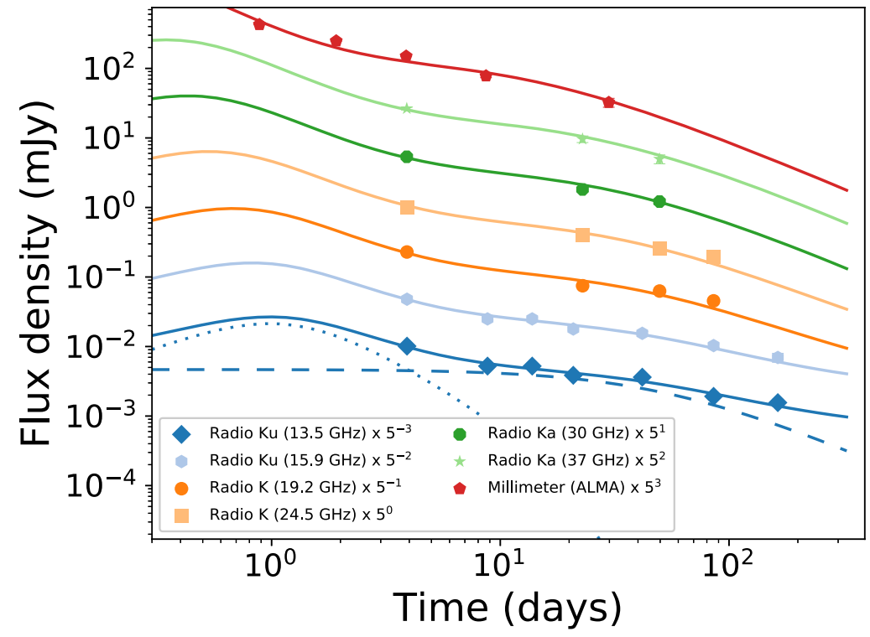
Examples: Reverse Shock
GRB 181201A showed
distinct spectra at 3.9 days, in radio
Leading explanation: emission from mildly relativistic reverse shock)
Other examples:
  GRB 160821B showed reverse shock
  & kilonova & energy injection (Lamb+20)
  GRB 190114C also showed early
  decaying IR component attributed
  to the reverse shock
(Laskar+19)

Slide 9
State of the afterglow modeling & Goal
Numeric codes (BoxFit…) - Computationally expensive.
Semi-analytic codes (afterglowpy…) - FS & synchrotron only.
Code requirements for multimessenger studies:
- speed (suitable for inference or NN training) – semi-analytic dynamics;
- jet structure (layers with different properties);
- FS & RS;
- synchrotron & SSC – numerical evolution of electron spectra;
- multiple observables: spectra & sky maps;
- extendable (possibility to implement new physics & approximants).

Slide 10
Building an Afterglow Model

Slide 11
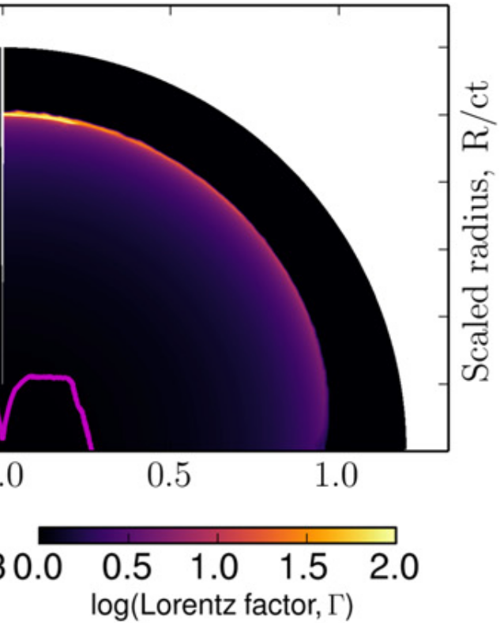
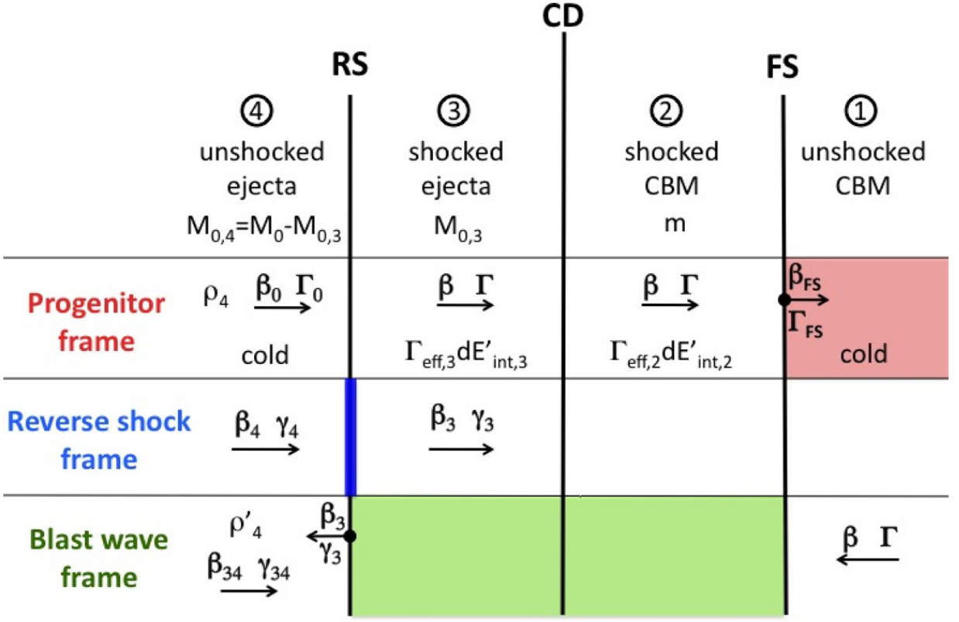
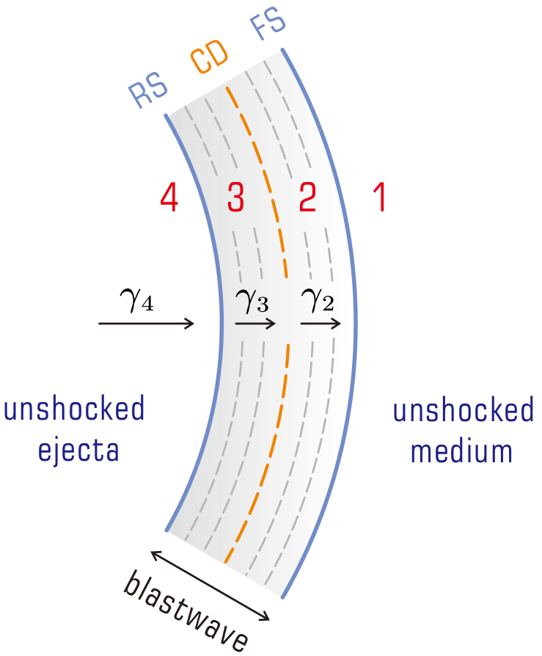
Building Afterglow Model: FS & RS dynamics
Numerical HD simulation of a jet
Thin shell forms
Thin shell approximation
Xie+18
Z. L. Zhang+22
Nava+13
Write evolution equations for the
System (blastwave) Lorentz factor

Slide 12
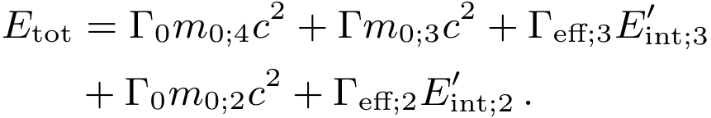
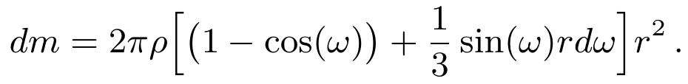
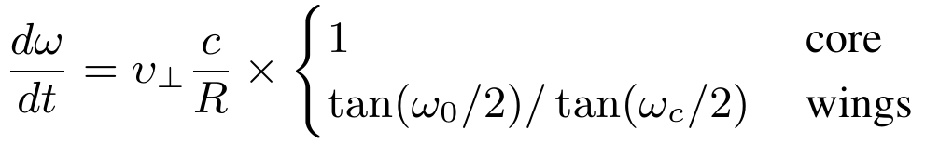
Building Afterglow Model: FS & RS dynamics
Total blast wave energy
Energy conservation equation
Accreted mass and lateral spreading
sound-speed-based;
calibrated with numerical simulations

Slide 13
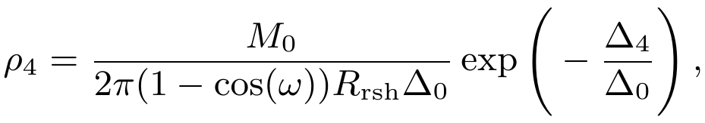
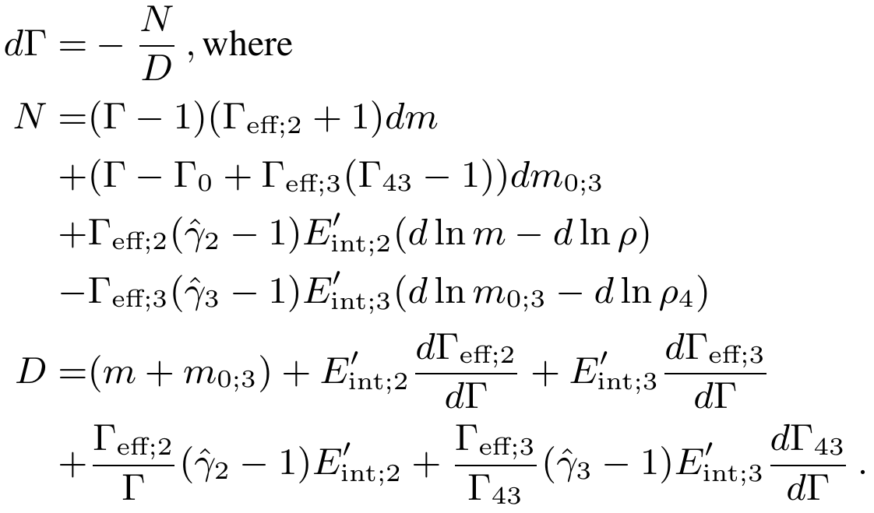
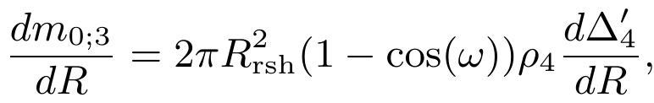
Building Afterglow Model: FS & RS dynamics
Evolution equation:
after some algebra...
Assumed ejecta shell density profile
Mass accreted by RS
System of ODEs is solved numerical
with DOP8(53) method

Slide 14
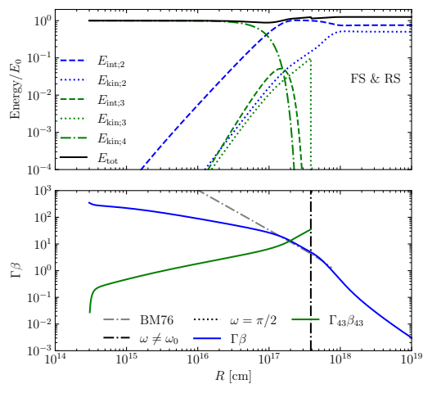
Building Afterglow Model: FS & RSexample
During the evolution
Total energy ~ conserved
Reverse shock shocks ejecta
RS crosses the ejecta
Dynamics
deceleration when
RS is crossing ejecta
Lateral spreading
BM solution is recovered close
to RS crossing

Slide 15
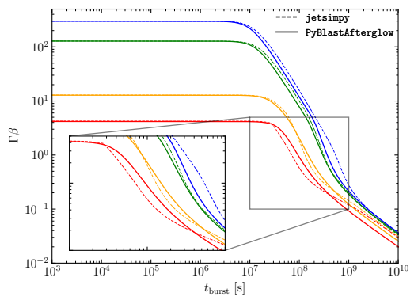
Building Afterglow Model: Comparison
Dynamics with lateral spreading against
2D thin-shell hydrodynamics model (using structure and Spreading)
calibration to BM can be added
spreading prescription
can be improved

Slide 16

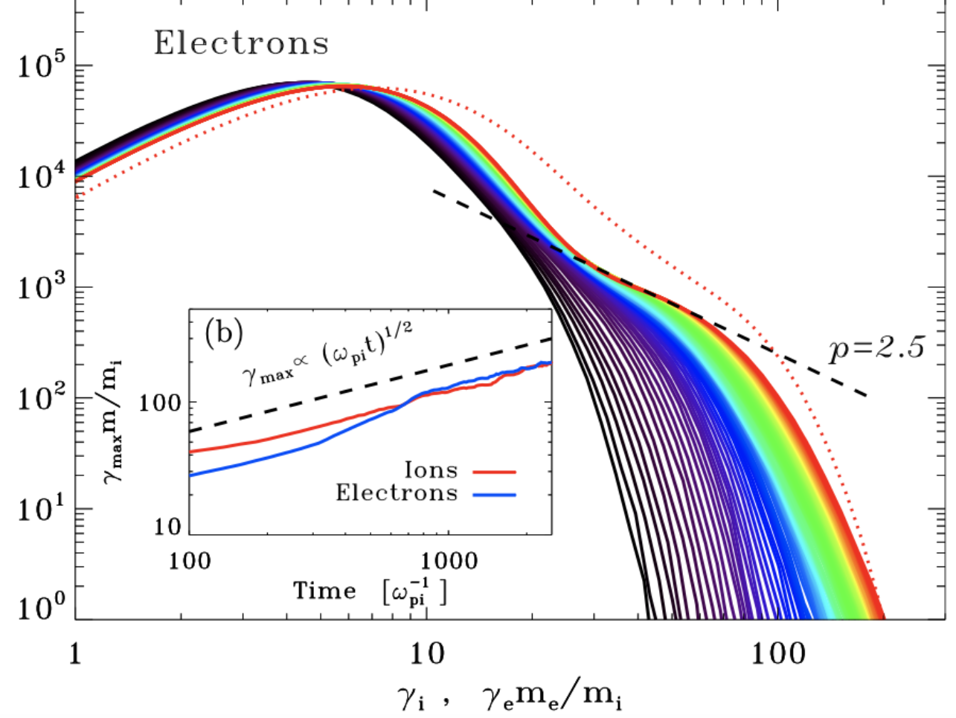

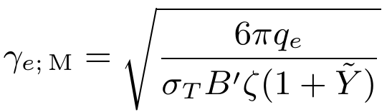
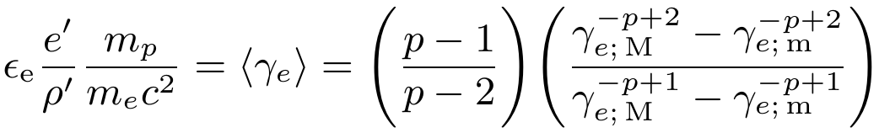
Building Afterglow: Shock Microphysics
Energy Density
Magnetic Field
Injection spectrum
Free parameter
Spectral limits
Compton parameter
M
Microphysics parameter
m
Free parameter
Solving for minimum

Slide 17
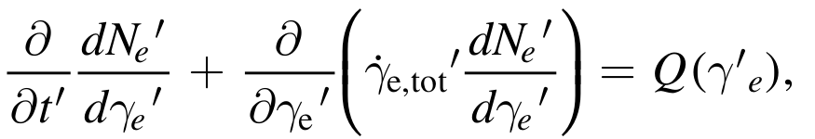
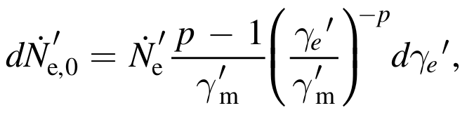



Building Afterglow: Electron Evolution
Electron distribution evolution
Electron injection
Electron energy loss
Assumed
injection
distribution
Solved using Chang-Cooper scheme with substeps for cooling
Numerically compute
- Synchrotron emissivity
- SSA coefficient
- SSC emissivity

Slide 18
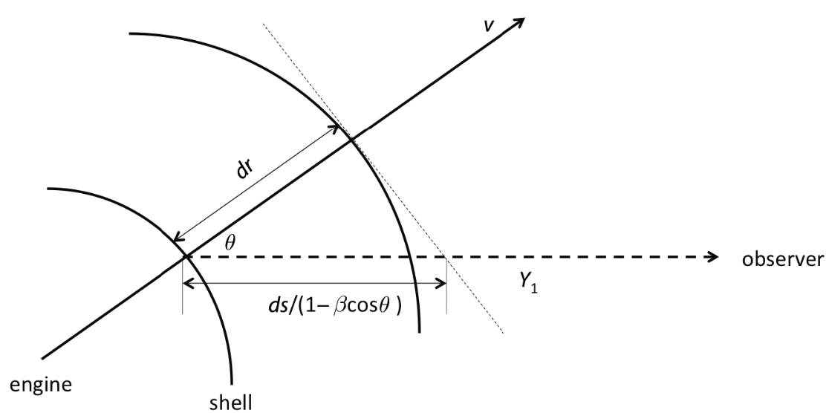
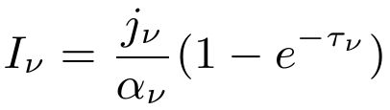

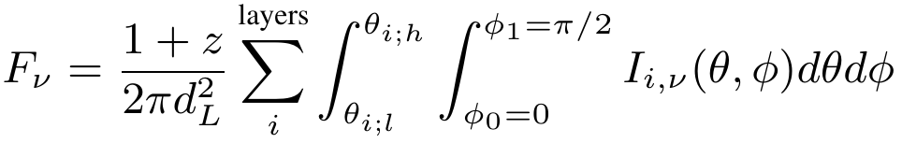
Building Afterglow: Intensity and Flux Density
From comoving emissivities to observed radiation flux density
Radiation intensity (observer frame)
Thickness of the emitting region
depends on the observer
Equal-arrival time surface integration

Slide 19
Preliminary Results

Slide 20
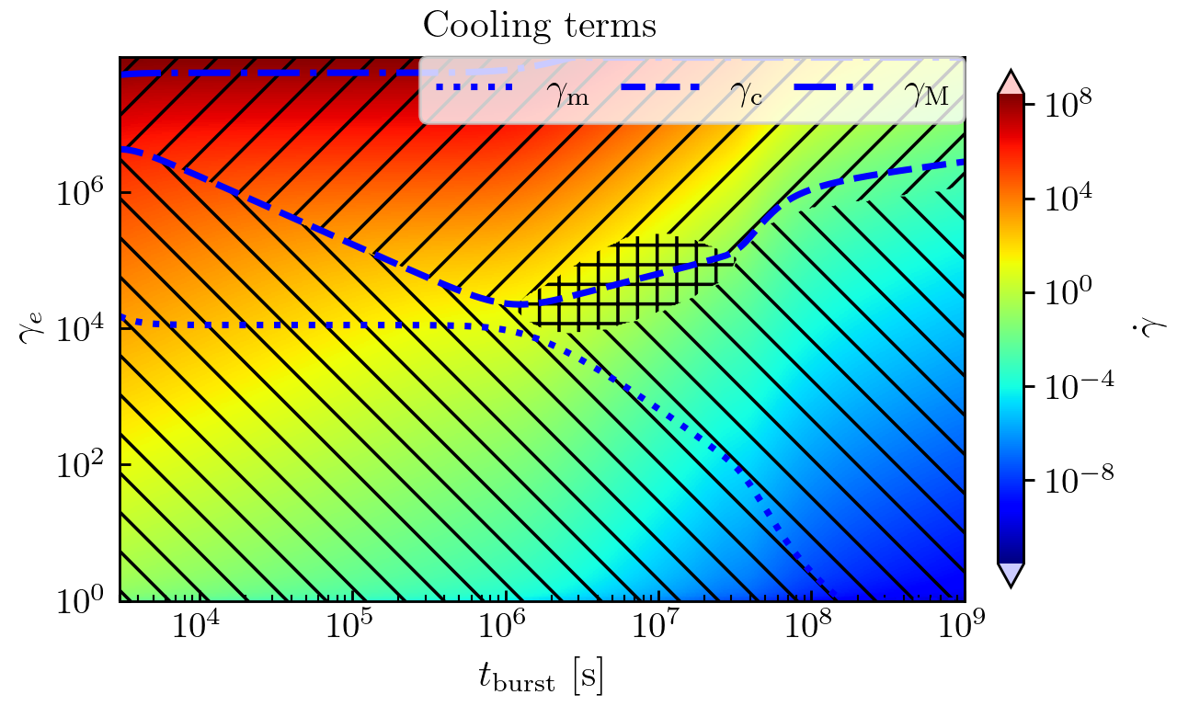
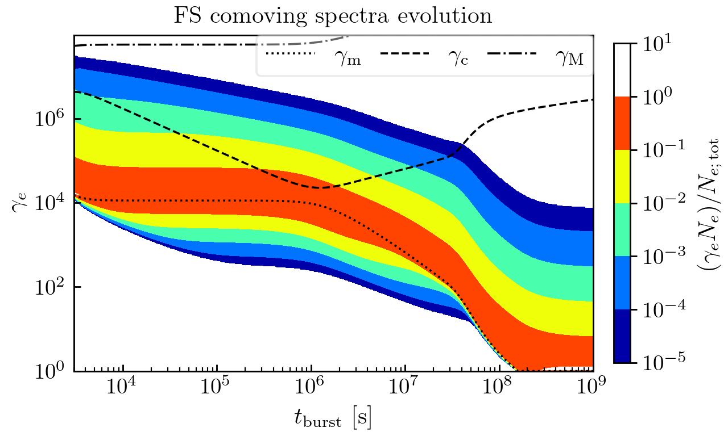
Preliminary results: Electron Spectrum
Synchrotron
SSC
Electron spectrum evolution
Adiabatic
Dominant cooling process
Cooled part of the spectrum

Slide 21
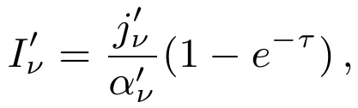
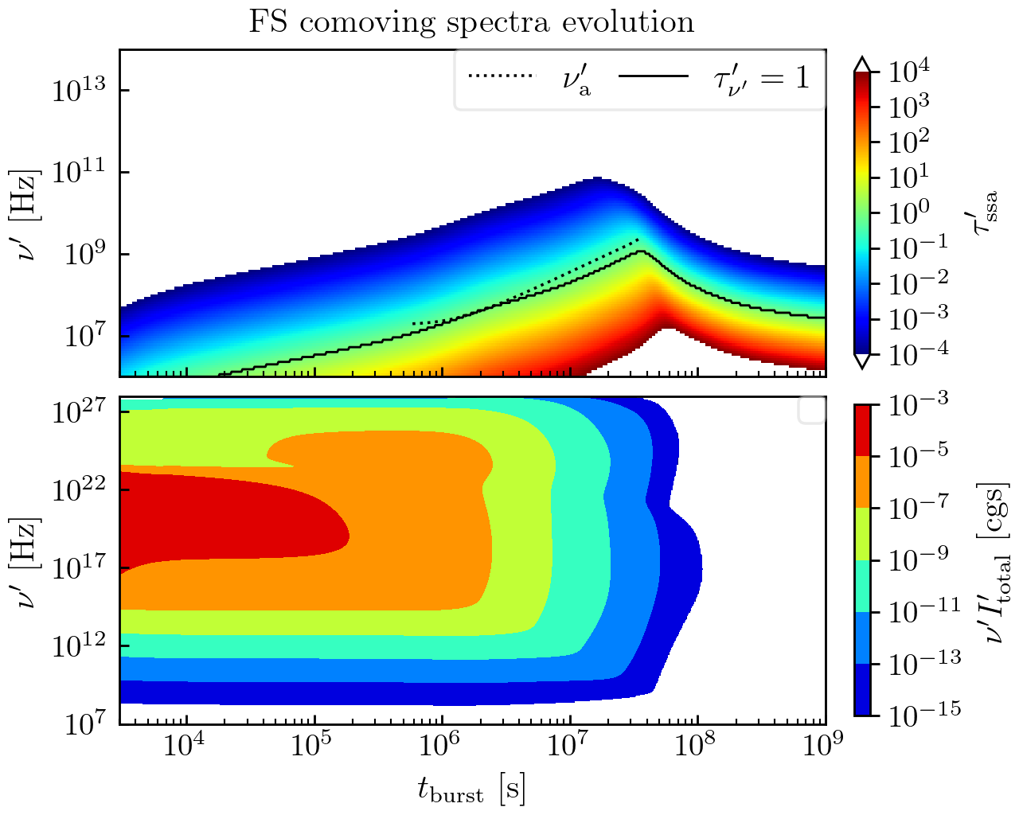
Preliminary results: Radiation Spectra
Spectrum is primarily optically thin
Optical depth
Comoving synchrotron
and SSC spectra
SSC
Synch

Slide 22
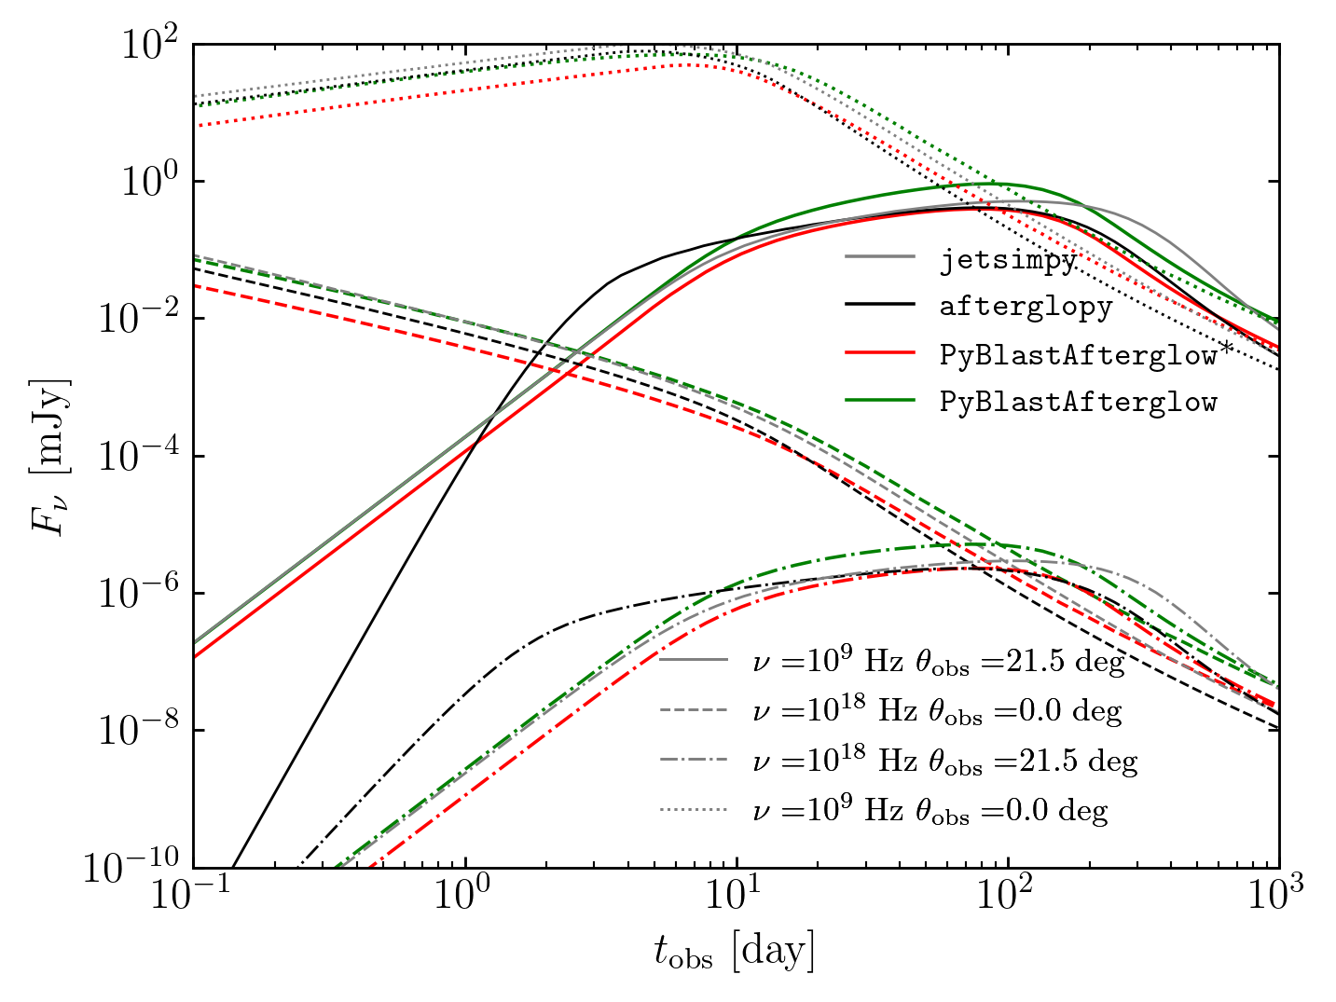
Comparison with afterglowpyl; jetsimpy
On-axis afterglow
Shallow slope due to structure
Off-axis afterglow
Comparison:
Gaussian Jet
Forward Shock only
Synchrotron only

Slide 23
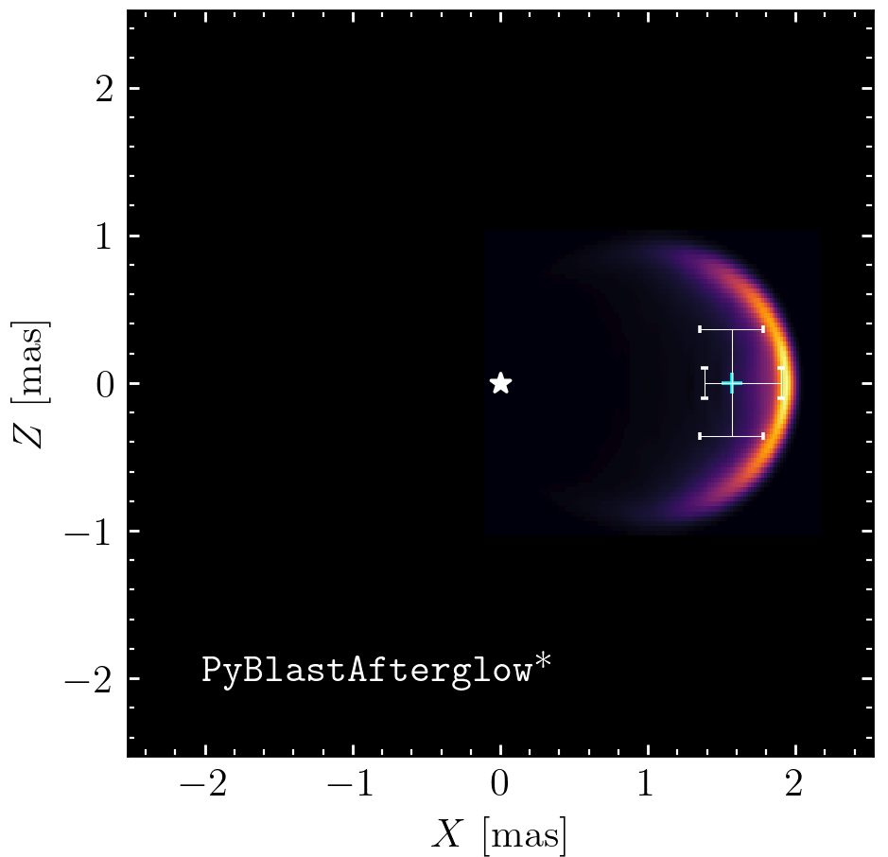
Example: sky map
Flux centroid
Sky map – intensity distribution projected onto a plane orthogonal to the line of sight.
Properties:
- Centroid position
- Size
Shows:
- geometry of the ejecta
- jet inclination angle
Origin
dx
Image size (FWHM)

Slide 24
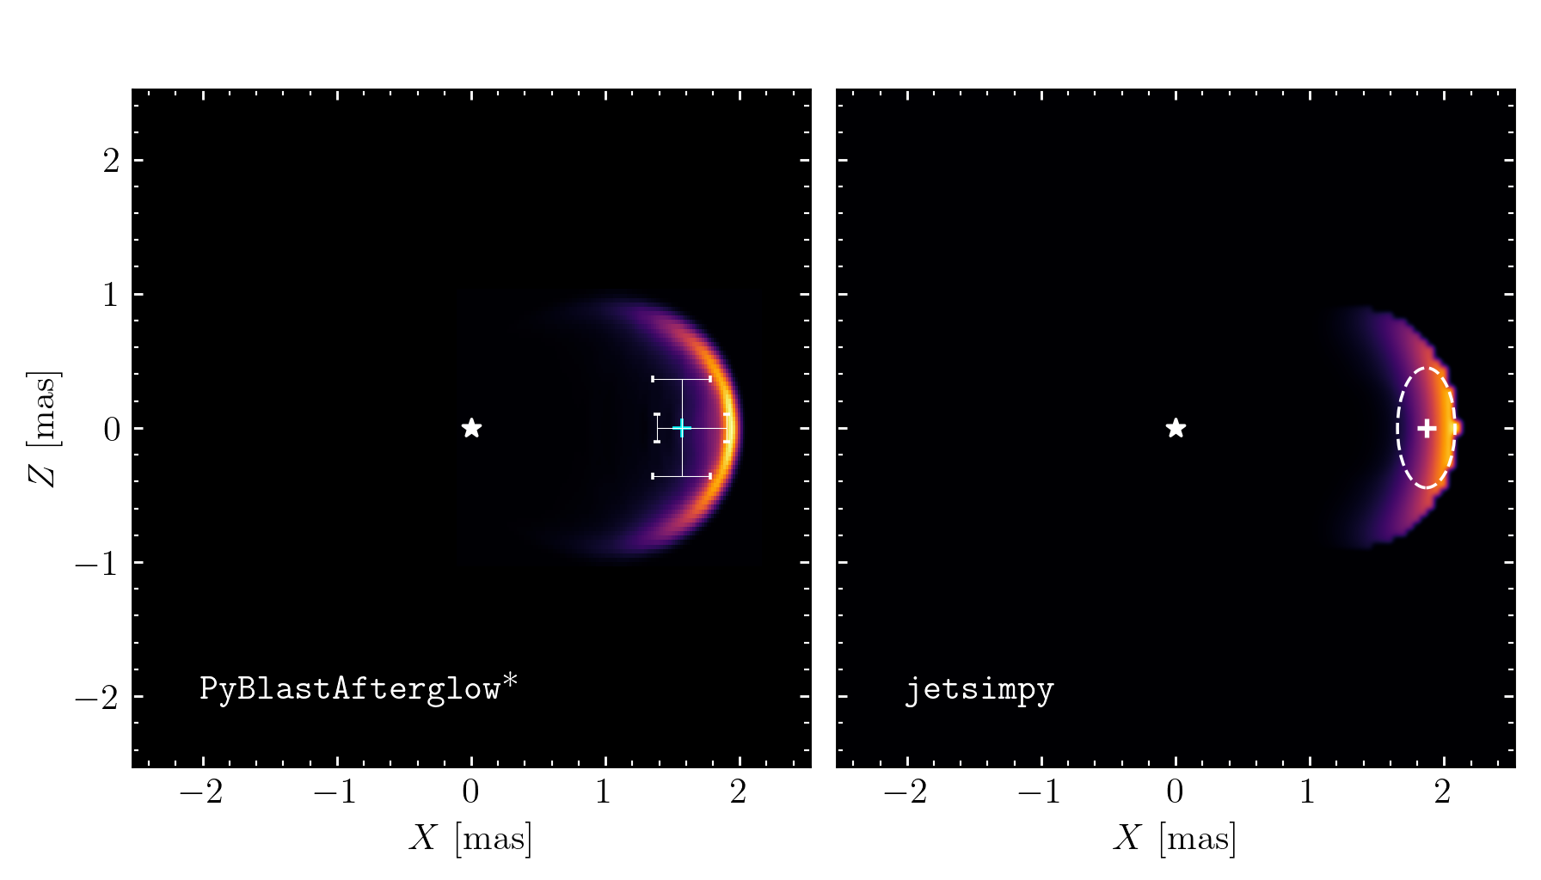
Comparison with jetsimpy
Comparison: Gaussian Jet; Forward Shock only; Synchrotron only

Slide 25
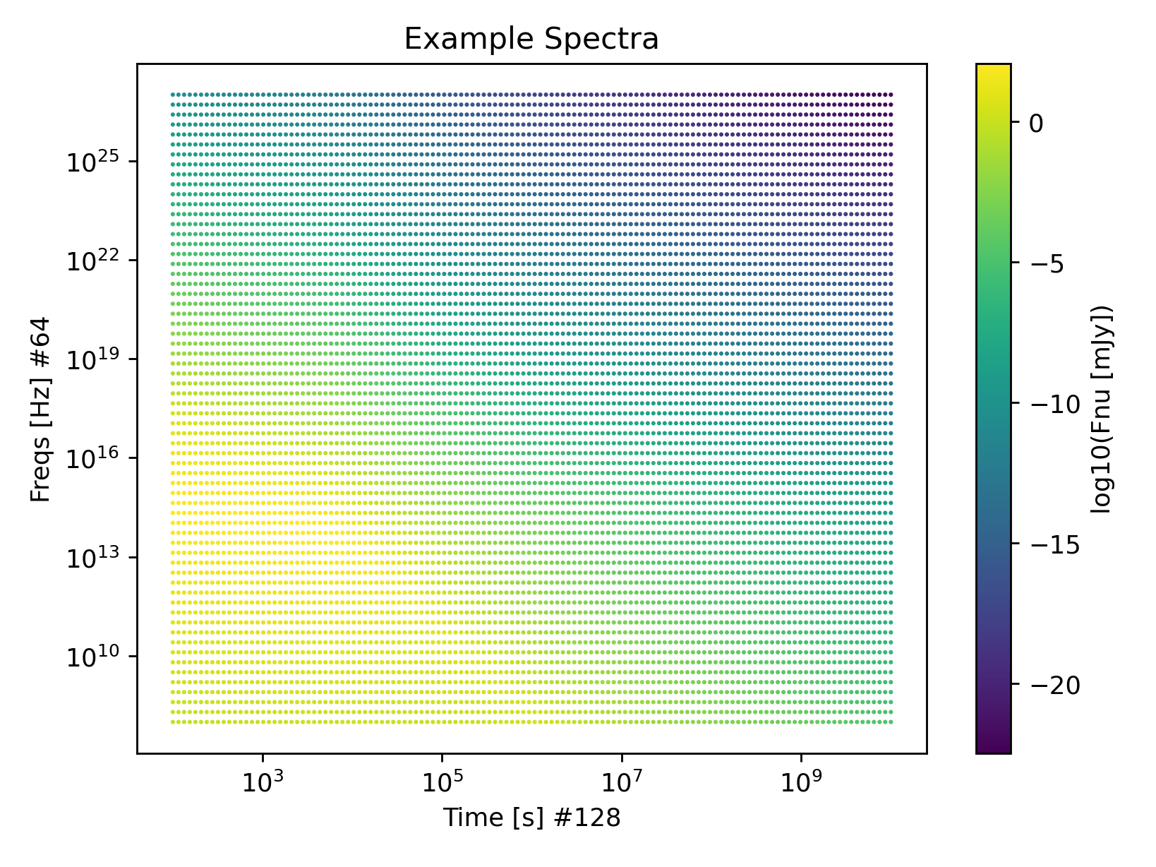
Building a Surrogate Model: Dataset
Building train dataset
(with afterglowpy)
- Set of time-dependent
Spectra (images)
Features:
- Microphysics (3)
- Jet structure (3)
- Observer (3)
Metadata
- 10000 spectra
- 26 GB training set

Slide 26
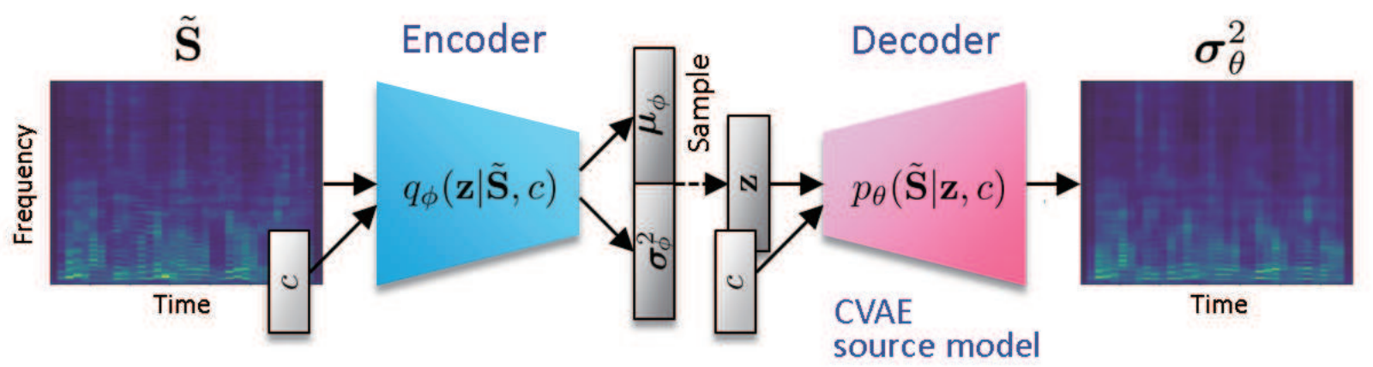
Building a Surrogate Model: Architecture
Neural networds; generative model;
conditional variational autoencoder (cVAE)
Kameoka+18

Slide 27
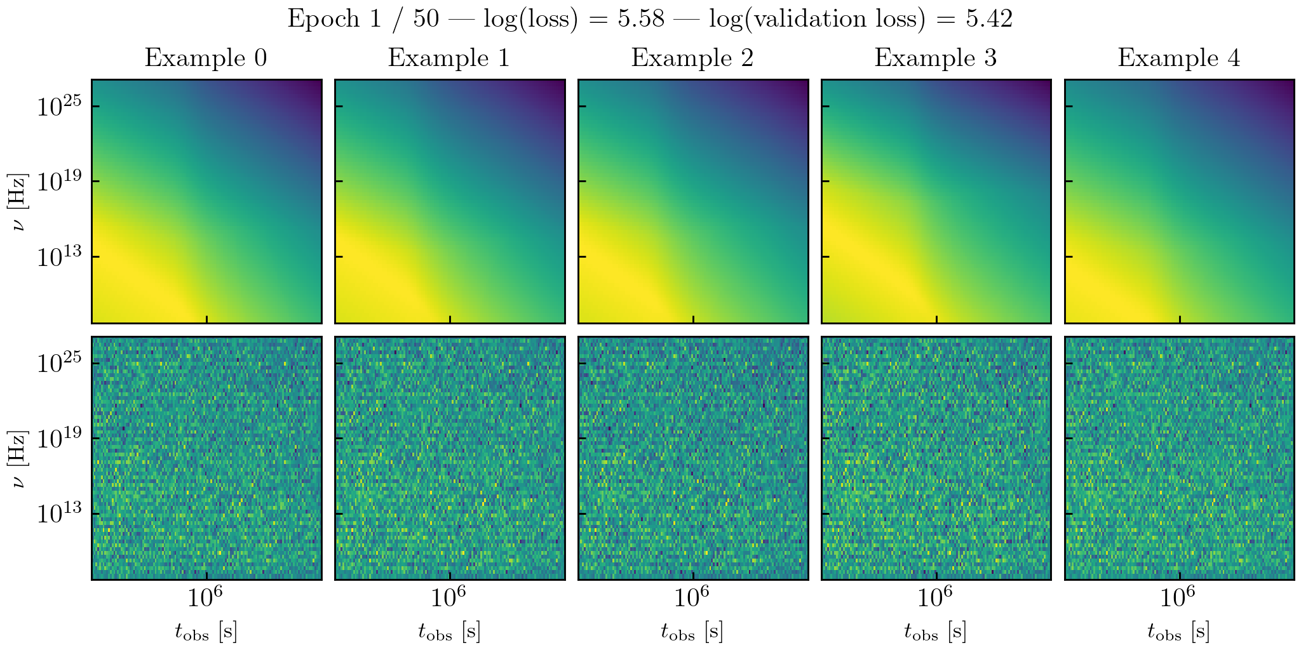
Building a Surrogate Model: Training
Training model on a 1000 spectra : Starting Epoch

Slide 28
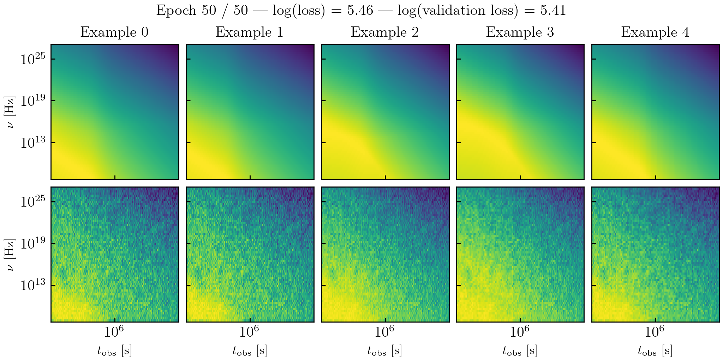
Building a Surrogate Model: Training
Training model on a 1000 spectra : Last Epoch

Slide 29
Additional points

Slide 30
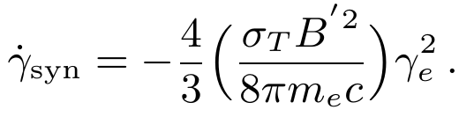
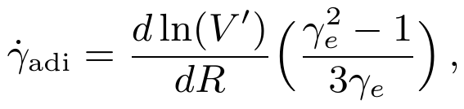
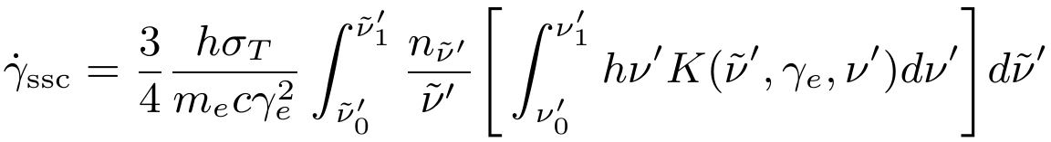
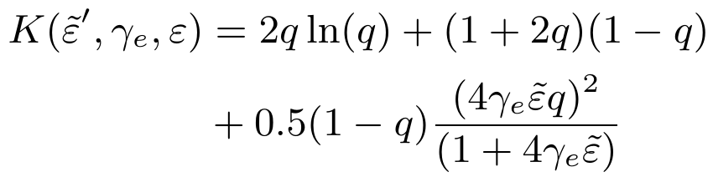
Building Afterglow: Cooling terms
Cooling terms
Synchrotron cooling
Adiabatic cooling
SSC cooling
SSC kernel

Slide 31
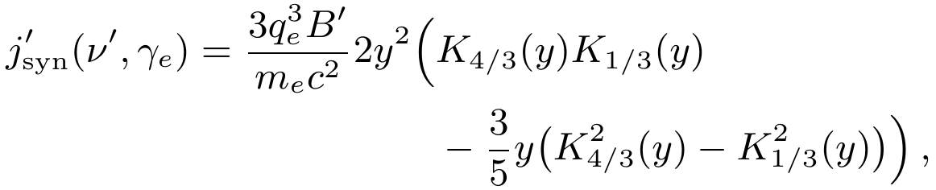

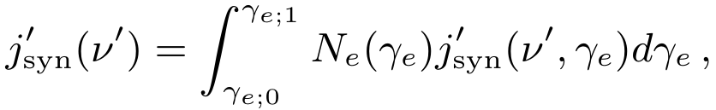
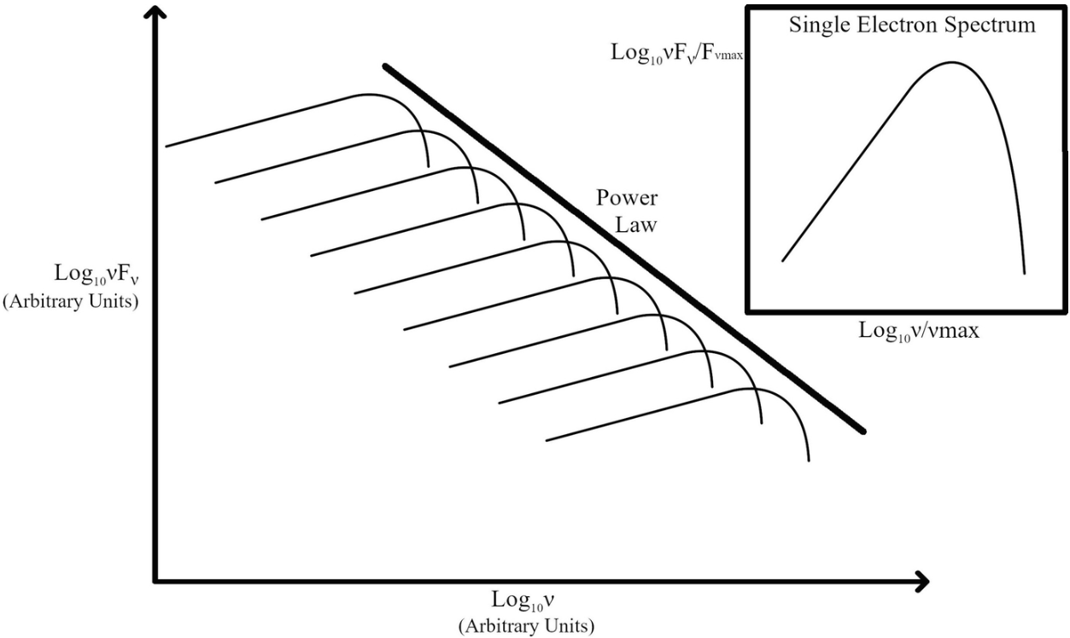
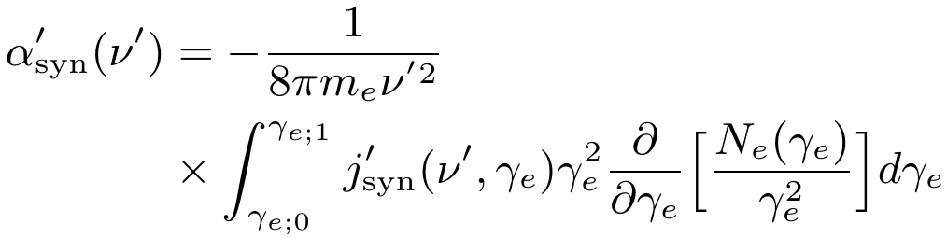
Building Afterglow: Synchrotron Emission
Convolving the emission of a single electron gyrating around magnetic field lines with electron distribution function
Emission power by a single electron
Synchrotron
self-absorption (SSA)

Slide 32
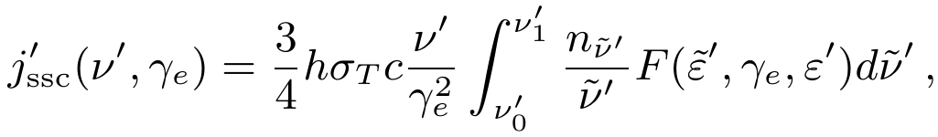


Building Afterglow: SSC emission
Synchrotron self-Compton spectrum
Seed photon spectrum
Comoving escape time

Slide 33

Preliminary results: Radiation Spectra
Comoving synchrotron and SSC spectra
Numerical spectrum peak > analytical
SSC reaches peak at BW deceleration

Slide 34


Building Afterglow Model: FS & RS dynamics
Total blast wave energy
Energy conservation equation
Evolution equation: after some algebra...
Adaptive ODE solve used

Slide 35


Building Afterglow Model: FS only example
Total blast wave energy (assume ejecta is already shocked)
z
Schematic picture of a Blast wave
(Nava+13)
Energy conservation equation
Neglected here
Evolution equation: after some algebra...
Final set of ODEs we solve numerically

Slide 36






Building Afterglow Model: lateral spreading
Required 2D HD simulations. Using approximants. Many options...
Calibrated with early HD simulation (Granot+12)
Sound-speed based formulation (Huang+00)
Structured-jet aware formulation (Ryan+20)

Slide 37

Building Afterglow Model: FS only example
Energy:
kinetic → internal energy
total energy is conserved c
Dynamics:
free coasting (constant momentum)
deceleration (BM solution)
lateral spreading
non-relativistic stage (ST solution)

