Slide 1
Cyber Terrorism
Presented By
R.Srividya
16X41A1239

Slide 2
Contents:
Introduction
Features
Examples
Black out Day
Traditional Terrorism
Affects in Future
Need To Do
Prevention And Protection
Conclusion

Slide 3
Introduction
As the use of Internet is increasing day by day, traditional concepts and methods of terrorism have taken new dimensions.
Individuals or groups can use the anonymity afforded by cyberspace to threaten citizens, specific groups(i.e. with membership based on ethnicity or belief), communities and even the countries.

Slide 4
Features
Difficulty Identifying Attackers: It remains difficult to determine the identity of the initiators of most cyber attacks.
Lack of Boundaries: Attacks can originate from anywhere in the world and from multiple locations simultaneously.
Speed of Development: The time between the discovery of a new vulnerability and the emergence of a new tool or technique that exploits the vulnerability is getting shorter.
Low Cost of Tools: The technology employed in attacks is simple to use, inexpensive, and widely available.
Automated Methods: The methods of attack have become automated and more sophisticated, resulting in greater damage from single attack.

Slide 5
Examples
Hacking into computer systems.
Introducing virus to vunerable networks.
Website Defacing.
Denial-of-servies(DOS) attacks.
Terreristic threats made via e-mail.

Slide 6
How Does Cyber Terrorism Works
Hacking: To gain access to (a computer file or network) illegally or without authorization.
Misinformation: To provide with incorrect information.
Virus: A computer program that duplicates itself in a manner that is harmful to normal computer use. Most virus work by attacking themselves to another program. The amount of damage varies; viruses may erase all data or do nothing but reproduce themselves.
Worm: A malicious program that replicates itself until it fills all of the storage space on a drive or network.

Slide 7
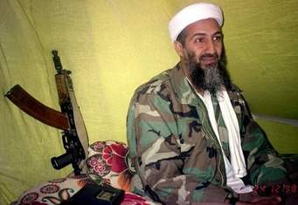
Who partakes in the act of cyber terrorism
Terrorists- Anyone who terrorizes by using violence, threats, coercion, and/or intimidation as a way to install fear and gain submission.

Slide 8
3 most common attack methods
IP Spoofing.
Password Cracking.
Denial-of-Service attack.

Slide 9
IP Spoofing
Refers to creation of IP packets with forged source IP address with the purpose of concealing the identity of sender.
Mostly used in Denial-of-sevice attacks.
Most effective in corporate networks where users can log in without a username or password.

Slide 10
Password Cracking
Password Cracking can be implemented using brute-force attacks, Trojan horse programs and IP Spoofing.
Password attacks usually refer to repeated attempts to identify a user account and/or password; these repeated attempts are called brute-force attacks.
One example is weak encryption(LM hash) used by Microsoft windows XP, can easily be attacked.

Slide 11
Denial-of-Service attacks
Denial-of-Service attacks focus on making a service unavailable to intended users.
2 forms of DOS attacks: those that crash sevices and those that flood services.
One common attack method involves saturating the target machine with communications request such that it cannot respond to the traffic.

Slide 12
Examples of Cyber Terrorist attacks
9/11 attack.
Ahmedabad bomb blast.
26/11 mumbai attack.

Slide 13
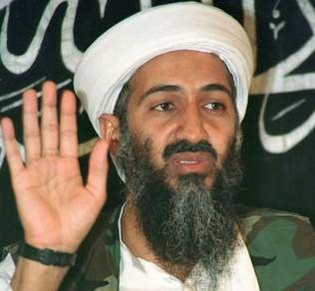
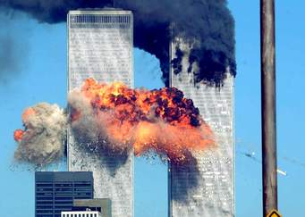
9/11 Twin Towers Attack
Al-Qaeda laptop was found in Afghanistan.
Hits on websites that contained “ Sabotage Handbook”.
Al-Qaeda actively researched publicly available information concerning critical infrastructure posted on websites.

Slide 14
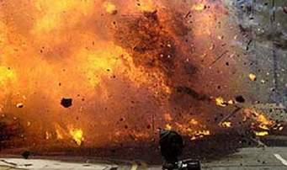
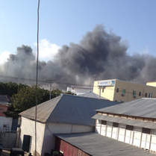
Ahmedabad Bomb Blast(26-07-08)
Amail with id alarbi_gujrat@ yahoo.com was being sent by a group of terrorists .
Person named Kenneth Haywood's unsecured WIFI router in his house was being misused by terrorists.
3 more mails are sent after blast with the same misuse of unsecured WIFI routers.

Slide 15
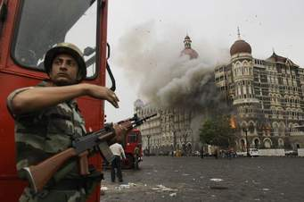
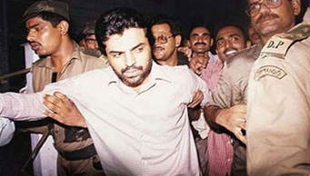
26/11 Mumbai Attack
Terrorists communicated with handlers in pakistan through callphonex using VoIP(Voice over Internet protocal).
The accused communicated to terrorists with an email id kharak_telco@yahoo.com which was accessed from 10 different IP addresses.

Slide 16
Black out Day
It was first cyber war at “New York” city on 14th,August,2003.
Real incidents that horribly suffered New York for 3 days.
The hacker attacks on power lines.
Before 3 days some where realize the virus named as “BASTER”.
And it a self active.
100 power plants are shut down.
By the incident effects on whole traffic,airline power,water system,&nuclear reactor too.
New York government struggled for 3 months to find the accused .
That was Russian government is totally responsibility to this act.

Slide 17
Cyber Terrorism In India
ECIL(Electronic Corporation of India imited) which was invented electro voting system in India, controlling parliament security system, Nuclear plants, Defense etc.
ECIL CYBER website was hacked by Phrozenmyst.
Not only ECIL and also ISRO, BARC.
The hacker Phrozenmyst was stolen sensitive data from ECILand pasted on PAGEBIN website.
Due to they are macking some illegal tenders and he tweet on his tweeter account.
From 2010 to pakistan and china attacking the India by cyber.
Recently pakistan is made a successfully attack on India by an fack currency at elections time.

Slide 18
Cyber Terrorism Against Traditional Terrorism
In the future, cyber terrorism may become a feasible option to traditional physical acts of violence due to:
Perceived anonymity.
Low risk of detection.
Low investment.
Operate from nearly any location.
Few resources are needed.

Slide 19
How Does Cyber Terrorism affect you and your Future?
Air traffic control towers or our airlines infrastructure could be hacked into.
Banking systems could be violated and all of our money could be stolen.
Bombs and other explosives could be set off by remote .
Hospitals could lose all of their information.
Learn Government secrets and plans.
The Tamparing of our water system.

Slide 20
What do we need to do??
Maintain high alert &vigilance.
Update OS and applications regularly.
Enforce strong passwords.
“Lock Down” systems.
Keep anti-virus software installed and up-to-date.
Employ intrusion detection systems and firewalls.

Slide 21
Prevention & Protection
Be cautious about opening email attachments.
Complete software update.
Create difficult passwords.
Download anti-virus software.
Uninstall unused applications or services.

Slide 22
Conclusion
Cyber terrorism is a scary concept for many reasons.
The information age has brought us many good things, but along with those good things came some bad things too.
Our government is trying to do its part, so let's support them and their efforts and stop this cyber battle.
“Tomorrow’s terrorist may be able to do more damage with a keyboard than with a bomb”.

Slide 23



Queries Please......

Slide 24
Thank You

