Slide 1
AQUAPONICS –Smart Farming
Aquarium + Hydroponics
In general terms , this works on a mutual relationship between the plants and the fishes.
Often the aquarium is placed below the plant bed and the water along with the excreta of the fishes is sent to the plants to provide water as well as nutrients to them.
In return the drain water can be filtered an sent back in the aquarium.
This can be as small as a decorative in the house or can be extended to large areas for commercial cultivations.

Slide 2
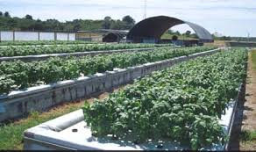
Commercial scale.

Slide 3
Implemented already??
Aquaponics has been implemented but without being connected to the internet or data acquisition centers.
With the increasing prices of petrol ,water, grains transportation the experts suggest aquaponics is a very convenient way of farming and most probably the future.
Even in countries where water shortages aren’t an immediate problem, aquaponics holds some promise of cutting down transportation costs, because it can be done on a fraction of the land of traditional architecture.
Aquaponics isn’t the silver bullet that will raise yields at the rate that the world needs, but it could be part of a future agricultural economy that blends the local and vertical in urban centers, while indoor farming extends the growing season year round.
Hence the following places have already implemented aquaponics efficiently.
California
berlin
Kenya
Kerala

Slide 4
What do we offer?
IOT (Internet of things), connecting every farmer to the internet with a simple module no bigger than 1sq feet.
Apart from the normal implementation of aquaponics we provide the user with the privilege to get connected to it technologically.
Sitting in any corner of the world you are in full control and have real time data about the crops.
In depth data analysis that can provide near perfect accuracy.

