Slide 1
SemanticSpotter Generative Search System for Insurance Policy Documents
By Parul Mishra

Slide 2
Problem Statement
Insurance companies deal with a vast amount of policy documents, ranging from individual policies to complex corporate contracts.
These documents contain critical information such as coverage details, exclusions, premiums, and legal clauses.
Manual processing of these documents is time-consuming, error-prone, and inefficient
Why LlamaIndex
LlamaIndex is a sophisticated tool that applies advanced natural language processing (NLP) techniques to streamline document management processes.
It automates the extraction of relevant information from insurance policy documents, making them easily searchable and retrievable.

Slide 3
Introduction
Welcome to our presentation on Semantic Search and Response Generation for Insurance Policy Documents. In this project, we aimed to develop a system that efficiently provides accurate responses to user queries based on a single policy document using LlamaIndex.
Project Overview
Our project workflow involves leveraging a single policy document as the primary data source. LlamaIndex uses advanced NLP techniques to parse and analyze insurance policy documents.
It indexes the documents in a structured format, making it easy to search for specific terms, clauses, or information.
The system generates responses to user queries based on the indexed data, providing accurate and relevant results.

Slide 4
Goals
Develop a generative search system capable of understanding and interpreting insurance policy documents.
Provide accurate and relevant answers to user queries based on the content of the policy documents.
Enhance search efficiency and user experience within the insurance domain.
Data Preparation
For this project, we used a policy document
Principal-Sample-Life-Insurance-Policy.

Slide 5
Key Features
Efficient indexing and retrieval of insurance policy documents:
LlamaIndex indexes insurance documents in a manner that facilitates quick and accurate retrieval of information.
Advanced natural language processing (NLP) techniques for accurate information extraction:
The system applies state-of-the-art NLP algorithms to extract key information from insurance documents, including policy terms, clauses, and coverage details.
Scalability to handle large volumes of textual data:
LlamaIndex is designed to scale horizontally, allowing it to handle large datasets efficiently.
Customizable search queries for tailored results:
Users can formulate complex search queries to retrieve specific information from insurance documents, such as policy clauses related to a particular coverage type or exclusion.

Slide 6
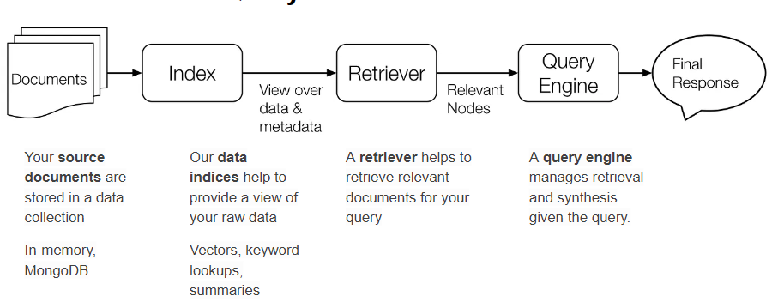
Step-by-step explanation of the indexing process
:Document retrieval:
LlamaIndex retrieves insurance documents from the designated data source, whether it's a local file system, cloud storage, or a document management system.
Information aggregation:
The system processes the retrieved documents, extracting relevant information such as policy terms, clauses, and metadata.
Query generation:
LlamaIndex generates responses to user queries based on the indexed data, utilizing the RAG methodology to ensure accuracy and relevance.

Slide 7
Challenges Faced
One of the primary challenges encountered was the scarcity of data, given the reliance on a single policy document.
Fine-tuning models for domain-specific language and terminology presented another challenge, requiring extensive efforts to ensure optimal performance.
Future Directions
Future enhancements could involve integrating additional policy documents to broaden coverage and improve accuracy.
Further fine-tuning of models with domain-specific data could enhance performance and relevance of generated responses.
Expansion of the system to support multi-document retrieval and generation would enable a more comprehensive and robust solution for users.

Slide 8
Thank You
PARUL MISHRA

