Slide 1
RnD
Parul mishra

Slide 2
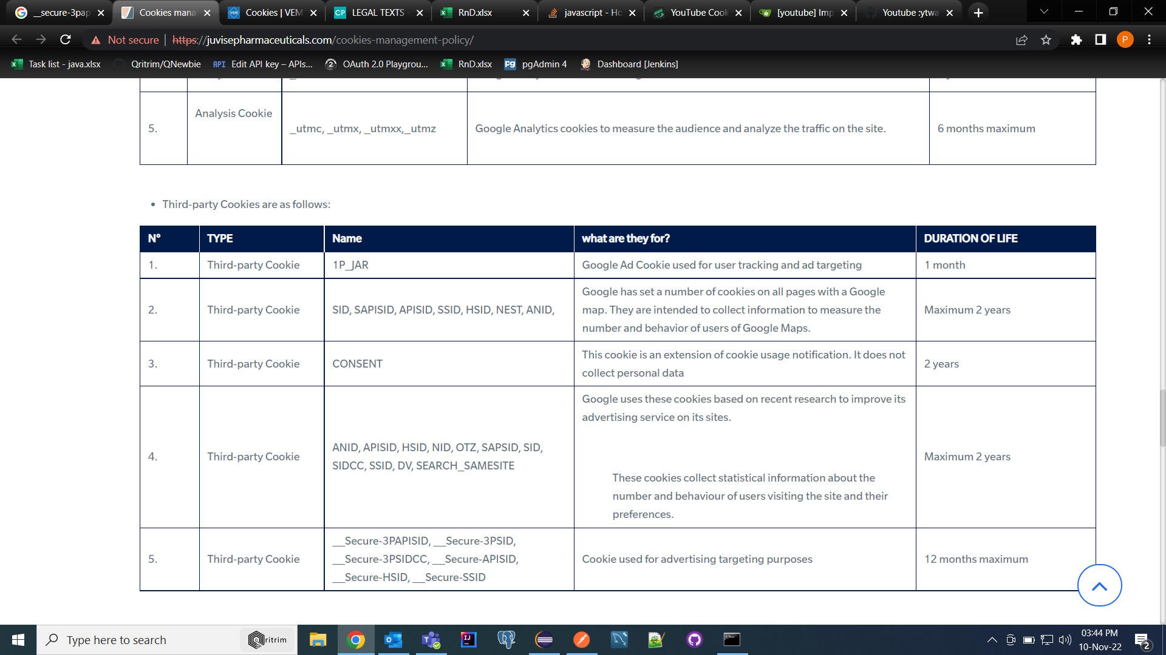
YouTube Impressions

Slide 3
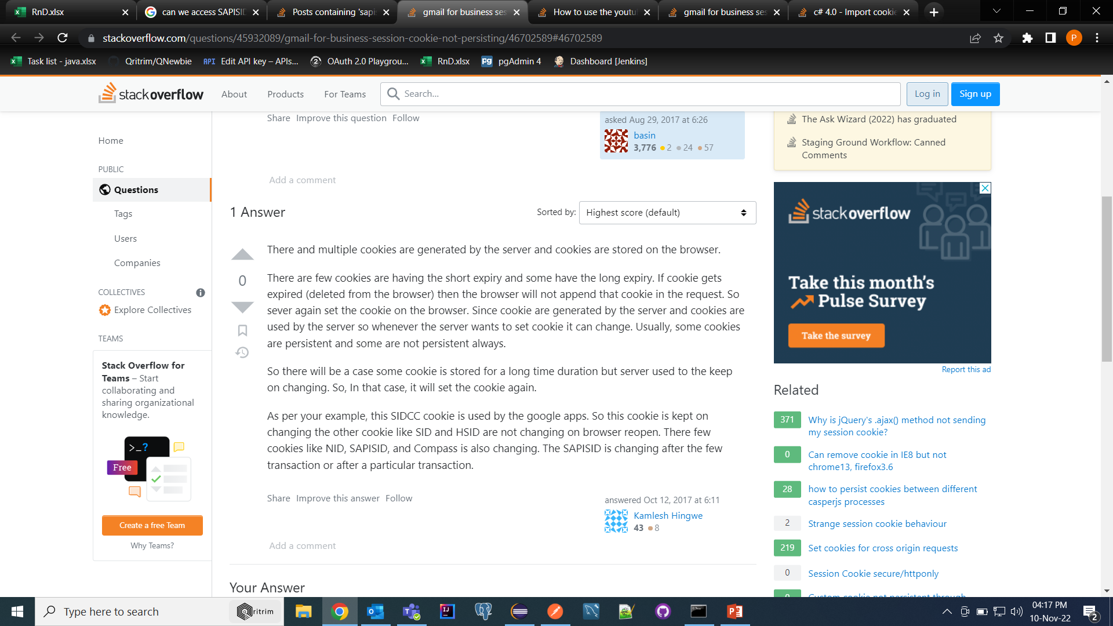

Slide 4
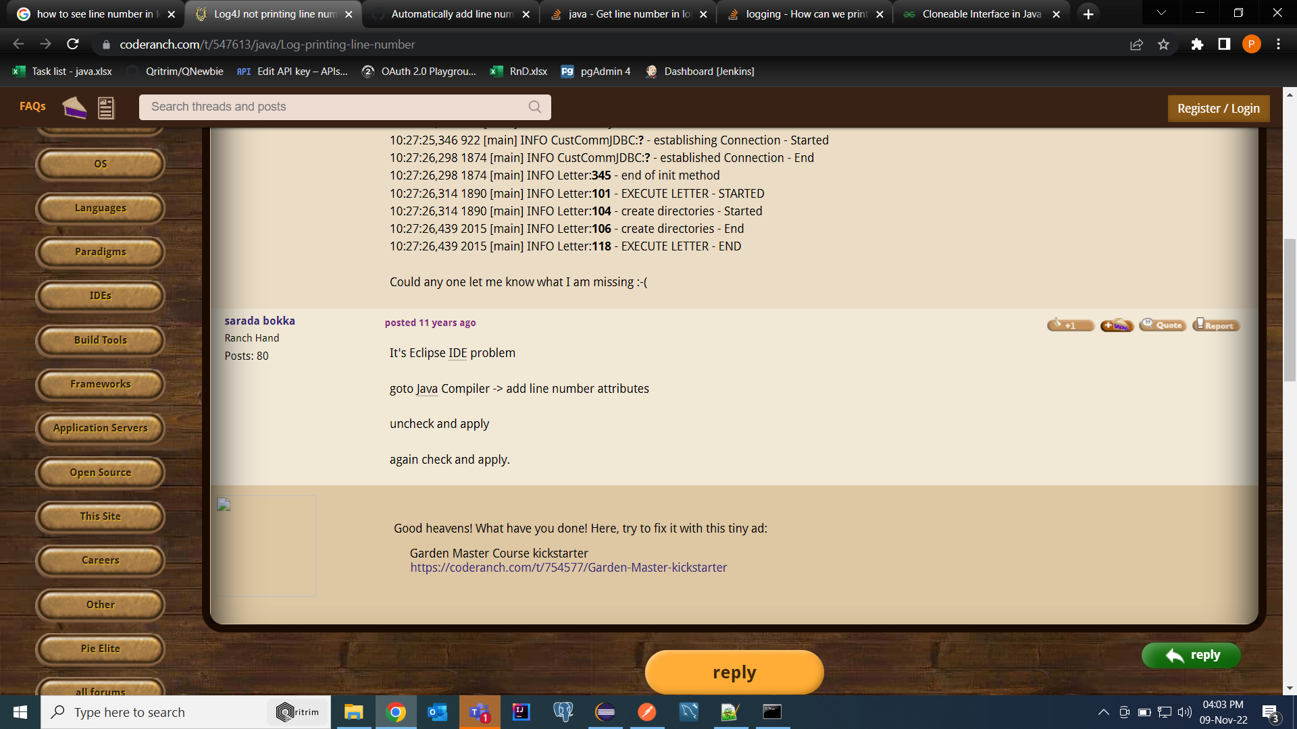
Eclipse Pageno

