Slide 1

ZENNITH NEXUS
Buying and Selling used BOOKS
.
PARTICIPANT:
PARUL PRASHAR

Slide 2
ZENNITH NEXUS
INTRODUCTION:
“Imagine a world where every textbook tells a story of multiple journeys, where students not only gain knowledge but also contribute to a sustainable future”. Welcome to Zennith Nexus, where we make education more accessible by connecting students who wish to sell their used textbooks with those seeking affordable learning materials.
VISION: “From Waste to Wisdom”
"We aim to turn unused materials into valuable resources by giving a second life to used books, ensuring they continue to educate and inspire. Our goal is to foster a continuous loop of learning and sustainability, where students thrive and ecological impact is minimized."
MISSION:
Our mission is to ignite a new era of learning by offering a seamless, eco-friendly solution for book exchange. We envision a world where students can access high-quality educational resources at a fraction of the cost, while contributing to a greener planet. Through innovation and community engagement, we are dedicated to making education more inclusive, affordable, and environmentally responsible.

Slide 3
THE PROBLEM
Financial Loss For Sellers
Underutilization Of Usable Books
Extremely High Prices For Buyers
Books are often disposed off as scrap, yielding minimal to no financial return to the sellers who had bought them at extremely high prices.
Many used books, which are still in good condition, go unused when discarded as a scrap or in landfills leading to a significant resource wastage.
Brand-New books cost huge amounts making it difficult to be afforded for huge population especially the economically weaker families.
Ecological Damage Of New Book Production
Undervalue of Story Books, Novels, etc
Unnecessary Book Recycling System
New books lead to large scale deforestation (approx. 2.5 pounds of paper for one book) and generates severe carbon emissions.
Story Books once read only occupy space and disposing them yields no return but selling or lending to someone can bring of high profits.
Recycling of disposed books into new books causes wastage of resources, time and money that could be avoided if books were reused directly.
Study suggests that high textbook prices increase illiteracy by 20% due to less resources.
During recycling, De-inking and cleaning of paper uses strong chemicals that produce greenhouse gases and often leads to a significant increase in carbon footprint.
High costs of books leads to increased debts on student loans as books cost approx. Rs. 15,000 each year.
I
M
P
A
C
T

Slide 4

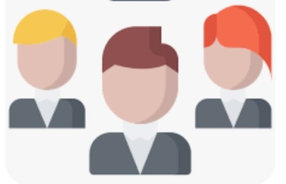
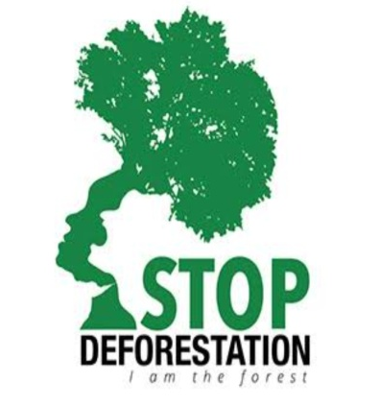
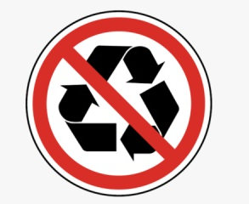
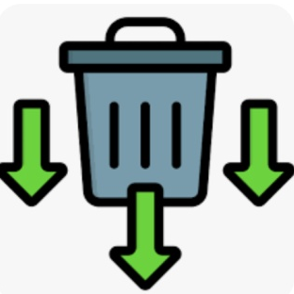
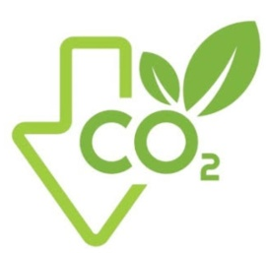

THE SOLUTION
How can we transform the educational landscape while promoting sustainability and reducing financial burdens on students?
Sellers can sell their used books between 40% and 70% of the original cost based on quality, yielding better monetary returns than selling as scrap.
CENTRALIZED PLATFORM FOR BUYING, SELLING AND RENTING BOOKS
Buyers can obtain good quality used books at a fraction of the original cost, making expensive educational materials accessible to all.
Our platform offers short-term rentals, allowing students to borrow books only for the duration they need, saving significant money.
By reducing the demand for new books, we help lessen the environmental strain of book manufacturing and recycling. Hence less deforestation and lower carbon emissions.

Slide 5
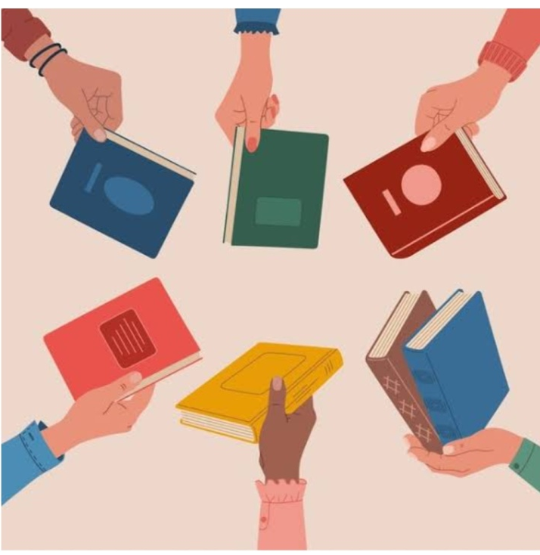

ELEVATOR PITCH
Zennith Nexus is a pioneering platform that revolutionizes the book exchange market. By enabling students to buy, sell, and rent quality-assured books affordably, we make education accessible and promote sustainability.
“FROM WASTE TO WISDOM”

Slide 6
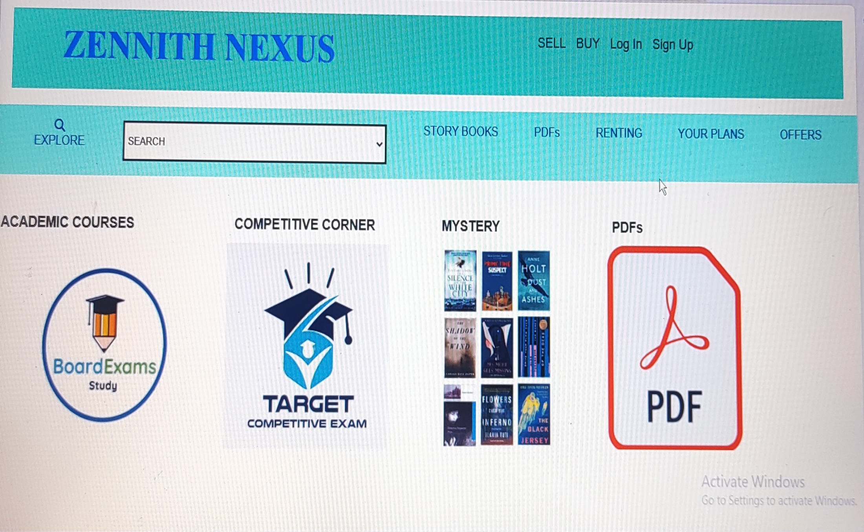
WEBSITE MODEL

Slide 7
SALES PITCH
WHY THEY SHOULD CHANGE?
Outdates and inefficient Systems
WHY CHANGE NOW?
High Costs and Unpredictable Pricing
Large-Scale Deforestation
Trust and Quality Concerns
High Carbon Emissions
Limited Support and Flexibility
Intensive Water Usage
High Energy Consumption
Chemical Pollution
WHY AT THIS PRICE?
Excess Waste Generation
Making Education Affordable
Fair Return for Sellers
Considering the poor buyers
Accessible resources
Contribution to Educational Equality
To compete with Market Alignment
Resource Depletion

Slide 8
WHY OUR PRODUCT?
WHY OUR PRODUCT?
Consistent Pricing: We offer a stable pricing structure with a minimum discount of 40% for buyers and up to 70% for sellers, minimizing cost fluctuations and user inconvenience.
Flexible Return Policy: If expectations aren't met, we provide a one-week return policy to guarantee satisfaction with your purchase.
Affordable Transaction Fees: Our platform charges minimal, transparent transaction fees, ensuring that buyers get the best value without inflated costs.
Collaborations with Major Libraries and Book Stores: We partner with large-scale libraries and book stores to ensure a steady supply of high-demand books, offering a diverse and reliable inventory.
24/7 Customer Support: Our dedicated support team is available around the clock to assist with any issues or inquiries ensuring a smooth user experience.
Rigorous Quality Checks: We double check the quality of all books first through AI platform and then Manually in our warehouses.
Enhanced Trust: Our close collaborations with schools and libraries enhance our credibility and reliability, fostering a trustworthy environment for students.
Low Shipping Costs: Enjoy minimal shipping fees with options for local pickup or affordable doorstep delivery, optimizing convenience and reducing costs.

Slide 9
MARKETING PLAN
Target Market Analysis
.
Unique Selling Proposition
.
Marketing Channels
.
Primary Audience: Students, Parents, Teachers.
Secondary : Libraries, Book Donors.
Market Needs: Affordable options, quality assurance.
Market Trends: High textbook costs, growing demand for eco-friendly solutions.
Best Pricing: 40% and 70% of the original cost.
Certified Quality: Guaranteed good quality books.
User-Friendly: Streamlined buying, selling, and renting.
Trusted Partnerships: Collaborations with schools and libraries.
Social Media: Instagram,
Facebook, Twitter, etc. for engagement and targeted ads.
SEO : Website for search engines and blog content.
Email Campaigns: Newsletters for updates and information.
Offline Marketing: college fairs, book drives.
Metrics and KPIs
.
Promotional Strategies
.
Budget Allocation
.
User Metrics: new sign-ups, engagement $churn rate
Sales Metrics: book transactions, revenue.
Customer Feedback: Reviews,
Surveys
Seasonal Promotions:
Contests and Giveaways:
Influencer Collaborations:
Launch Campaign:
Referral Programs:
Workshops and Seminars
Marketing and Advertising: 30%
Platform Development: 25%
Operations and Logistics: 20%
Staff and Salaries: 15%
Miscellaneous: 10%
.

Slide 10
FINANCIAL PLAN
YEARLY EXPENSES
CATEGORY | DETAILS | AMOUNT
Warehouse Rent |  | ₹ 3,60,000
Utilities | Electricity, water | ₹ 3,00,000
Employee Salaries | Warehouse Staff, Customer Support | ₹13,80,000
Management Software |  | ₹60,000
Packaging and Shipping Supplies |  | ₹2,40,000
Marketing and Promotions | SEO, Social Media, etc. | ₹4,20,000
Office Rent |  | ₹3,00,000
Office Supplies |  | ₹1,50,000
Internet and Communication |  | ₹60,000
Miscellaneous Expenses |  | ₹1,20,000
Total Yearly Expenses |  | ₹33,90,000

Slide 11
FINANCIAL PLAN
YEARLY REVENUE
CATEGORY | DETAILS | AMOUNT
Book Sales | 500(aprox. half rate price) × 5000(no. of books sold) | ₹ 25,00,000
Rentals | 700(books rented) × 200(cost per month) × 3months(renting period) | ₹ 4,20,000
Transactions | 6000(buyers) × 500(approx cost of each book) × 5%(transaction charges) | ₹ 1,50,000
Commission | 6000(sellers) ×500(approx cost of each book) × 5%(commission rate) | ₹ 1,50,000
Online PDFs | 70(cost per pdf) × 2000(pdfs sold) | ₹ 1,40,000
Counseling Sessions | 150(cost per session) × 400(no. of sessions) | ₹ 60,000
Subscription Plans | Basic Plan: 200(monthly cost) × 12(yearly) × 500(no. of subscribers) Premium Plan: 500(monthly cost) × 12(yearly) × 100(no. of subscribers) | ₹ 12,00,000
 |  | ₹ 6,00,000
Total Yearly Revenue |  | ₹ 52,20,000

Slide 12
SUMMARY TABLE:
CATEGORY | AMOUNT(INR)
Total Revenue | ₹ 52,20,000
Total Expenses | ₹33,90,000
Net Profit | ₹18,30,000
Profit Margin | 35.05%

Slide 13
CORE TEAM MEMBERS
PARUL PRASHAR
EMAILS:
parulprashar018@gmail.com

Slide 14
WRAP UP
THE BEST IDEA
IMPACT
FUTURE SUCCESS
Affordable Access
Environmental Sustainability
Advanced technology integration
Commitment to quality Holistic approach
Community Support
Cost Savings and Efficiency
Stimulates Economic Activity
Reduces Environmental Costs
Fosters Economic Inclusivity
Encourages Investment in Local Communities
Broad Adoption
High Student Engagement
Positive Reputation
Long-Term Growth
Enhanced Educational Outcomes
Market Leadership
“JOIN US IN REVOLUTIONIZING THE WAY WE THINK ABOUT TEXTBOOKS. TOGETHER, WE CAN MAKE EDUCATION MORE ACCESSIBLE, AFFORDABLE AND SUSTAINABLE. INVEST IN ZENNITH NEXUS AND BE A PART OF THE CHANGE”

