Slide 1

Business Ideas For The Holiday Season

Slide 2

BUSINESS IDEAS FOR HOLIDAY SEASON
The holiday season is a time everyone looks forward to as it offers time to relax, unwind and socialize. However, it is also a good time for starting small businesses to make substantial earnings while you have some time off from your regular jobs.

Slide 3
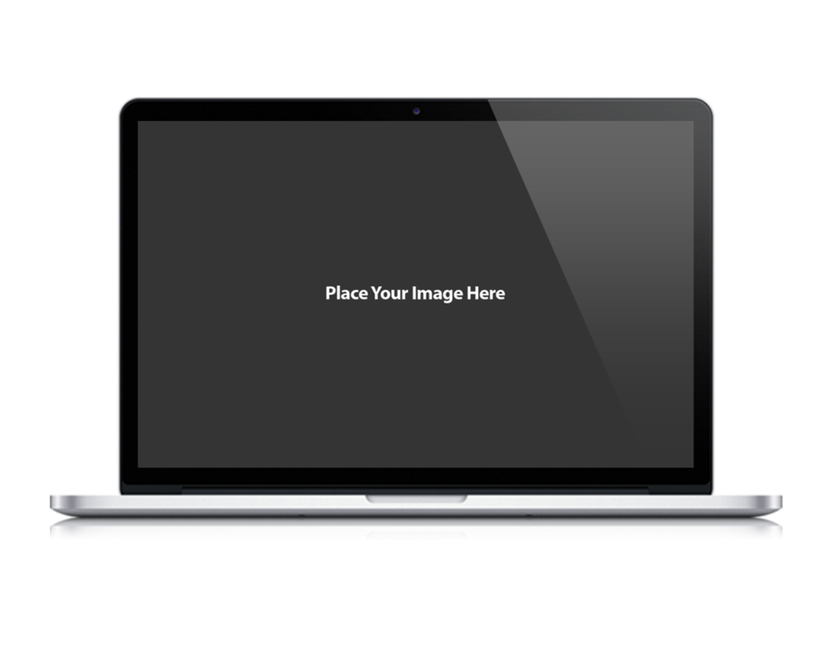

SIMPLE BUSINESS IDEAS FOR THE HOLIDAY SEASON

Slide 4
1
Set up an E-commerce store for creative gifts-
2
Baking Services-
  During Christmas time there is a huge demand for cakes and cookies. If baking is your forte, you can advertize your services and start supplying homemade cakes and cookies.
Christmas is the time when everyone is looking for unique gifts. You can connect with sellers of gifts and showcase them on your site. Buyers can buy them through your store.
3
Store for Christmas Decorations–
4
Offer Online decoration services-
You can connect with individuals who provide decoration services, set up a website and connect with clients requiring those services. You can arrange for the services to be provided as per the convenience of clients.
You can set up a store for Christmas decorations in your garage. It will attract customers because of its location. You can offer these items at a price lower than that in retail stores to make your store attractive.
5
Online Catering Services-
6
Rent out your space-
You can build a brochure of different caterers and advertise it on your website. People requiring these services will connect with you and avail these services.
If you are planning to go on a holiday, you can rent out your home as a vacation rental. It will be a good source of income.
Set up an Online garment store-
7
Online sales peak during the holiday season. It is a good idea to set up an E-commerce store for winter garments.

Slide 5
IN CONCLUSION
Although the holiday season is a time to relax and enjoy, but nothing like using simple ideas to start you business to earn without compromising on the fun and excitement.

Slide 6

CONTACT US
Corporate Head Office-India:
Branch Office-UK:
IT-C2, Dibon Building, 4th Floor,
Sector 67, Mohali, India. Pin:160062
Phone: +91 172 4666 711-712
Mobile: +91 9592016444
E-mail: info@webguruz.in
Website: www.webguruz.in
53, Birchend Close
South Croydon, CR2 7DS , United Kingdom
Phone: +44 333 011 6966
Cell Number: +44 758 8418 605
E-mail: info@webguruz.co.uk
Website: www.webguruz.co.uk
Australia :
USA :
1035/2, Mill Park Street , Rhodes , NSW 2138 , ABN: 63 970 061 767
535 Mission Street San Francisco
CA 94105

