Slide 1

Do We Really Need
Off-Page Optimization Anymore?

Slide 2

SEARCH ENGINE OPTIMIZATION
Search Engine Optimization comprises On-page and Off-page optimization techniques.
On-page techniques are measures taken within the website to improve its ranking on SERPs.
Off-page techniques are steps taken in the background such as acquiring backlinks, etc. to enhance the rankings.

Slide 3
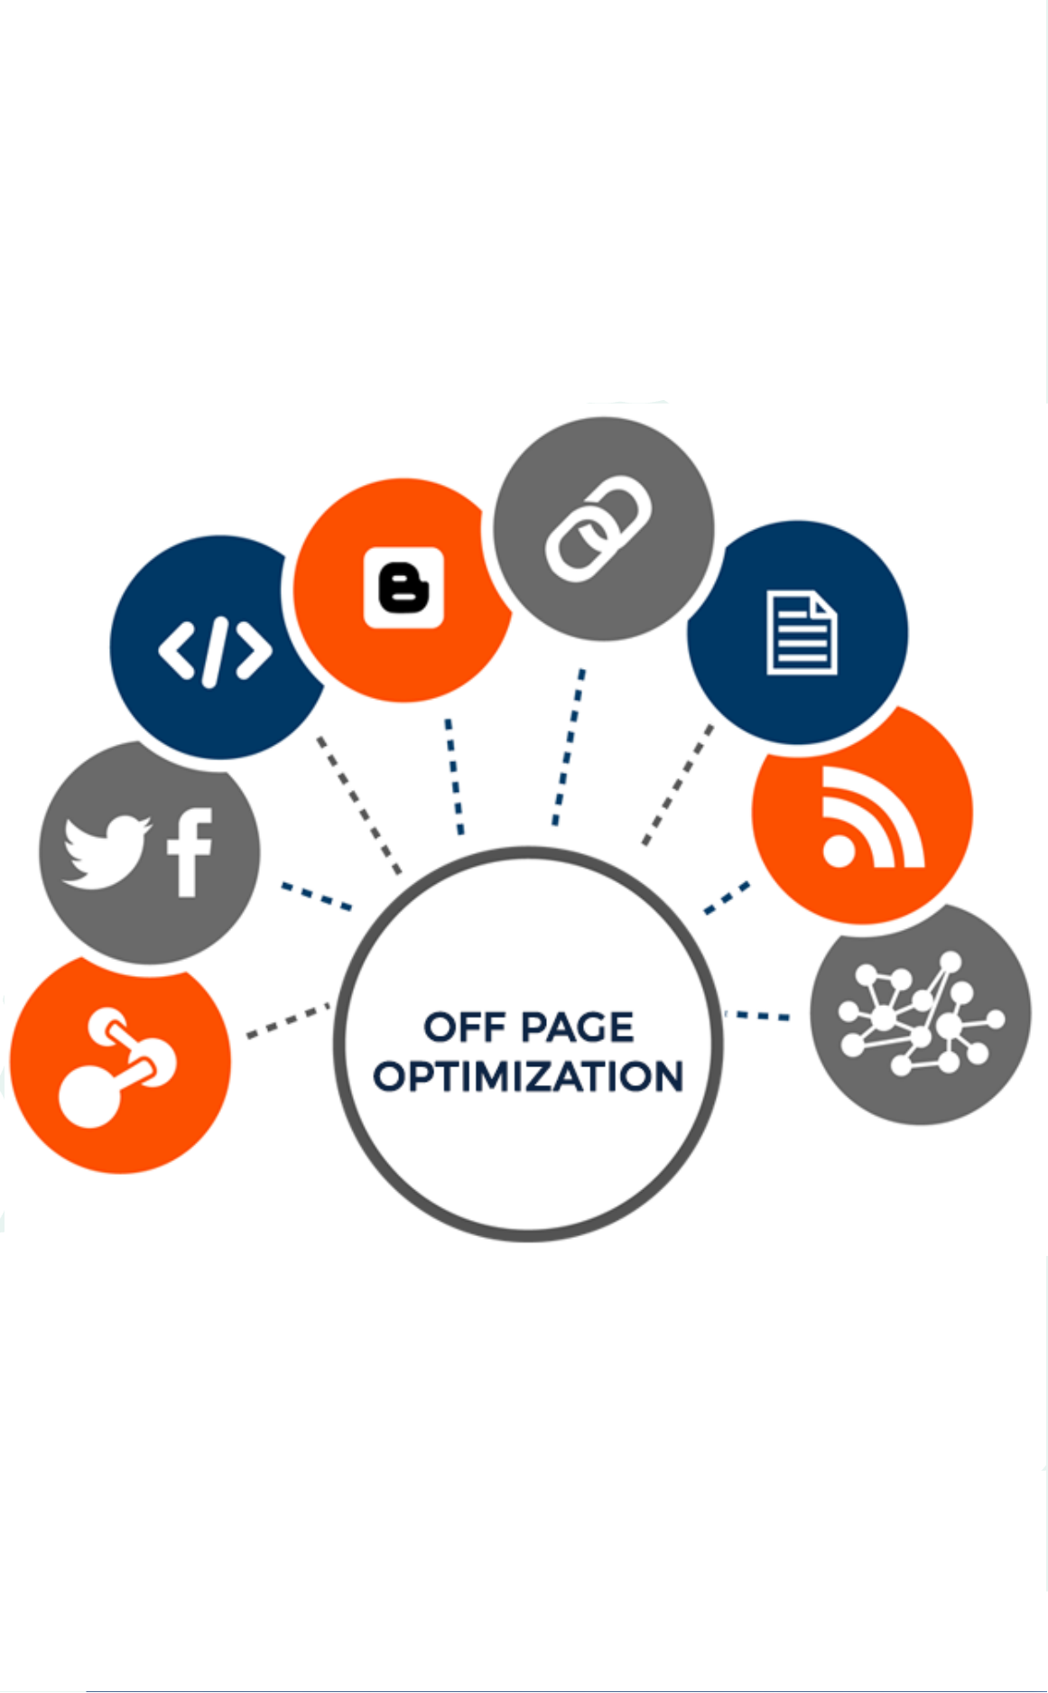
What is Off-Page Optimizaton
Ranking on Google depends on:
Linking to authority websites
Linking to websites with high page rank
Linking to niche based websites
Linking to websites having low outbound links
The objective of off-page optimization is attracting prospects and search engine crawl bots. This leads to a positive brand image, enhanced ranking increasing traffic to your site and more conversions.

Slide 4
SIGNIFICANCE OF OFF-PAGE SEO
1. INCREASED RANKINGS
2. INCREASED PAGE RANK
3. ENHANCED EXPOSURE

Slide 5
COMPONENTS OF OFF-PAGE SEO
1
SOCIAL MEDIA METRICS
2
COMMENTS BY USERS
2
COMMENTS BY USERS
4
FORUM POSTING

Slide 6

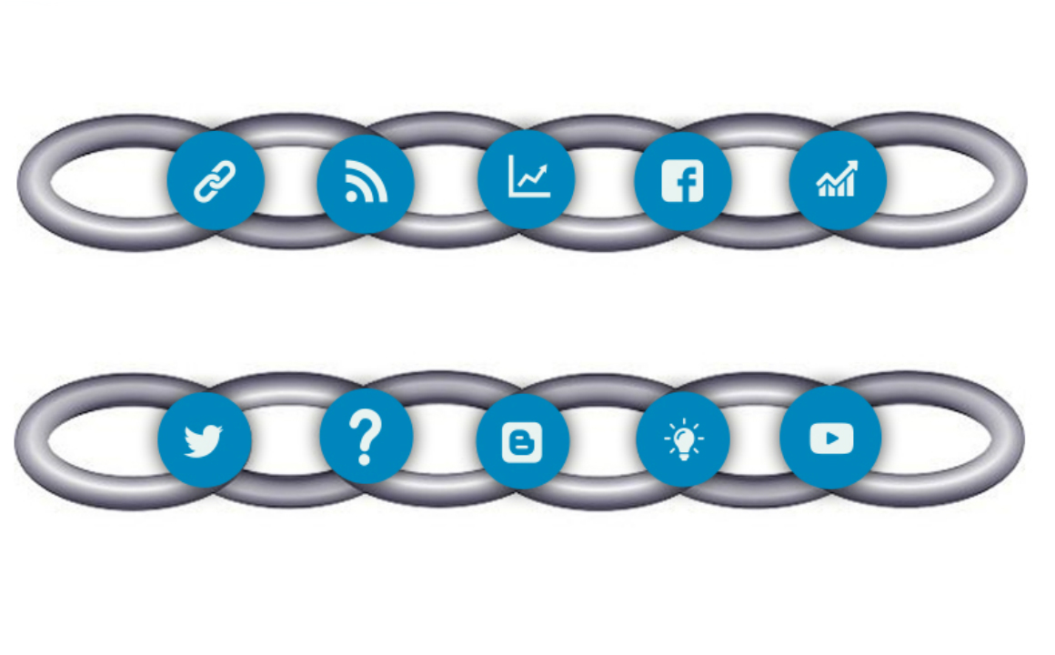
HOW TO GET
QUALITY BACKLINKS?

Slide 7
1
GUEST BLOGGING
4
LEVERAGE SOCIAL MEDIA
Research the top blogs in your niche. Create quality content relevant to these blogs. If your article gets published , you get quality backlinks.
  One of the most effective means for off-page SEO is enhancing your social shares.
2
BUILDING BROKEN LINKS
5
ANSWER QUESTIONS ON QUORA
Links on authority blogs become broken while transferring files or migration of sites. Carrying out a backlink analysis and contacting owners of sites with broken links creates a possibility that the owners may include your link on their website.
Providing in-depth answers to queries on your niche helps in off page optimization. If the answers are accepted by your audience in the form of upvotes, your answers are displayed by Google for related queries.
6
YOU TUBE VIDEOS
3
INFOGRAPHICS
Creating attractive infographics and promoting them helps attract audience and acquire authoritative backlinks.
You Tube has become the most popular search engine after Google. You Tube viewership is growing exponentially. Links on meta descriptions of your You Tube videos have the power to boost your off page SEO.

Slide 8
7
BLOG LINK ROUND UPS
9
SUBMIT TO DIRECTORIES AND FORUMS
Connect with other bloggers in your niche. Attract attention towards your content by establishing these links.
Posting content on certain directories and forums enhances its visibility drastically.
8
SECURE YOUR SITE FROM GOOGLE PENALTIES
In order to penalize that use “Black Hat” SEO techniques, Google has introduced an algorithm Google Penguin. It is vital to save your website from such penalties as recovering from them is very difficult.

Slide 9
CONCLUSION
On page and Off page Optimization techniques are essential for boosting the search engine ranking of a page. As online businesses are on the rise, it is apparent that off page SEO will be required for leveraging websites. Professional search engine optimization services are offered by companies to enable businesses surge in SERPs.

Slide 10

CONTACT US
Corporate Head Office-India:
Branch Office-UK:
IT-C2, Dibon Building, 4th Floor,
Sector 67, Mohali, India. Pin:160062
Phone: +91 172 4666 711-712
Mobile: +91 9592016444
E-mail: info@webguruz.in
Website: www.webguruz.in
53, Birchend Close
South Croydon, CR2 7DS , United Kingdom
Phone: +44 333 011 6966
Cell Number: +44 758 8418 605
E-mail: info@webguruz.co.uk
Website: www.webguruz.co.uk
Australia :
USA :
1035/2, Mill Park Street , Rhodes , NSW 2138 , ABN: 63 970 061 767
535 Mission Street San Francisco
CA 94105

