Slide 1

Hubspot Marketing:
The Future of Inbound Marketing Tools?

Slide 2

MARKETING TECHNIQUES
Marketing techniques have seen drastic changes over the years. Marketing techniques used earlier were ‘outbound’ where the message about the business was spread outside to attract customers. It was done through seminar series, cold calling, email marketing through purchased lists, etc. But now the techniques that are used are ‘inbound’ where the customer finds the business instead of business reaching out to the customer.

Slide 3
Post relevant content to attract visitors.
Present content in the form of blogs.
Share content on social media for increasing visibility.
Attract
Process of Inbound Marketing
Convert
Connect with your visitors through messages , forms, or meetings and convert them into leads.
Close
Close your leads into customers by nurturing them through emails, predictive lead scoring, etc.
Delight
Engage your customers so that they are loyal to you and they advertise your product/services to their friends.

Slide 4

HUBSPOT MARKETING
Hubspot Marketing is a popular tool for inbound marketing. It enables the growth of traffic to your site and increases conversions through creation and optimization of attractive content. In addition, you can design workflows, prepare and format content for publishing.

Slide 5
1
BLOGGING
7
WEBSITE SEO
COMPONENTS OF HUBSPOT MARKETING
2
LANDING PAGES
8
SOCIAL MEDIA MONITORING
3
E-MAIL
9
CALL-TO-ACTION
4
MARKETING AUTOMATION
10
ADS
11
SALES FORCE INTEGRATION
5
LEAD MANAGEMENT
6
ANALYTICS

Slide 6
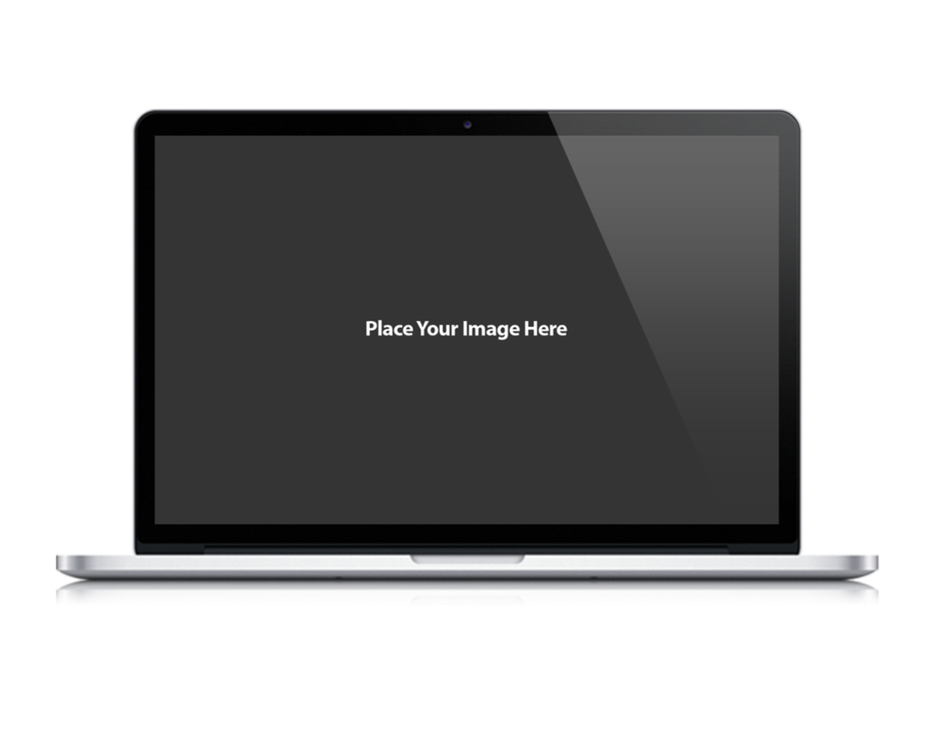
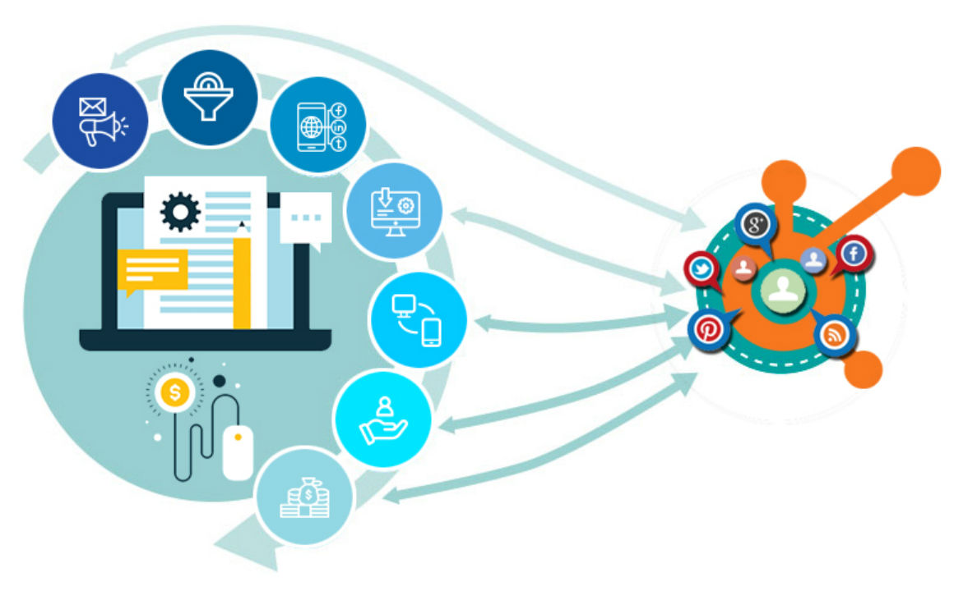
HOW MARKETING EFFORTS CAN BE ENHANCED USING HUBSPOT

Slide 7
1
PERSONALIZED MARKETING
3
SOCIAL MEDIA MARKETING
Email marketing can be improved using Hubspot. It enables users to design workflows, prepare, format, and publish content. You can also segment, nurture, and evaluate leads in a personalized manner.
Hubspot enables focusing on qualified leads that are likely to close the deal.
2
COMPACT AND READY TO USE MARKETING FUNNEL
4
OPTIMIZED CONTENT FOR SMARTER TARGETTING
  You can create attractive landing pages using drag and drop.
  You can distribute the best content and manage how your leads interact from a single dashboard.
  You can customize and configure Sales and CRM modules.
It has a ready to use marketing funnel through which you can access your traffic data and analyze the impact of your marketing strategy on your sales and overall performance.

Slide 8
5
A FULLY ANALYZABLE IMPACT
9
COST-EFFECTIVE
You can analyze the impact of your campaigns on your sales since all the relevant information is available through Hubspot CRM or Salesforce.
Hubspot offers numerous benefits at reasonable prices.
6
WELL CONNECTED
8
SUPPORT
Hubspot is integrated with marketing assets such as:
Leading CMSs
Email service providers and communication tools,
Productive E-commerce platforms and marketplaces
Social Networks
Hubspot has a team of experienced professionals who offer reliable and timely support to users. You also have the provision to look for solutions through the platform’s vast resource and study library.
7
MOBILE READY
Hubspot enables complete access on mobile devices providing users control of their campaigns even when not in office.

Slide 9
What Inbound Marketing Strategies have to prepare for?
Optimization will be required not only for search engines alone but also for Human Enjoyment
THE FUTURE OF INBOUND MARKETING
Making designs responsive on Mobiles will not be all that necessary.
The future of inbound marketing is dependent on the changes in technology. With AI and machine learning playing a major role, inbound marketing techniques will have to become more targeted and personalized.
Chatbots will become essential to assist sales and marketing professionals in everyday tasks.

Slide 10
PRODUCTS AND UPDATES BY HUBSPOT FOR THE FUTURE
1. VISUAL WORKFLOWS
2. ENHANCED REPORTING
3. UNIFIED HUBSPOT MOBILE-APP
4. CONTENT STRATEGY
5. AMP
6. FACEBOOK ADS
7. PROJECTS
8. DEEPER FUNCTIONALITY IN CRM

Slide 11
CONCLUSION
Developments in technology will impact inbound marketing. Inbound marketing strategies will need to adapt to these changes so that the marketing efforts are fruitful. Hubspot has planned various updates and products which will enable marketing utilizing the new technologies effectively. So we can safely conclude that Hubspot is the future of inbound marketing.

Slide 12

CONTACT US
Corporate Head Office-India:
Branch Office-UK:
IT-C2, Dibon Building, 4th Floor,
Sector 67, Mohali, India. Pin:160062
Phone: +91 172 4666 711-712
Mobile: +91 9592016444
E-mail: info@webguruz.in
Website: www.webguruz.in
53, Birchend Close
South Croydon, CR2 7DS , United Kingdom
Phone: +44 333 011 6966
Cell Number: +44 758 8418 605
E-mail: info@webguruz.co.uk
Website: www.webguruz.co.uk
Australia :
USA :
1035/2, Mill Park Street , Rhodes , NSW 2138 , ABN: 63 970 061 767
535 Mission Street San Francisco
CA 94105

