Slide 1

Is It Necessary to Migrate from
Magento to Magento 2

Slide 2

MAGENTO
Magento is a popular open source platform which was released in 2008 with excellent features. It offered store owners a means to create stores with pre made extensions. Besides store owners could create stores that they could control, customize and even host if required.
MAGENTO2
Magento2 is the latest version of Magento that was released in 2015. This platform was able to overcome most of the shortcomings of Magento. Magento lacked speed, performance optimization, mobile responsiveness, and admin capabilities. Magento2 enhanced the scalability and performance of all B2B and B2C businesses.

Slide 3
1
Faster speed of site
4
User-friendly Admin Interface
Features of Magento2
2
Check out is User friendly
5
Mobile Friendly
3
Vital Integrations
6
Latest Technologies

Slide 4
Presently, migration tools are at the development stage, therefore migration is not simple. While porting of data is possible , themes need to be created from scratch.
Extensions from Magento cannot be ported to Magento2. You will need to repurchase extensions and hire resources for integration. This will increase your expenses.
Enterprise edition of Magento 2 is expensive.
You will also need to incur expenses towards its license.
Shortcomings of Magento2

Slide 5
PROBLEMS FACED WHILE MIGRATING FROM MAGENTO TO MAGENTO2
1. Difficult Process
2. Migration of Extensions and Themes
3. Performance Issues

Slide 6
In case you have a small store and your site is performing well, you are receiving orders and you are not using an outdated version of Magento1, you can wait for some time before migrating. But if you are using an outdated version or a new version with performance issues, you need to consider revamping it.
If you are not facing any major performance issues with your site, you need not rush through migration. The reason being that since Magento2 is in its development stage, there is a likelihood of it offering more options and themes to its users.
Is it Really Necessary to Migrate?

Slide 7
Reasons to Migrate to Magento2
Magento2 will replace Magento
In the field of technology, things change at breakneck speed. It is quite likely that Magento will soon become obsolete.
Simplified Upgrade
The current trends indicate that by the end of 2018, it will become necessary to migrate.
Since Magento2 has a better architecture than Magento, upgrading to its higher versions is simple.
Easy to Build Themes and Extensions
Building a theme or extension is simplified as there is only one folder and a relevant code.
Caching is possible
Full page caching is possible in Magento2 making accessing of sites easy on subsequent requests.

Slide 8
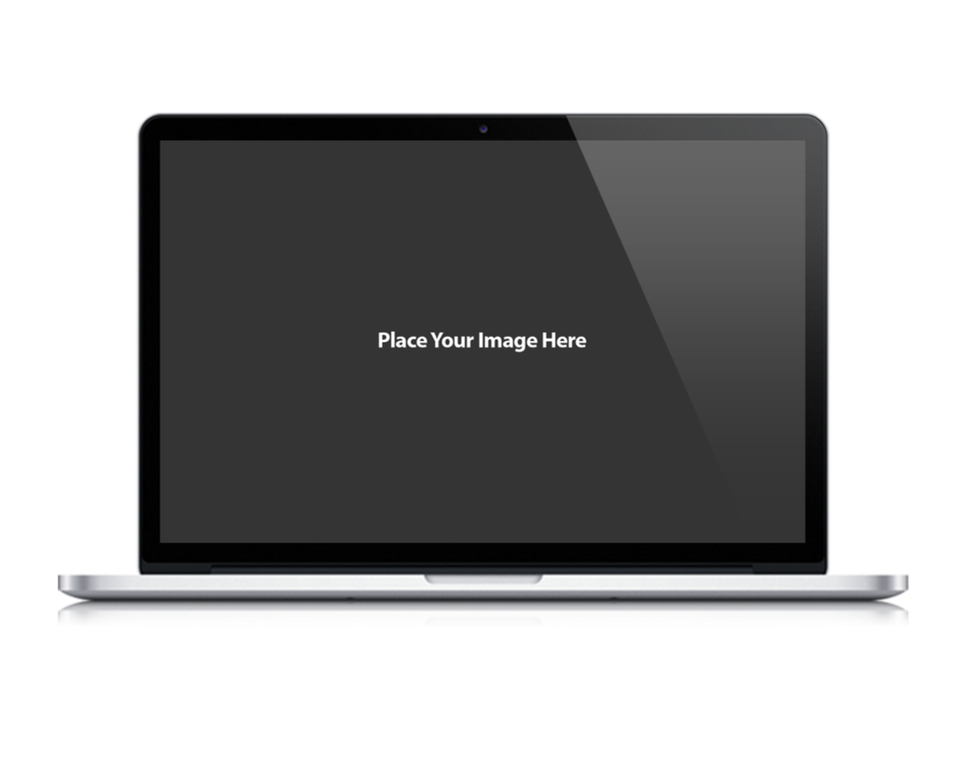
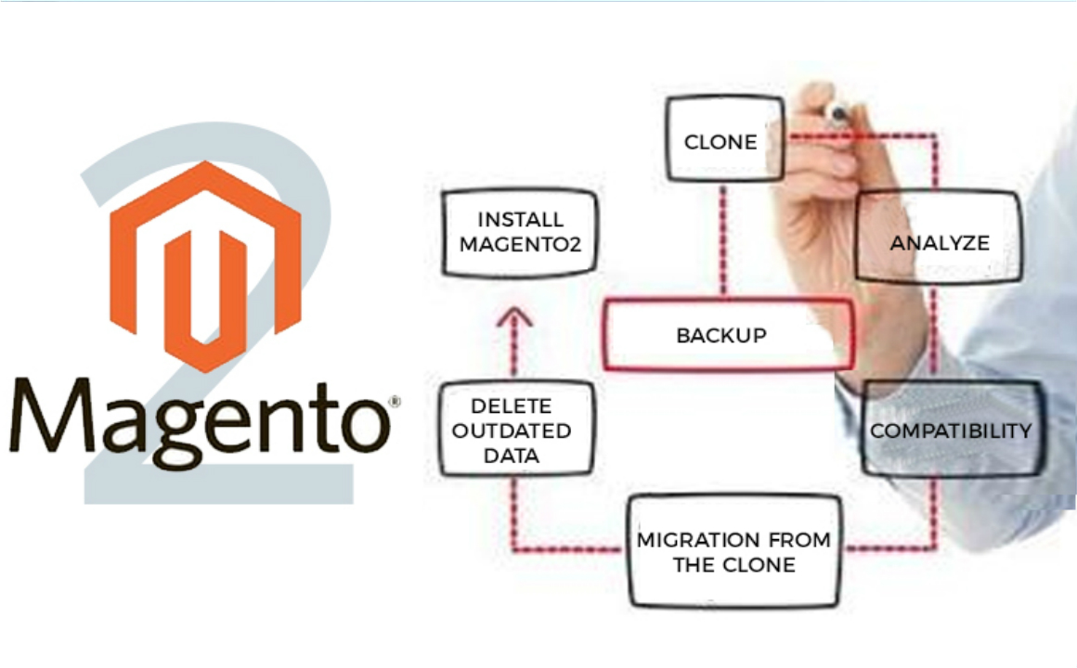
STEPS TO BE FOLLOWED BEFORE YOU START THE MIGRATION PROCESS

Slide 9
1
Backup Your Magento store by including all files, folders, and database.
2
Create a Clone of your Magento store.
3
Analyze your store and delete all redundant data
4
Verify the compatibility of your custom themes, extensions, and custom codes with Magento2
5
Carry out the migration from the clone of Magento
6
Delete all the outdated data from the database
7
To make the process easy, Magento2 should be installed on the same hosting server as Magento

Slide 10
Enhanced shopping experience is offered to customers in Magento2 through various themes. Since Magento themes are incompatible, new themes are created.
Theme Migration
COMPONENTS OF MIGRATION
Magento extensions available in Magento Marketplace are used for providing better features and extended functionalities.
Extension Migration
Custom Codes
Migration of some custom codes are possible using “ Code Migration Toolkit.”
Data Migration
Migration of all the essential data such as products, categories, orders, store configurations is possible using Magento Data Migration tool.

Slide 11
CONCLUSION
In case you are confused about whether you should migrate from Magento to Magento2, it is recommended that you seek the advice of a professional E-commerce development company. They are aware of the pros and cons and how suitable the migration is for your site. Besides, they can also help you in the migration process.

Slide 12

CONTACT US
Corporate Head Office-India:
Branch Office-UK:
IT-C2, Dibon Building, 4th Floor,
Sector 67, Mohali, India. Pin:160062
Phone: +91 172 4666 711-712
Mobile: +91 9592016444
E-mail: info@webguruz.in
Website: www.webguruz.in
53, Birchend Close
South Croydon, CR2 7DS , United Kingdom
Phone: +44 333 011 6966
Cell Number: +44 758 8418 605
E-mail: info@webguruz.co.uk
Website: www.webguruz.co.uk
Australia :
USA :
1035/2, Mill Park Street , Rhodes , NSW 2138 , ABN: 63 970 061 767
535 Mission Street San Francisco
CA 94105

