Slide 1




TECHNIQUES FOR BEING BLOG SAVVY ON WORDPRESS

Slide 2




TOPICS
1. INTRODUCTION
2. WHY WORDPRESS
3. BEST TECHNIQUES FOR BLOGGERS
4. CONCLUSION

Slide 3

INTRODUCTION
WordPress is a Content Management System which is used by people worldwide for building websites.

Slide 4


SEO FRIENDLY
Why WordPress

Slide 5



Why WordPress
+
=
BLOGGING
E-COMMERCE
MONEY

Slide 6
Why WordPress
EASY TO USE

Slide 7

Why WordPress
A TOOL FOR THE NOVICE

Slide 8

Why WordPress
SUPPORTED WORLDWIDE

Slide 9
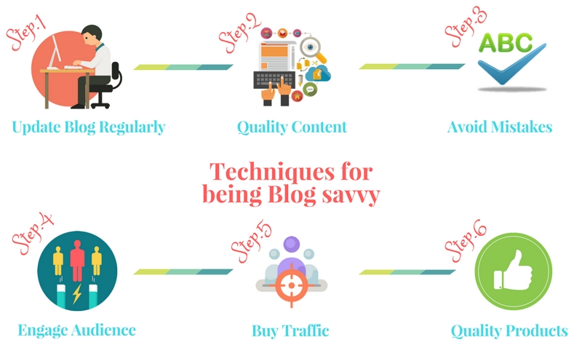

Slide 10
CONCLUSION
TIPS TO BECOME A SUCCESSFUL BLOGGER:
Give quality content
Engage your audience
Provide trustworthy information
Build a good long term relationship with your audience.

Slide 11

CONTACT US
Corporate Head Office-India:
IT-C2, Dibon Building, 4th Floor,
Sector 67, Mohali, India. Pin:160062
Phone: +91 172 4666 711-712
Mobile: +91 9592016444
E-mail: info@webguruz.in
Website: www.webguruz.in
Australia :
1035/2, Mill Park Street , Rhodes , NSW 2138 ,
ABN: 63 970 061 767
Branch Office-UK:
53, Birchend Close
South Croydon, CR2 7DS , United Kingdom
Phone: +44 333 011 6966
Cell Number: +44 758 8418 605
E-mail: info@webguruz.co.uk
Website: www.webguruz.co.uk
USA :
535 Mission Street San Francisco
CA 94105

Slide 12
THANK YOU !

