Slide 1




Factors to be borne in mind while selecting an SEO Tool

Slide 2


Budget and Requirements
To run SEO operations smoothly:
1. Analyze which tools your Business needs
2. Outline the expected cost for purchasing those tools

Slide 3

Streamlined Features
SEO Tools must be able to perform various tasks like
SEO and Analyzing it’s results all in one place

Slide 4
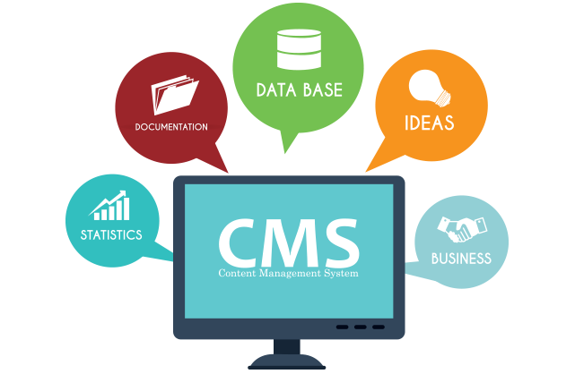
Platform and tools compatibility
SEO Tools must work well with the CMS platform

Slide 5

Interface must be User-Friendly
SEO Tools Must be Easy to Use

Slide 6

Data Accuracy
Tools must use
Data gathered from
Reliable Data sources

Slide 7

Updated tools
Tool you choose
must incorporate newest
Technological advancements

Slide 8
Reporting and Documentation
Tool must
comprehend the
Data and Analytics clearly

Slide 9

Online Marketing Metrics
SEO tool must be
able to measure
Online Marketing Metrics

Slide 10

Technical Support
SEO tool providers must also assist with any Query post-purchase

Slide 11

Conclusion
In a nutshell, the ultimate goal of a company is to make money. Purchasing lots of SEO tools won't help it getting profitable business, but wisely estimating which tools best suits the business goals will.

Slide 12

CONTACT US
Corporate Head Office-India:
IT-C2, Dibon Building, 4th Floor,
Sector 67, Mohali, India. Pin:160062
Phone: +91 172 4666 711-712
Mobile: +91 9592016444
E-mail: info@webguruz.in
Website: www.webguruz.in
Australia :
1035/2, Mill Park Street , Rhodes , NSW 2138 ,
ABN: 63 970 061 767
Branch Office-UK:
53, Birchend Close
South Croydon, CR2 7DS , United Kingdom
Phone: +44 333 011 6966
Cell Number: +44 758 8418 605
E-mail: info@webguruz.co.uk
Website: www.webguruz.co.uk
USA :
535 Mission Street San Francisco
CA 94105

Slide 13

THANK YOU !

