Slide 1
A Universal Turing Machine

Slide 2
A limitation of Turing Machines:
Turing Machines are “hardwired”
they execute
only one program
Real Computers are re-programmable

Slide 3
Solution:
Universal Turing Machine
Attributes:
Reprogrammable machine
Simulates any other Turing Machine

Slide 4

Universal Turing Machine
simulates any other Turing Machine
Input of Universal Turing Machine:
Description of transitions of
Initial tape contents of

Slide 5
Tape 1
Three tapes
Description of
Universal
Turing
Machine
Tape 2
Tape Contents of
Tape 3
State of

Slide 6
Tape 1
Description of
We describe Turing machine
as a string of symbols:
We encode as a string of symbols

Slide 7








Alphabet Encoding
Symbols:
Encoding:

Slide 8






State Encoding
States:
Encoding:
Head Move Encoding
Move:
Encoding:

Slide 9
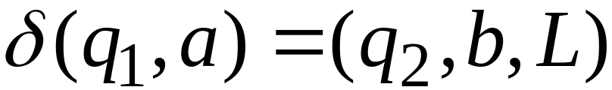
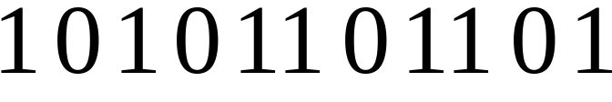
Transition Encoding
Transition:
Encoding:
separator

Slide 10
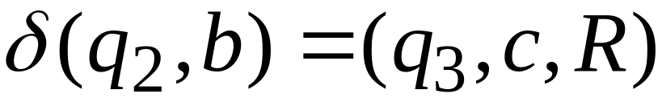

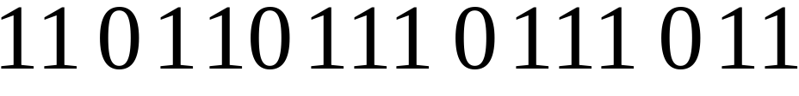
Machine Encoding
Transitions:
Encoding:
separator

Slide 11
Tape 1 contents of Universal Turing Machine:
encoding of the simulated machine
as a binary string of 0’s and 1’s

Slide 12
A Turing Machine is described
with a binary string of 0’s and 1’s
Therefore:
The set of Turing machines forms a language:
each string of the language is
the binary encoding of a Turing Machine

Slide 13
Language of Turing Machines
L = { 010100101,
00100100101111,
111010011110010101,
…… }
(Turing Machine 1)
(Turing Machine 2)
……

Slide 14
Countable Sets

Slide 15
Infinite sets are either:
Countable
or
Uncountable

Slide 16
Countable set:
Any finite set
or
Any Countably infinite set:
There is a one to one correspondence
between
elements of the set
and
Natural numbers

Slide 17
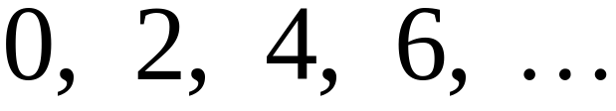
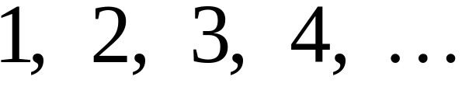


Example:
The set of even integers
is countable
Even integers:
Correspondence:
Positive integers:
corresponds to

Slide 18
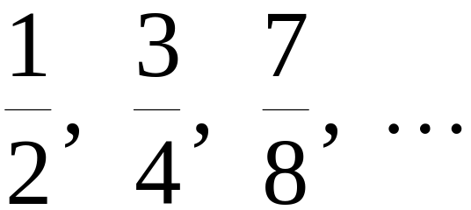
Example:
The set of rational numbers
is countable
Rational numbers:

Slide 19
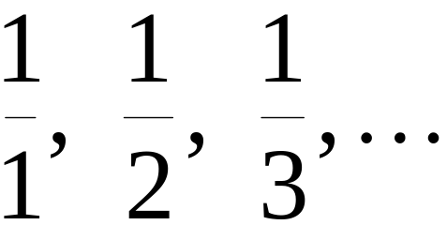
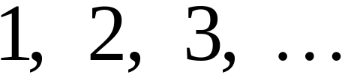
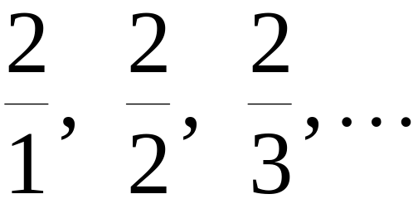
Naïve Proof
Rational numbers:
Correspondence:
Positive integers:
Doesn’t work:
we will never count
numbers with nominator 2:

Slide 20










Better Approach

Slide 26
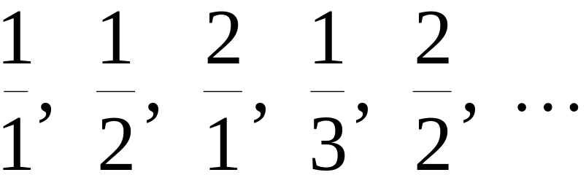
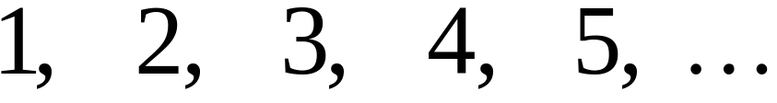
Rational Numbers:
Correspondence:
Positive Integers:

Slide 27
We proved:
the set of rational numbers is countable
by describing an enumeration procedure

Slide 28

Definition
Let be a set of strings
An enumeration procedure for is a
Turing Machine that generates
all strings of one by one
and
Each string is generated in finite time

Slide 29
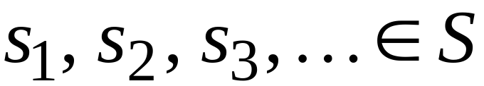
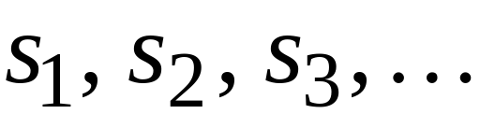

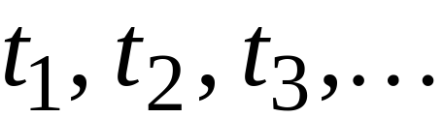
strings
Enumeration
Machine for
output
(on tape)
Finite time:

Slide 30







Enumeration Machine
Configuration
Time 0
Time

Slide 31






Time
Time

Slide 32
Observation:
If for a set there is an
enumeration procedure,
then the set is countable

Slide 33
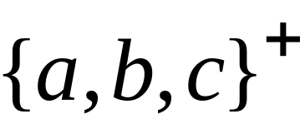
Example:
The set of all strings
is countable
Proof:
We will describe an enumeration procedure

Slide 34



Naive procedure:
Produce the strings in lexicographic order:
Doesn’t work:
strings starting with
will never be produced

Slide 35
Better procedure:
Proper Order
1. Produce all strings of length 1
2. Produce all strings of length 2
3. Produce all strings of length 3
4. Produce all strings of length 4
..........

Slide 36















length 1
Produce strings in
Proper Order:
length 2
length 3

Slide 37
Theorem:
The set of all Turing Machines
is countable
Proof:
Any Turing Machine can be encoded
with a binary string of 0’s and 1’s
Find an enumeration procedure
for the set of Turing Machine strings

Slide 38
Enumeration Procedure:
Repeat
1. Generate the next binary string
of 0’s and 1’s in proper order
2. Check if the string describes a
Turing Machine
if YES: print string on output tape
if NO: ignore string

Slide 39
Uncountable Sets

Slide 40
Definition:
A set is uncountable
if it is not countable

Slide 41
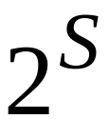
Theorem:
Let be an infinite countable set
The powerset of is uncountable

Slide 42
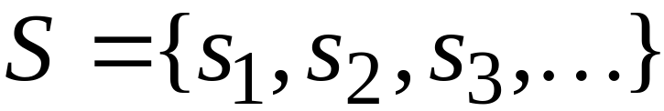
Proof:
Since is countable, we can write
Elements of

Slide 43
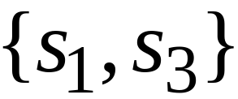
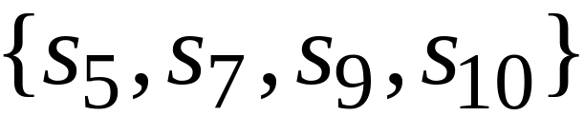
Elements of the powerset have the form:
……

Slide 44




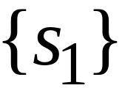

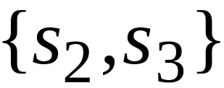
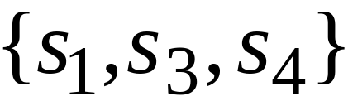
We encode each element of the power set
with a binary string of 0’s and 1’s
Encoding
Powerset
element

Slide 45
Let’s assume (for contradiction)
that the powerset is countable.
Then: we can enumerate
the elements of the powerset

Slide 46




Powerset
element
Encoding

Slide 47
Take the powerset element
whose bits are the complements
in the diagonal

Slide 48

New element:
(birary complement of diagonal)

Slide 49

The new element must be some
of the powerset
However, that’s impossible:
from definition of
the i-th bit of must be
the complement of itself
Contradiction!!!

Slide 50
Since we have a contradiction:
The powerset of is uncountable

Slide 51
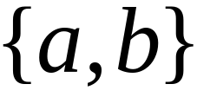
An Application: Languages
Example Alphabet :
The set of all Strings:
infinite and countable

Slide 52
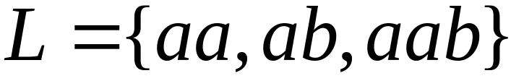
Example Alphabet :
The set of all Strings:
infinite and countable
A language is a subset of :

Slide 53




Example Alphabet :
The set of all Strings:
infinite and countable
The powerset of contains all languages:
uncountable

Slide 54



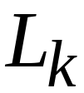
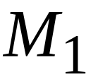
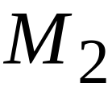
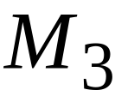

Languages: uncountable
Turing machines: countable
There are more languages
than Turing Machines

Slide 55
Conclusion:
There are some languages not accepted
by Turing Machines
(These languages cannot be described
by algorithms)

Slide 56
Languages not accepted by Turing Machines
Languages
Accepted by
Turing Machines

