Slide 1
BIO-DIVERSITY

Slide 2

Presented By:-
Nimish Gupta(16ucs119)
Ninaad Sharma(16ucs120)
Parag Singhal(16ucs121)
Paras Garg(16ucs122)

Slide 3
1. Definition:-
The variety of plant and animal life in the world or in a particular habitat, a high level of which is usually considered to be important and desirable. It is the sum of all the different species of animals, plants, fungi and microbial organisms living on Earth

Slide 4
Classifications
Genetic
Species
Ecosystem

Slide 5
Genetic diversity is the total number of genetic characteristics in the genetic makeup of a species. Genetic diversity serves as a way for populations to adapt to changing environments.

Slide 6
Species diversity is the variety of species within a habitat or a region. Species are the basic units of biological classification and thus the normal measure of biological diversity.

Slide 7

Ecological diversity is the intricate network of different species present in local ecosystems and the dynamic interplay between them. An ecosystem consists of organisms from many different species living together in a region and their connections through the flow of energy, nutrients and matter.

Slide 8
Measurement of Biodiversity:- Biodiversity is basically the variety within and among life forms on a site, ecosystem, or landscape. Biodiversity is defined and measured as an attribute that has two components — richness and evenness.

Slide 9
Why biodiversity is important ??

Slide 10
1. Ecological stability:-
Ecosystems including (air and water purification, soil fertility etc.) provide support of production and services without which humans could not survive.

Slide 11

2. Natural Resources:- Food, water ,wood, energy and medicines etc.

Slide 12
3. Economic benefits to humans :-
Most people see biodiversity as a reservoir of resources for the manufacture of food, and cosmetic products.
Also in tourism and recreation i.e. wild nature and animals are a source of beauty and joy for many people.

Slide 13

Factors responsible for decline of biodiversity:-

Slide 14
1. Climate change
2. Pollution
3. Overexploitation of resources
4. Loss of the habitats
5. Acid rain
6. Human population growth
7. Invasive/ exotic species

Slide 15
Habitat:- Clear-cutting forests to create fields, creating dams that change river flow. Habitat loss is due to:- -Conversion of natural areas to farms, houses. -Fragmentation of ecosystems by human activities, housing, transportation, agriculture

Slide 16
Overuse:- ->It means more consumption at an unsustainable rate than the replacement naturally. -> Ex: Cut tree down and do not replace. -> It can lead to disappearance of species.

Slide 17

Overpopulation:
More than 7 billions people in the entire world use resources. This leaves fewer resources for earth’s species and habitat
Due to this factor , consumption and production pattern threats to biodiversity and hence many species become extinct.

Slide 18
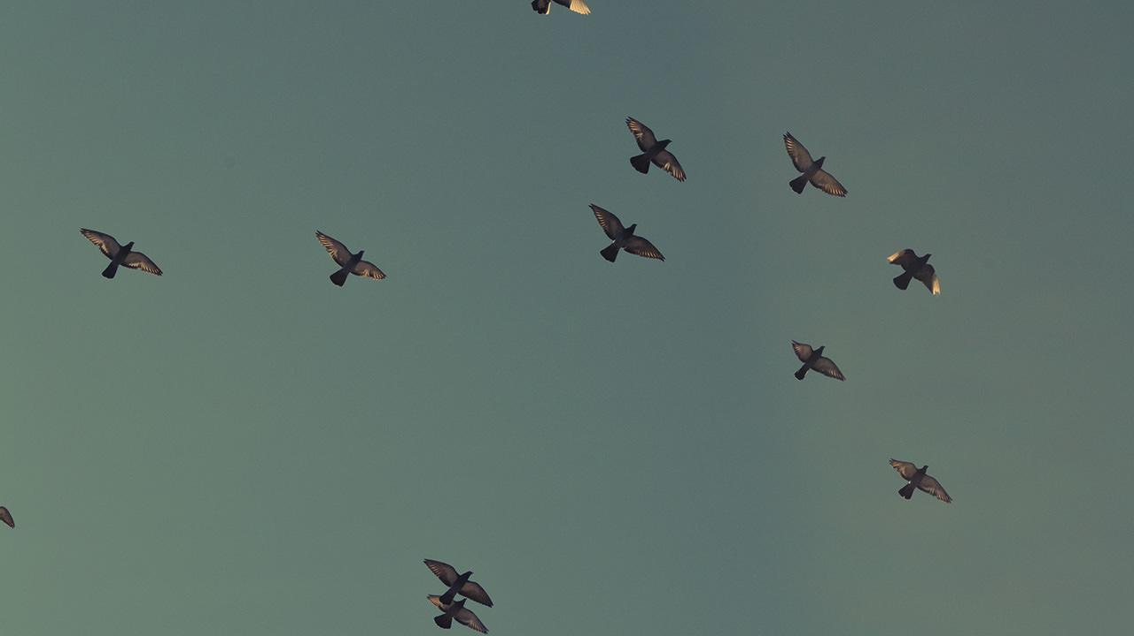
Invasive/Exotic Species:
It is a plant, fungus or animal species that is not native to a specific location and which can cause damages to environment. They are moved by humans from one place to another . It can disrupt entire ecosystem. It can affect to native plants and animals by eating them , infecting them and competing with them.

Slide 19
Pollution:-
Several reasons cause pollution in the environment, like Oil Spills, Artificial Agricultural Waste,Acid Deposition, as well as Genetic Pollution cause a major disruption in biodiversity.

Slide 20
Characteristics shared by endangered species:- Large body size. Restricted to smaller areas. Dependence on specific food sources, not adjustable to human caused alterations. Low productive rates and low mortality. Commercially Valuable Negative human interactions(like attacks on humans or livestock

Slide 21
How Humans can Protect Boidiversity
Many laws have been devised for the sole purpose of protection of biodiversity. These include:-
India passed the Biological Diversity Act in 2002 for the conservation of biological diversity in India.
United Nations Convention on Biological Diversity (1992) and Cartagena Protocol on Biosafety implemented several laws for the same.
Endangered Species Act (ESA),1973

