Slide 1
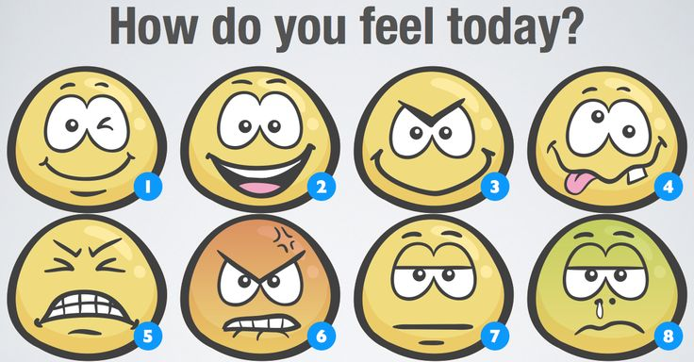

Slide 2
Emotions
Complex multicomponent episode that creates readiness to act

Slide 3
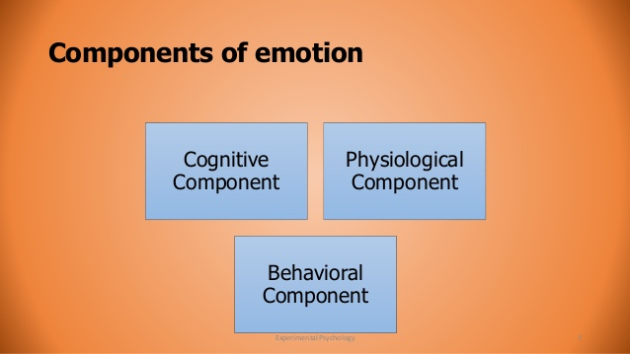

Slide 4
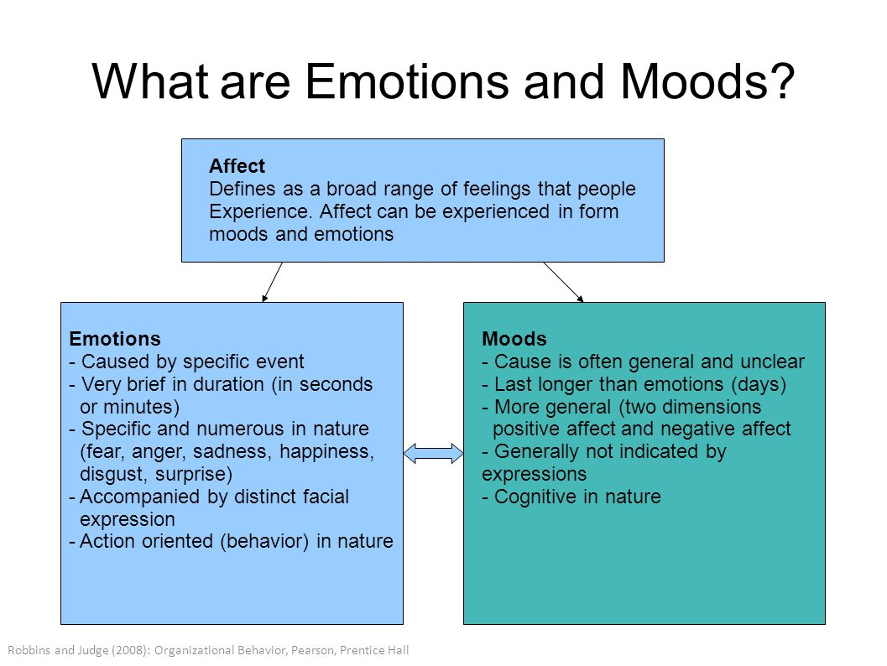

Slide 5
Process of Emotions
Emotional Responses:
2. Subjective experience
3. thought- action tendencies
4. Internal Bodily Changes
5. Facial expression
P*E
1.
Cognitive Appraisal
6.
Response to emotions
If people could be induced to be in a general state of autonomic arousal, the quality of their Emotion would be determined solely by their appraisal of the situation

Slide 6
What really matters for success???
Cognitive Skills vs. Emotional Skills
Hemispheric division: Left brain vs. Right brain
Problem focused strategies vs. Emotion focused strategies
Stage fright or social phobia
Relationship problems
Suicides???

Slide 7
Intelligence???
An intelligent behavior usually have two components
The ability to learn from experiences
Role of different cognitive processes
The ability to adapt to the surrounding environment
Interpersonal vs. Intrapersonal Intelligence
Leadership and intelligence

Slide 8
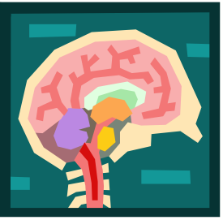
Emotional Intelligence
Ability to perceive and express emotion, assimilate emotion in thought, understand and reason with emotion, and regulate emotion in oneself and others
4-8

Slide 9
Emotional Intelligence (EQ)
 | Personal Competence | Relational Competence
Knowledge | Self awareness | Awareness of others
Management | Self Control | Building Relationship

Slide 10
Self awareness:
how well you know in comparison to how others perceive you?
What are my strength and weaknesses?
Congruence?
Confidence about own skill and abilities?

Slide 11
Self control
How well you manage your emotions and actions
What can I do to manage myself when under stress?
How do my values shape my word and actions?
When do I take initiative to solve problems?
How do I support my continued growth and development?

Slide 12
Awareness of others
Emotions
Strength
Weaknesses
Values
Needs
Preferences etc.
Can you anticipate needs, feelings and concerns of others???

Slide 13
Building Relationship
How we utilize awareness of others to their potential and our relationship
Am I able to identify difference between healthy and toxic conflict

Slide 14
Model of Emotional Intelligence
Highest
Relationship Management
Managing other people’s emotions
Social Awareness
Perceiving and understanding the meaning of others’ emotions
Self-management
Managing our own emotions
Self-awareness
perceiving and understanding the meaning of your own emotions
Lowest
4-14

