Slide 1
Warm up 4/16
Do you have a good memory?
What kinds of things do you remember most clearly?
How do you remember?

Slide 2
Memory Game
What techniques did you use to try and remember where the cards were?
Was it successful?

Slide 3
Introduction to Memory

Slide 4
Three Stages of Memory
Encoding – putting things into the memory
Storage – Maintaining the memory
Retrieval – Recovering the memory

Slide 5
Encoding
Translation of info into a form so it can be stored as a meaningful entity.
3 ways to do this
  Visual codes—Trying to make a mental picture
  Acoustic codes—Read it to yourself and repeat it in your head
  Semantic codes—Relating it to meaning

Slide 6
Storage
2nd Process of memory
Memory of stored after being encoded
Use a variety of strategies to store new info.

Slide 7
Retrieval
3rd memory process
Locating stored memory and returning it to conscious thought
Much like retrieving info from a computer—have to know the file name to know where to look.

Slide 8
Three Memory Stores
The Atkinson- Shiffrin Theory
Information is first placed into the SENSORY store
It is then transferred into the SHORT TERM store.
If we are successful in remembering – it moves into the LONG TERM store.

Slide 9
THE SENSORY STORE
Captures all info captured by senses.
Decays quickly - from a few tenths of a second for the visual to a few seconds for the auditory.
Small portion is transferred from SENSORY to SHORT TERM.
Think about your FIRSTS!!!

Slide 10
THE SHORT TERM STORE
Also known as WORKING MEMORY
Five characteristics:
  Info that you are conscious of
  Readily accessible
  Decays in about 20 seconds
  Rehearsal prevents decay
  Can be processed and transported to long term memory (process is called ELABORATION)

Slide 11
THE LONG TERM STORE
Large repository of info in our brain. Holds all info that is available to us.
Three characteristics:
  Info enters LTS from STS via elaborative processes
  Size of LTS is unlimited
  Info is acquired via retrieval and put back into STS where it can be accessed and manipulated.

Slide 12
DIFFERENT TYPES OF MEMORY
Episodic / Flashbulb
Generic
Procedural

Slide 13
Flashbulb Memory
Recall certain important events in great detail
Why does this happen?
  We pay attention to events that have special meaning to us and arouse powerful feelings

Slide 14
Memory
In more detail

Slide 15
Sensory Memory
Types of sensory memory most carefully studied are:
  Vision which is called ICONIC memory
    and
  Audition which is called ECHOIC memory

Slide 16
Read me
Read and annotate the ICONIC MEMORY handout.
What is partial report procedure?
What is whole report condition?

Slide 17
Warm up 4/19
Read and memorize the piece provided.
You have 7 minutes to work on this.

Slide 18
How did you do?
Test yourself.
  Pick a partner. Recite the poem. What percentage did you memorize correctly?
How did you memorize? What strategies did you use?
Did you understand the poem? Did that make it easier/worse?

Slide 19
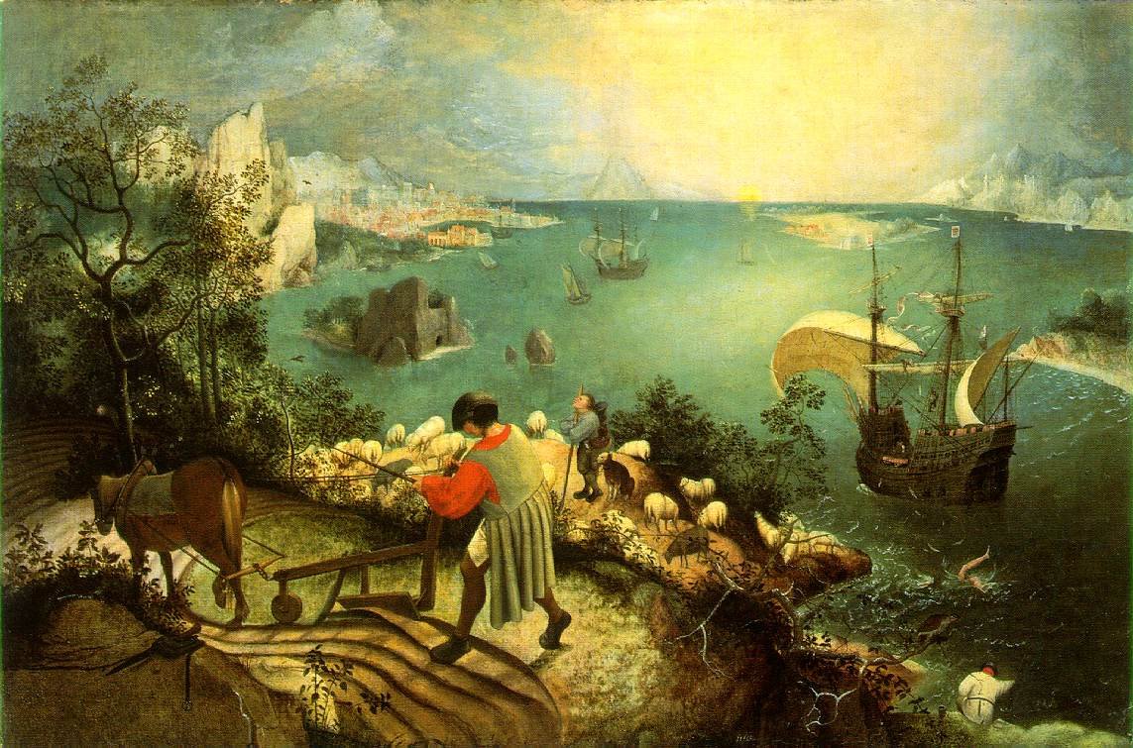

Slide 20
STS or Working Memory
To encode info into the working memory we have to attend to it.
We are selective about what we attend to so not everything makes the transition from sensory to working memory.

Slide 21
Storage strategies
Maintenance Rehearsal
  Repeating it over and over again
    More time spent, longer it will be remembered
Elaborative Rehearsal
  Relating it to info already known
    More effective, lasts longer

Slide 22
Coding
We encode visually, phonologically and semantically.
That means be remember the visual details, the way something sounds or what it means or relates to.
Some people can see something briefly and have complete recall. That is called EIDETIC MEMORY.

Slide 23
Try this
6422347

Slide 24
Write it down
Write down the number that you just saw.
As you wrote in down did you visualize it or repeat it in your head?

Slide 25
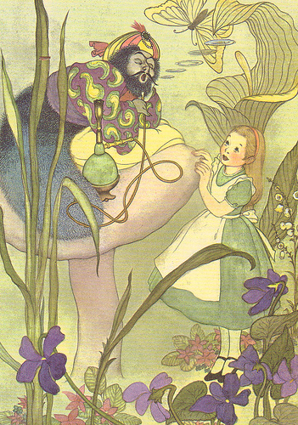

Slide 26
Write
Describe the picture in as much detail as you possibly can.

Slide 27
How many
How many yellow swirls are on the man’s shirt?
How many stripes are there on his hat?
How many rings of smoke are there?
How many purple flowers?

Slide 28
Warm up 4/21
Pretend this is your diary. Journal about your day yesterday. Write as much as you can remember in as much detail as you can remember.

Slide 29
Part 2
Switch your warm up with someone in the class.
Read the warm up.
  What does the information that they have recalled tell you about how they are remembering?
    Is it chronological?
    Is it a snapshot of info?
    Do they use their senses etc.

Slide 30
Limitations
Our working memory is limited.
Ever wonder why phone numbers are 7 digits – that’s all we can hold in our working memory – 7 items (+ or – 2).

Slide 31
Chunking
Because of our capacity limit we chunk info.
Try this. Memorize:
  SRUOYYLERECNIS

Slide 32
How did you do?
Now try this. Memorize:
  SINCERELY YOURS

Slide 33
Much better right
If we chuck info, e.g.
  805-672-3457
Instead of
  8056723457
We have a better chance of remembering.

Slide 34
Long Term Store
There are different kinds of memory in your LTS.
Implicit - a type of memory in which previous experiences aid in the performance of a task without conscious awareness of these previous experiences
Explicit - conscious, intentional recollection of previous experiences and information .

Slide 35
Episodic Memory
Memory of a specific event
  Ex. – what you had for dinner last night
Flashbulb Memory
  Specific events that are important affect you as if there had been a “flashbulb” that went off in your head and took a picture of it.
  Vivid and relatively permanent record of emotionally charged and significant event.

Slide 36
Flashbulb Memory
Write your own example. Try something like:
  9/11
  Your first kiss
  Your first game
  Your first pet

Slide 37
Semantic (Generic) memory
Semantic memory consists of all explicit memory that is not autobiographical. Examples of semantic memory is knowledge of historical events and figures; the ability to recognize friends and acquaintances; and information learned in school, such as specialized vocabularies and reading, writing and mathematics.

Slide 38
Semantic (Generic) Memory
General Knowledge
  Washington was the 1st. President
Don’t remember when or where we learned it
  Ex. – alphabet- do you know when, where, and how you learned it?
    Most of what you learn in school is this

Slide 39
Procedural Memory
Learned skills or procedures
Once you learn a skill it usually stays with you for a long time
Ex. – riding a bike, using a computer, driving a car, etc.

Slide 40
Memory Game
Take a handful of LEGOS and create something. It does not have to be anything that we would recognize. You need to work in PRIVATE on this.
When you are done, take a picture of it with your phone.
Pick a partner and give them 30 seconds to look at the creation.
Take it and break it up.
Your partner’s task is to recreate the piece as accurately as possible.

Slide 41
Game Reflection
What strategies did you use to remember what the piece looked like?
How accurate was the recreation?

Slide 42
Warm up 4/23
Write three examples of long term memories from your own experience.
  One should be episodic, one should be procedural and one should be semantic.

Slide 43
Implicit or Explicit
Which are they?
  Procedural
  Episodic/Flashbulb
  Semantic (Generic)

Slide 44
Explicit – Episodic & Semantic
Implicit - Procedural

Slide 45
Forgetting
Items in our memory decay over time. There are many reasons for this:
Old items are replaced by new ones.
There is interference.
We cannot find a meaning for the info.

Slide 46
How not to forget
Organization
  We are better able to remember info if we categorize and organize it.
  Try this: remember this list of names as they appear.
  Bob, James, Emmanuel, Carmine, Elora, Heidi, Benjamin, Freda, Melanie, Cherie, Karen, Jonah.

Slide 47
Organization
  Now try this: remember this list of names but organize them in some fashion.
  Malcolm, William, Iris, Yolanda, Susan, Bradi, Jamie, Molly, Pixie, Jessica, Bruce, Zander
  Which was more effective? How did organization help?

Slide 48
Context
It is easier to remember something if you are in the same context as you were when you encoded it.
If you were to have to remember the names of your 1st grade class, you would probably remember more if you were actually back at your classroom.

Slide 49
Repression & Amnesia
Repression and amnesia are extreme forms of forgetting
Repression – pushing disturbing memories from conscious mind
  A way of protecting feelings of anxiety, guilt, shame, pain, etc.
    We do this on purpose without even knowing it

Slide 50
Amnesia
Severe memory loss caused by brain injury, shock, fatigue, illness, or repression
  Infantile Amnesia - can’t remember events from infancy and early childhood
    If you think you can what you are doing is reconstructing that memory from other memories
  Anterograde amnesia – prevents a person from forming new memories after a trauma
  Retrograde amnesia – forget the period leading up to the trauma

Slide 51
Two famous cases
Clive Wearing – video
HM – Homework
  Read About HM (Henry Gustav Molaison)
  What is his memory loss? What brain damage has occurred? How is his life impacted by this?

Slide 52
Forgetting
In 1885, Hermann Ebbinghaus discovered the exponential nature of forgetting. The following formula can roughly describe the forgetting:
  where R is memory retention, S is the relative strength of memory, and t is time.

Slide 53
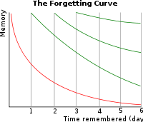
Forgetting Curve

Slide 54
Forgetting
Illustrates the decline of memory retention in time. A related concept is the strength of memory that refers to the durability that memory traces in the brain. The stronger the memory, the longer period of time that a person is able to recall it.
A typical graph of the forgetting curve shows that humans tend to halve their memory of newly learned knowledge in a matter of days or weeks unless they consciously review the learned material.

Slide 55
Forgetting
The speed of forgetting depends on a number of factors such as the difficulty of the learned material (e.g. how meaningful it is), its representation and physiological factors such as stress and sleep.
The basal forgetting rate differs little between individuals. The difference in performance (e.g. at school) can be explained by mnemonic skills.

Slide 56
Eye witness testimony
Eyewitness identification evidence is the leading cause of wrongful conviction in the United States. Of the more than 200 people exonerated by way of DNA evidence in the US, over 75% were wrongfully convicted on the basis of erroneous eyewitness identification evidence

Slide 57
The Innocence Project
The Innocence Project has facilitated the exoneration of 214 men who were convicted of crimes they did not commit, as a result of faulty eyewitness evidence.
Why is eye witness testimony unreliable?
  Stress
  Weapons
  Rapid decline

Slide 58
Remembering
  Primacy effect- recall first items because you have more time to practice them
  Recency effect- recall last items because they are fresher since last given

Slide 59
Retrieval Cues
Any stimulus that helps us recall information in long-term memory
Two general principles govern the effectiveness of retrieval cues – encoding specificity and distinctiveness.

Slide 60
Encoding specificity
According to this principle, stimuli may act as retrieval cues for an experience if they were encoded with the experience. Pictures, words, sounds, or smells will cause us to remember an experience to the extent that they are similar to the features of the experience that we encoded into memory. For example, the smell of cotton candy may trigger your memory of a specific amusement park because you smelled cotton candy there.

Slide 61
Distinctiveness
Distinctiveness determines the effectiveness of retrieval cues. Suppose a group of people is instructed to study a list of 100 items. Ninety-nine are words, but one item in the middle of the list is a picture of an elephant. If people were given the retrieval cue “Which item was the picture?” almost everyone would remember the elephant.

Slide 62
Déjà Vu and Jamais Vu
Describe a time where you could swear that you remember doing something before. You don’t know when but you know you have done the exact thing once before.

Slide 63
How it works
The sense of déjà vu (French for “seen before”) is the strange sensation of having been somewhere before, or experienced your current situation before, even though you know you have not. One possible explanation of déjà vu is that aspects of the current situation act as retrieval cues that unconsciously evoke an earlier experience, resulting in an eerie sense of familiarity.
Another puzzling phenomenon is the sense of jamais vu (French for “never seen”). This feeling arises when people feel they are experiencing something for the first time, even though they know they must have experienced it before. The encoding specificity principle may partly explain jamais vu; despite the overt similarity of the current and past situations, the cues of the current situation do not match the encoded features of the earlier situation.

Slide 64
Tip of the Tongue
Refers to the situation in which a person tries to retrieve a relatively familiar word, name, or fact, but cannot quite do so.
Although the missing item seems almost within grasp, its retrieval eludes the person for some time

Slide 65
Theories
An intruding item essentially clogs the retrieval mechanism and prevents retrieval of the correct item. That is, the person cannot think of one thing because another gets in the way and blocks retrieval of the correct name.
Another idea is that the phenomenon occurs when a person has only partial information that is simply insufficient to retrieve the correct item, so the failure is one of activation of the target item.

