Slide 1
Perception

Slide 2
Definition
“We don’t see things as they are; we see things as we are”
Perception in Organization
A process by which individuals select, organize and interpret their sensory impressions in order to give meaning to their environment.
People’s behavior is based on their perception of what reality is, not on reality itself.
The world as it is perceived is the world that is behaviorally important.

Slide 3
Factors Influencing Perception
Perception
Situation
Perceiver
Target

Slide 4
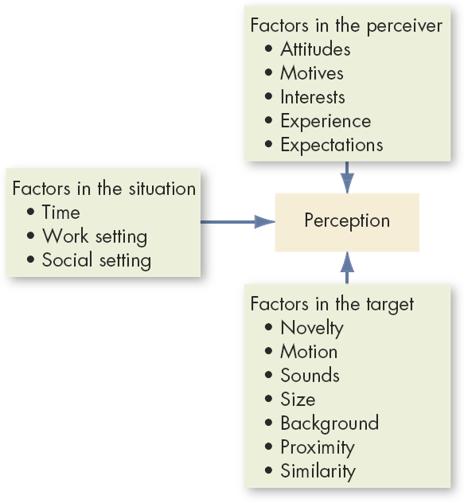
Factors Influencing Perception

Slide 5
Point to ponder
Have you ever noticed that while glancing at a newspaper or a news Web site, information that is interesting or important to you jumps out of the page and catches your eye?

Slide 6
Social Perception
The Process of Understanding/ Judging Others
The Attribution Process
Correspondence Inferences : From Acts to Dispositions
Act (What Some one does)
Dispositions (What someone is like)
Disorganized Office
Person may be sloppy and careless

Slide 7
Whether the behavior being considered is voluntary and freely chosen.
Non-common effects
Effects that can be caused by a specific factors but not by others.
Whether the behavior is socially desirable.

Slide 8
NON-COMMON EFFECTS PRINCIPLE: WHICH CAR WILL YOU BUY?
Car A Car B Car C
Lead-free petrol 4-star petrol Diesel
Power steering Power steering Power steering
Air bag Air bag Air bag
Expensive to service Cheap to service Cheap to service
If you buy Car A, we can infer that lead-free petrol is important to you. You will not have made your decision because of the power steering or air bags, as they are common to the other two cars. We might then infer that you also care about the environment.

Slide 9
First Impression and The Job Interview
Your first opportunity to make a great impression starts even before the interview, the moment you send your résumé.
Be sure that you send your résumé to the correct people,
You spell the name of the contact person correctly!
Make sure that your résumé looks professional and is free from typos and grammar problems.
Be prepared for the interview.
Prepare answers for standard questions such as, “tell me about yourself” or “why do you want to work here?”

Slide 10
Research the company.
When you are invited for an office interview, be sure to dress properly.
Be on time to the interview. Being late will show that you either don’t care about the interview or you are not very reliable.
During the interview, be polite. Use correct grammar, show eagerness and enthusiasm, and watch your body language.
Sources: Adapted from ideas in Bruce, C. (2007, October). Business Etiquette 101: Making a good first impression. Black Collegian, 38(1), 78–80; Evenson, R. (2007, May). Making a great first impression. Techniques, 14–17; Mather, J., & Watson, M. (2008, May 23). Perfect candidate. The Times Educational Supplement, 4789, 24–26; Messmer, M. (2007, July). 10 minutes to impress. Journal of Accountancy, 204(1), 13; Reece, T. (2006, November–December). How to wow! Career World, 35, 16–18.

Slide 11
Perception of Organization
“Image, identity and culture are concepts occupying the minds of companies and organizations of our time, because things must be connected in a world where every institution’s or person’s role and place are renegotiated almost everyday.”

Slide 12
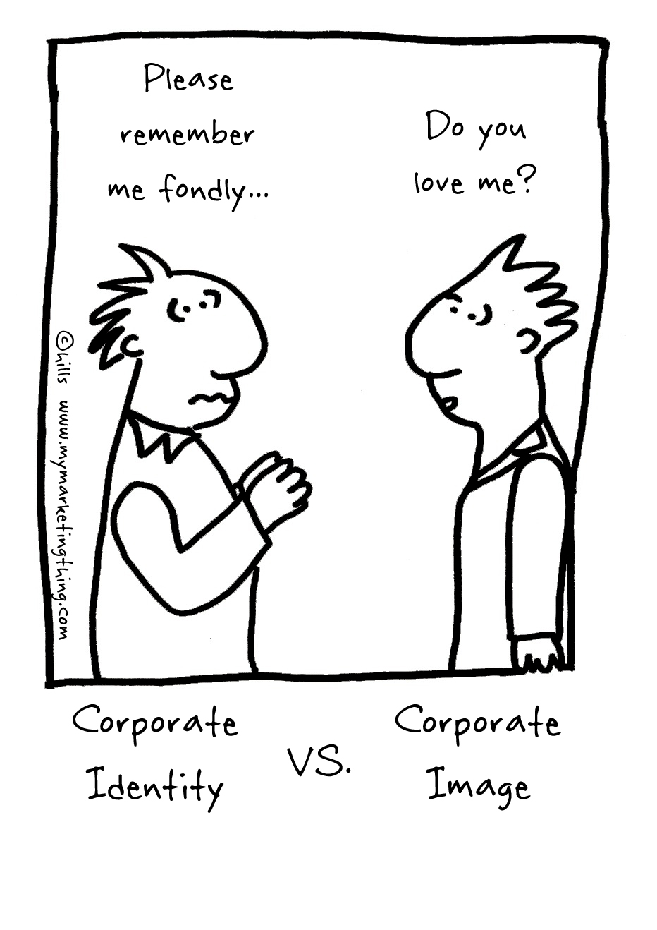
Corporate Image vs. Corporate Identity
“Identity and image have more in common with blood than the heart. Their being is in connecting. It is the streams that are interesting, not the pump, as there is no independent pump in market streams.”

Slide 13
Perception of Organization
 | Frame | Form of identity | Key words | Problem/ Discipline
Corp. Image | How the company is perceived by the market (not least by its most important audiences). | Ascribed identity | Good will Reputation Rumors | Segments Marketing Public relations
Corp. Identity | How does the company perceive the market and itself. How does the company presents itself - consciously and unconsciously. By what kind of signs is it represented on the market. What does it wish to communicate to the market. | Factual Identity Value Identity | Brand Logo Advertising Employee politics Buildings and more | Consistence Marketing Organization Human resource management

Slide 14
Person Perception: Attribution Theory
Suggests that perceivers try to “attribute” the observed behavior to a type of cause
Internal – behavior is believed to be under the personal control of the individual
External –the person is forced into the behavior by outside events/causes

Slide 15
Determinants of Attribution
Consensus – does everyone who faces a similar situation respond in the same way as the individual did
Consistency – does the person respond the same way over time
Distinctiveness – whether an individual displays different behaviors in different situations (the uniqueness of the act)

Slide 16
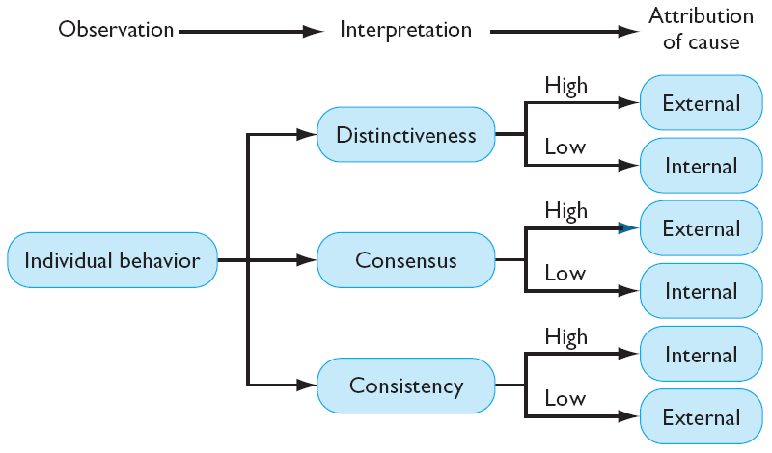
Determination of Attribution

Slide 17

Internal Attribution
No one else complains
(Consensus-Low)
This person always complains in the restaurant
(Consistency-high)
This person also complains in other settings
(Distinctiveness -Low)
He/she complained because he/ she is difficult to please
(Internal Attribution)

Slide 18
External Attribution
Several others also complains
(consensus-High)
This person always complains in the restaurant
(consistency-high)
This person does not complain complains in other settings
(Distinctiveness -High)
He/she complained because restaurant is terrible
(External Attribution)

Slide 19
Attribution Errors
Fundamental Attribution Error
The tendency to underestimate the influence of external factors and overestimate that of internal factors.
Self-Serving Bias
Occurs when individuals overestimate their own (internal) influence on successes and overestimate the external influences on their failures.

Slide 20
Shortcuts Used in Judging Others
Selective Perception – a perceptual filtering process based on interests, background, and attitude. May allow observers to draw unwarranted conclusions from an ambiguous situation.
Halo Effect – drawing a general impression based on a single characteristic.
Similar to Me Effect: If you like me, you must be pretty Good
Stereotyping – judging someone on the basis of the perception of the group to which they belong.

Slide 21
Group Discussion
Are Women CEOs/ Leaders/ Bosses Perceived Differently Than Men
Why do we have very few women CEO’s

Slide 22
Possible Link Between Perception and Decision Making
Decision making occurs as a reaction to a perceived problem

Slide 23
Rational Decision-Making Model
Define the problem.
Identify the decision criteria.
Allocate weights to the criteria.
Develop the alternatives.
Evaluate the alternatives.
Select the best alternative.
Seldom actually used: more of a goal than a practical method

Slide 24
Assumptions of the Model
Complete knowledge of the situation
All relevant options are known in an unbiased manner
The decision-maker seeks the highest utility

Slide 25
Bounded Rationality
The limited information-processing capability of human beings makes it impossible to assimilate and understand all the information necessary to optimize
So people seek solutions that are satisfactory and sufficient, rather than optimal (they “satisfice”)
Bounded rationality is constructing simplified models that extract the essential features from problems without capturing all their complexity

Slide 26
Decision Making in Bounded Rationality
Simpler than rational decision making, composed of three steps:
Limited search for criteria and alternatives – familiar criteria and easily found alternatives
Limited review of alternatives – focus alternatives, similar to those already in effect
Satisficing – selecting the first alternative that is “good enough”

Slide 27
Intuitive Decision Making
An non-conscious process created out of distilled experience
Increases with experience
Can be a powerful complement to rational analysis in decision making

Slide 28
Three-Component Model of Creativity
Expertise
Intrinsic Task Motivation
Creative-Thinking Skills

Slide 29
Common Biases and Errors
Overconfidence Bias
As managers and employees become more knowledgeable about an issue, the less likely they are to display overconfidence
Anchoring Bias
A tendency to fixate on initial information and fail to adequately adjust for subsequent information
Confirmation Bias
Seeking out information that reaffirms our past choices and discounting information that contradicts past judgments

Slide 30
Common Biases and Errors
Availability Bias
The tendency to base judgments on information that is readily available
Escalation of Commitment
Staying with a decision even when there is clear evidence that it is wrong
Hindsight Bias
The tendency to believe falsely that we could have accurately predicted the outcome of an event after that outcome is already known

Slide 31
Organizational Constraints on Decision Making
Performance evaluations
Reward systems
Formal regulations
Self-imposed time constraints
Historical precedents

Slide 32
Implications for Managers
Perception:
To increase productivity, influence workers’ perceptions of their jobs
To improve decision making:
Analyze the situation
Adjust your decision approach
Be aware of biases and minimize their impact
Combine rational analysis with intuition
Try to enhance your creativity

Slide 33
Decision Making Styles
High
Tolerance
for
Ambiguity
Low
Rational Intuitive
Way of thinking
Analytic
Conceptual
Directive
Behavioral

Slide 34
There are four essential styles of decision making:
Directive: The group leader solves the problem, using the information he possesses. He/she does not consult with anyone else nor seek information in any form. This style assumes that the leader has sufficient information to examine all the relevant options and make an effective decision, but that is rarely the case.
Analytical: When the leader does not possess sufficient information to make an effective decision, they will need to obtain information or skill from others. They may not tell them what the problem is; normally, they simply asks for information. The leader then evaluates the information and makes the decision.
Conceptual: The leader explains the situation to the group or individuals whom he provides with relevant information, and together they generate and evaluate many possible solutions. This style tends to be have a long-term perspective and, as a result, will be more creative and expansive in their approach entailing a higher level of risk for the long-term benefit of the organization.
Behavioral: The leader explains the situation to the group or individuals and provides the relevant information. Together they attempt to reconcile differences and negotiate a solution that is acceptable to all parties. The leader may consult with others before the meeting in order to prepare his case and generate alternative decisions that are acceptable to them.

