Slide 1
CORRELATION

Slide 2
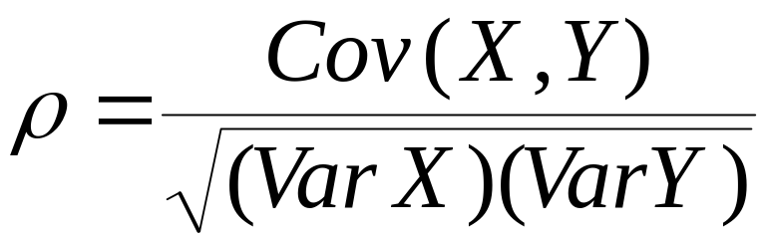
Correlation
In this section, we are trying to measure the linear relation between X and Y.
The theoretical parameter used to measure the linear relationship between X and Y is the Pearson coefficient ρ. This parameter is defined by
The parameter ρ assumes values between -1 and 1 inclusive. Values of -1 and 1 indicate perfect negative and positive relationships respectively. A value of 0 indicates no linear relationship. When this occurs, we say that X and Y are uncorrelated.

Slide 3
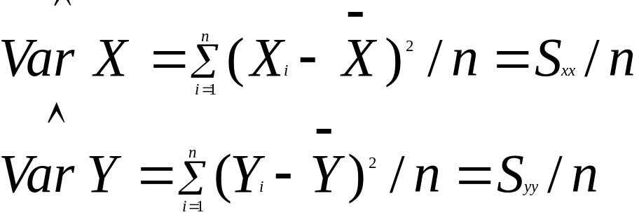
Previously, we found that the theoretical value of ρ based on knowledge of the joint density function for X and Y. But these are seldom known in practice. So our job is to estimate ρ based on set of observations {(x_{i},y_{i}):i=1,2,…n} on the random variable (X,Y). We must use Var X, Var Y and Cov (X,Y) for this purpose.
To estimate Cov(X,Y), note that

Slide 4
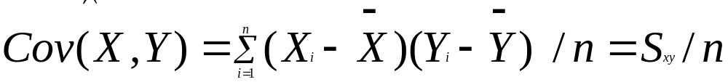
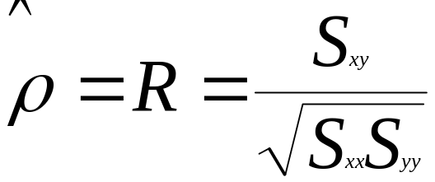
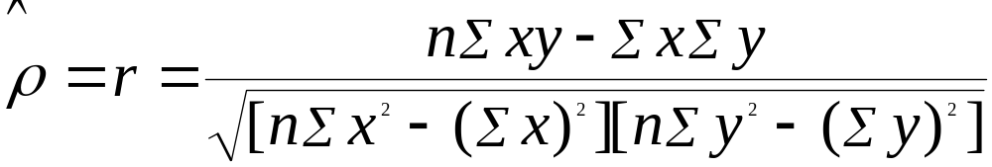
We estimate Cov(X,Y) by averaging products analogous to that on the right hand side of the previous equation.
When we combine these estimators, the estimator for ρ is given by
The computational formula for the estimator for ρ is

Slide 5
X: 1,2,3,4,5 and y: 2,4,6,8 and 10.
5.32 The joint density for (X,Y) where X is the tempreture and Y is the time that it takes for a diesel engine on an automobile to get ready to start is given by
f(x,y) = 1/6640 (4x+ 2y +1) 0≤ x≤ 40, 0≤ y ≤ 2. Find E(X), E(Y), E(XY), E(X^{2),} E(Y^{2),} Var X, Var Y, Cov(XY) and ρ between X and Y.

