Slide 1
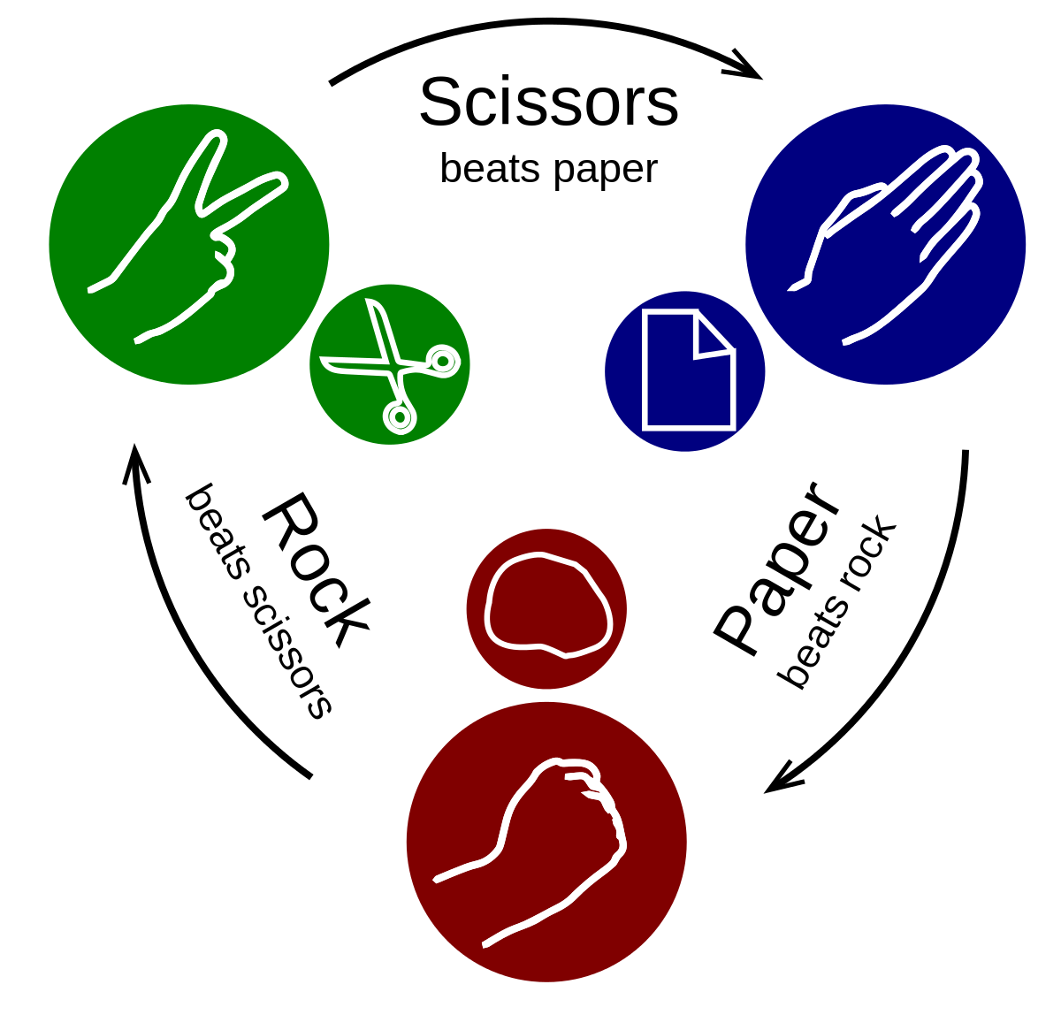
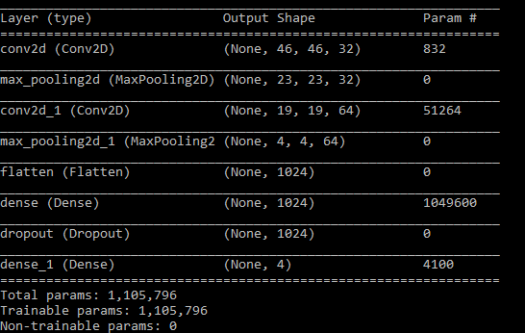



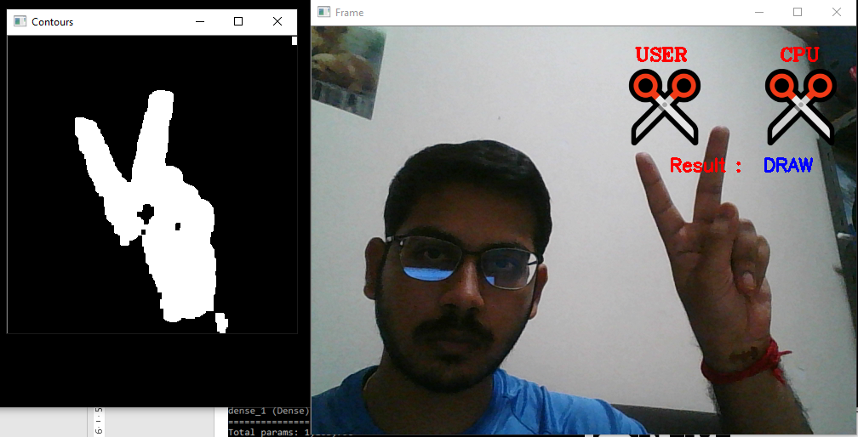
Scissor-Paper-Stone
Model Architecture:
Steps
1. Build dataset by capturing 1200 50x50px images for each class
2. Convert images to csv file.
3. Train CNN model
4. Run the application and Play

