Slide 1
SETU-X
Hybrid-cloud microservices · experimental platform
How network delay, failures and resilience policies shape latency and availability across (simulated) clouds
Parv Agarwal · Junior Research Associate (Technical), AI NLP ML Research Laboratory, IIT Patna · October 2026
63%
10.4×
10 runs
of requests are slow with 100-way fan-out when each server is slow 1% of the time [1]
rise in tail latency from mismanaging one dependency in a microservice benchmark [2]
detected a 10% regression reliably; single runs did not [3]
Research question
With services placed in different (simulated) cloud environments, how do inter-environment delay, dependency failures and client-side resilience policies (timeouts, retries, circuit breakers, cross-environment fallback) change end-to-end latency and success rate? Which of these effects can a local lab establish?
Hypotheses H1 delay propagation · H2 timeouts and breakers · H3 cross-environment fallback · H4 placement · H5 bounded retries
Independent mini-project, not an officially endorsed IIT Patna project.
Notes:
Hello, I'm Parv Agarwal, a Junior Research Associate in the AI NLP ML Research Laboratory at IIT Patna. This is SETU-X, a mini-project I built independently. It is not an official IIT Patna project.
When an application's services run in different clouds, every call between them adds delay and one more way to fail. Three findings from the literature show why that matters. With a hundred-way fan-out, if each server is slow just one percent of the time, sixty-three percent of requests end up slow. In a microservice benchmark, mismanaging a single dependency raised tail latency more than ten times. And a single run of an experiment could not reliably detect a ten percent regression, while ten runs could.
So my question is this. When services sit in different, simulated, cloud environments, how do delay, failures and resilience policies such as timeouts, retries, circuit breakers and fallback change latency and success rate? And which of those effects can a small local lab actually establish? I turned this into five hypotheses, H1 to H5.

Slide 2
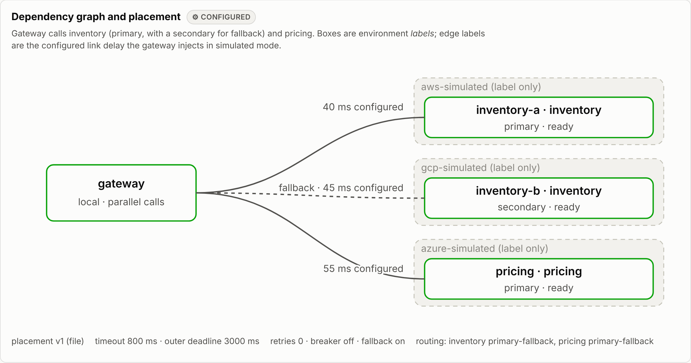
Known pieces, joined in one runnable lab
Research gap: what the papers leave open
G1
Placement is studied mostly with models and simulators [4, 5]
→ SETU-X measures it on running containers with documented link delays
G2
Fault-injection tools find bugs but prescribe no measurement method [6, 7]
→ SETU-X couples injection with run-level replication
G3
Cloud networks vary; even emulators drift from their settings [8–10]
→ Every simulated result carries explicit validity limits
Genuine capture: SETU-X dashboard, simulated mode (Linux build workspace, 26 Oct 2026); controller and runner not drawn.
local
default; no injected delay
simulated
environment labels + injected link delay
cloud
off; adapters only validate configuration
G4
Methodology principles often go unmet in cloud studies [3, 11, 12]
→ SETU-X builds them in by default
Safety: faults allow-listed, time-bounded, self-expiring; non-root containers on 127.0.0.1
Cost: no cloud resources, no spend. Ladder simulated → configured → connected → deployed → verified; all providers: not configured
Scope: a gap in accessible, disciplined experiment tooling for teaching and small labs, not a claim of novel systems research.
Notes:
The building blocks already exist, but separately. Placement has mostly been studied with models and simulators. Fault-injection tools such as Gremlin and Filibuster are built to find bugs, not to measure trade-offs. Real cloud networks vary, and even network emulators drift from their own settings. And methodology papers show that cloud studies often skip basic rules, such as repeated runs.
SETU-X joins these pieces in one runnable lab. On the right is the real dashboard. A gateway calls an inventory service and a pricing service, each labelled as if it lived on AWS, Google Cloud or Azure, with a second inventory replica for fallback. These are labels on one Docker host, and the gateway injects the configured link delays. There are three modes: local, simulated, and cloud, which stays switched off. The cloud adapters only check configuration, so nothing is created and nothing costs money. Faults are allow-listed, time-limited and expire on their own.

Slide 3
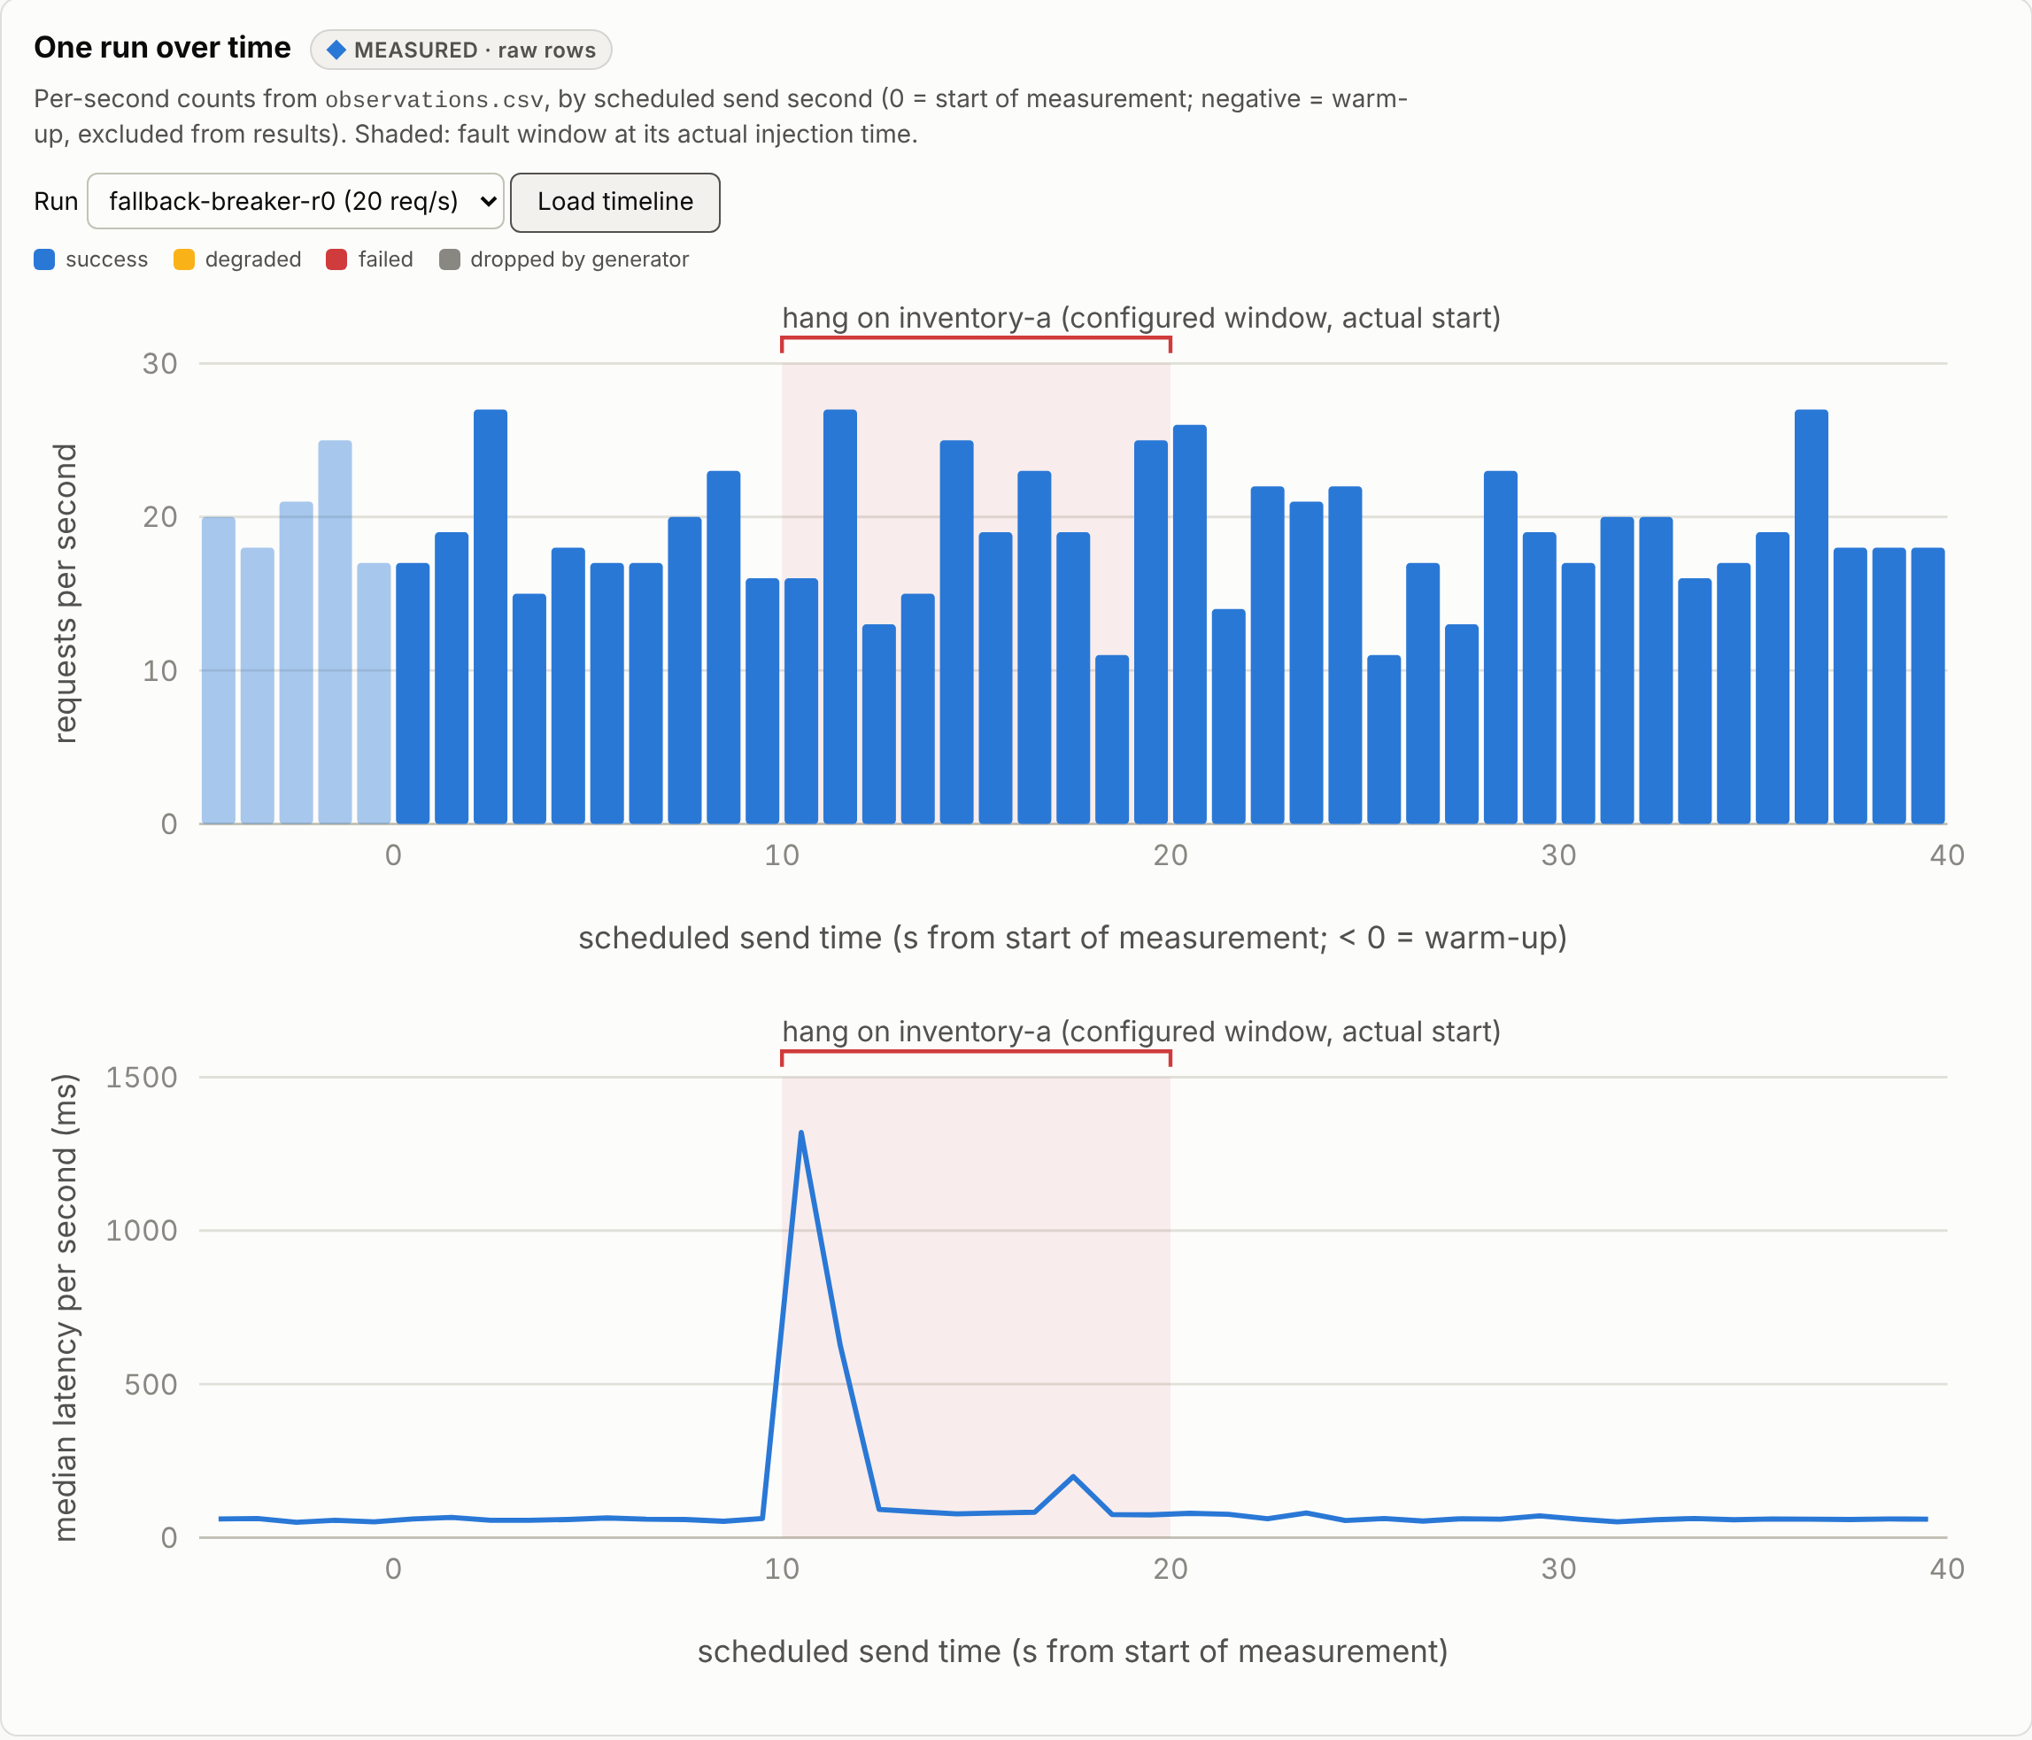
Measured per run, checked by automated gates
How the campaign was run
Open-loop Poisson load from inside the Compose network; latency from the scheduled send time
Every run reset and reseeded; run order randomized
The run is the unit of replication: 3 runs per condition (5 for the baseline), 95% bootstrap CI over runs
Percentiles per run only (p95 needs ≥ 200 samples, p99 ≥ 1,000), never averaged
Raw rows and manifest (scenario hash, git commit) re-validated before any analysis
Campaign: 8/8 experiments validated · 64.8 min · one Windows PC (i5-13500, Docker Desktop 29.4.2) · commit bfe122c
Testing gates
337
10
13
18/18
unit, contract, integration
end-to-end
browser (Playwright)
clean-clone checks, Linux + Windows
Genuine capture of the Windows records in the dashboard: one Experiment G run (fallback + breaker). The primary hangs for 10 s; every request still succeeds, and latency spikes only until the breaker opens.
GitHub Actions runs the same gates on every push. The pilot caught a 5 s client timeout overriding the scenario's 15 s; fixed, with a regression test, before the campaign.
Notes:
Numbers are only useful if the measurement is honest, so the harness follows published methodology rules. The load is open-loop: requests go out on schedule whether or not earlier ones have finished, so a slow system cannot hide its own slowness. Every run starts from a reset, with a fresh seed, in random order. The run, not the single request, is the unit of replication. Confidence intervals are bootstrapped over runs, and percentiles are never averaged.
I ran the full campaign on my own Windows PC: eight experiments in about sixty-five minutes, with every record validated. The screenshot shows one of those runs in the dashboard. The primary inventory service hangs for ten seconds, yet every request succeeds, because the gateway falls back to the replica. Latency spikes only until the circuit breaker opens.
Behind this sit 337 automated tests, plus end-to-end and browser tests, and an eighteen-check clean-clone verification that passed on Linux and on Windows. The pilot run even caught a timeout bug before the real campaign.

Slide 4
All five hypotheses held here, each with a cost
 | Hypothesis | Measured on this machine (medians over runs) | Verdict
H1 | Delay adds ≈ d on a sequential path; parallel calls hide it [1] | Sequential +26.6 / 51.3 / 102.9 ms for d = 25 / 50 / 100 ms; parallel +6.0 / 8.0 / 56.7 ms | Supported
H2 | Timeouts bound latency; breakers cut load and fail fast [13] | Failed requests 10.0 s → 0.81 s with a timeout. Breaker: 78% fewer calls, fails in 17 ms, but recovery 1.0 s → 5.2 s | Supported, slower recovery
H3 | Fallback to another environment raises success, at a latency cost | Success 0.74 → 1.00 (+0.257 [0.251, 0.266]); p95 +749 ms; with a breaker p95 239–524 ms | Supported
H4 | Placement helps only when it moves the critical path | Moving pricing saves 31.3 ms [29.0, 34.3]; moving inventory 0.4 ms [−3.7, 2.6] | Supported
H5 | Retries reach 1 − p^(1+r) and multiply calls [1] | Success 0.50 / 0.77 / 0.88 vs predicted 0.5 / 0.75 / 0.875; 1.00 / 1.48 / 1.75 calls per request | Supported*
E | Where this host saturates (exploratory) | Gateway at its 0.5-CPU limit by 40 req/s (46.4–47.1% CPU); at 80 req/s goodput collapses to 0.5–9.2 req/s | Observed
* The injected errors are independent by construction, so H5 checks the retry logic, not real-world failure correlation. [a, b] = 95% bootstrap CI over runs; 3 runs per condition; local and simulated modes on one Windows PC.
Notes:
Here are the results. All of them are medians over runs, on that one machine.
H1: on a sequential call path, adding d milliseconds of delay added almost exactly d: about 27, 51 and 103 milliseconds for 25, 50 and 100. With parallel calls, most of it was hidden, until the delayed call became the slowest one.
H2: without a timeout, failed requests waited ten seconds. With an 800-millisecond timeout, they failed in about 0.8 seconds. The circuit breaker cut calls to the hung service by 78 percent and failed in 17 milliseconds. But it stayed open after the service recovered, so recovery took about five seconds instead of one.
H3: falling back to the replica in another environment raised success from 74 percent to 100 percent, at the cost of a slower p95.
H4: moving the service on the critical path saved 31 milliseconds. Moving the other one saved nothing measurable.
H5: retries matched the textbook prediction closely, and multiplied the calls as expected.
Finally, at 80 requests per second the gateway ran out of CPU, and throughput collapsed instead of levelling off.

Slide 5
What transfers, what does not, what is next
What the lab shows
What it cannot show
Next
The critical path decides: delay and placement matter only where they sit on it
Each resilience policy trades something: errors for bounded latency, recovery time for less load, latency for success
Without admission control, overload collapses goodput instead of levelling it off
Provider numbers: one host, constant injected delay, application-level faults
Independent failure domains: both replicas share one kernel
Fine tails: p99 is reportable only for the baseline; 3 runs per condition
Same scenarios on real providers (adapters target ECS Fargate, Azure Container Apps, Cloud Run)
Jitter and loss models, admission control, more runs
Code, data and CI (Apache-2.0; docs and results CC BY 4.0):
github.com/Parv-01/setu-x
References (full bibliography with DOIs: docs/references.bib)
[1] J. Dean, L. A. Barroso. The tail at scale. CACM, 2013.
[2] Y. Gan et al. An open-source benchmark suite for microservices… ASPLOS 2019.
[3] S. Eismann et al. Microservices: a performance tester's dream or nightmare? ICPE 2020.
[4] A. Brogi, S. Forti. QoS-aware deployment of IoT applications through the fog. IEEE IoT J., 2017.
[5] M. Mota-Cruz et al. Optimizing microservices placement in the cloud-to-edge continuum. arXiv:2412.01412, 2024.
[6] V. Heorhiadi et al. Gremlin: systematic resilience testing of microservices. ICDCS 2016.
[7] C. S. Meiklejohn et al. Service-level fault injection testing. SoCC 2021.
[8] P. Leitner, J. Cito. Patterns in the chaos: performance variation in public IaaS clouds. ACM TOIT, 2016.
[9] A. Uta et al. Is big data performance reproducible in modern cloud networks? NSDI 2020.
[10] A. Jurgelionis et al. An empirical study of NetEm network emulation functionalities. ICCCN 2011.
[11] A. V. Papadopoulos et al. Methodological principles for reproducible performance evaluation in cloud computing. IEEE TSE, 2021.
[12] T. Hoefler, R. Belli. Scientific benchmarking of parallel computing systems. SC 2015.
[13] F. Montesi, J. Weber. Circuit breakers, discovery, and API gateways in microservices. arXiv:1609.05830, 2016.
Notes:
What should you take away? First, the critical path decides: delay and placement matter only where they sit on it. Second, every resilience policy trades something. Timeouts trade errors for bounded latency, breakers trade recovery time for less load, and fallback trades latency for success. Third, without admission control, overload causes a collapse, not a plateau.
Just as important is what this lab cannot show. These are not AWS, Azure or Google numbers. Everything ran on one host, with constant injected delay and application-level faults, and both failure domains share one kernel. With three runs per condition, I make no claims about the extreme tail.
The next step is to run the same scenarios on real providers, add jitter and packet-loss models, and try admission control. All the code, data and CI are open on GitHub: Apache 2.0 for the code, and CC BY for the documentation and results. Thank you.

