Slide 1
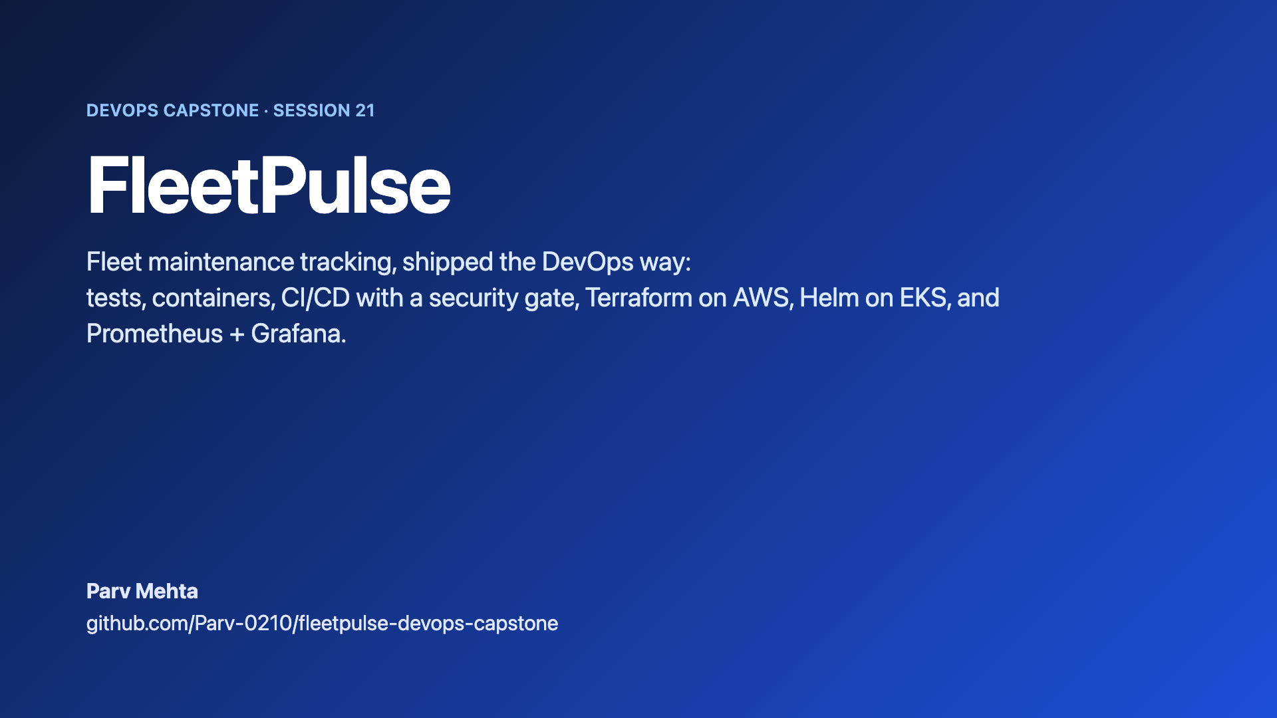
Notes:
Hi, I'm Parv. This is FleetPulse, my DevOps capstone project. The app tracks vehicle maintenance, but most of the work is the path around it: tests, containers, a CI/CD pipeline with a security gate, AWS infrastructure in Terraform, a Helm chart on EKS, and monitoring with Prometheus and Grafana.

Slide 2
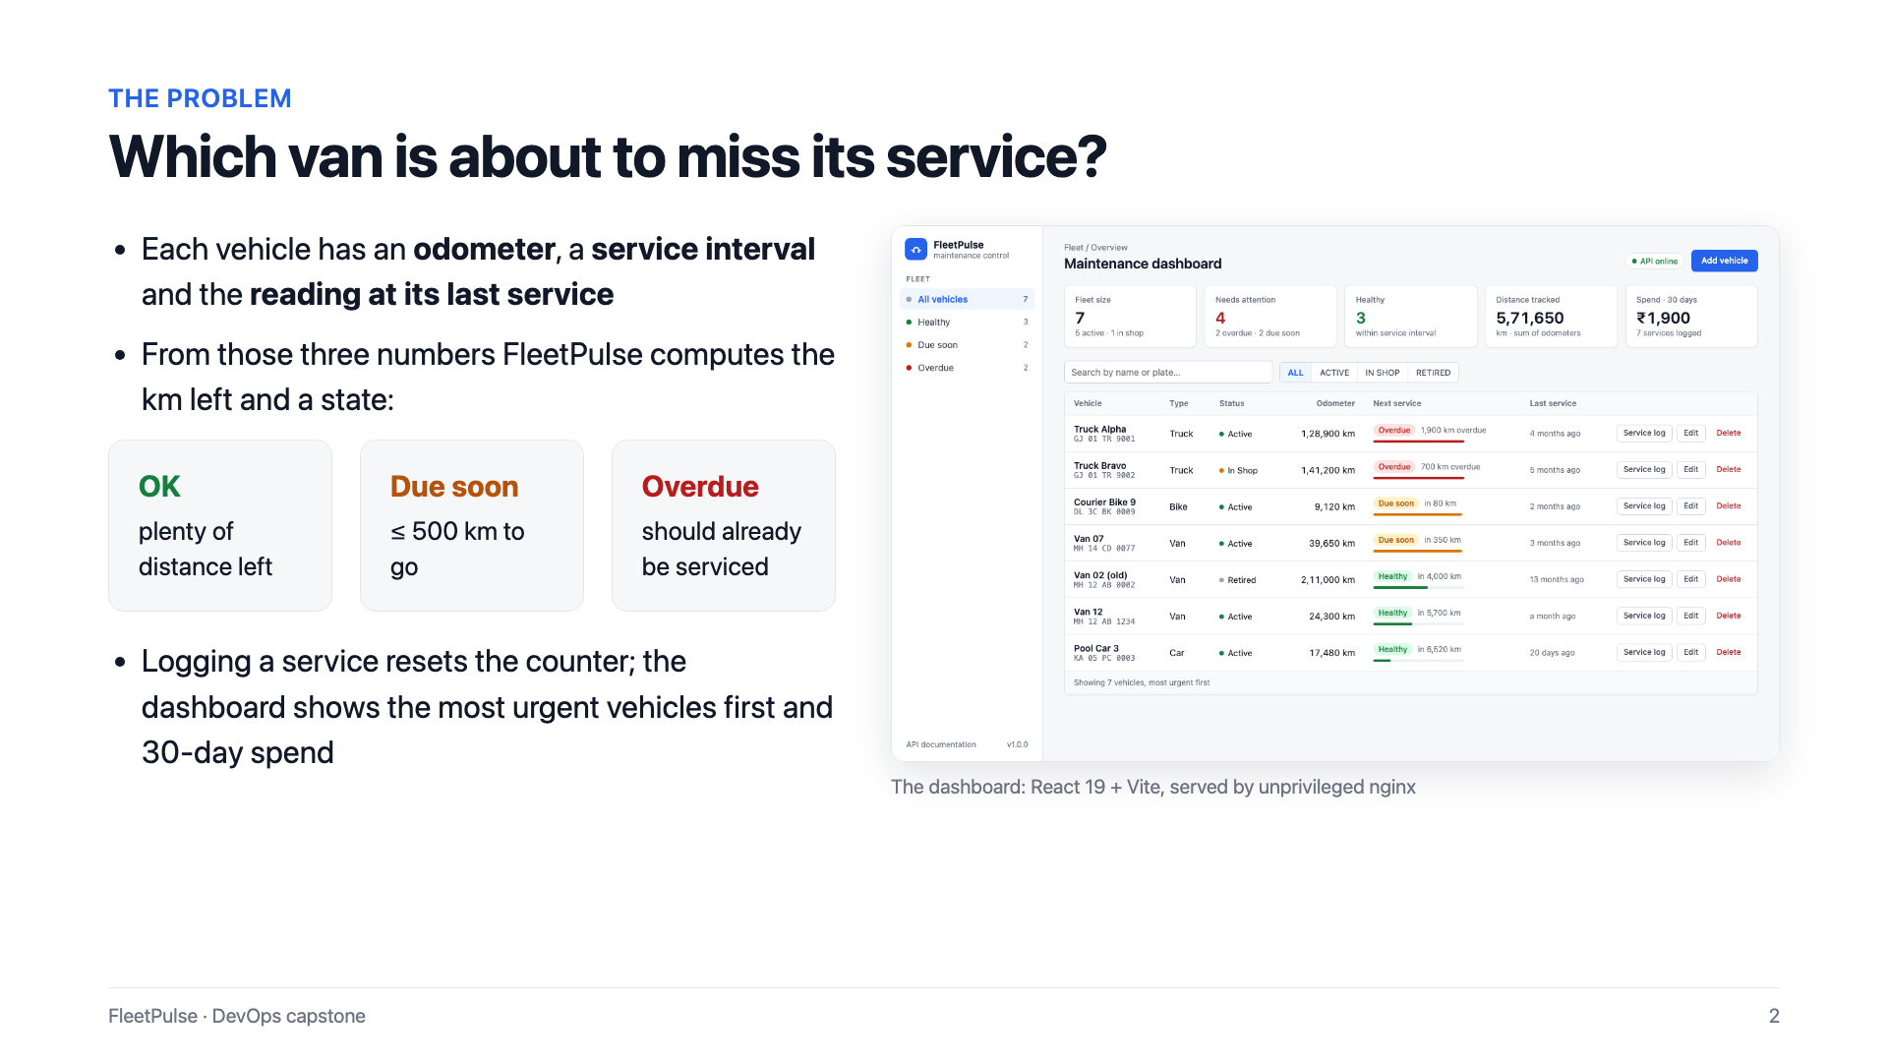
Notes:
The idea came from a simple question: which of our vans is about to miss its next service? Every vehicle has an odometer reading, a service interval, and the reading at its last service. From those three numbers, the app works out how many kilometres are left, and puts each vehicle into one of three buckets: OK, due soon, or overdue. Logging a service resets the counter.

Slide 3
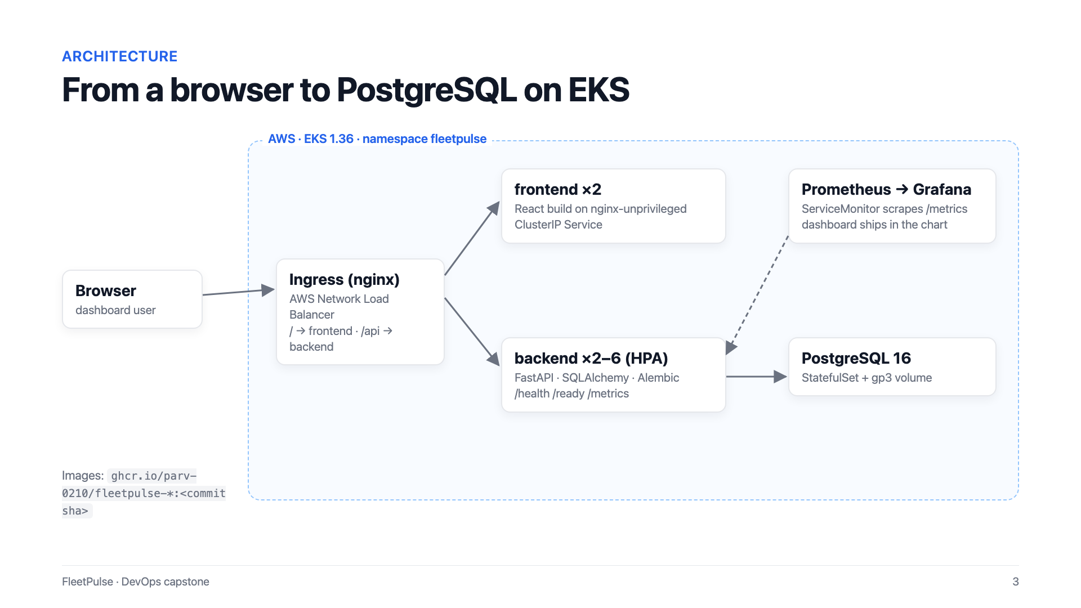
Notes:
Here is the architecture on AWS. A browser reaches an nginx Ingress behind an AWS Network Load Balancer. Slash goes to the React frontend, and slash A P I goes to the FastAPI backend. Both run with at least two replicas, and the backend scales with a horizontal pod autoscaler. Data lives in PostgreSQL. Prometheus scrapes the backend's metrics, and Grafana shows them on a dashboard that ships inside the Helm chart.
[Live demo] Let's look at the running app. I started the full stack locally with docker compose up. At the top are the fleet numbers: size, vehicles that need attention, and the spend over the last thirty days. The table is sorted by urgency, so the overdue trucks come first. The sidebar filters by maintenance state, for example only overdue, or due soon. And search works on name or number plate.
[Live demo] Now I'll register a new van. It has driven forty-eight thousand two hundred kilometres, with a ten thousand kilometre service interval, and it was last serviced at thirty-eight thousand. That is two hundred kilometres past due, so it lands at the top of the table as overdue. I open its service log and record an oil change at the current reading. The maintenance counter resets, and the van moves to healthy.
[Live demo] The backend is FastAPI, so the Swagger documentation is generated automatically. Here is the fleet stats endpoint, executed live against PostgreSQL. The health endpoint answers UP. And slash metrics exposes Prometheus metrics, including my own business gauges: how many vehicles are OK, due soon, or overdue.

Slide 4
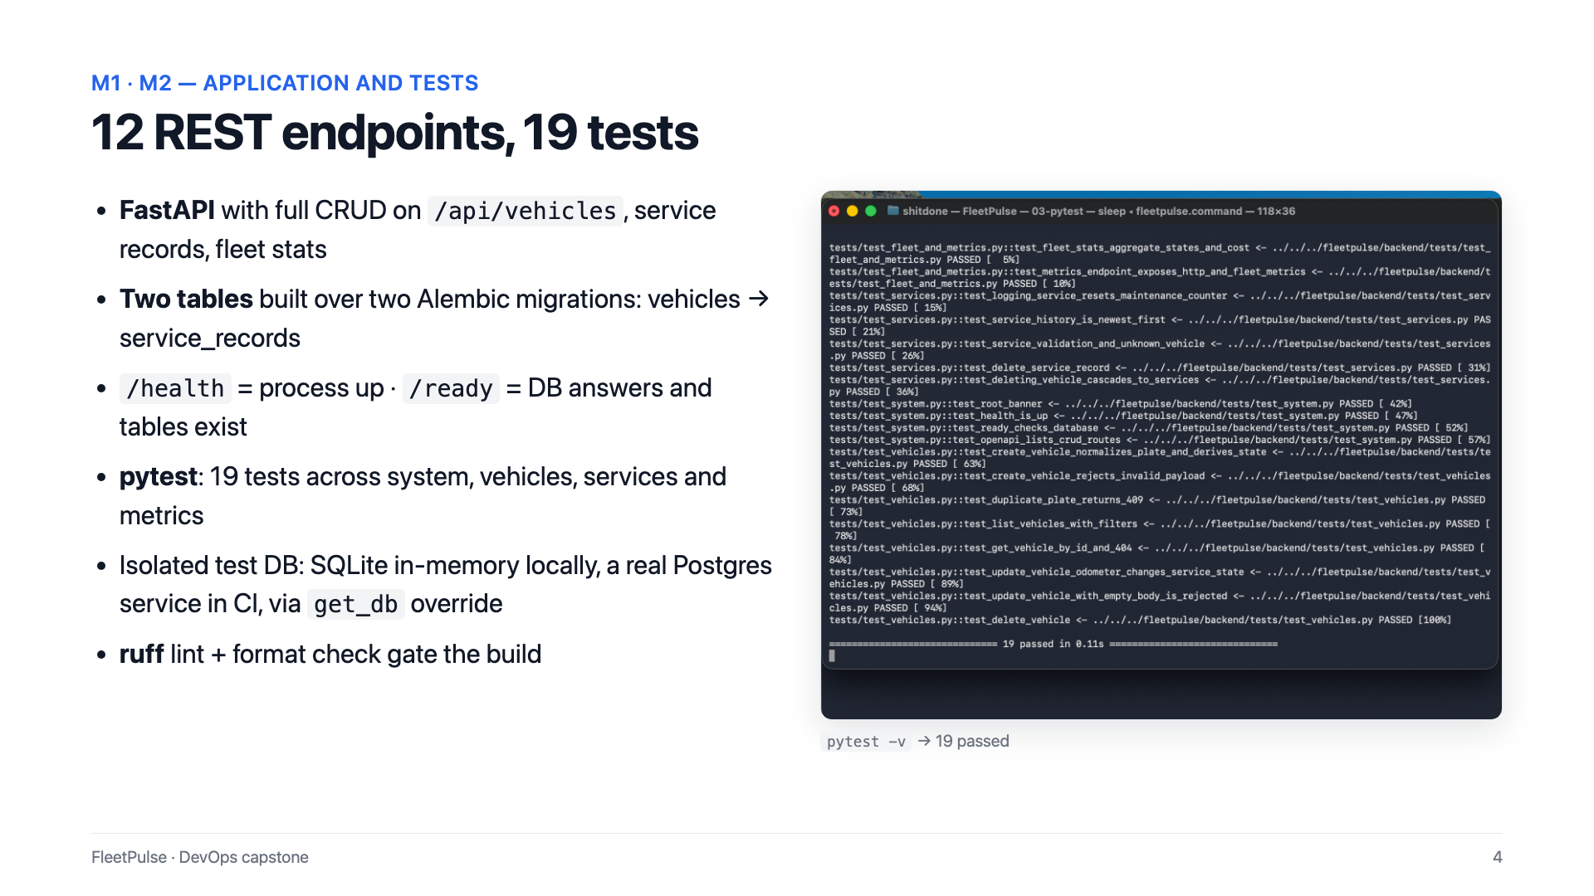
Notes:
On the application side, there are twelve REST endpoints with full create, read, update and delete on vehicles, plus service records. The schema is built over two Alembic migrations. There are nineteen pytest tests, and they never touch a real database: locally they use in-memory SQLite, and in CI they run against a throwaway PostgreSQL service. Ruff lint and format checks also gate the build.

Slide 5
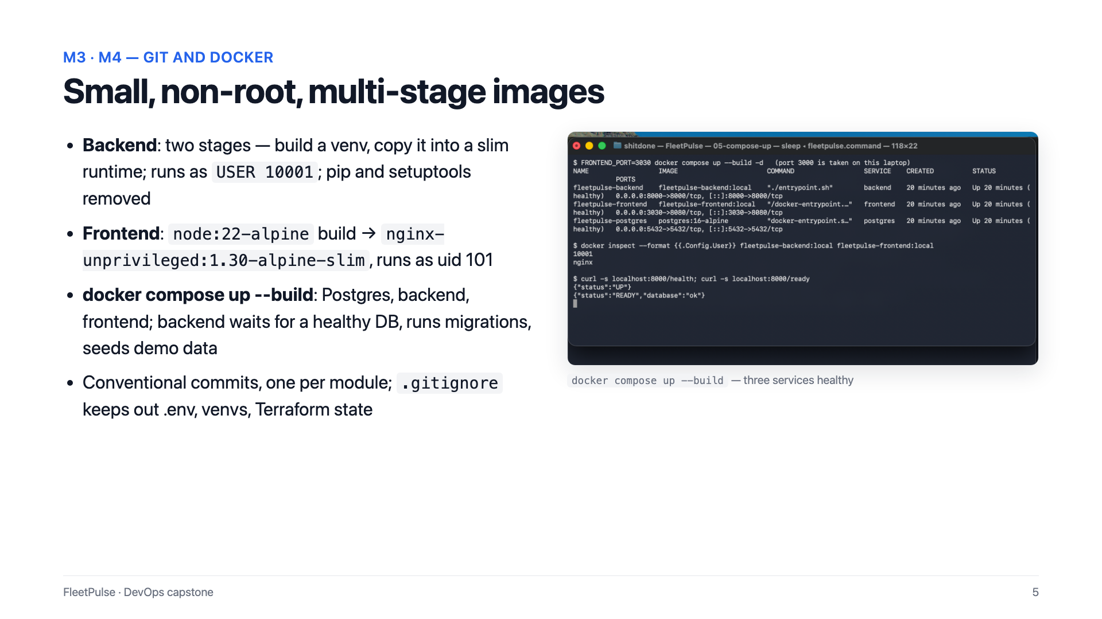
Notes:
Both images use multi-stage builds and run as non-root users. The backend copies a prebuilt virtual environment into a slim runtime and removes pip. The frontend is built with Node, then served by an unprivileged nginx image. Docker compose starts PostgreSQL, the backend and the frontend, and the backend waits for a healthy database before it runs migrations.

Slide 6
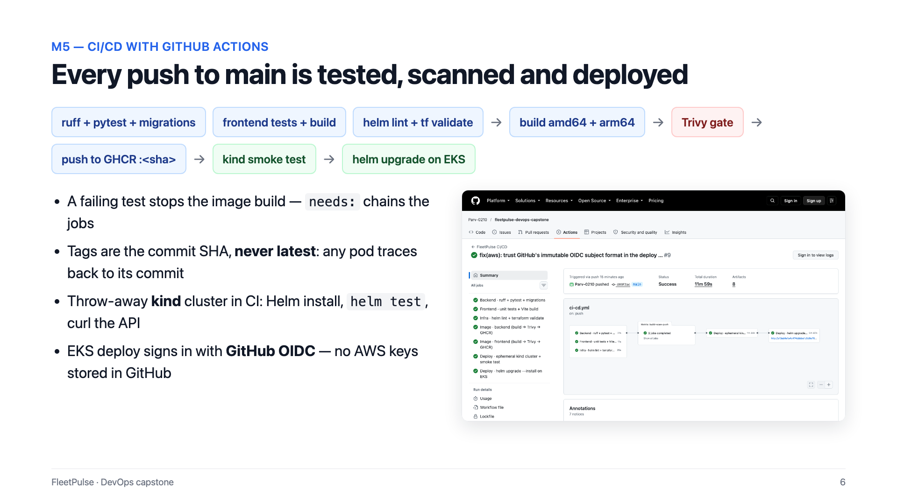
Notes:
The CI/CD pipeline runs on every push to main. Backend tests, the frontend build and infrastructure validation run in parallel. Only if they pass are both images built for A M D sixty four and ARM, scanned by Trivy, and pushed to the GitHub Container Registry, tagged with the commit SHA, never latest. The chart is then installed on a throwaway kind cluster inside CI and smoke tested, and finally deployed to EKS. The deploy job signs in to AWS with GitHub's OIDC token, so no AWS keys are stored in GitHub.
[Live demo] Here is the pipeline on GitHub Actions, with the history of runs on main. Opening the latest run, every job passed: backend tests, the frontend build, infrastructure checks, both images through the Trivy gate, the kind smoke test, and finally the Helm deployment to EKS.

Slide 7
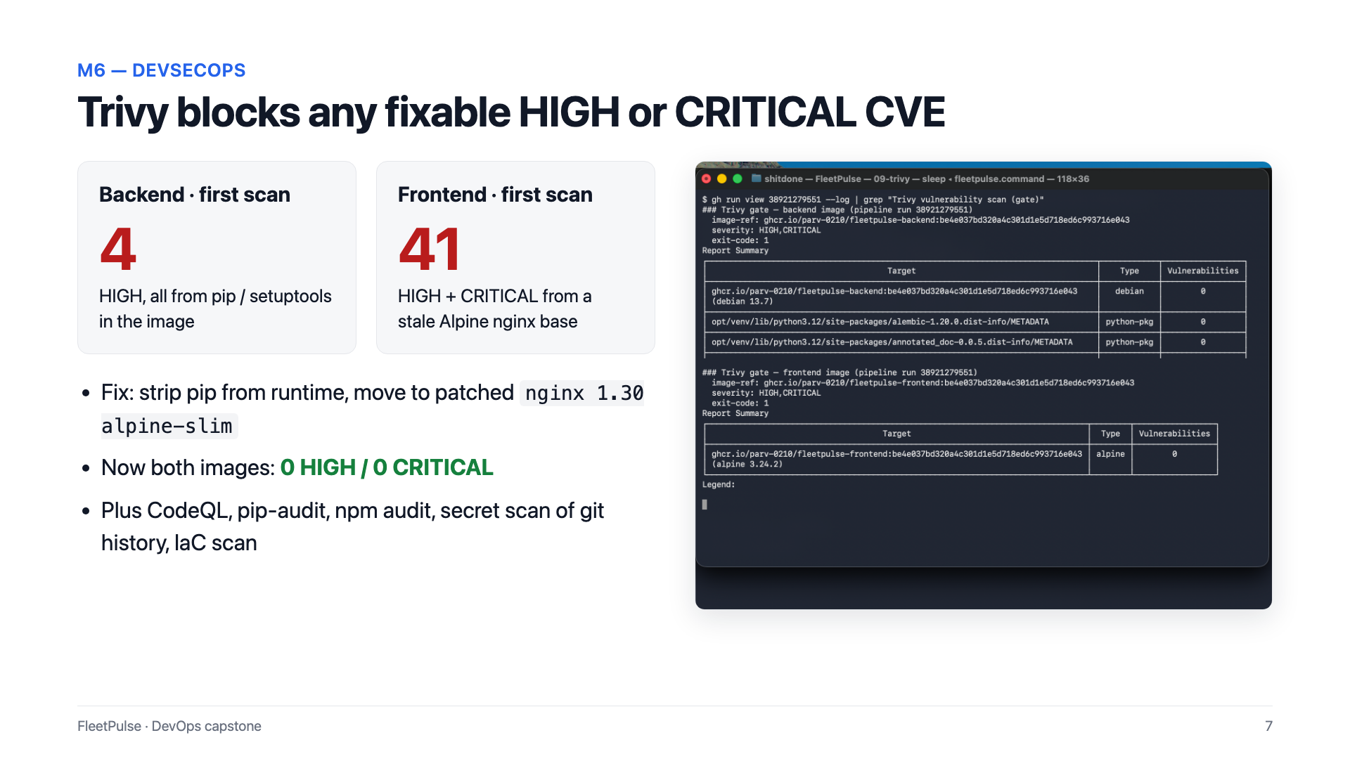
Notes:
Security is a gate, not a report. Trivy fails the pipeline on any fixable high or critical vulnerability. My first scan found four high issues in the backend image and forty-one high or critical issues in the frontend image. None were in my code: they came from pip in the runtime image and from an outdated nginx base. After removing pip and moving to a patched nginx image, both scan clean. A separate security workflow adds CodeQL, dependency audits, a secret scan of the full git history, and an infrastructure misconfiguration scan.

Slide 8
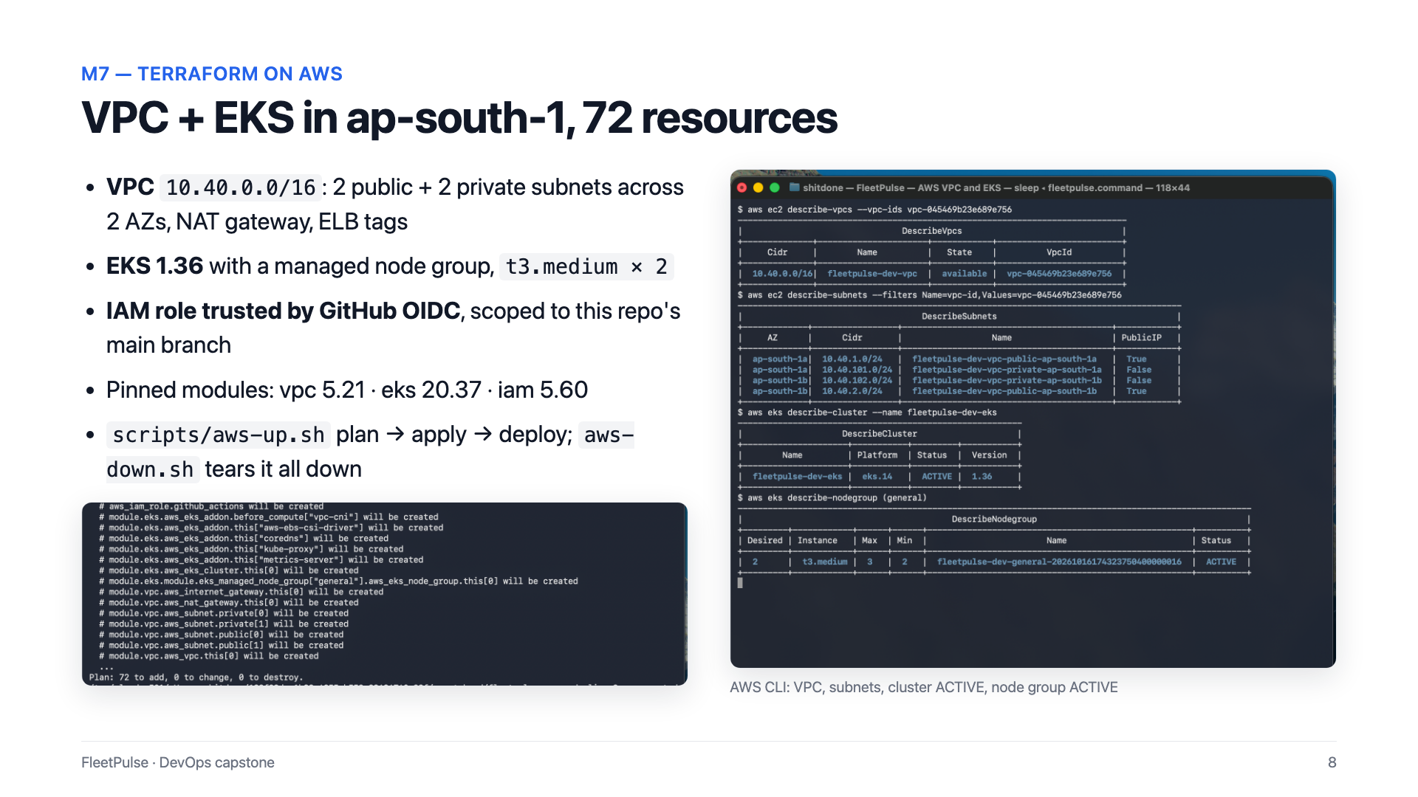
Notes:
The AWS infrastructure is written in Terraform: seventy-two resources. A VPC with two public and two private subnets across two availability zones, with a NAT gateway. An EKS cluster, version one point three six, with a managed node group of two t3 medium instances. And an IAM role that trusts GitHub's OIDC provider, but only for this repository's main branch. One script creates everything, and another tears it all down, so the cluster only costs money while I need it.

Slide 9
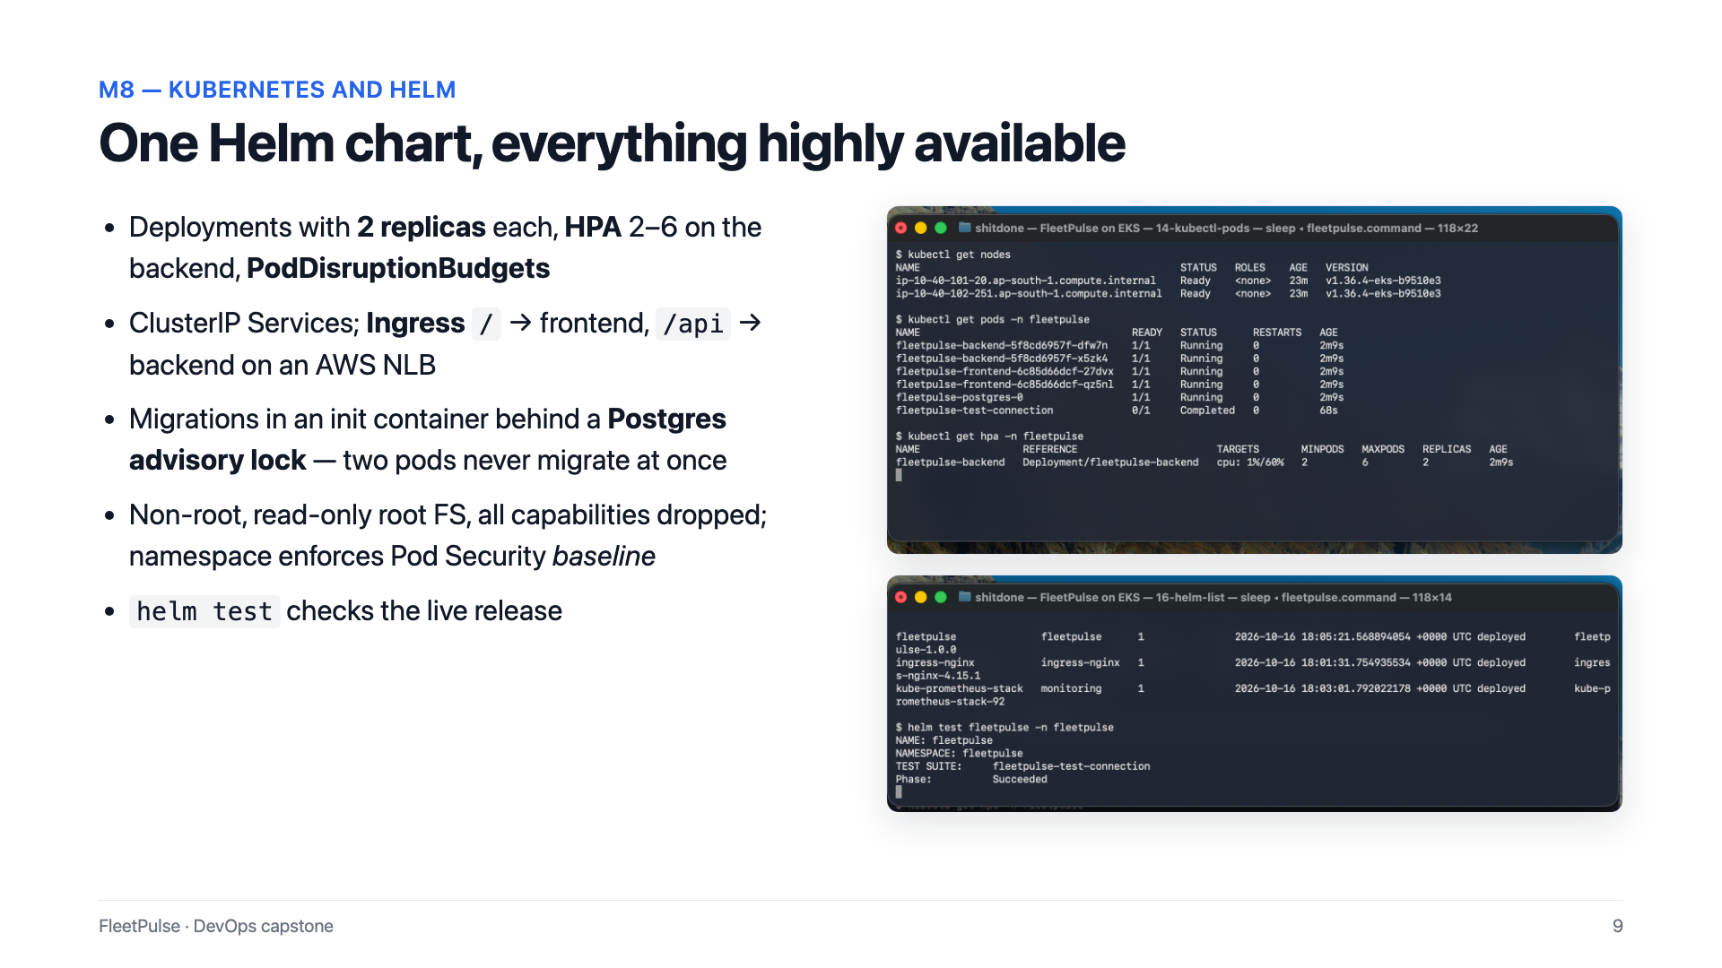
Notes:
Kubernetes is deployed with a single Helm chart. Each service runs two replicas, the backend has an autoscaler from two to six pods, and pod disruption budgets protect availability. The Ingress routes slash to the frontend and slash A P I to the backend. Database migrations run in an init container that first takes a PostgreSQL advisory lock, so two pods starting together never migrate at the same time. Containers are non-root, with a read-only file system and all Linux capabilities dropped.

Slide 10
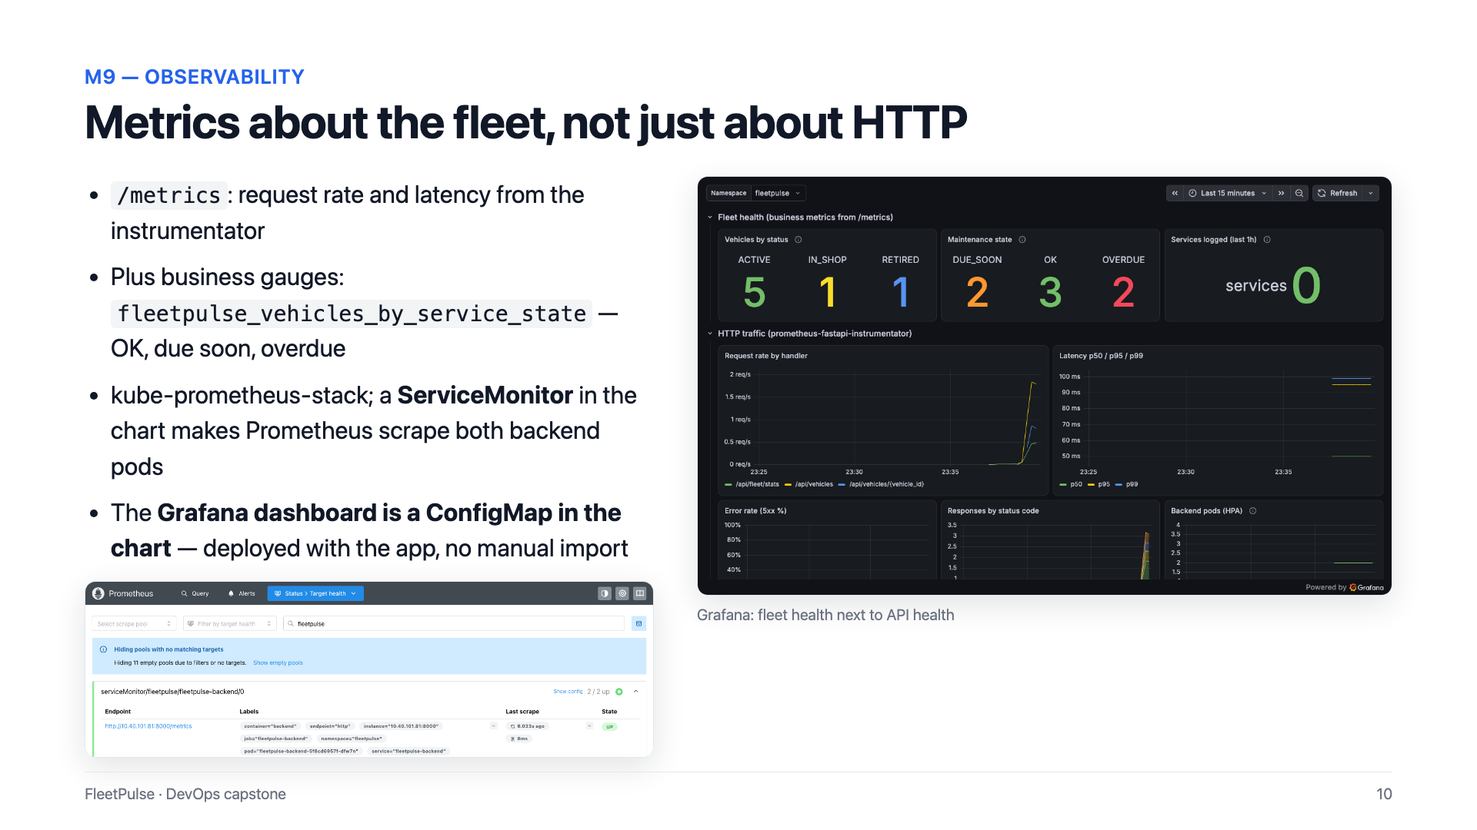
Notes:
For observability, the backend exposes request rate and latency, plus metrics about the fleet itself. A ServiceMonitor in the chart tells Prometheus to scrape both backend pods, and the Prometheus targets page shows them up. The Grafana dashboard is stored in the chart as a config map, so it is deployed together with the app, and shows fleet health right next to API health.

Slide 11
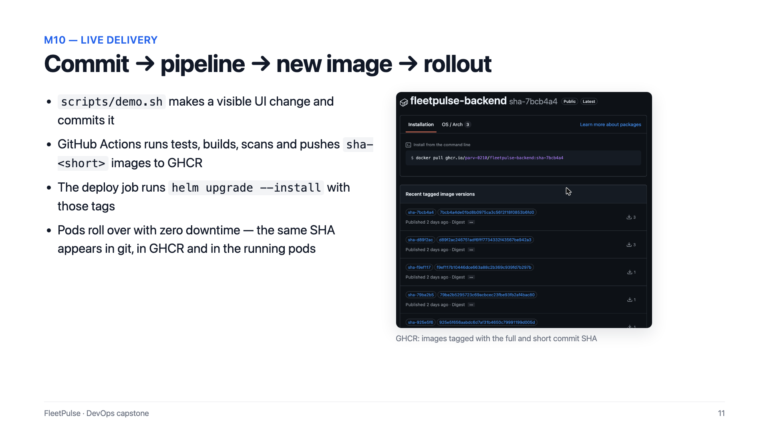
Notes:
The live delivery demo ties it together. A script makes a visible change to the UI and pushes it. The pipeline tests, builds, scans and publishes images tagged with that commit, and the deploy job rolls the cluster onto them. The same SHA appears in git, in the container registry, and in the running pods.

Slide 12
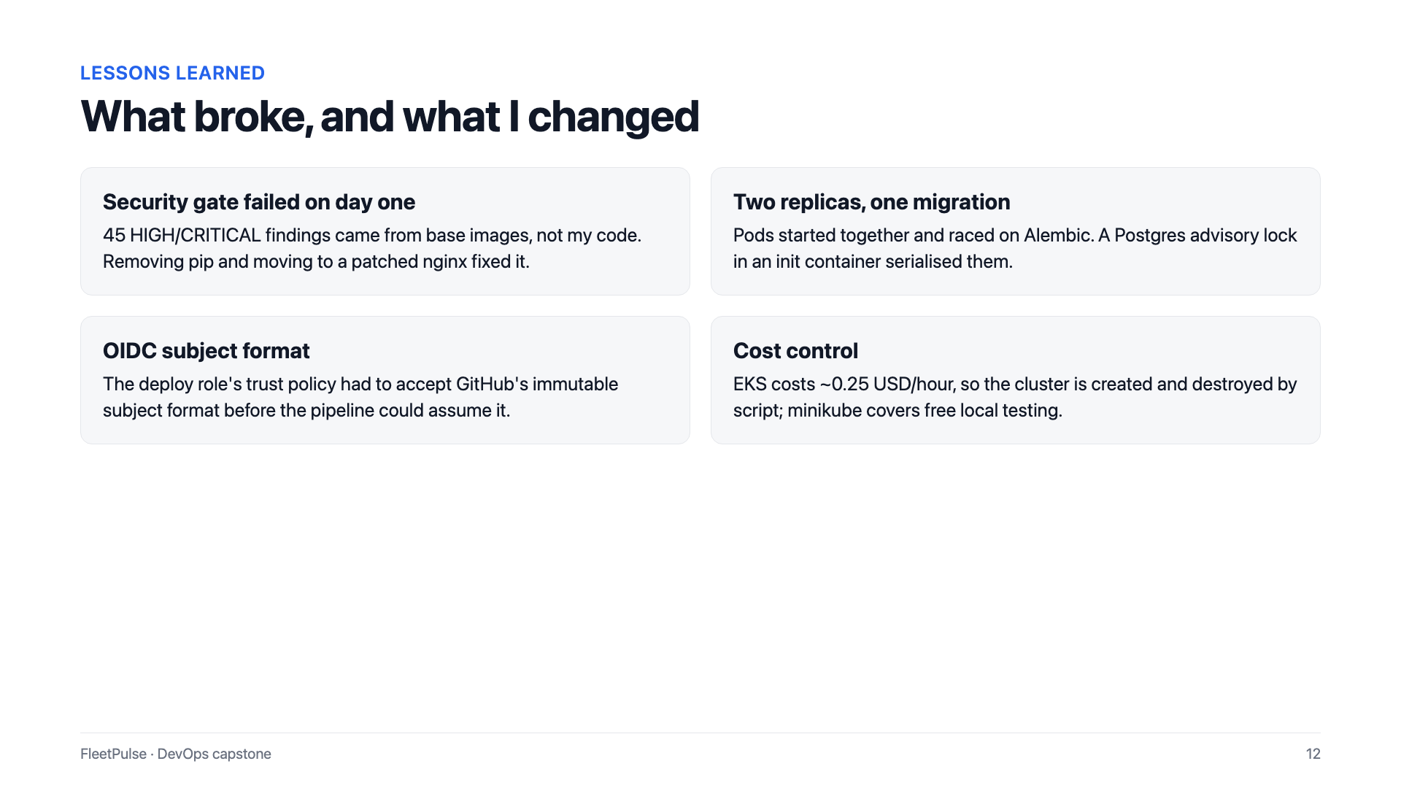
Notes:
A few lessons. The security gate failed on the first day, and the fix was in the base images, not the code. Two replicas starting together raced on migrations, which the advisory lock solved. The OIDC trust policy needed GitHub's newer subject format. And because EKS costs money by the hour, the whole environment is created and destroyed by script.

Slide 13
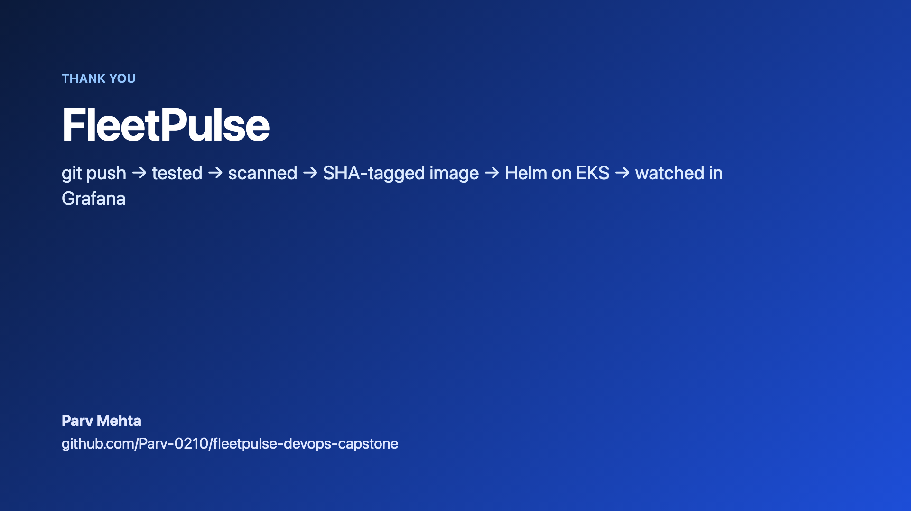
Notes:
To sum up: a git push is tested, scanned, built into a SHA-tagged image, deployed with Helm on EKS, and watched in Grafana. Thank you for watching.

