Slide 1

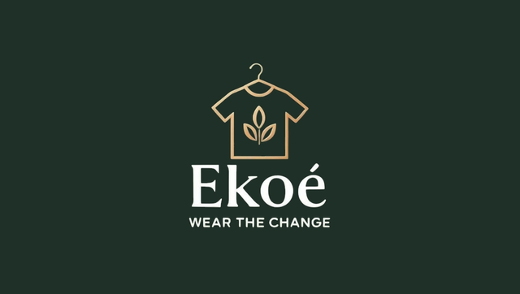
MARKETING MANAGEMENT
SUSTAINABLE CLOTHING BRAND: EKOÉ

Slide 2
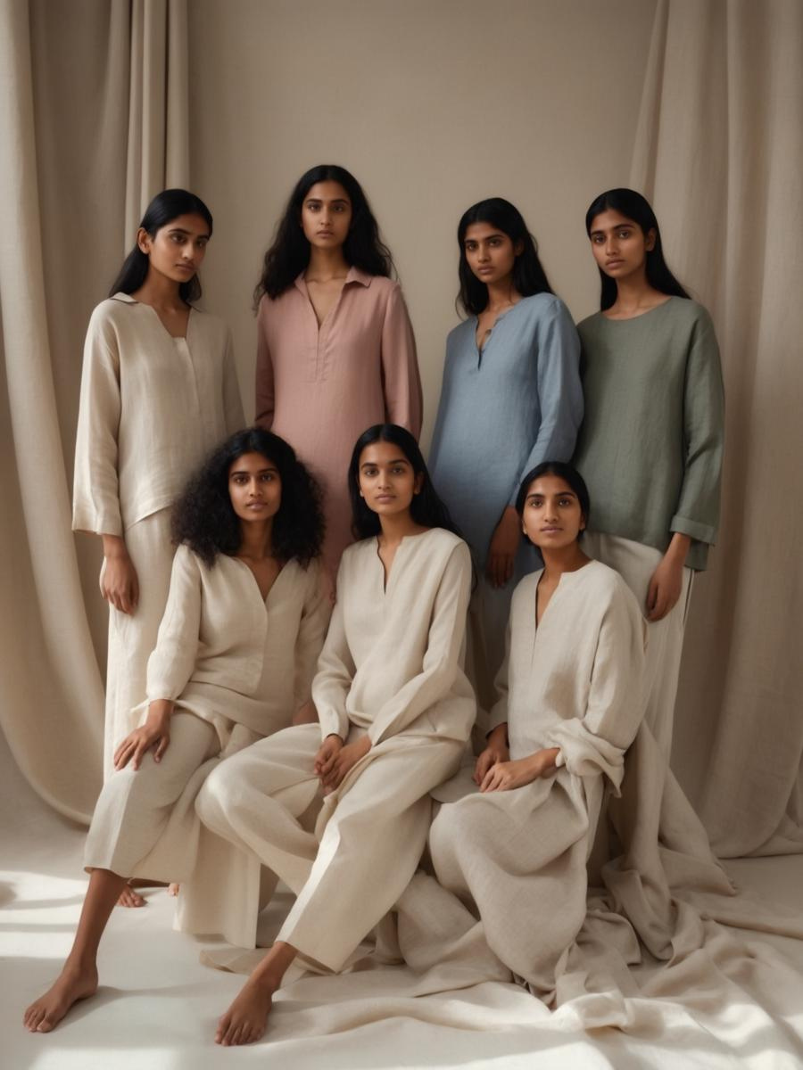
EXECUTIVE
SUMMARY
Ekoé is a premium sustainable clothing brand designed for eco-conscious consumers.
This report outlines our external environment analysis (PESTEL), industry competitiveness via Porter’s Five Forces, STP framework, consumer insights, the making of the logo and tagline, and final marketing recommendations.
We aim to establish Ekoé as a premium yet accessible lifestyle brand that blends timeless fashion with sustainability.

Slide 3
PESTEL ANALYSIS
Political Factors
Government programs : PM MITRA Parks, PLI Scheme offer substantial financial support.
Ekoé’s local sourcing strategy shields it from global supply chain issues.
Financial Considerations
High-Income Buyers
Price-Conscious Market
Competitive Edge
Technology Needs
Online Engagement
Quick Processes
New Products
Green Making
Environmental Impact
Lasting Style
Earth-Kind Packaging
Green Image
Social Factors
Shifting Consumer Views
Brands as Storytellers
Lifestyle Focus

Slide 4
PORTER’S FIVE FORCES
1) Threat of New Entrants: Moderate
  Barriers to entry are relatively low in the fashion industry. But tapping into the premium sustainable category is not easy.
  Gaining trust, finding sustainable materials, and ensuring brand consistency all take capital, design skills, and reliable supply chains.
2) Bargaining Power of Suppliers: Moderate
  The suppliers have fair amount of negotiating power as good eco-friendly raw material like recycled fabric, cotton, linen, bamboo, etc. are available in short supply
3) Bargaining Power of Buyers: High
  Our customers (22–45 years; household income > ₹50K/month) are urban and aware about sustainability. They are conscious about fashion as well as budget.

Slide 5
PORTER’S FIVE FORCES
4) The Threat of Substitutes: Moderate – High
  Consumers can easily transition to premium fashion brands including H&M Premium, Zara, Mango, Doodlage and Uniqlo.
  Choices such as second-hand fashion, thrift platforms and rental clothing services are increasingly popular among conscious consumers.
5) Rivalry Among Existing Competitors: High
  Premium fashion market is very competitive. The market is saturated with global brands, new eco-friendly companies selling directly to customer and India fashion brand trying to establish their place.

Slide 6
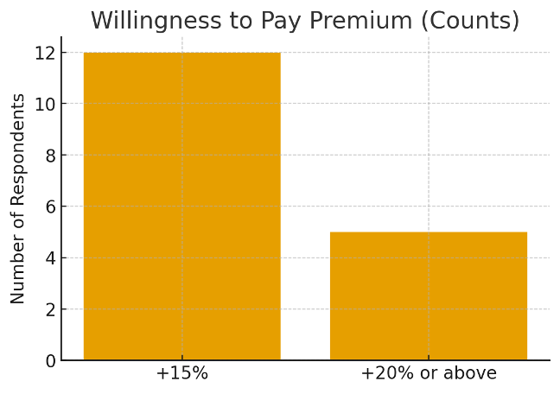
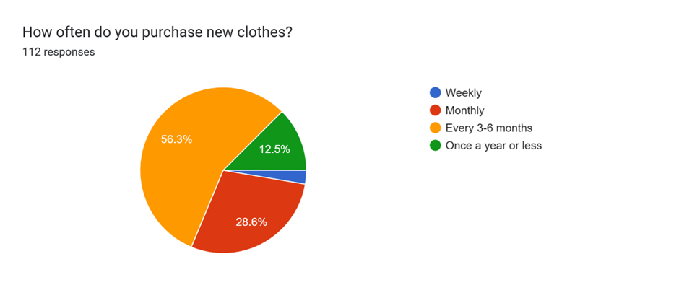
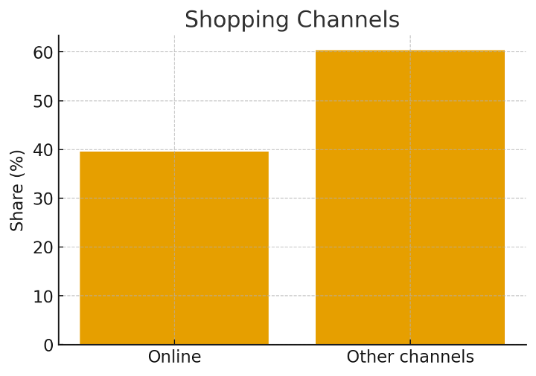
Data Analyses & Visual Representations
Willingness to Pay – Respondent Counts
Frequency of Purchase of new clothes
Channel Preference (from survey)
Note: Additional respondents indicate willingness to pay ~10% premium (qualitative).
85 respondent shop every 3-6 months, whereas 43 respondent shop once a month
39.6% shop online. Remaining respondents use other channels (offline/local).

Slide 7
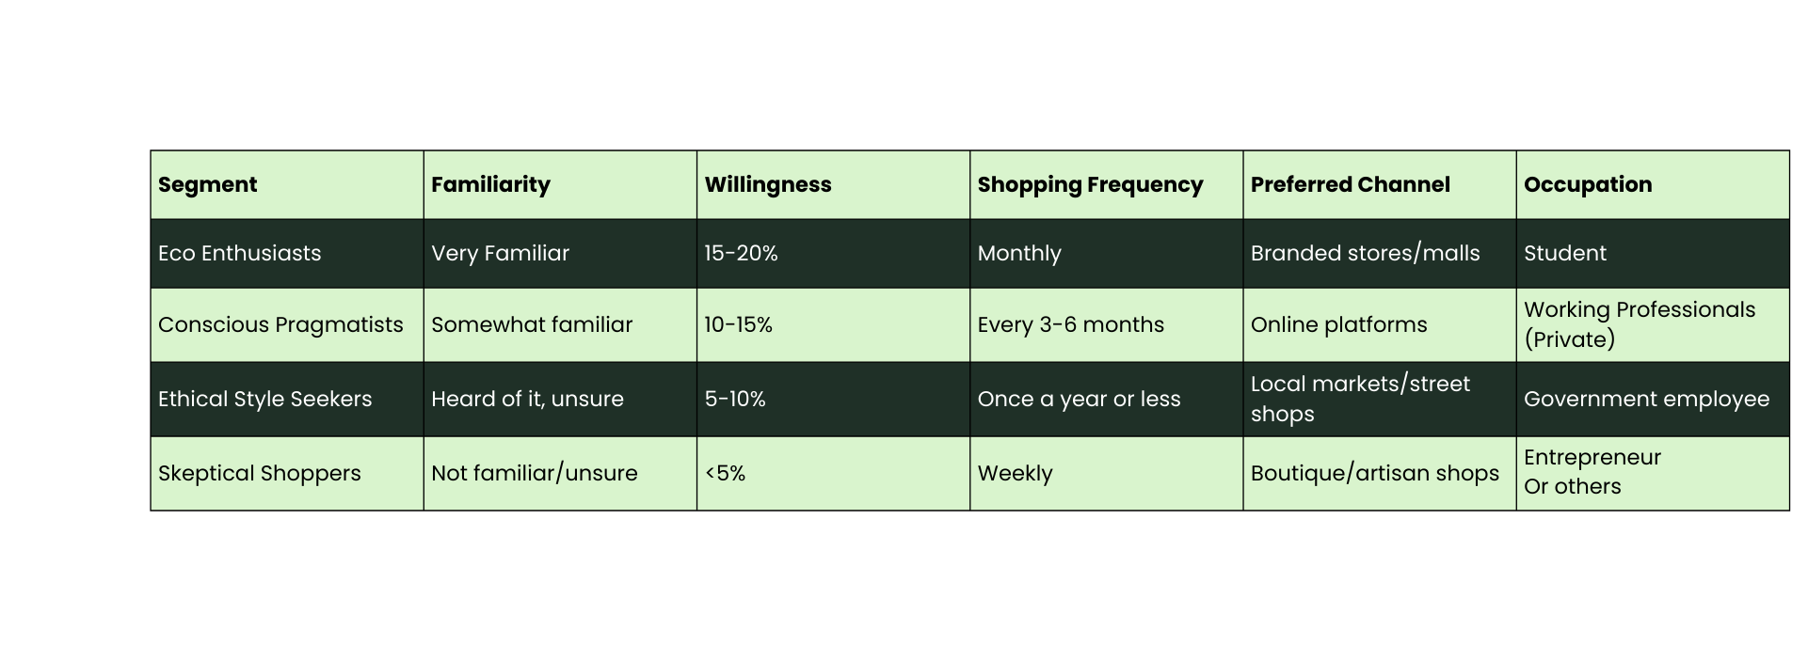
STP FRAMEWORK
Primary segment category: Eco enthusiasts (Small but high value)
  Willing to pay 15-20% more for sustainable clothing, shop monthly
  Prefer Boutique or branded shops and have high awareness
Second segment category: Conscious Pragmatists (largest respondents’ category)
  Willing to pay 10-15%, shop every 3-6 months
  Prefer online platform and have moderate sustainability awareness

Slide 8
POSITIONING
For conscious professionals and style-forward changemakers, Wear the Change offers ethically crafted, premium clothing that blends timeless design with environmental integrity.
Pillar | Description
Premium Craftsmanship | Use of premium yet breathable fabrics such as linen, cotton and bamboo silk, crafted silhouettes, and thoughtful designs
Sustainable Procurement | Sourcing materials with local artisan partnerships, and transparent procurement strategy along with circular practices
Emotional Connection | Storytelling about each piece’s origin, impact, and purpose
Digital-first experience | Instagram led brand presence with curated range, direct sales, and community interaction and engagement strategy

Slide 9
OUR STRATEGY
Product Strategy:
To Launch capsule collections in ranges to reduce wastage with premium fabrics such as linen, Cotton and bamboo silk
Channel Strategy:
Focus on online platforms further expanding to branded retail partnerships
Pricing Strategy:
Tiered pricing with premium lines starting at 15–20% above market that is Rs 1500-6000
Communication Strategy:
Using storytelling for emotional connection, certifications, and polls and reels with craftsmanship importance to build trust
Season | Campaigns Theme | Material focus | Product Category
Spring (Feb–Apr) | “Fresh Starts, Earth First” | Organic cotton, linen | Everyday wear, light workwear
Summer (May–Jul) | “Breathe Easy, Dress Light” | Bamboo silk, linen blends | Resort wear, breathable formals
Monsoon (Aug–Sep) | “Weather the Change” | Treated cotton, quick-dry linen | Layered wear, monsoon-friendly sets
Winter (Dec–Jan) | “Warmth with Purpose” | Heavier linen, cotton knits | Layered formals, cozy essentials

Slide 10
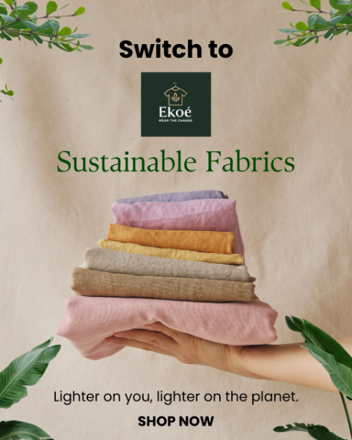
INSTAGRAM MARKETING
  Visual Structure: Using minimal and earthy tones, simple product design, artisanal textures
  Content Strategy: Craftsmanship , sustainable procurement stories, premium lifestyle, customer engagement
  Sales Strategy: Instagram-led brand presence , limited/periodic range drops, pre-order model to waste reduction due to size issues and customization requests
  Engagement: Using polls for trend and customer analysis, reels for better reach, styling tips and behind-the-scenes sourcing for customer engagement
Our team worked to design a series of posters and social medial content as shown above in order to advertise and market our sustainable clothing brand, we also worked on a social media page for the brand

Slide 11

THANK YOU

