Slide 1

Field Project
On
Real-Time Human Detection using GAIT
Under the supervision of:
Mr. Navin Kumar Agrawal
(Department of CEA)
Presented by:-
Parv Agrawal (2215001218)
Arpit Tomar (2215000351)
Kanhaiya Garg (2215000865)
Sagar Gautam (2215001519)
Sankit Saraswat (2215001583)

Slide 2
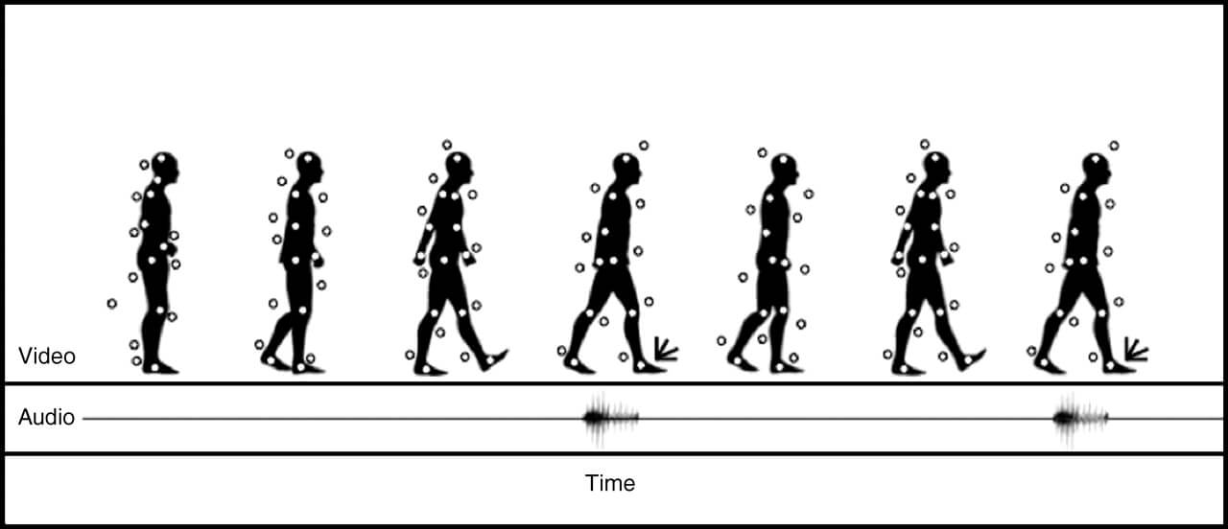
INTRODUCTION
Human detection is a fundamental task in computer vision that plays a vital role in numerous applications, including surveillance, human-computer interaction, activity recognition, and robotics. Traditional human detection methods primarily rely on visual cues, such as body shape and appearance, which can be limited in challenging scenarios where lighting conditions are poor, individuals are occluded, or there is significant variation in clothing and appearance.
The GAIT dataset, which serves as the foundation for this project, comprises a vast collection of gait patterns captured through different sensing modalities, including accelerometers, gyroscopes, and motion capture systems. This dataset offers a wealth of information for developing robust and accurate human detection models that can exploit the distinctive features of gait.
This project focuses on utilizing the GAIT dataset to develop a human detection model based on gait analysis. By exploiting the unique walking patterns of individuals, we aim to overcome the limitations of traditional methods and enhance the accuracy and robustness of human detection systems in various practical applications.

Slide 3
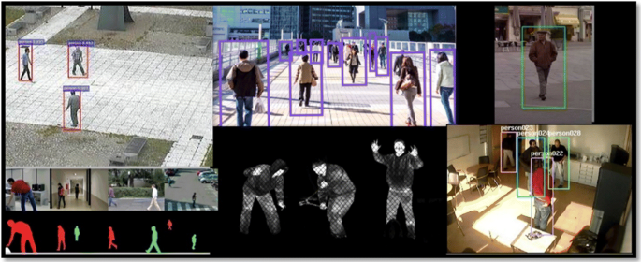
Uses Of Real-Time Human Detection using GAIT

Slide 4
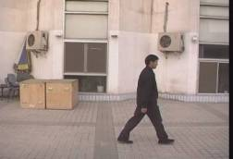
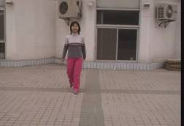
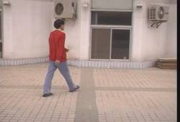
CASIA GAIT DATASET
CASIA GAIT dataset A can be downloaded from this site:
http://www.cbsr.ia.ac.cn/english/Gait%20Databases.asp
We have only downloaded some parts of CASIA Dataset A which was available as a sample. The size of the original CASIA GAIT dataset is around 28 GB, but resource constraints prevented us from utilizing the complete dataset.
The size of Dataset A is about 2.2GB and the database includes 19139 images.

Slide 5
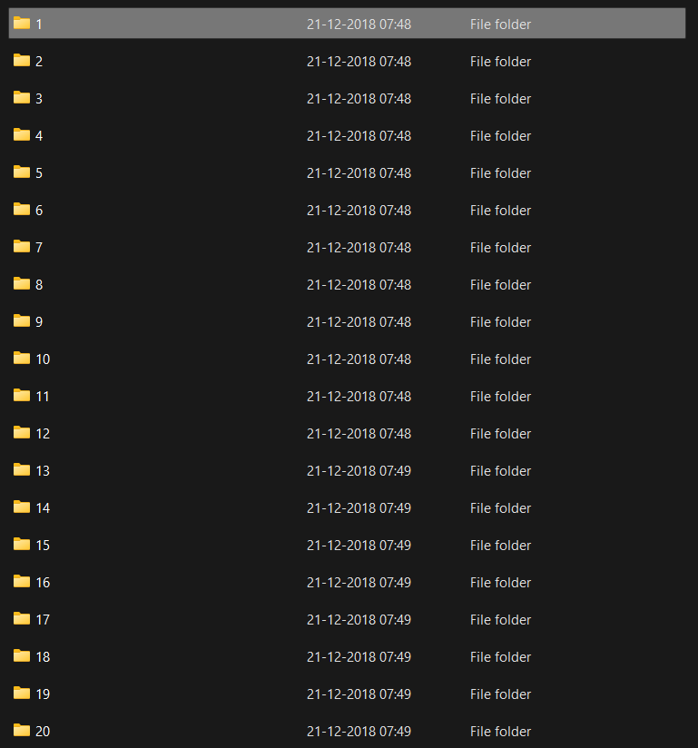
Dataset Structure and Working
After opening the folder named GaitDatasetA-silh, there are 20 subfolders named 1 to 20 that represent 20 different objects

Slide 6
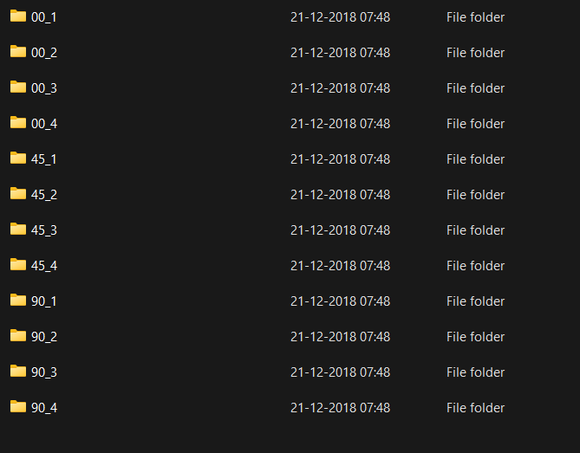
In each folder, there are sub-folders denoting the angles of the dataset captured i.e. parallel, 45 degrees, and 90 degrees to the image plane.

Slide 7
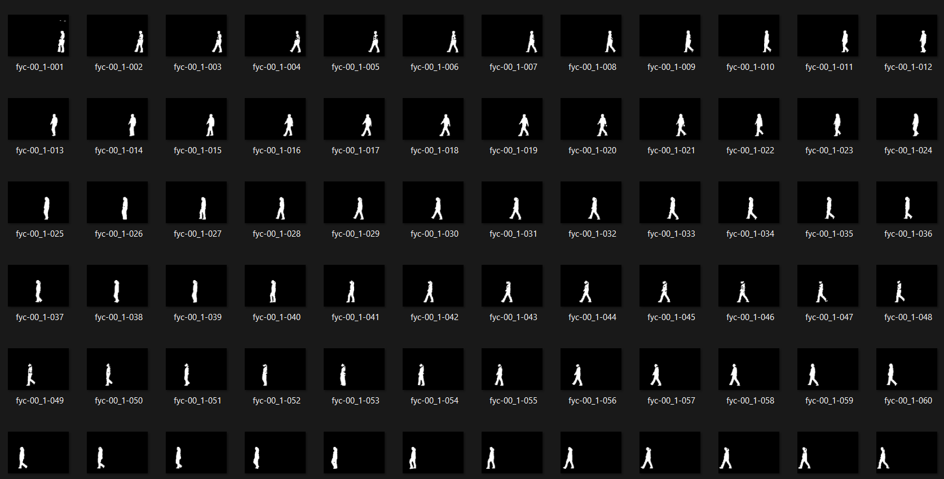

Slide 8
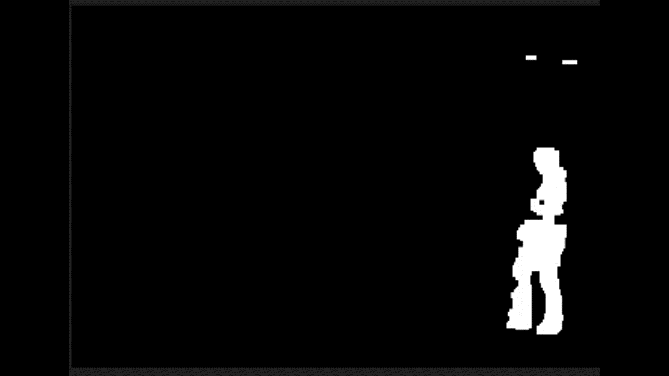
Video Clip on how image patterns are arranged

Slide 9
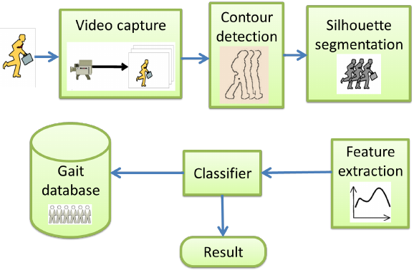
Steps Required

Slide 10
Modules Used
We have trained a model based on our GAIT dataset by the code which can be further used in human detection code.
Here's a breakdown of the modules used and a step-by-step explanation of the code:
os: The os module in Python provides a way to interact with the operating system. It allows you to perform various tasks such as manipulating file paths, creating and deleting directories, accessing environment variables, and executing system commands.
cv2: cv2 is the Python interface for OpenCV (Open Source Computer Vision Library). OpenCV is a powerful library for computer vision and image processing tasks. It provides a wide range of functions and algorithms to handle images and videos.
numpy (imported as np): numpy is a fundamental library for numerical computing in Python. It provides high-performance multidimensional array objects, along with a collection of mathematical functions to operate on these arrays efficiently.

Slide 11
sklearn.model_selection: The sklearn.model_selection module in the scikit-learn library provides various tools for model selection and evaluation. It includes functions for splitting datasets into training and testing sets using strategies like random splitting, stratified splitting, cross-validation, and time series splitting. Additionally, it provides utilities for parameter tuning, model evaluation metrics, and hyperparameter optimization.
keras: Keras is a high-level deep learning library that runs on top of other deep learning frameworks, such as TensorFlow or Theano. It provides a user-friendly and intuitive interface for defining and building neural network models. With Keras, you can easily create and train various types of neural networks, including convolutional neural networks (CNNs), recurrent neural networks (RNNs), and more. It also offers pre-trained models, tools for model evaluation, and utilities for data preprocessing.

Slide 12
Limitations and Challenges
The size of the original CASIA GAIT dataset which is around 28 GB posed a limitation, as resource constraints prevented us from utilizing the complete dataset. Consequently, the diversity and variability of the gait patterns used for model training were somewhat limited.
Environmental factors, such as changes in lighting conditions or camera angles, could impact the performance of the GAIT model. Further research is necessary to enhance its adaptability to different real-world scenarios.
So, currently, it is not accurate as our dataset is small and not complete in order to recognize human currently

Slide 13
FUTURE WORK SCOPE
Future work should focus on expanding the dataset to include a broader range of gait patterns, incorporating additional environmental factors for better generalization, and exploring more advanced model architectures to improve the performance further.
In future, we will continue and improve this project by using more advanced datasets and systems.

Slide 14
Thank You

