Slide 1
FRAUDSHIELD AI / 01
FraudShield AI
Real-time fraud intelligence.
Every signal explained.
• Digital lending · hybrid detection · human investigation
• Local interview demonstration | FastAPI + React
LOCAL DEMONSTRATION · SYNTHETIC DATA · REAL INFERENCE
Notes:
Refer to docs/PRESENTATION.md for the full talk track. Digital lending · hybrid detection · human investigation Local interview demonstration | FastAPI + React

Slide 2
FRAUDSHIELD AI / 02
The problem
Static rules see fragments. Fraud spans behavior.
• Unusual amounts may be legitimate; a familiar device may be compromised.
• Signals need context: history, velocity, device and location.
• Investigators need evidence they can inspect, not an unexplained score.
LOCAL DEMONSTRATION · SYNTHETIC DATA · REAL INFERENCE
Notes:
Refer to docs/PRESENTATION.md for the full talk track. Unusual amounts may be legitimate; a familiar device may be compromised. Signals need context: history, velocity, device and location. Investigators need evidence they can inspect, not an unexplained score.

Slide 3
FRAUDSHIELD AI / 03
The solution
Detect → score → explain → investigate → learn
• Combine supervised prediction, deterministic rules and behavioral signals.
• Persist the features and evidence behind every policy decision.
• Keep the analyst in control of the investigation label.
LOCAL DEMONSTRATION · SYNTHETIC DATA · REAL INFERENCE
Notes:
Refer to docs/PRESENTATION.md for the full talk track. Combine supervised prediction, deterministic rules and behavioral signals. Persist the features and evidence behind every policy decision. Keep the analyst in control of the investigation label.

Slide 4
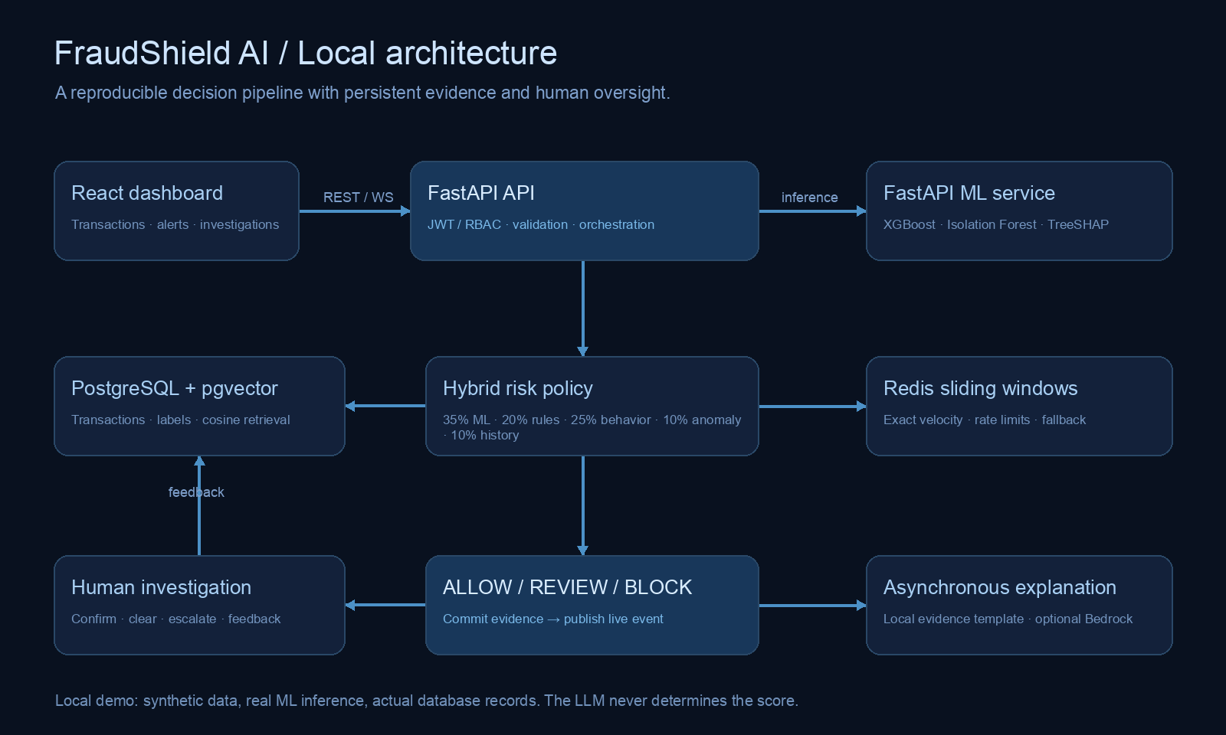
FRAUDSHIELD AI / 04
Local architecture
Five services. One complete workflow.
LOCAL DEMONSTRATION · SYNTHETIC DATA · REAL INFERENCE
Notes:
Refer to docs/PRESENTATION.md for the full talk track.

Slide 5
FRAUDSHIELD AI / 05
The decision pipeline
A transaction becomes an auditable decision.
• Validate identity, role, amount and request schema.
• Derive features from committed history and Redis windows.
• Run ML + rules + behavior + anomaly + pgvector retrieval.
• Aggregate the score; commit evidence; notify the dashboard.
LOCAL DEMONSTRATION · SYNTHETIC DATA · REAL INFERENCE
Notes:
Refer to docs/PRESENTATION.md for the full talk track. Validate identity, role, amount and request schema. Derive features from committed history and Redis windows. Run ML + rules + behavior + anomaly + pgvector retrieval. Aggregate the score; commit evidence; notify the dashboard.

Slide 6
FRAUDSHIELD AI / 06
Machine learning
Train and measure. Never hardcode predictions.
• 18,000 synthetic examples; 60 / 20 / 20 train-validation-test split.
• XGBoost model selection uses validation PR-AUC only.
• Isolation Forest detects departures from legitimate training behavior.
• No real-world fraud prevalence or deployment performance is claimed.
LOCAL DEMONSTRATION · SYNTHETIC DATA · REAL INFERENCE
Notes:
Refer to docs/PRESENTATION.md for the full talk track. 18,000 synthetic examples; 60 / 20 / 20 train-validation-test split. XGBoost model selection uses validation PR-AUC only. Isolation Forest detects departures from legitimate training behavior. No real-world fraud prevalence or deployment performance is claimed.

Slide 7
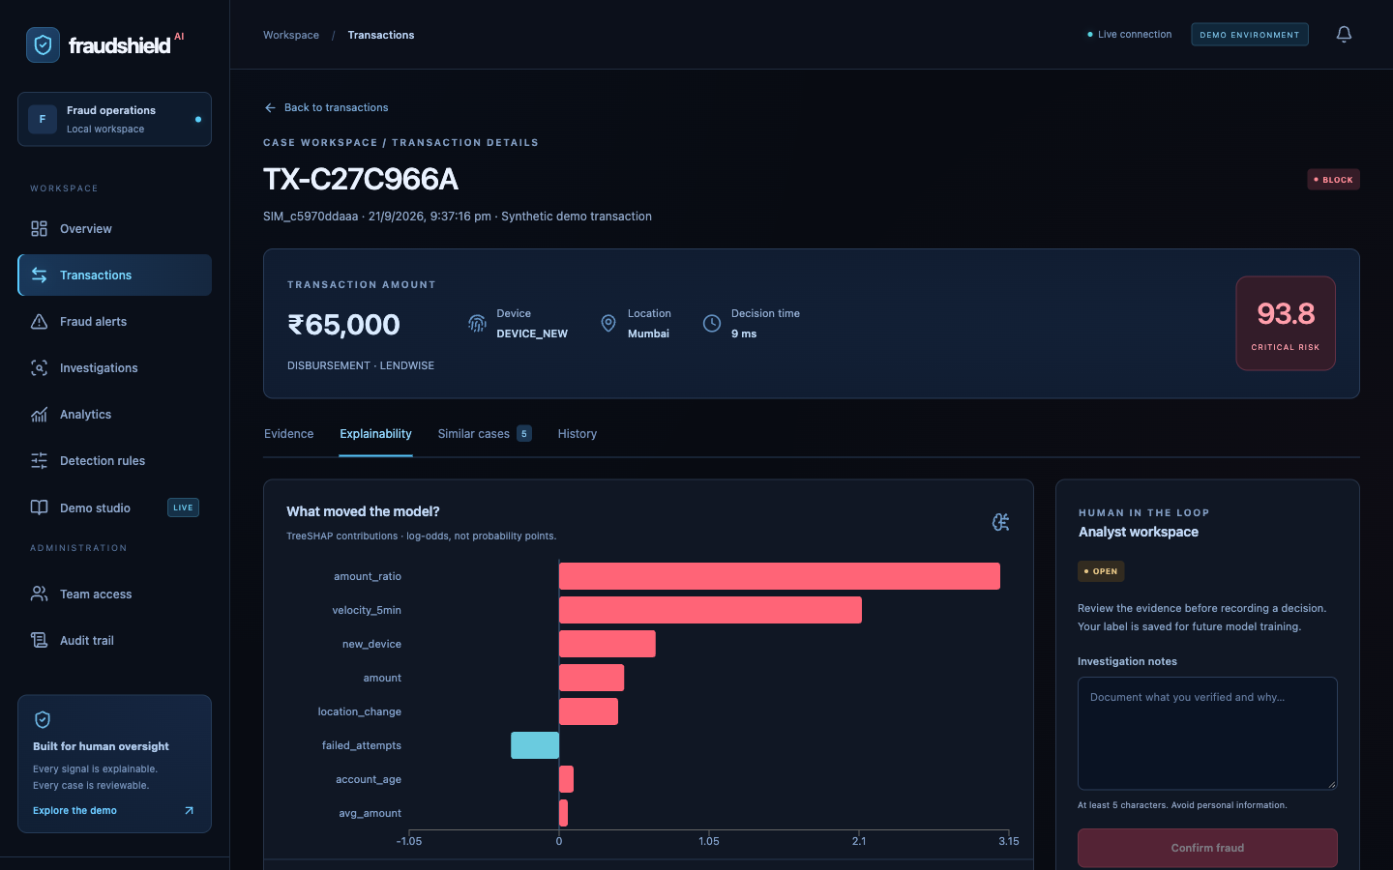
FRAUDSHIELD AI / 07
Explainability
Show why the model moved.
• TreeSHAP contributions are measured in log-odds.
• Contributions + base reconstruct the actual model prediction.
• Local prose cites captured evidence; it is explicitly not LLM output.
LOCAL DEMONSTRATION · SYNTHETIC DATA · REAL INFERENCE
Notes:
Refer to docs/PRESENTATION.md for the full talk track. TreeSHAP contributions are measured in log-odds. Contributions + base reconstruct the actual model prediction. Local prose cites captured evidence; it is explicitly not LLM output.

Slide 8
FRAUDSHIELD AI / 08
Historical cases
Similar patterns add context, not certainty.
• pgvector executes actual cosine similarity search.
• 256-dimensional local hashing vectors represent pattern text.
• Only confirmed cases from the matching embedding provider are retrieved.
• Reference cases are labeled synthetic; analyst confirmations enter retrieval.
LOCAL DEMONSTRATION · SYNTHETIC DATA · REAL INFERENCE
Notes:
Refer to docs/PRESENTATION.md for the full talk track. pgvector executes actual cosine similarity search. 256-dimensional local hashing vectors represent pattern text. Only confirmed cases from the matching embedding provider are retrieved. Reference cases are labeled synthetic; analyst confirmations enter retrieval.

Slide 9
FRAUDSHIELD AI / 09
Security and consistency
Make the boundaries explicit.
• JWT + bcrypt + ADMIN / ANALYST / VIEWER roles.
• Parameterized SQL, strict validation and minimized identifiers.
• Idempotency protects retries; per-customer locks protect velocity counts.
• Audit events capture access, policy edits and investigation decisions.
LOCAL DEMONSTRATION · SYNTHETIC DATA · REAL INFERENCE
Notes:
Refer to docs/PRESENTATION.md for the full talk track. JWT + bcrypt + ADMIN / ANALYST / VIEWER roles. Parameterized SQL, strict validation and minimized identifiers. Idempotency protects retries; per-customer locks protect velocity counts. Audit events capture access, policy edits and investigation decisions.

Slide 10
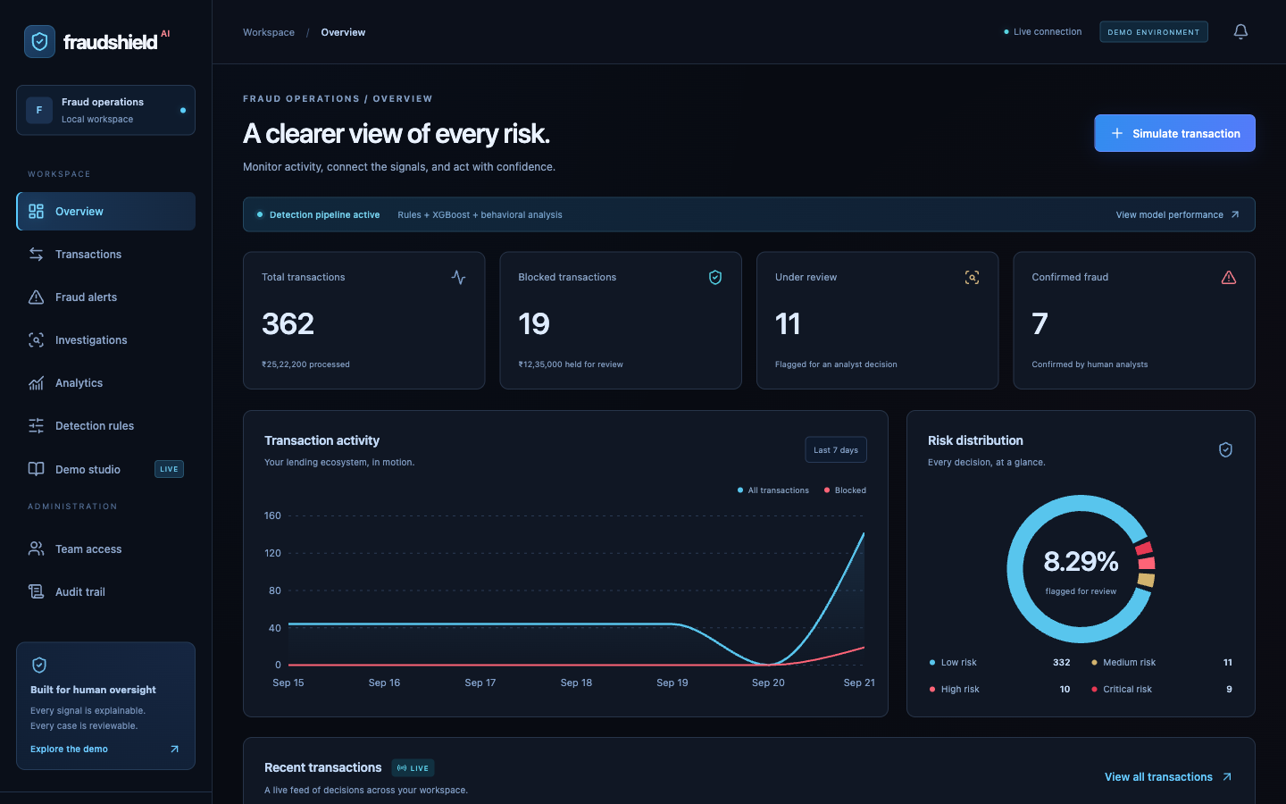
FRAUDSHIELD AI / 10
The dashboard
A workspace for fraud operations.
LOCAL DEMONSTRATION · SYNTHETIC DATA · REAL INFERENCE
Notes:
Refer to docs/PRESENTATION.md for the full talk track.

Slide 11
FRAUDSHIELD AI / 11
Live demonstration
Normal → review → block → investigate
• Known-device repayment → ALLOW.
• Unusual amount on familiar device → REVIEW.
• New device + new city + real burst → BLOCK.
• Confirm fraud, or mark legitimate and retain the original policy output.
LOCAL DEMONSTRATION · SYNTHETIC DATA · REAL INFERENCE
Notes:
Refer to docs/PRESENTATION.md for the full talk track. Known-device repayment → ALLOW. Unusual amount on familiar device → REVIEW. New device + new city + real burst → BLOCK. Confirm fraud, or mark legitimate and retain the original policy output.

Slide 12
FRAUDSHIELD AI / 12
Measured results
Synthetic holdout performance — not a production claim.
• Precision 88.83% | Recall 88.38% | F1 88.61%.
• PR-AUC 0.9285 | ROC-AUC 0.9779.
• False positive rate 1.37% | False negative rate 11.62%.
• The dashboard separately reports selected analyst-review feedback.
LOCAL DEMONSTRATION · SYNTHETIC DATA · REAL INFERENCE
Notes:
Refer to docs/PRESENTATION.md for the full talk track. Precision 88.83% | Recall 88.38% | F1 88.61%. PR-AUC 0.9285 | ROC-AUC 0.9779. False positive rate 1.37% | False negative rate 11.62%. The dashboard separately reports selected analyst-review feedback.

Slide 13
FRAUDSHIELD AI / 13
Responsible AI and future scope
A useful prototype has honest limits.
• Risk is not proof; human review can correct false positives.
• No funds are moved, no creditworthiness is assessed, no users are banned.
• Next: representative data, calibration, fairness audits and durable jobs.
• At scale: shared events, vector indexes, model registry and rollback.
LOCAL DEMONSTRATION · SYNTHETIC DATA · REAL INFERENCE
Notes:
Refer to docs/PRESENTATION.md for the full talk track. Risk is not proof; human review can correct false positives. No funds are moved, no creditworthiness is assessed, no users are banned. Next: representative data, calibration, fairness audits and durable jobs. At scale: shared events, vector indexes, model registry and rollback.

Slide 14
FRAUDSHIELD AI / 14
FraudShield AI
From reactive rules to explainable fraud intelligence.
• Real-time detection. Persistent evidence. Human oversight.
• Run the complete demo locally: http://localhost:3000
• Read the code, repeat the tests, inspect every decision.
LOCAL DEMONSTRATION · SYNTHETIC DATA · REAL INFERENCE
Notes:
Refer to docs/PRESENTATION.md for the full talk track. Real-time detection. Persistent evidence. Human oversight. Run the complete demo locally: http://localhost:3000 Read the code, repeat the tests, inspect every decision.

