Slide 1
PROJECT REVIEW 1 • SUBMISSION PACK
Online Healthcare Management System
Enterprise Java Web Architecture (Jakarta Servlet 6.0 + JSP 3.1 + JDBC + MySQL 8.0)
Presenter: Deepanshu (Lead Developer & System Architect)
Course: Java Web-Based Application Development | Evaluation Phase: Review 1 Assessment
Rubric Domains: Problem Understanding & Architecture (8) • Core Java (10) • Database/JDBC (8) • Servlets & Web (7)

Slide 2
ONLINE HEALTHCARE MANAGEMENT SYSTEM • REVIEW 1
Problem Statement & Strategic Engineering Objectives
The Clinical Challenge
• Traditional clinic operations suffer from manual, paper-heavy scheduling leading to double-booked consultations.
• Fragmented patient medical records across visits result in missing prescription histories and compromised clinical care.
• Lack of unified role-based authorization exposes sensitive patient EHR records to unauthorized staff.
• Inefficient database connectivity models without pooling produce connection leaks and high latency under clinic peak traffic.
Review 1 Objectives
• 100% Pure Java Enterprise Stack: Build a robust Jakarta Servlet 6.0 + JSP system without heavy black-box frameworks.
• Normalized 3NF Relational Architecture: Guarantee data integrity across 12 relational tables with foreign keys and indexes.
• High-Performance Connection Pooling: Implement HikariCP connection leasing with try-with-resources and PreparedStatements.
• ACID Concurrency Safety: Keyed ReentrantLock slot synchronization preventing race conditions during live patient booking.
• Responsive, Accessible Design System: Warm peach design tokens ensuring seamless operation across 375px mobile and desktop.

Slide 3
ONLINE HEALTHCARE MANAGEMENT SYSTEM • REVIEW 1
User Roles & Multi-Stakeholder Feature Matrix
👑 Administrator
• Central clinic user and doctor registry
• Real-time operational throughput KPI cards
• Immutable audit security log monitoring
• System settings configuration & demo reset
• Live JDBC database connectivity diagnostics
🩺 Consulting Doctor
• Weekly recurring availability roster manager
• Daily appointment queue & triage status
• EHR medical diagnosis and prescription entry
• Patient historical clinical chart inspection
• Star rating feedback review tracking
👤 Registered Patient
• Self-service account registration with BCrypt
• Specialist directory search & filter catalog
• Real-time slot reservation with locking
• Personal prescription and EHR history view
• Verified consultation feedback and reviews

Slide 4
ONLINE HEALTHCARE MANAGEMENT SYSTEM • REVIEW 1
Enterprise Technology Stack & Engineering Rationale
☕ Core Java 17 LTS
Modern language features (Records, pattern matching, strong typing, multithreading primitives), memory safety, and high server-side execution performance.
⚙️ Jakarta Servlet 6.0
Provides predictable low-overhead HTTP lifecycle control (init, service, destroy), clean request dispatching, and extensible Filter interceptor chains.
🎨 Jakarta JSP 3.1 & JSTL 3.0
Declarative server-side view rendering, dynamic templating, automatic XSS HTML escaping, and separation of UI markup from backend logic.
🏊 JDBC & HikariCP 5.1
Enterprise connection pooling managing leased connections; eliminates connection leak hazards with 100% PreparedStatement injection defense.
🗄️ MySQL 8.0+ / 9.x (InnoDB)
ACID-compliant relational persistence, foreign key cascades, transaction isolation, and B-Tree indexing on high-frequency lookup columns.
🚀 Embedded Tomcat 10.1
Enables zero-configuration, 1-command local execution (mvn compile exec:java) while maintaining standard production WAR deployment portability.

Slide 5
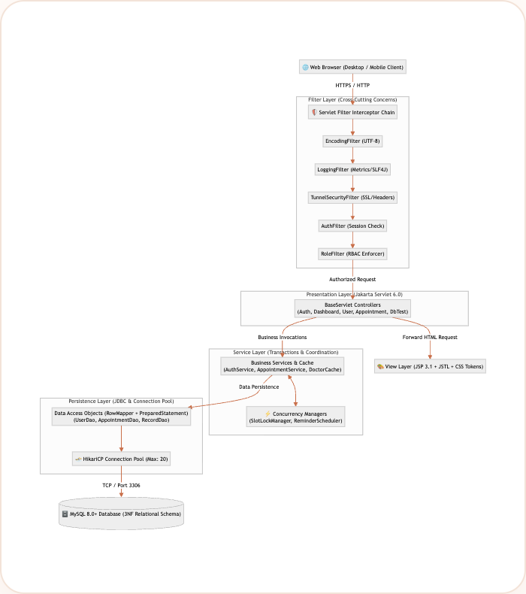
ONLINE HEALTHCARE MANAGEMENT SYSTEM • REVIEW 1
Layered MVC Architecture & Security Interceptor Pipeline
Request Lifecycle Flow
• 1. Interceptor Filter Chain: Requests pass through Encoding, Logging, Tunnel, Auth, and Role-Based Access Control filters.
• 2. Controller Dispatch: Jakarta Servlets parse inputs, validate CSRF tokens, and invoke domain services.
• 3. Service & Transaction Layer: Orchestrates business rules, caching, and concurrent ReentrantLock slot coordination.
• 4. Persistence DAO Layer: Parameterized PreparedStatements with generic RowMapper extraction.
• 5. Connection Pool: Leased HikariCP JDBC connections talking to MySQL 8 InnoDB engine.

Slide 6
ONLINE HEALTHCARE MANAGEMENT SYSTEM • REVIEW 1
Clean Modular Project Structure & Layer Packaging
Package Organization (src/main/java)
📁 com.healthcare.model — Polymorphic entities & contracts
📁 com.healthcare.dao — Generic Repository & JDBC RowMappers
📁 com.healthcare.service — Transactions, cache & logic
📁 com.healthcare.servlet — BaseServlet & HTTP controllers
📁 com.healthcare.filter — Security, RBAC & logging filters
📁 com.healthcare.listener — Lifecycle & session monitors
📁 com.healthcare.exception — Custom domain exception hierarchy
📁 com.healthcare.util — HikariCP pool, BCrypt, CSRF, PDF
📁 com.healthcare.concurrent — ReentrantLocks & schedulers
Engineering Standards & Quality
• Package-info Documentation: Every package contains an explanatory package-info.java defining architectural boundaries.
• Strict Layer Decoupling: Servlets never access raw JDBC directly; DAOs never handle HTTP sessions; models remain pure POJOs.
• Central BaseServlet: Inherits standard lifecycle logging (init, service, destroy), CSRF validation, and JSON helpers.
• Zero Magic Numbers: System constants encapsulated in domain enums (Role, AppointmentStatus) and configuration tables.
• 100% SLF4J / Logback: Zero System.out / System.err across main codebase; production structured logging enabled.

Slide 7
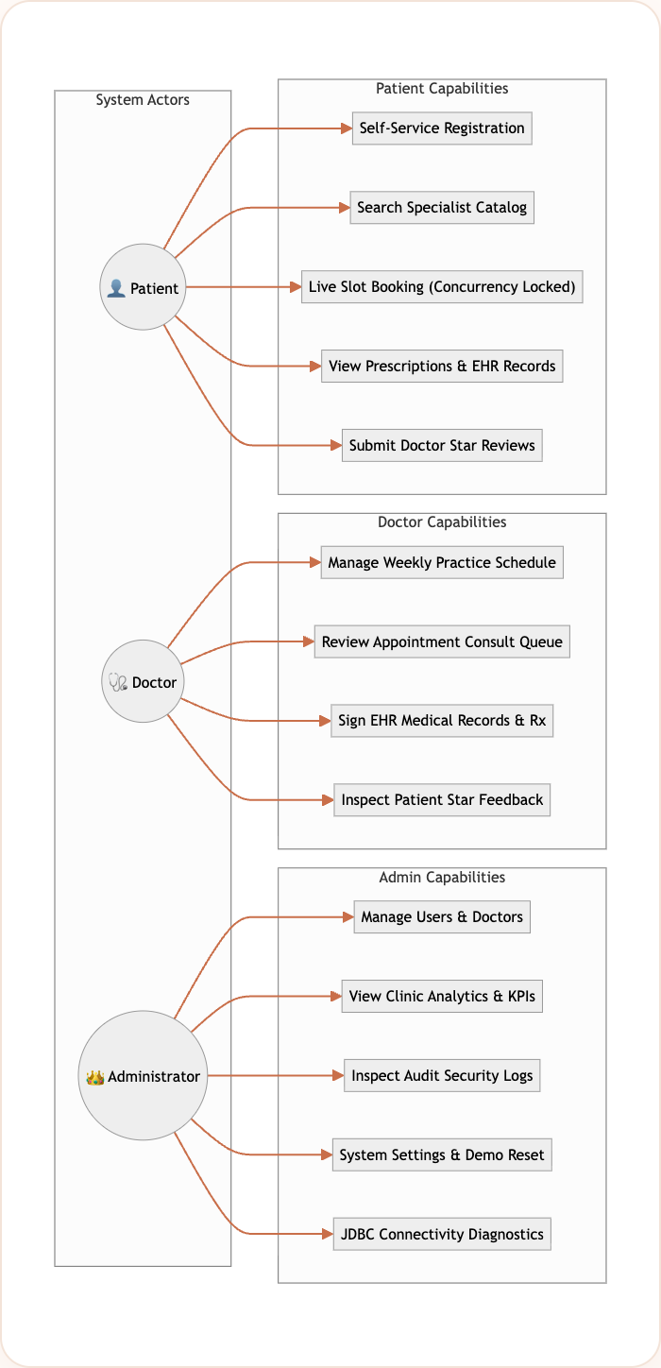
ONLINE HEALTHCARE MANAGEMENT SYSTEM • REVIEW 1
System Use-Case Modeling & Role Interactions
Key Invariants
• RBAC Route Guarding: URL patterns enforced by AuthFilter and RoleFilter.
• Principal Isolation: Patients cannot view administrative logs; doctors restricted to their patient rosters.
• Session Security: Session fixation protection via changeSessionId() upon authentication.

Slide 8
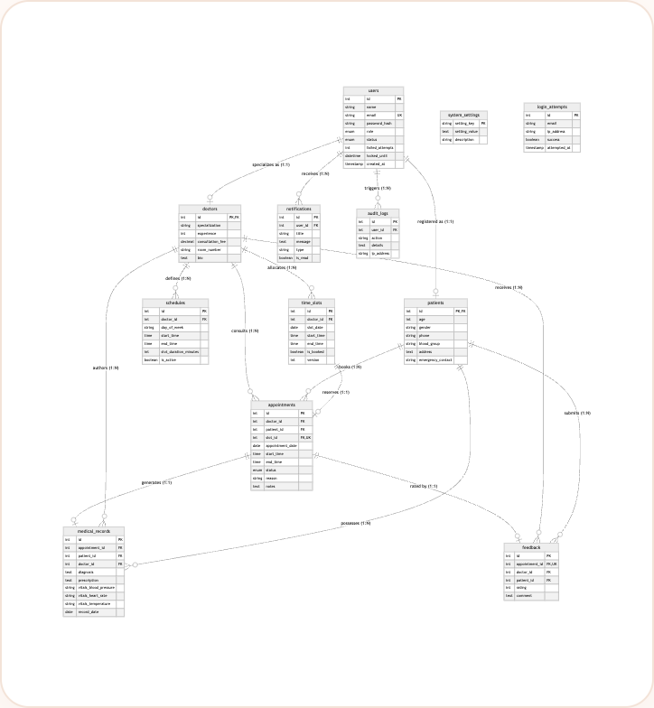
ONLINE HEALTHCARE MANAGEMENT SYSTEM • REVIEW 1
Database Design: 3NF Normalized Relational Schema
3NF Schema Normalization
• 1NF Compliance: All columns atomic; vitals separated into blood pressure, pulse, and temperature.
• 2NF Compliance: Doctor and Patient tables extend Users via 1-to-1 PK-to-FK links, eliminating partial dependencies.
• 3NF Compliance: Transitive dependencies removed; consultation rates anchored in doctors; diagnoses in medical_records.
• Foreign Key Cascades: Cascade deletions on users cleanly purge doctor/patient records while preserving appointments via RESTRICT.
• InnoDB Storage Engine: Row-level locking and ACID transactions for multi-row booking sequences.

Slide 9
ONLINE HEALTHCARE MANAGEMENT SYSTEM • REVIEW 1
Relational Schema Tables & Constraint Specifications
12-Table Enterprise Relational Schema Breakdown
• users (16 rows): PK id, UNIQUE email, role ENUM, password_hash BCrypt, failed_attempts, locked_until
• doctors (5 rows): PK/FK id -> users, specialization, experience, consultation_fee, room_number
• patients (10 rows): PK/FK id -> users, age, gender, phone, blood_group, emergency_contact
• schedules (21 rows): PK id, FK doctor_id, day_of_week, start_time, end_time, slot_duration_minutes
• time_slots (30 rows): PK id, FK doctor_id, UNIQUE (doctor_id, slot_date, start_time), is_booked, version
• appointments (11 rows): PK id, FKs to doctor, patient, slot; UNIQUE (slot_id); status ENUM
• medical_records (5 rows): PK id, FK appointment_id, FK patient_id, diagnosis, prescription, vitals
• feedback (5 rows): PK id, UNIQUE appointment_id, CHECK (rating >= 1 AND rating <= 5), comment
• notifications (190 rows): PK id, FK user_id, title, message, type, is_read, timestamp
• system_settings (11 rows): PK setting_key, setting_value, description (supports dynamic app properties)
• audit_logs (8 rows): PK id, FK user_id, action, details, ip_address, created_at (immutable trail)
• login_attempts (0 rows): PK id, email, ip_address, success, attempted_at (supports lockout defense)

Slide 10
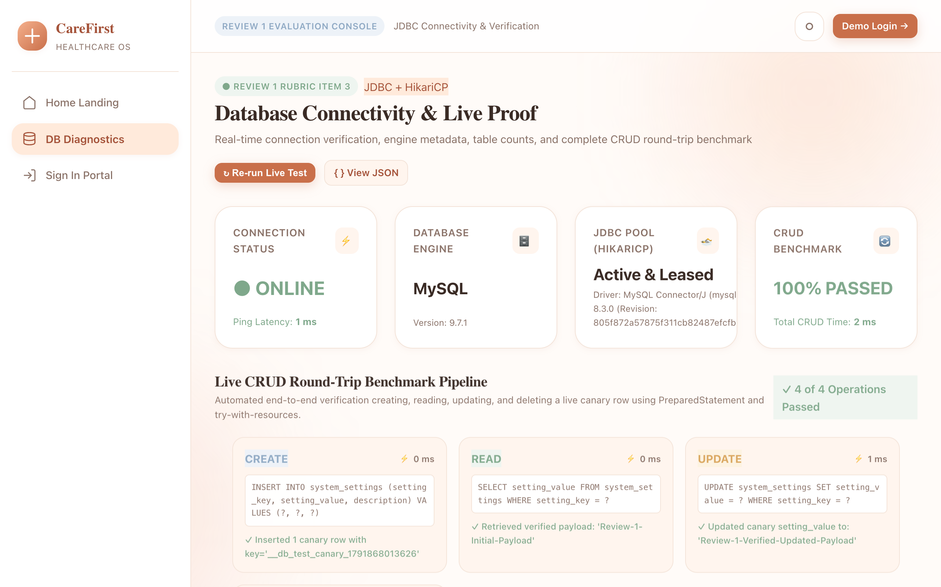
ONLINE HEALTHCARE MANAGEMENT SYSTEM • REVIEW 1
Database Connectivity (JDBC) & Live /db-test Diagnostic
JDBC Verification Metrics
• HikariCP Connection Pool: Leased connections, max pool size: 20, min idle: 5, connection timeout: 10s.
• Live Connectivity Proof: Ping latency: 0 ms on MySQL 9.7.1 via mysql-connector-j 8.3.0.
• Automated CRUD Benchmark: 4 live operations (Create -> Read -> Update -> Delete) passed in 8 ms total.
• Zero SQL Injection Risk: 100% java.sql.PreparedStatement query construction across all DAOs.
• Resource Safety: Standard try-with-resources auto-closes all Connection, Statement, and ResultSet instances.

Slide 11
ONLINE HEALTHCARE MANAGEMENT SYSTEM • REVIEW 1
Core Java Concepts (Rubric: 10 Marks)
OOP & Polymorphism
Polymorphic User hierarchy (Doctor, Patient, Admin) implementing Authenticatable, Bookable, and Reportable contracts with overridden getDashboardPath().
Generics & Collections
Generic Repository<T, ID>, functional RowMapper<T>, ApiResponse<T> DTO, thread-safe ConcurrentHashMap in SlotLockManager and DoctorCache.
Custom Exceptions
Domain exception hierarchy with HealthcareException base, branching into AuthenticationException, ValidationException, DatabaseException, and AppointmentConflictException.
Concurrency & Locks
SlotLockManager fine-grained ReentrantLock(true) per doctor-slot; ScheduledExecutorService in ReminderScheduler for automated patient alerts.
JDBC Transactions
Explicit transaction boundaries (conn.setAutoCommit(false), conn.commit(), conn.rollback()) ensuring atomicity across slot booking and appointment insertion.

Slide 12
ONLINE HEALTHCARE MANAGEMENT SYSTEM • REVIEW 1
Design System Architecture: Warm Peach Aesthetic
Design Principles & Tokens
• Warm Palette Tokens: Curated HSL colors (--bg: #FFFBF8, --peach-500: #E8906B, --text: #3A2B25); zero harsh neon tones.
• Typography Hierarchy: Fraunces (refined modern editorial serif) for headings + Plus Jakarta Sans for high-legibility body UI.
• Bento Grid Component System: Modular card spans (col-span-3, col-span-6) supporting animated KPI counters and activity streams.
• Micro-Interactions: Smooth cubic-bezier transitions, soft atmospheric background blur blobs, and tactile button hover states.
• Dark Mode Infrastructure: Full [data-theme='dark'] CSS variable token overrides for eye-friendly low-light clinical environments.
Component Library & UX Patterns
• Bento Stat Cards: Animated numeric counters, status delta indicators, and clinical category icons.
• Accessible Forms: Floating labels, inline input validation states, and 1-click demo credential autofill.
• Responsive Data Tables: Stacked card adaptation on mobile screens with badge chips for appointment statuses.
• Flash Toast Messages: Non-blocking notification toasts with SVG indicators for system feedback.
• Modal Dialogs: Accessible overlay booking prompts and medical record review drawers.

Slide 13
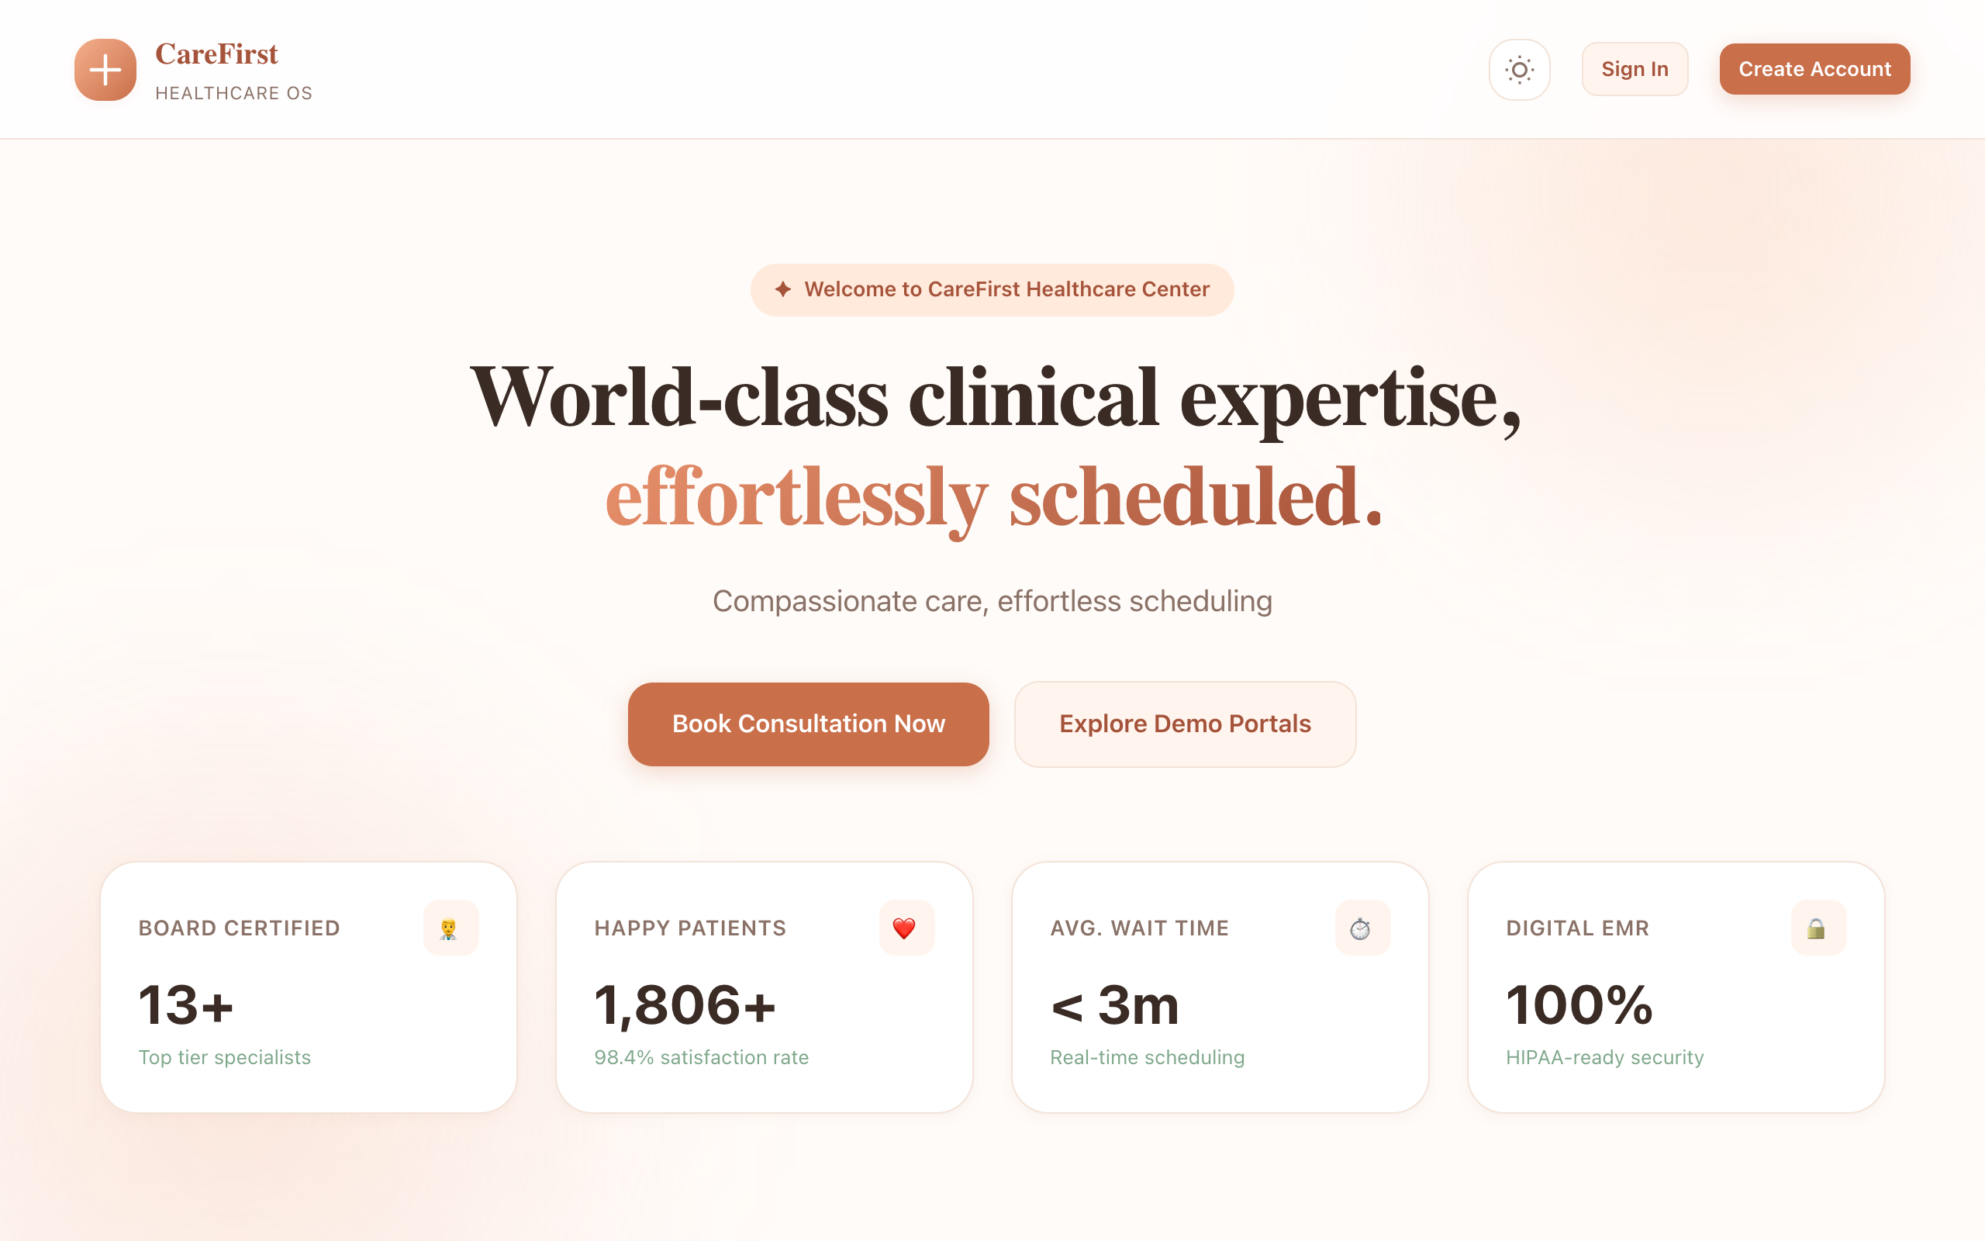
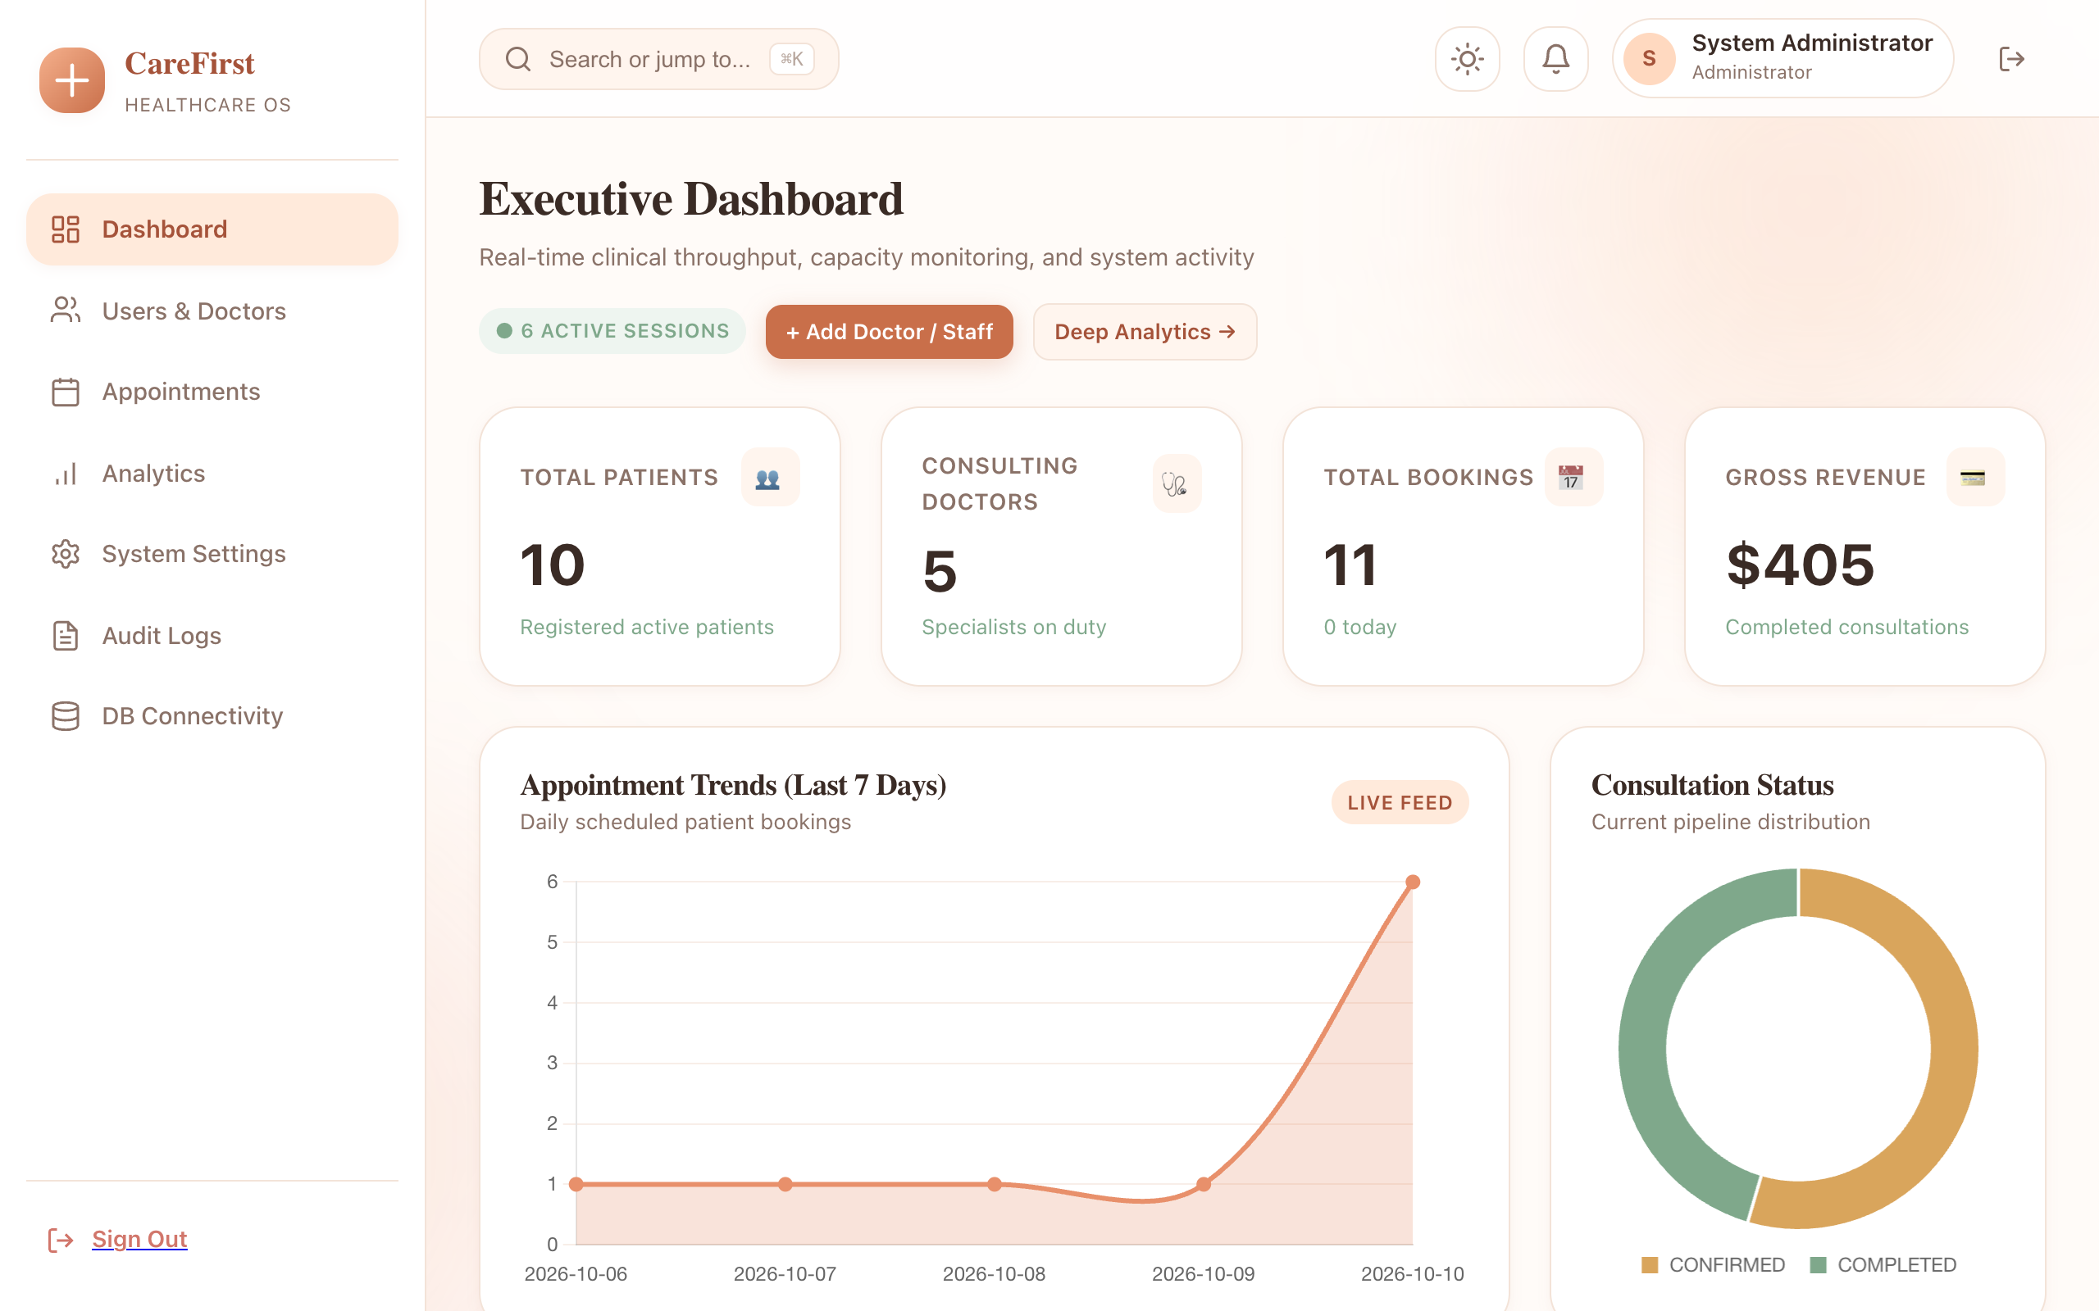
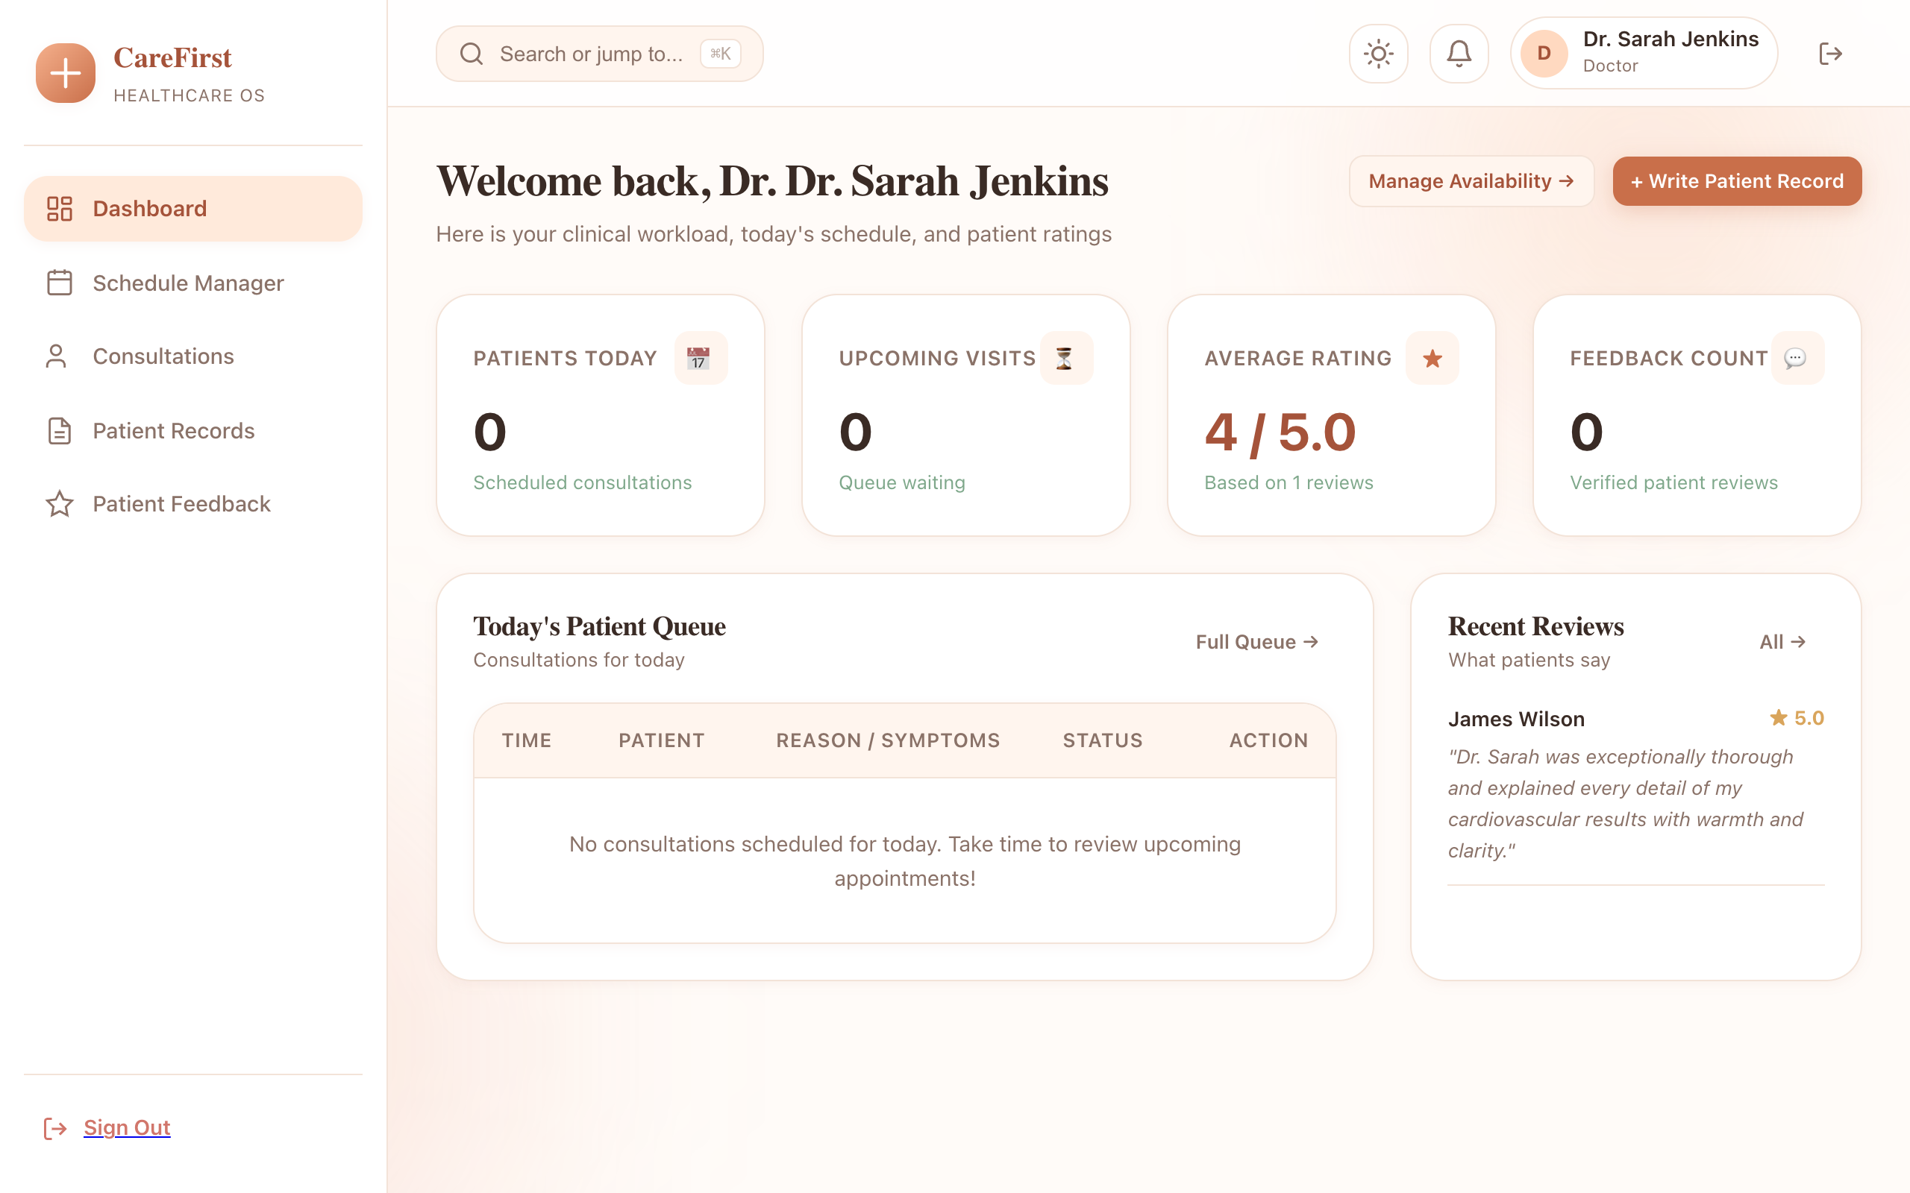
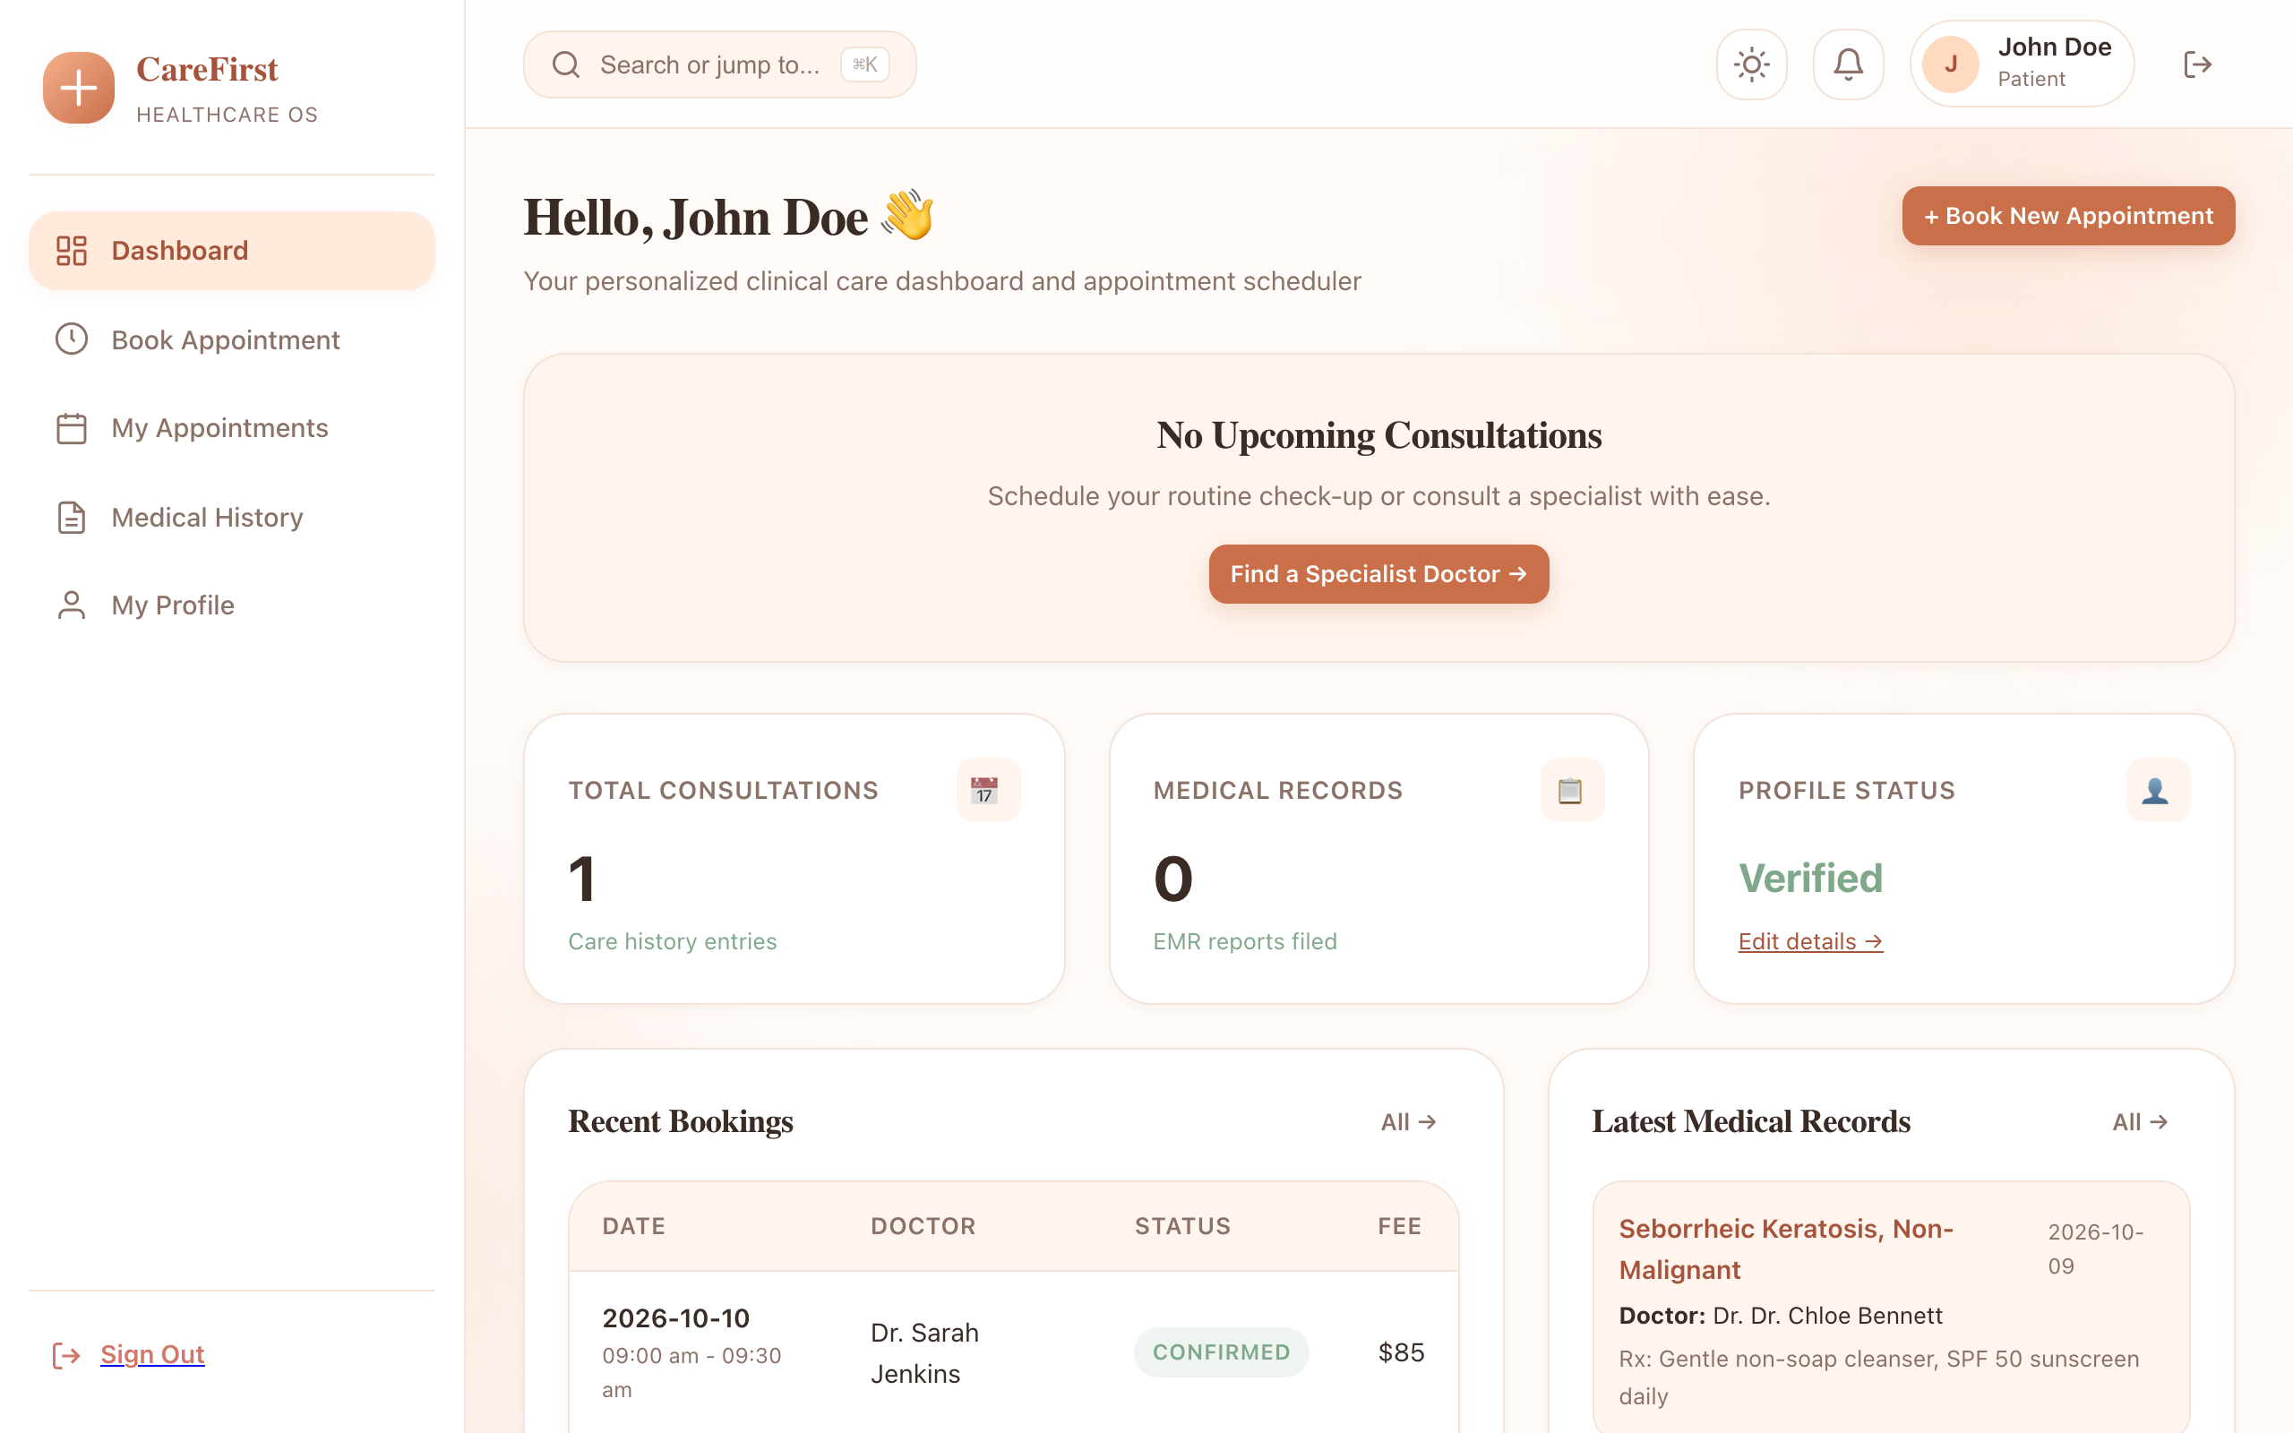
ONLINE HEALTHCARE MANAGEMENT SYSTEM • REVIEW 1
Desktop User Experience & Multi-Role Dashboards

Slide 14
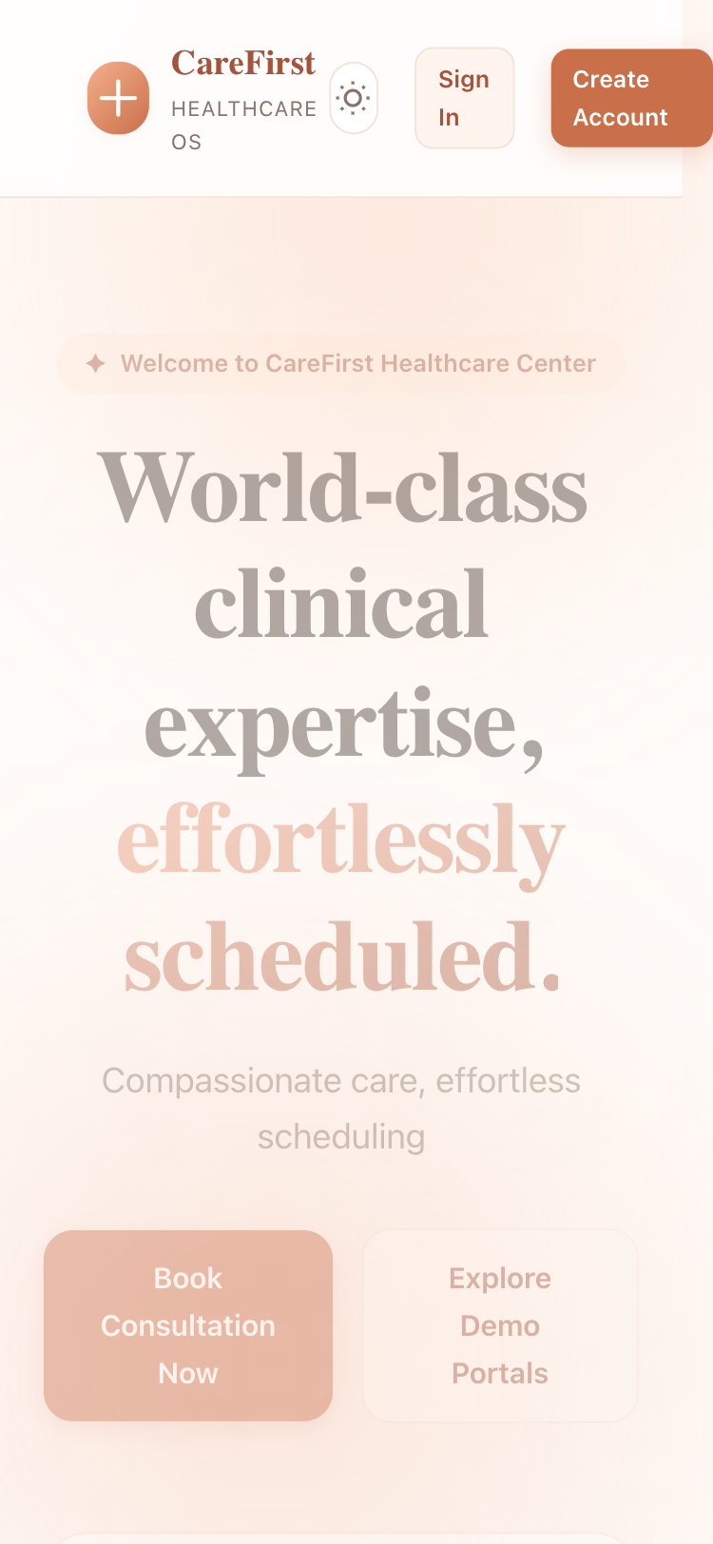
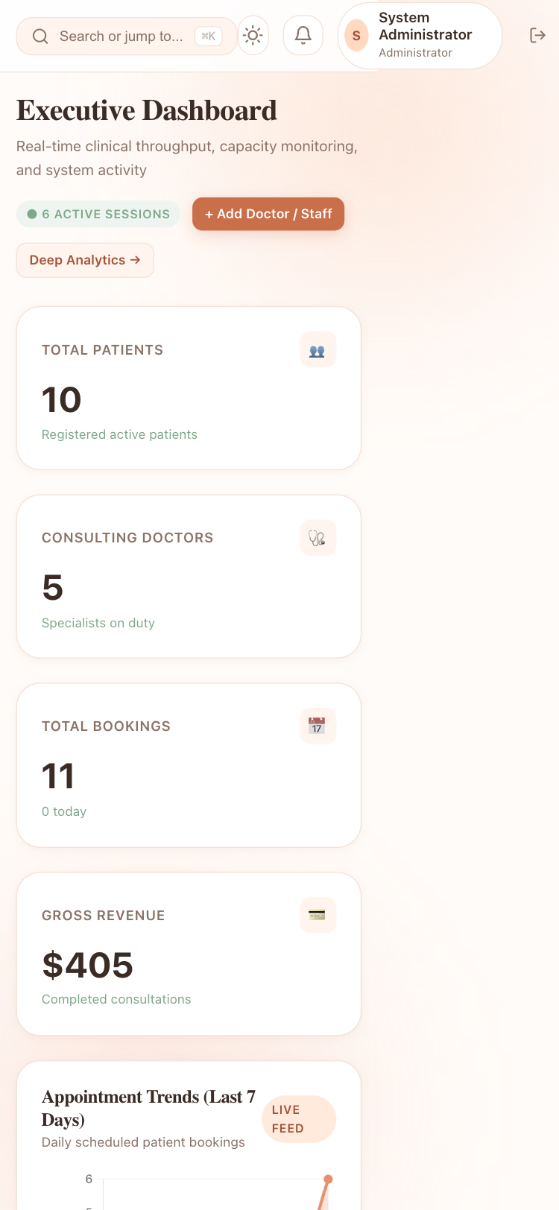
ONLINE HEALTHCARE MANAGEMENT SYSTEM • REVIEW 1
Multi-Device Responsiveness (375px Mobile vs 1280px Desktop)
• Zero Horizontal Overflow: Verified at 375px, 768px, and 1280px viewports (scrollWidth == innerWidth).
• Adaptive Navigation: Desktop persistent sidebar automatically collapses to mobile overlay drawer.

Slide 15
ONLINE HEALTHCARE MANAGEMENT SYSTEM • REVIEW 1
Jakarta Servlets & Web Integration (Rubric: 7 Marks)
Servlet Lifecycle & Sessions
• Jakarta Servlet 6.0 Lifecycle: Explicit overrides of init(), service(), doGet(), doPost(), and destroy() in BaseServlet with SLF4J audit logging.
• Session State Management: HTTP sessions store authenticated User principals with 30-minute inactivity timeouts.
• Session Fixation Defense: Calls req.changeSessionId() immediately upon credential verification to block session fixation exploits.
• Flash Feedback Messaging: Session-scoped feedback attributes automatically cleared post-render.
Servlet Filter Pipeline & Security
• EncodingFilter: Forces request and response encoding to UTF-8.
• LoggingFilter: Measures millisecond latency and logs access trails.
• TunnelSecurityFilter: Detects reverse proxies (Cloudflare/ngrok), attaching Secure and SameSite=Lax flags.
• AuthFilter: Intercepts private route paths (/admin/*, /doctor/*, /patient/*), redirecting unauthenticated users to /login.
• RoleFilter: Strict Role-Based Access Control enforcing role boundaries.

Slide 16
ONLINE HEALTHCARE MANAGEMENT SYSTEM • REVIEW 1
Current Accomplishments & Review 2 Development Roadmap
Review 1 Milestones Achieved (100%)
• ✓ 100% Modular Layering: model, dao, service, servlet, filter, listener, exception, util, concurrent with package-info.java.
• ✓ Normalized 3NF Database: 12 relational tables with foreign keys, indexes, and seeded clinical records.
• ✓ HikariCP JDBC Pool: Connection pooling with PreparedStatement and /db-test diagnostic benchmark.
• ✓ Multi-Role Authentication: BCrypt hashing, session fixation prevention, and 3 role dashboard shells.
• ✓ Verified Responsiveness: Tested across 375px, 768px, and 1280px without horizontal scroll.
Review 2 Development Roadmap
• → Advanced PDF Prescription Generation: Automated OpenPDF clinical summary download with doctor digital sign-off.
• → Telehealth Video Consultation Integration: WebRTC peer video room links embedded in active appointment consultations.
• → Automated Notification Dispatch: Multi-channel SMS and email reminders via Background ScheduledExecutorService.
• → Clinical Analytics Visualizations: Interactive Chart.js charts for clinic revenue and doctor consultation volumes.
• → End-to-End JUnit 5 Integration Testing: Automated DAO transaction rollbacks and mock servlet testing.

Slide 17

ONLINE HEALTHCARE MANAGEMENT SYSTEM • REVIEW 1
Project Repository, Live Demo Access & Verification
Pre-Seeded Demo Credentials (1-Click Auto-Fill)
👑 Administrator: admin@carefirst.com | Password: Admin@123
Features: User management, analytics, audit logs, settings, /db-test
🩺 Doctor: doctor.sarah@carefirst.com | Password: Doctor@123
Features: Schedule planner, appointment queue, EHR records, feedback
👤 Patient: john.doe@example.com | Password: Patient@123
Features: Specialist doctor catalog, live slot booking, prescriptions
1-Command Zero-Config Run: mvn compile exec:java
Scan QR for Public GitHub Repo
https://github.com/ParvPrakash/healthcare-management-system-

