Slide 1

Application using Okta authentication
Created by :
Parvan Andrei-Leonard
Ianosiu Oana Cosmina

Slide 2
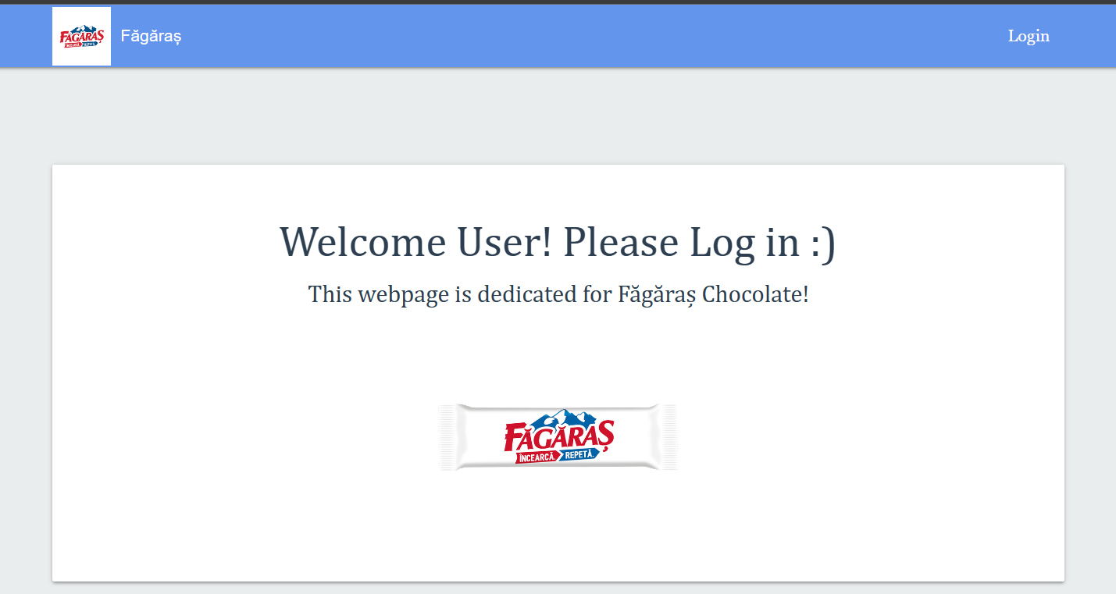
About our project
Web Application about Făgăraș chocolate
Using Okta as Authentication and Authorization tool
User rools

Slide 3
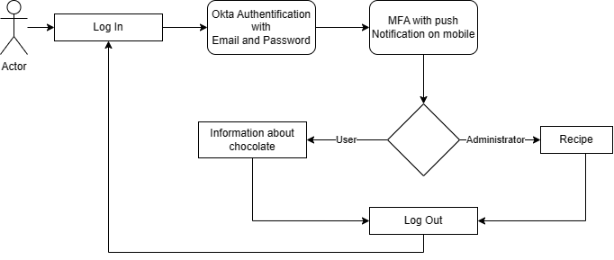
Authorization process flow

Slide 4
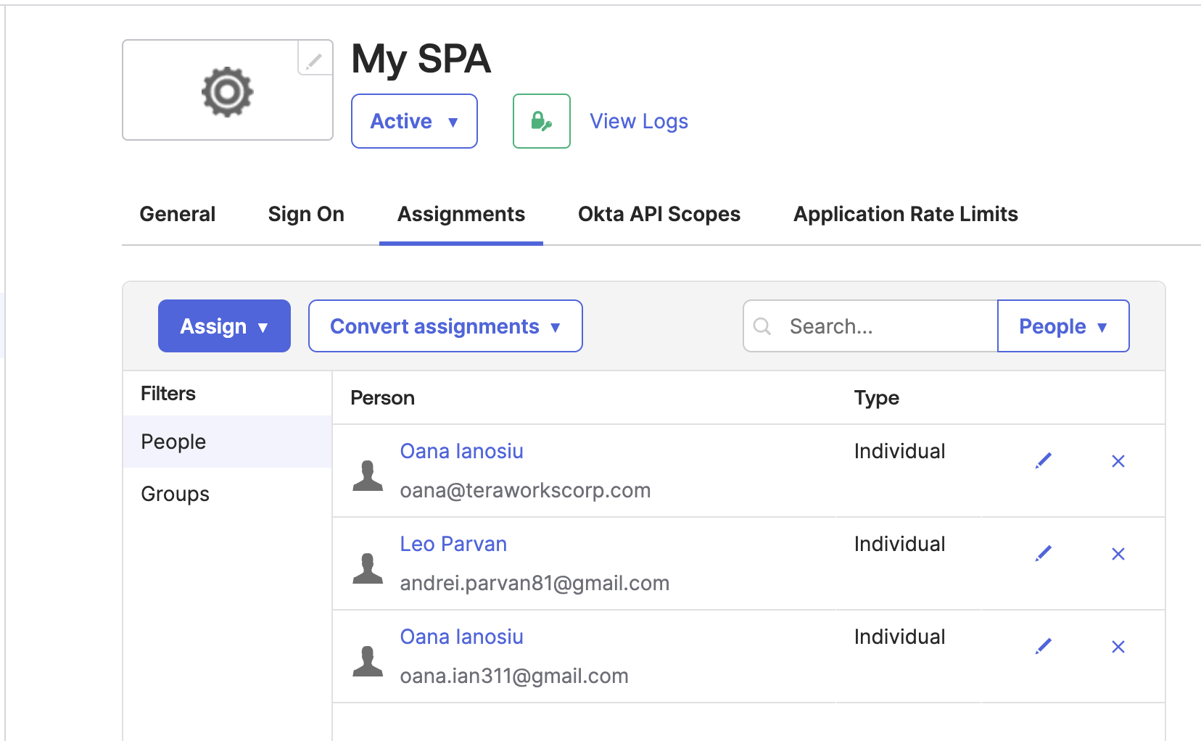
OKTA INTEGRATION
Identity management platform for user management, authentication, and authorization processes
API/SDK for user authentication and authorization
Notes:
Okta is a leading identity management platform that simplifies user management, authentication, and authorization processes for applications.
Our application leverages the Okta API/SDKs for user authentication and authorization.
Users register and authenticate themselves through Okta.
Okta offers secure user registration and authentication

Slide 5
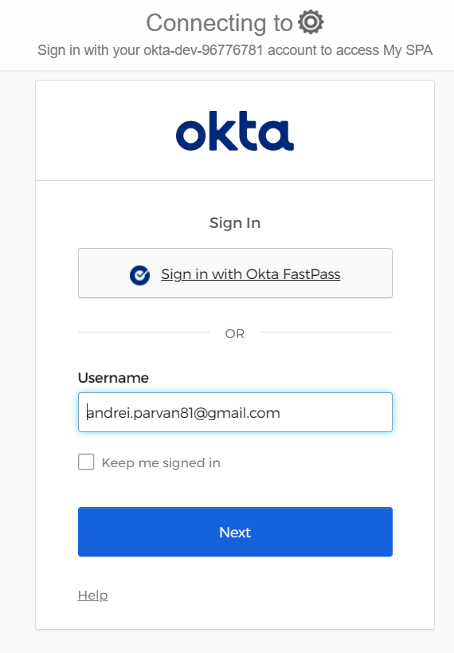
Authorization porcess flow
User is trying to access to the application
Application sends authentication request to Okta
Okta verifies user credentials
Upon successful authentication, Okta sends authorization details to the application
User gains access to the authorized resources within the application

Slide 6
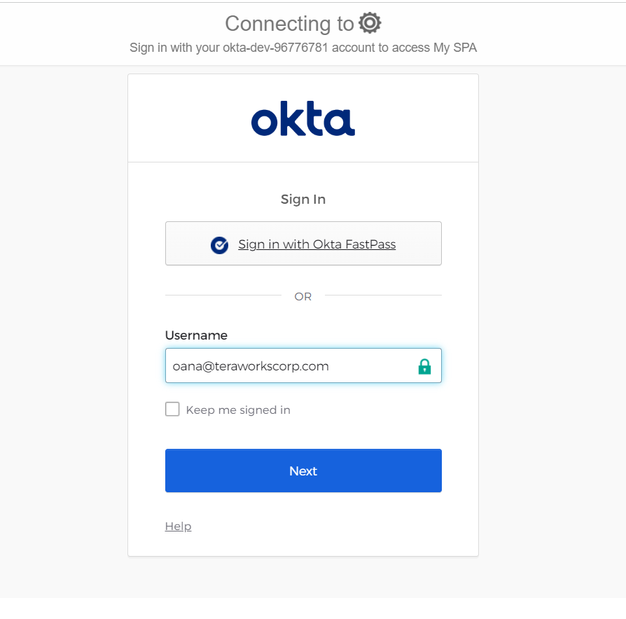
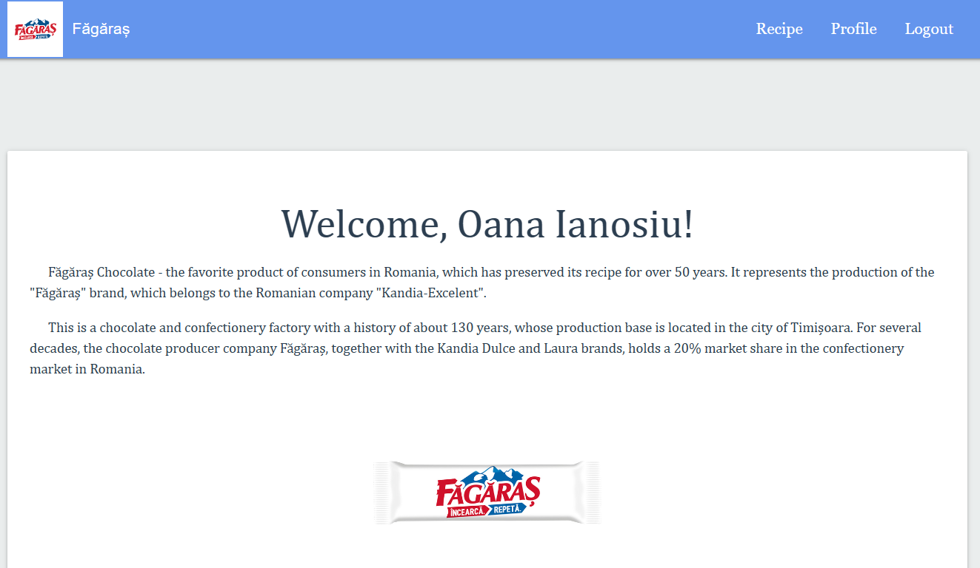
Main Page:
First Step
Second Step
Third Step

Slide 7
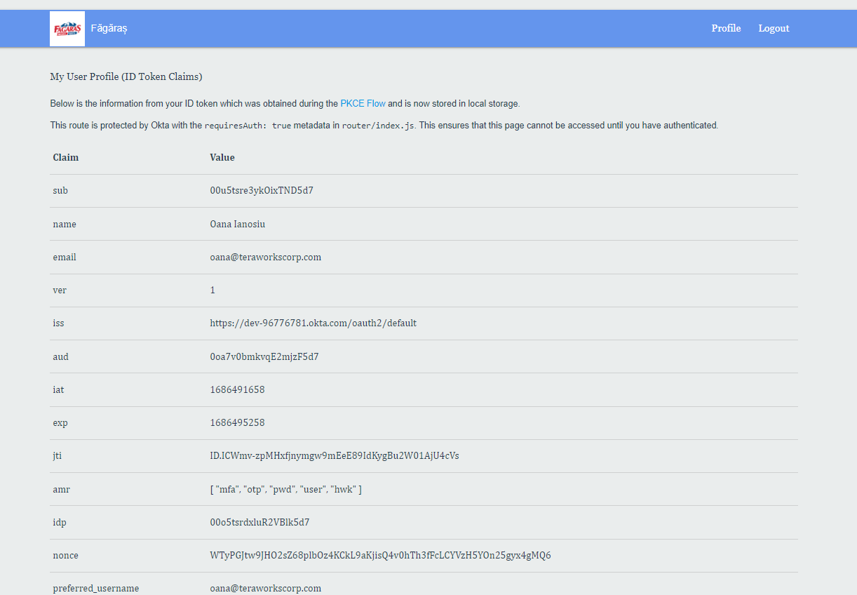
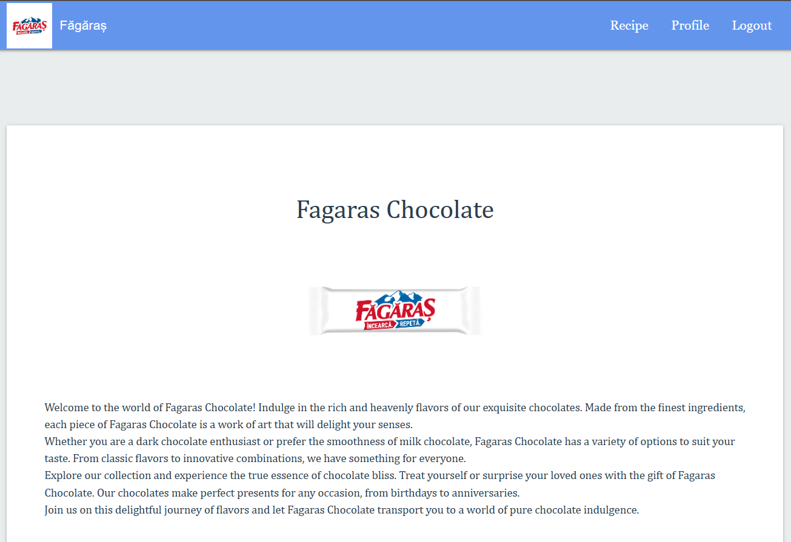
Features

Slide 8
Conclusions:
Okta plays a vital role in ensuring secure and streamlined authorization for our application.
By leveraging Okta's authentication, RBAC, and SSO capabilities, we enhance both security and user experience.
Okta provides a scalable and reliable identity management solution, empowering our application to meet the highest security standards.

Slide 9
Thank you for attention!

