Slide 1
SOCIAL MEDIA WEBSITE LIKE FACEBOOK
PARVATHI B G [22CSE108]
POOJA C S [22CSE109]
PRESENTED BY

Slide 2
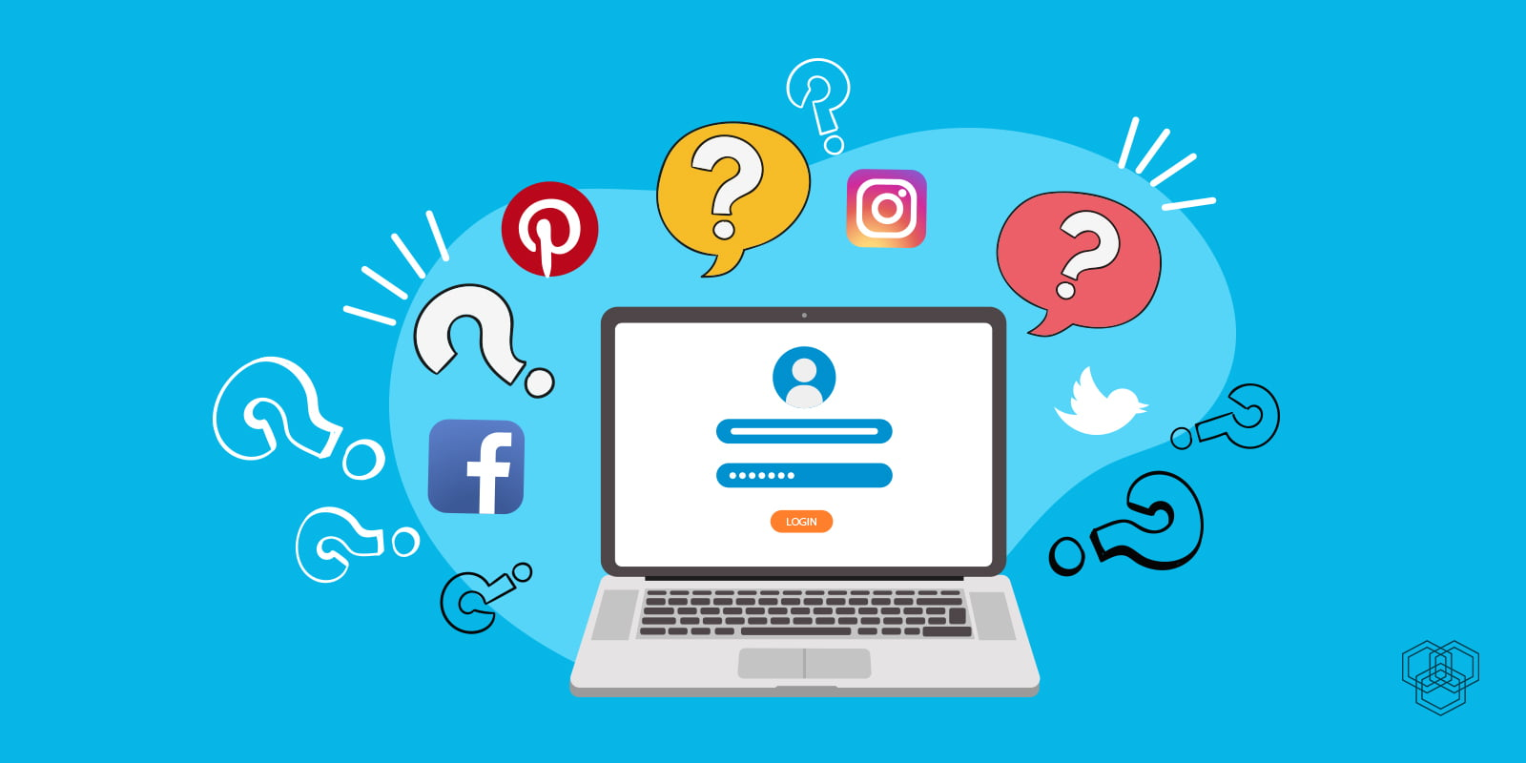
introduction
Welcome to our web development adventure!
In this project, we're crafting a special entryway – a login page. It's like having a secret code to enter your favorite place on the internet.
In this project, we're not just stopping at the login page; we're creating a warm and welcoming homepage for users who successfully unlock the door.

Slide 3
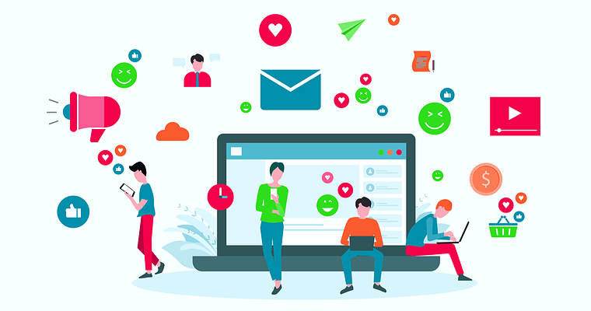
AGENDA
[1].What is social media?
[2].Why social media is important?
[3].Advantages
[4].How to use socialmedia safely?

Slide 4

[1].WHAT IS SOCIAL MEDIA?
Social media refers to the means of interactions among people in which they create, share, and/or exchange information and ideas in virtual communities and networks.
Social media is an internet-based form of communication. Social media platforms allow users to have conversations, share information and create web content.

Slide 5

[2].Why social media is important?
Social media is an important part of today's world. It helps people stay connected and share ideas, thoughts, and opinions with others in a safe and secure environment.
It can also be used to promote businesses, organizations, and causes, as well as to stay informed about current events and trends.
Additionally, social media can help build relationships with others, allowing us to interact with people from around the world and build meaningful connections
Finally, it can be used as a platform for self-expression, giving us the opportunity to express ourselves creatively and share our thoughts and experiences with others.

Slide 6
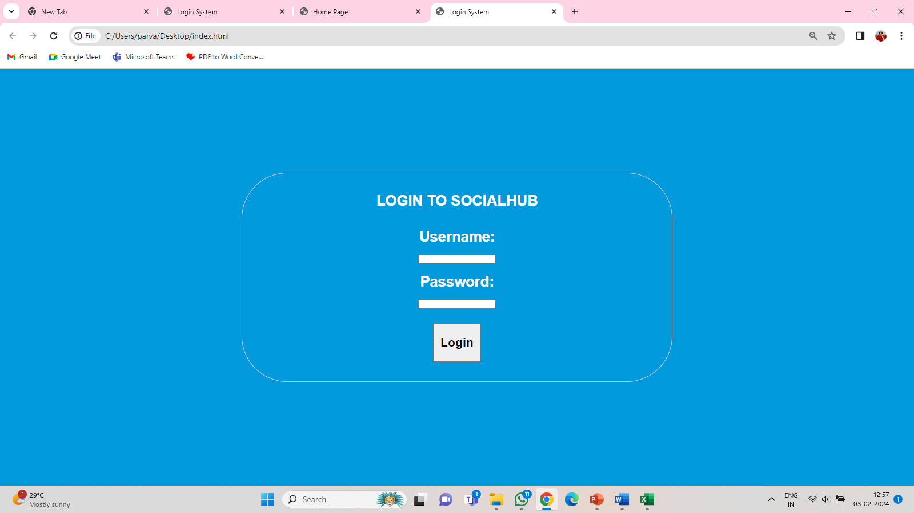
[3].ADVANTAGES
Basic Security Awareness: Raises awareness about basic security considerations such as password protection, even though real-world applications would require more advanced security measures.
Prevention of Unauthorized Access:Access Control: Quickly informs users when login attempts fail, preventing unauthorized access to the system.
Efficient User Flow:Streamlined Process: Directly navigating to the next page minimizes steps in the user flow, providing a more efficient and seamless experience.

Slide 7
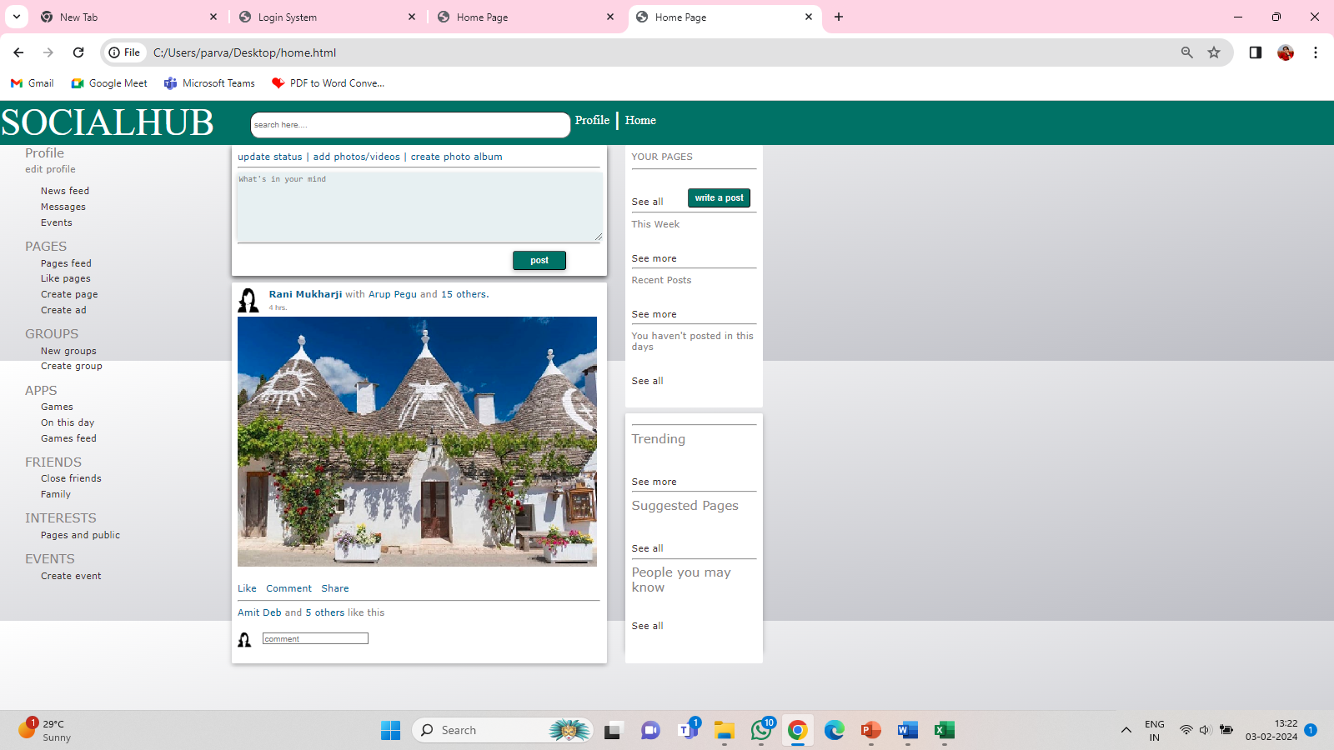
[4].HOW TO USE SOCIAL MEDIA SAFELY
Strong and Unique Passwords:Advice: Create strong, unique passwords for each social media account.
How to Implement: Use a combination of uppercase and lowercase letters, numbers, and special characters. Avoid using easily guessable information.
Limit Personal Information:Advice: Be mindful of the information you share on your profile.
How to Implement: Avoid sharing sensitive personal details such as your address, phone number, or financial information. Think before sharing information publicly.

Slide 8
CONCLUSION
This project is like a beginner's playground for learning how to create a basic login system for a website. It helps you understand how to build a page where users can enter their username and password to log in. If they get it right, it takes them to another page; otherwise, it shows a message saying they entered the wrong details.

Slide 9
THANK YOU

