Slide 1

Analyzing Real Time Meetup API
Parvathi Pai
Ekta Shah

Slide 2
Knowledge Share
Uses multiple technologies – Python, Scala, Kafka, Mongo DB, MySQL, Tableau for the pipeline.
Learnt how to build a real time pipeline using multiple technologies in local environment.

Slide 3
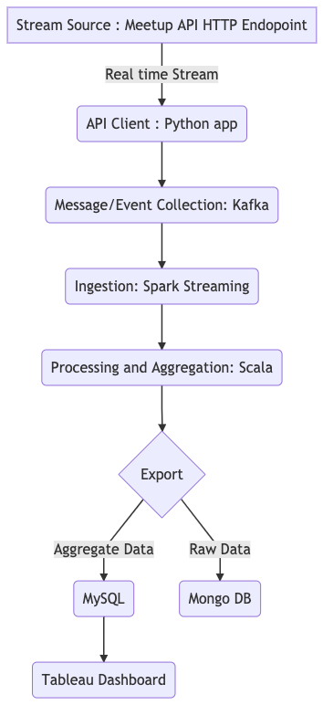
Architecture:
Data source is Meetup’s RSVP API that is exposed via HTTP and WebSockets
Data is collected using a Python project that calls the above HTTP endpoint and pushes to a Kafka topic
Data is queued using a Kafka service
Data is ingested into Apache Spark using Scala
Data is processed and aggregated using Apache Spark and Scala
Data is then exported and stored
As raw JSON documents to Mongo DB
As aggregates to MySQL
Aggregate data is visualized using Tableau

Slide 4
Architecture?
API End points :
HTTP: Uni-directional
Closes connection once response from the server is received.
WebSocket: Bi-directional
Connection is open until the state has died
Message/Event-Collector: Kafka
Real time handling and Batch processing
Storage:
The raw data is stored in MongoDB as JSON.
To processed data is stored in MySQL for visualization.
Tableau: Visualization

Slide 5
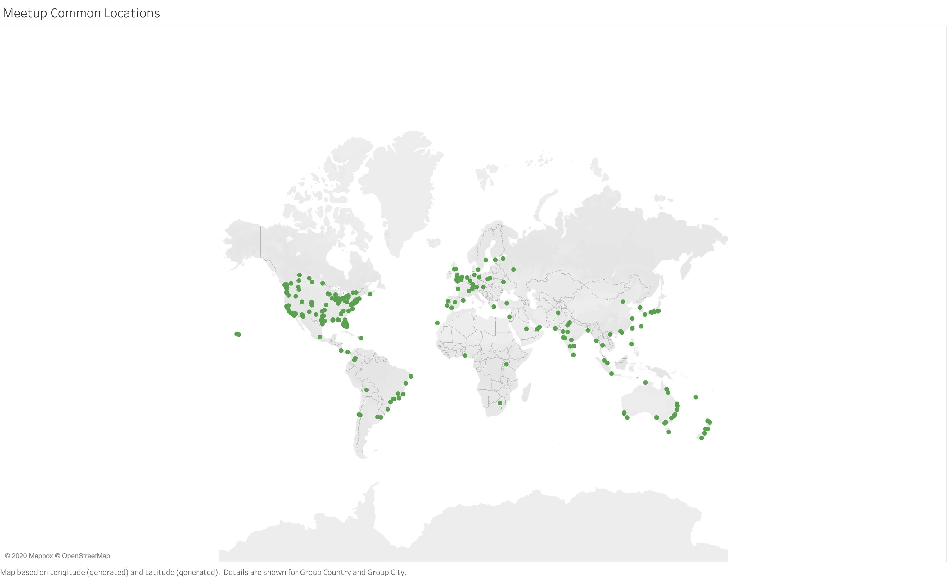
Frequent meetup locations

Slide 6
Demo:

