Slide 1

Affordable health care
CMPE-255 Sec 48 Data Mining
Parvathi Pai

Slide 2
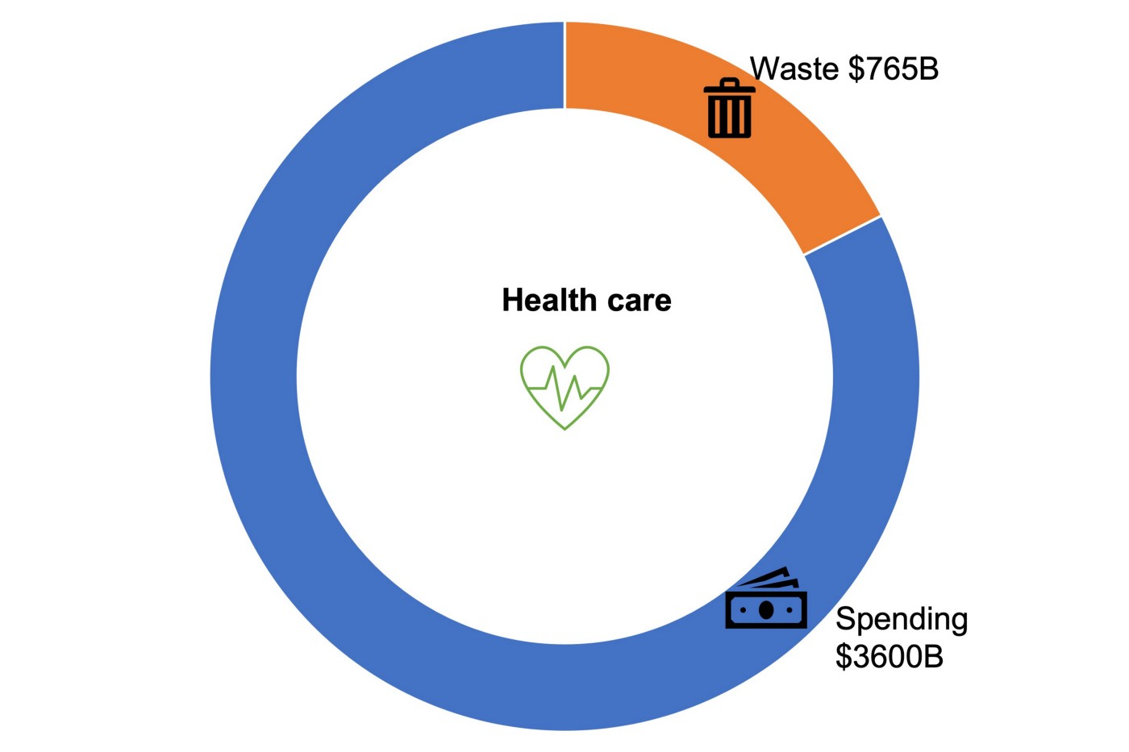
US yearly health care cost
The US health care industry is huge and there is lot of data coming out of it. It’s also very expensive — the overall spending is 3.8 trillion dollars per year!
There is massive waste in US health care — around $765 billion dollars per year.
Not only is cost an issue, but the quality of personal health care is perceived to be poor

Slide 3
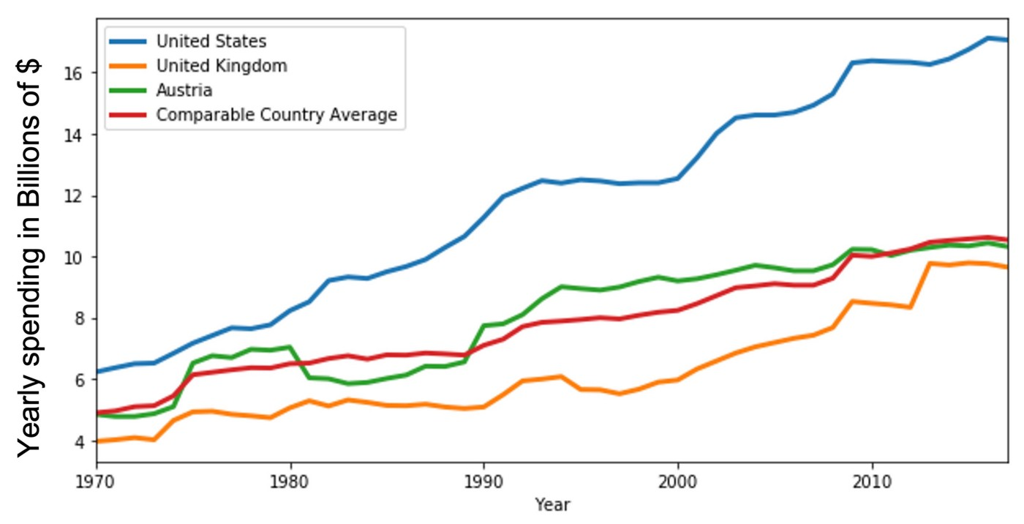
Cost of health care in US when compared to the other countries
We can observe that US has 60% higher rates in the insurance when compared to UK, Austria, and other countries average.
Why is this a case in USA?

Slide 4
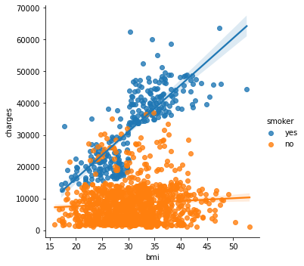
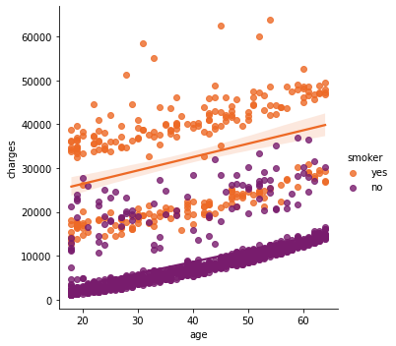
Understanding insurance cost
Several factors contribute to higher insurance rates a few being BMI and age for smoker and non-smoking people

Slide 5
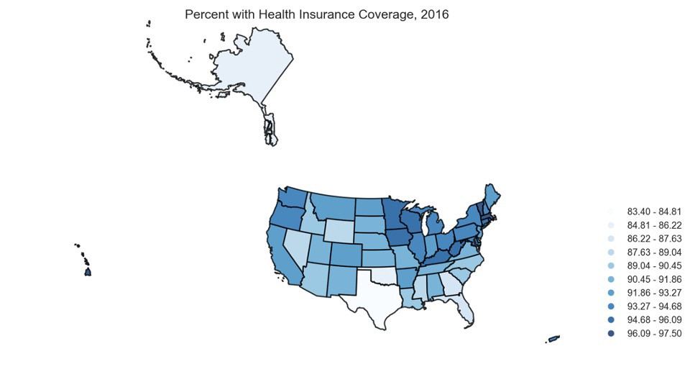
Despite higher cost are people having insurance?
Yes, most of the states have insurance providers.
Texas and Alaska have only 83% covered by insurance.

Slide 6
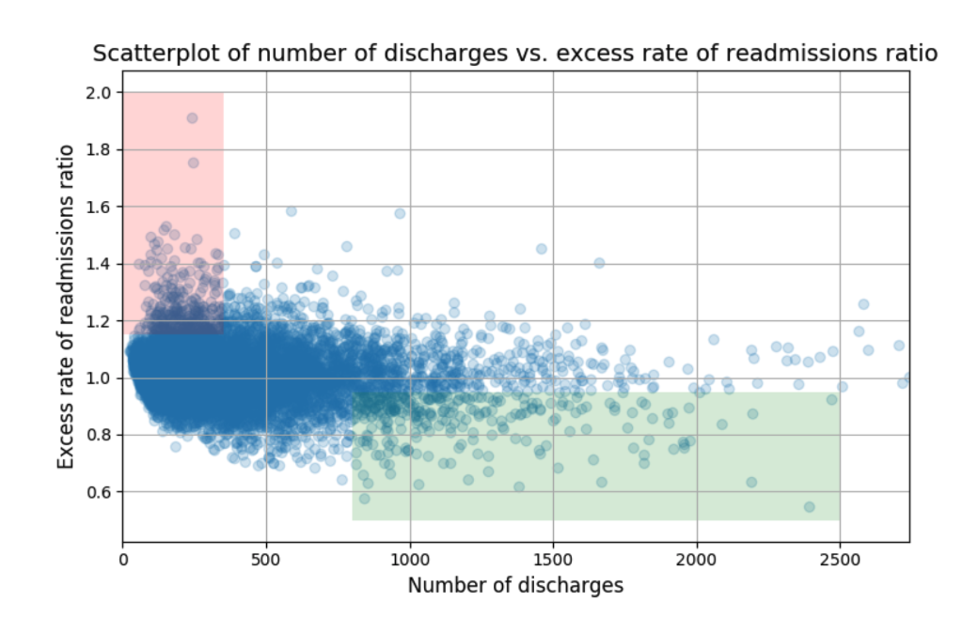
Hospital readmission ratio
According to the above chart the rate of readmission is trending down with the increase in the number of discharges.
With lower number of discharges there is excess rate of readmission.
With higher number of discharges lower rate of readmission.

Slide 7
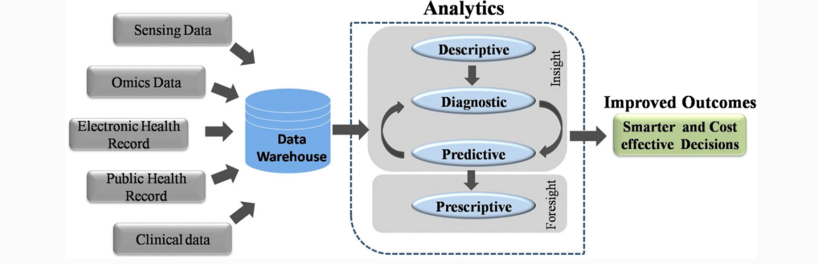
Data Collection
Health care data is available every where but not used

Slide 8
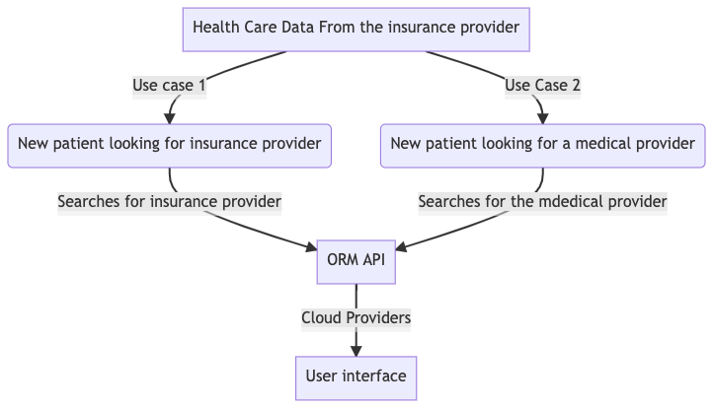
How technology can help solve this problem?
Use data mining techniques to assist new patients in an unfamiliar area discover local low-cost high- quality insurance providers based on several factors
Use relevant historic data to recommend low-cost high-quality care for a patient with a particular insurance provider.

Slide 9
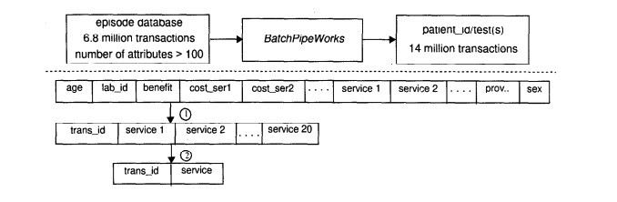
Algorithms
Associative pattern mining, similar to recommendation using matrix factorization.
Support: Number of items that are contained in a given set
Confidence: Increase in the frequency of items in the given set

Slide 10

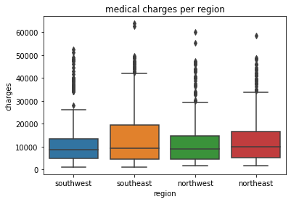
Summary
Providing the health insurance APIs to the customers helps them make a better decision in choosing the right treatment at the right place and at a better rate.
If people cultivate healthy life-style then medical cost reduces.
The south east region has higher fluctuations in medical cost.
For smokers the medical cost increases indisputably with BMI and age. It’s better to prefer hospital with higher rate of discharge and lower readmission ratio.

Slide 11
Future scope
Many APIs available in the market place with health care data with no useable application available for customers.
The APIs are now getting integrated with the voice assistance devices.
This health application could also be extended to animal health care.
Theses might help to reduce the hospital rates in the future

Slide 12
References
[1] Viveros, M. S., Nearhos, J. P., & Rothman, M. J. (1996, December). Applying data mining techniques to a health insurance information system. In VLDB (Vol. 96, pp. 286–294).
[2] Chae, Y. M., Ho, S. H., Cho, K. W., Lee, D. H., & Ji, S. H. (2001). Data mining approach to policy analysis in a health insurance domain. International journal of medical informatics, 62(2–3), 103–111.
Link to my medium article: https://medium.com/@parvathi.pai/affordable-health-care-2061f46b6f69
Link to my colab: https://colab.research.google.com/drive/1zve73ABBDKxM1RX0Erxp_qoB2CmvD5CJ?usp=sharing
Link to the dataset:
https://drive.google.com/drive/folders/1aK6yeHwUxOjTFa60rh5z668tTD8CsAXK?usp=sharing

