Slide 1


Text Extraction from store bills

Slide 2

Project Leadership
Sharat Manikonda
Director at Innodatatics and Sponsor
linkedin.com/in/sharat-chandra

Slide 3
Team Members
Name:Parvathy K R
https://www.linkedin.com/in/
parvathy-k-r

Slide 4

Contents
Business objective
Business Constraints
Project Architecture
Data collection and details
Exploratory Data Analysis
Visualization
Modeling
Evaluation
Deployment
Notes:
Change

Slide 5
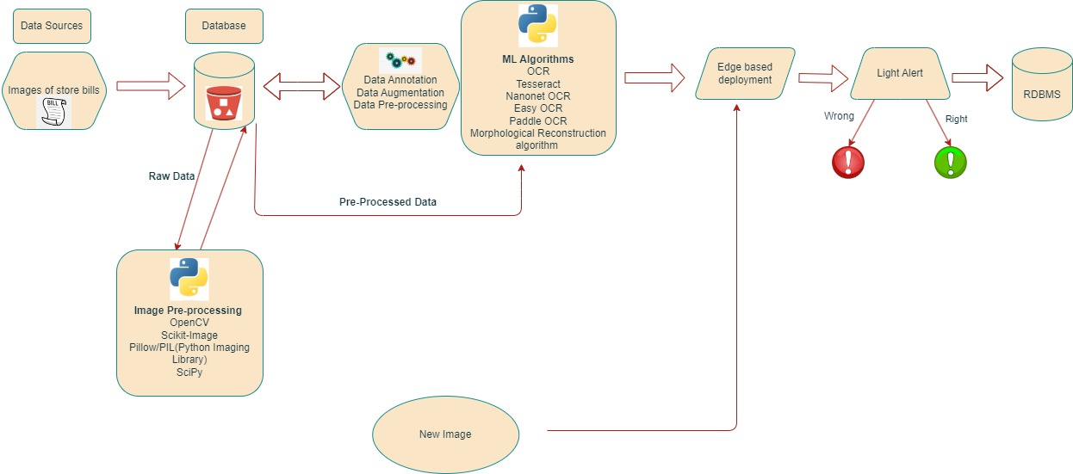
Project Overview and Scope

Slide 6
Business Problem
Manually doing data entry of the entries available on retail store bills will be extremely time consuming and is prone to human errors.

Slide 7
Business Objective
Objective
Constraints
Minimize the time taken to extract the text.
Minimize the human effort

Slide 8
CRISP-ML(Q) Methodology
There are six stages of CRISP-ML(Q) Methodology
1.Business and data understanding
2.Data preparation
3.Model building
4.Model evaluation
5.Model deployment
6.Monitoring and maintenance

Slide 9
Technical Stacks
Tools used:
1.For image pre-processing - OpenCV and Pillow
2.For text extraction - Optical Character Recognition (OCR) such as Easy OCR, Wand, etc.
3.For post-processing- Regular Expression
4.Output storage- MySQL
5.Deployment- Streamlit Application

Slide 10
Data Collection and Understanding
Data Collection- Data is collected from super market stores such as D-Mart and it is the invoices in the form of images.
Data Understanding- Data is unstructured. It is images in the form .jpeg

Slide 11
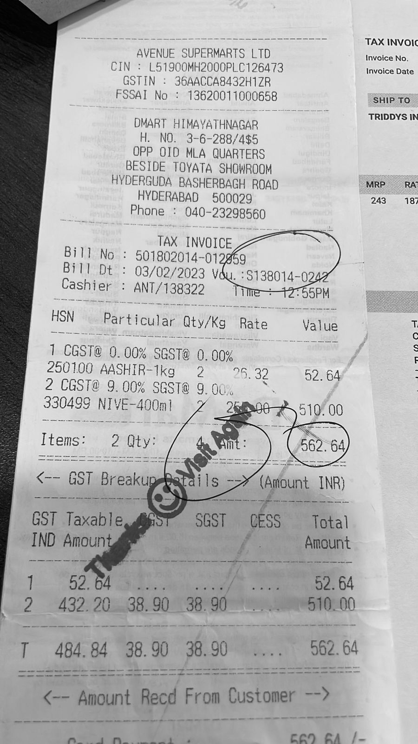
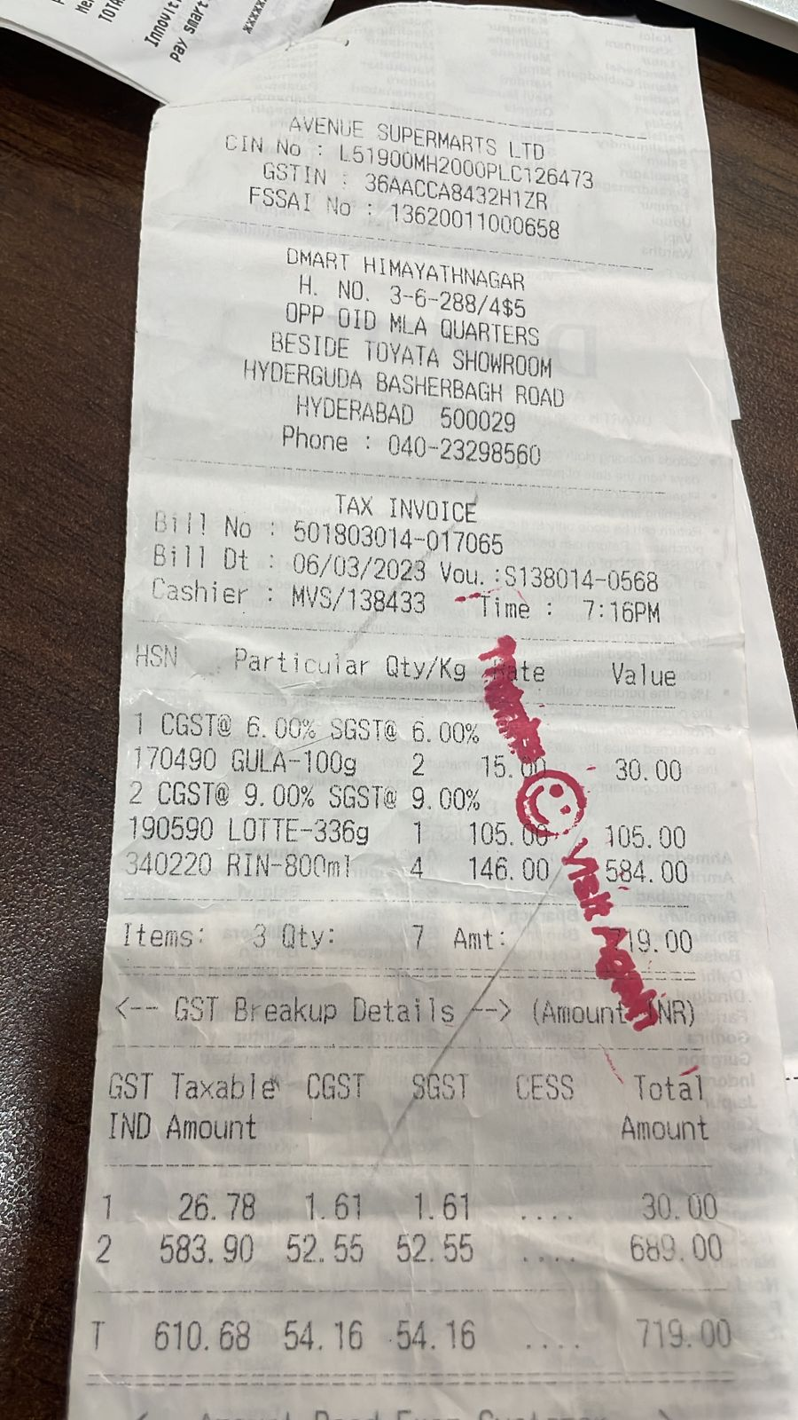
Data Information

Slide 12
Data Preprocessing
Resize: Standardize the image size.
Grayscale: Convert to grayscale for simplicity.
Noise Reduction: Apply filters to reduce noise.
Thresholding: Convert to binary to distinguish text from background.
Contrast Enhancement: Improve text visibility.
Morphological Operations: Refine text regions.
Rotation Correction: Correct skew or rotation.
Text Localization: Identify and locate text regions.
Notes:
Keep observations

Slide 13
Model Building
1. OCR(Optical Character Recognition) model.
1. PytesseractOCR model.
2. PaddleOCR model.
3. EasyOCR model.
4. KerasOCR model.
5. Wand model.
2. LLM(Large Language Model) for query based output.
Notes:
classification is the task of predicting a discrete class label. Regression is the task of predicting a continuous quantity.
What is classification techniques in machine learning?
The Classification algorithm is a Supervised Learning technique that is used to identify the category of new observations on the basis of training data. In Classification, a program learns from the given dataset or observations and then classifies new observation into several classes or groups.
What is regression techniques in machine learning?
Regression is a technique for investigating the relationship between independent variables or features and a dependent variable or outcome. It's used as a method for predictive modeling in machine learning, in which an algorithm is used to predict continuous outcomes.

Slide 14
Best Model –
Based on the word error rate and character error rate that has achieved from those different OCR model that are used for the text extraction from the store bills and by comparing the results of the WER and CER output the ‘Wand model’ gives the best result of the extracted text. So that we can say Wand is the best model then the other models which are used in the model building.
Notes:
Why Random Forest Regression is good?
A Random Forest Regression model is powerful and accurate. It usually performs great on many problems, including features with non-linear relationships
How is XGBoost different from random forest?
One of the most important differences between XG Boost and Random forest is that the XGBoost always gives more importance to functional space when reducing the cost of a model while Random Forest tries to give more preferences to hyperparameters to optimize the model..
n_estimators — the number of decision trees you will be running in the model

Slide 15
Model Deployment - Strategy
For the deployment of the model we had used the Streamlit application which is user-friendly and simple to uses. The Streamlit code has writ in the .py file which has all the same like working code of steps image preprocessing, text extraction, post-processing, data frame creation and storing the data frame into the MySQL database. All this steps are automated in the Streamlit it takes the bill image path and to push the data frame in to SQL it takes database name, user name, password. And gives the required details in a tabular form. For not troubleshooting any problem in deployment create a specific environment for model we working and deploy the Streamlit in that environment.

Slide 16
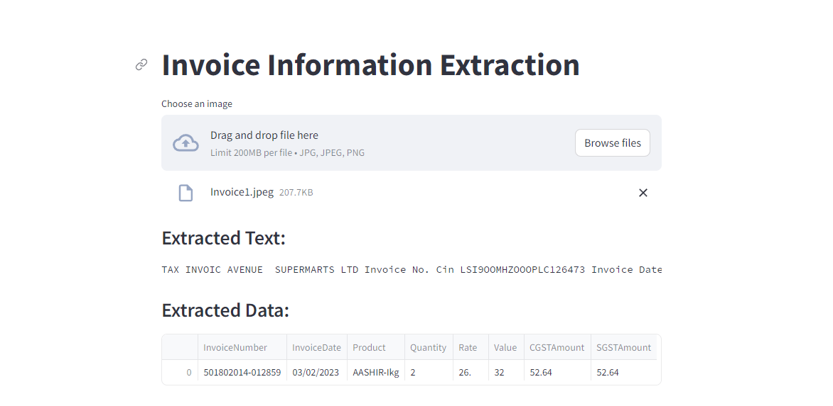
Screen shot of output

Slide 17
Challenges
Poor print quality (faded ink, smudges)
Varied fonts, text sizes, and styles
Background noise (logos, graphics)
Handwritten and cursive text
Multilingual content
Variable data field locations and structures
Receipt folds, distortions, and damage
Diverse receipt formats (thermal, digital)
Inconsistent text alignment
Extraction of specific information (dates, amounts)
Handwritten annotations
Security and privacy concerns (sensitive information)

Slide 18
Future Scopes
Improved accuracy with advanced AI and machine learning
Integration with computer vision and natural language processing
Real-time processing for instant access to transaction details
Edge computing for enhanced privacy and local data processing
Customizable and adaptive OCR models for specific industries and languages
Integration with blockchain for enhanced security and traceability
Augmented reality applications for immersive interactions
Enhanced extraction from unstructured text and complex layouts
Improved handling of diverse receipt formats, including digital receipts
Evolution into broader document understanding systems
Cross-platform integration for accessibility
Globalization and expanded language support for versatility

Slide 19

Queries ?

Slide 20


