Slide 1
Servlet

Slide 2
WEB SERVER
This is also known as http server. Responds to clients(web browsers) and returns html
pages,images,applets etc.,
Responsible for enforcing security policies, caching frequently requested files,logging requests etc.,
A web server listens on a port(standard is 80) for clients to come.
Http is a stateless protocol.

Slide 3
DIFFERENT WEB SERVERS
Apache web server
IIS (Internet Information Server)
Netscape Enterprise Server
IBM HTTP Server
iPlanet web server

Slide 4
APPLICATION SERVER
Web server will normally do only content management.
But a dynamic web site is the one in which the content will be generated dynamically from persistent store (say a database).
App servers take care of the server-side program execution.
For Ex. CFAS is an app server which works in tandem with any web server like IIS,Apache etc.,

Slide 5
DIFFERENT APPLICATION SERVERS
Weblogic
Websphere
JBoss
Oracle 10G

Slide 6
EXISTING SERVER-SIDE TECHNOLOGIES
Java Servlet
Java Server Pages
ASP (Active Server Pages)
CGI - Perl
SSJS - Server - side Java script
PHP - PHP HyperText Preprocessor
PSP - PL/SQL Procedure Pages
COLDFUSION

Slide 7
WHY SERVLETS ?
Servlet is a server-side component, which is used to service the web clients using HTTP protocol and generate dynamic content.
Servlets have many advantages over other contemporary technologies :
    - capable of running-in process
    - cross-platform
    - Durable
    - multi-threaded
    - Secure
    - cross-server

Slide 8
SERVLET ARCHITECTURE
javax.servlet.Servlet
--------------------------------------
init()
service()
destroy()
ServletConfig
----------------------
getInitParameter()
getInitParameterNames()
getServletContext()`
java.io.Serializable
GenericServlet
Javax.servlet.http.HttpServlet
doGet()
doPost()

Slide 9
LIFE CYCLE OF A SERVLET
When the first client calls init() method fires.
Then the service() method fires.
Then for all other client calls only the service() method fires.
When the web server is shut down, the destroy() method will fire.

Slide 10
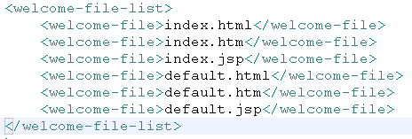
Welcome file
Displays the default page when the name of the website or name of the project is requested
No specific resource is requested only project name
http://localhost:8080/MyProject
MyProject
Web-Inf
Index.jsp
…….
……..
classes
lib
Web.xml

Slide 11
Welcome-file
This tag displays the first page or default or home page
Container will go and search based on welcome list order i.e
Firstly for index.html, if not exist then index.htm,and so on.
MyProject
<welcome-file>index.jsp</welcome-file>
container
Index.jsp
…..
…..
url does not start with slash /
The file must be placed outside web-inf folder

Slide 12
Development folder structure
MyProject
Src
webcontent
.java
Html
css
Java script
Web-inf
jsp
Web.xml
lib

Slide 13
Deployment Folder structure
MyProject
Web-Inf
Index.jsp
…….
……..
Client cannot access the files under web-Inf folder directly
Resources are kept safely
classes
lib
Web.xml
jsp

Slide 14
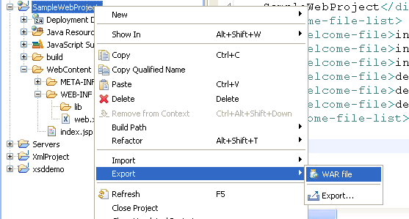
Creating a war file
Apachetomcat5.5
webapps
After creating , place the war file
.war

Slide 15
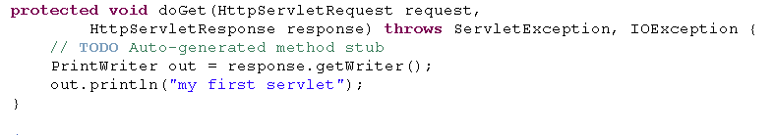
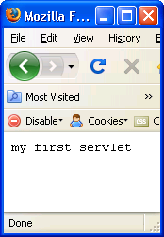
Creating a simple servlet
Using printwriter object fills the response obj
By default doGet() method is invoked by container
In Conole, main() is the start point of execution,
In j2ee doGet() or doPost() is the start point of execution

Slide 16
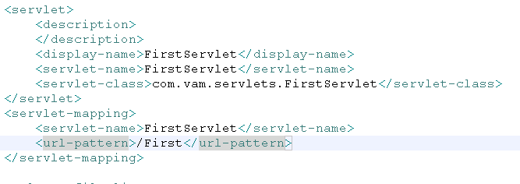
Deployment descriptor
2
3
1
http://localhost:8080/SampleWebProject/First

Slide 17
Application server
Web server has web container to manage web components ex tomcat
App servers have both web container and ejb container ex jboss, websphere, weblogic
CLIENT
WEB
Container
EJB
Container
HTTP
DB
HTML

Slide 18
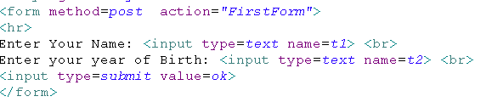
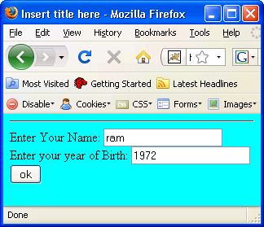
Post request
Firstform.html

Slide 19
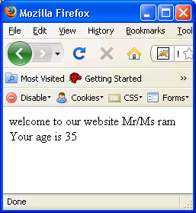
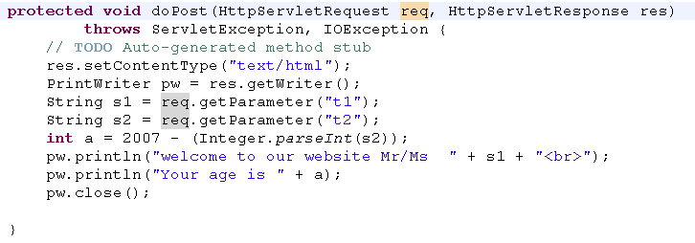
getParameter
Post carries the information safely to server
Unlimited info can be sent
getParameter of request obj gets the value of specified control

Slide 20
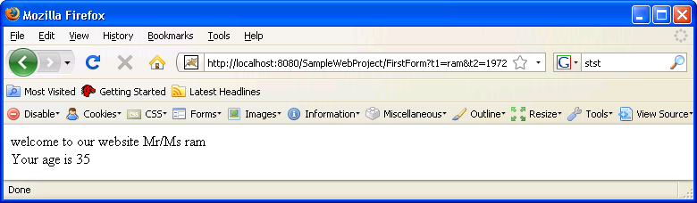
Get request
sends limited data
The data is appended to url,
Let us take same program
Do changes in the following
  Change method = get in html file
  Migrate the code from doPost() to doGet()

Slide 21
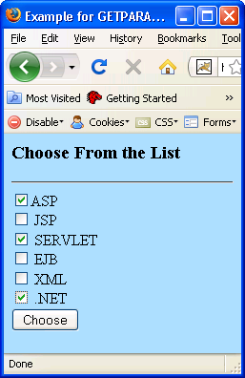
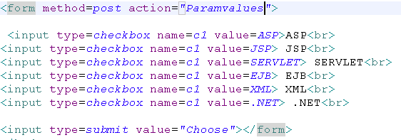
Checkbox

Slide 22
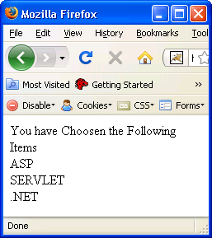
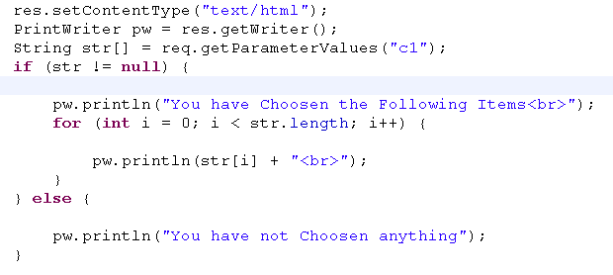
getParameterValues
Returns the string array of controls having same name

Slide 23
sendRedirect
It redirects the request to a completely different URL
This is costler tan request dispatcher
Generally This method is used, to send a request to another application
response.sendRedirect(/second);
browser
Web container
Servlet decides it is a different URL
browser
Servlet/jsp
…..
…..
Web container
302 status code
browser
response

Slide 24
Request Dispatcher
It works on server side whereas redirect works on client side
It hands the request to another web component
Generally, it happens with in application
RequestDispatcher rd = request.getrequestDispatcher(“first.jsp”);
rd.forward(request,response);
browser
Web container
Web component
Hands request to
Web component

Slide 25

ServletContext
It is also called application context
One context per app
The life of this object is alive till the app shuts down
This object shares to all the servlets and jsp for multiple request of multiple client
You cannot set data to context object programatically
out.println("context param "
+ getServletContext().getInitParameter("discount"));
Web component
Web component
SC
Web component
Web component

Slide 26
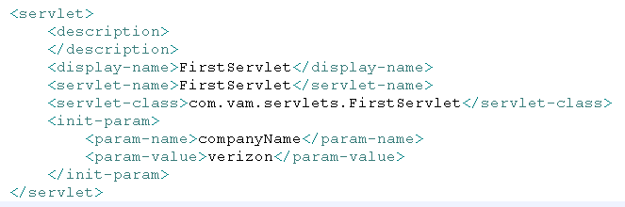
Servlet Config
getServletConfig.getInitParameter(“companyname”);
This object sets the data to a specific servlet
Context and servlet config objects are ready to use when the servlet is initialized
Both the objects can handle only string values
Cannot set programatically

Slide 27
COOKIE
Cookie is a Http mechanism that handles specific user settings and manages state.
Cookie is useful in tracking individual users as they traverse across the website.
Cookie is used to store and retrieve user specific information.

Slide 28
COOKIE
Foreground Process
Request
Client
Server
Response
Cookie
Background Process

Slide 29
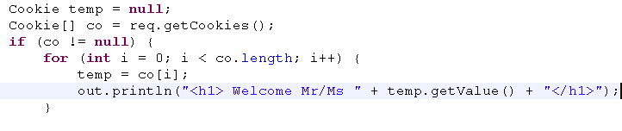
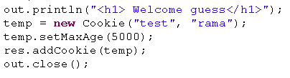
Cookies demo
Retrieving cookies
It gets all the cookies from request object
It gets you the value from cookie
Adding cookies
Create a cookie object
Set the max age
Adds the cookies to response

Slide 30
SESSION
Session is a persistent network connection between two hosts(A client and a server) that facilitates the exchange of server.
A session will be created when a connection to the server is established and will be closed when the connection is closed.
Every session will have a unique session id.
A session is timed out based on the time value that depends upon the web server.

Slide 31
LIFE CYCLE OF A SESSION
The client request the resource from the server.
Avoid long running queries, and provide methods for bulk Set/Get operations to avoid N/W trips between client & server.
Maintain good number of beans which are being accessed regularly in the cache.

Slide 32
SESSION TRACKING/HANDLING
(can be done with or without cookies)
With Cookie
      - A session object is create to hold all the values that are selected and also encapsulated with the session id details.
Without Cookie
      - When a cookie is not available the state is maintained by rewriting the url.
      - The state can also be maintained by passing the values from one another using hidden fields.

Slide 33
Attributes and scope
request | Only per request | req.setAttribute() req.getAttribute()
session | Multiple request same client | HttpSession sess =req.getHttpSession(); sess.setAttribute() sess.getAttribute()
Application | Multiple request multiple client | ServletContext sc = getServletContext(); Sc.setAttribute() Sc.getAttribute()
setAttribute(key,value) getAttribute(key) Attribute can handle objects and set programatically

Slide 34
SERVLET CHAINING
Servlet chaining is the process of passing the output of one servlet to another servlet as input.
The client request is passed on to the first servlet in the chain.
The servlet will process the request and send the output to the next servlet in the chain.
This process continues till the last servlet in the chain whose output will be sent to the client.
getInputStream( ) method of the HttpServletRequest class is used to read the previous servlet output.

Slide 35
SERVLET CHAINING
Client
Request
Servlet1
Servlet 2
Servlet 3
Response

Slide 36
ACCESSING A DATABASE
Register the jdbc driver with the driver manager.
Establish a data base connection.
Execute an sql statement.
Process the result.
Close the connection.

Slide 37
LIMITATIONS OF A SINGLE CONNECTION
The connection created in the service method will be closed once the servlet execution is over.
When another client calls the same servlet a new connection has to be created.
Hence performance will be drastically hit.
This has got a this can be solved by creating the connection in the init ( ) method so that it will be closed only by the destroy method.
Limitation that only one client can access the connection at a time. Otherwise it will lead to inconsistency.

Slide 38
CONNECTION POOL
REQUIREMENTS OF A CONNECTION POOL
Connection pool must hold number of open connections.
Connection pool must be able to determine when a connection is in use.
Connection pool should create more connections when needed.
When the pool is closed all the connections must be released.

