Slide 1
Hibernate

Slide 2
What is Hibernate?
Hibernate the latest Open Source persistence technology.
Hibernate maps the Java classes to the database tables.
It also provides the data query and retrieval facilities that significantly reduces the development time.
Hibernate allows transparent persistence that enables the applications to switch any database.
Hibernate can be used in Java Swing applications, Java Servlet-based applications, or J2EE applications using EJB session beans.

Slide 3
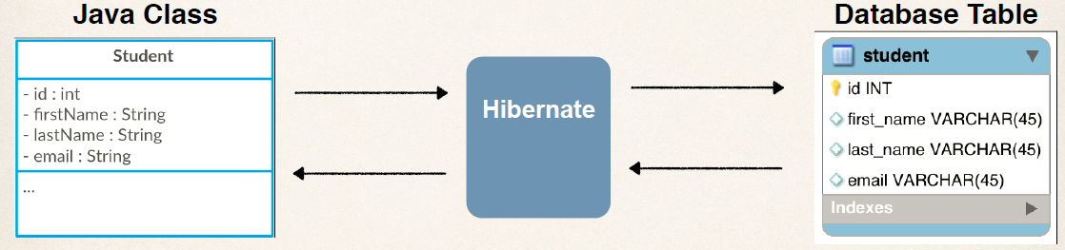
Hibernate Mapping

Slide 4
Solutions
Hibernate is not the best solutions for data centric applications that only uses the stored-procedures to implement the business logic in database.
It is most useful with object-oriented domain modes and business logic in the Java-based middle-tier.

Slide 5
Features of Hibernate
Hibernate provides three full-featured query facilities: Hibernate Query Language, the newly enhanced Hibernate Criteria Query API, and enhanced support for queries expressed in the native SQL dialect of the database.
Enhanced Criteria query API: with full support for projection/aggregation and subselects.
Runtime performance monitoring: via JMX or local Java API, including a second-level cache browser.
Hibernate is Scalable: Hibernate is very performant and due to its dual-layer architecture can be used in the clustered environments.

Slide 6
Features of Hibernate
Less Development Time: Hibernate reduces the development timings as it supports inheritance, polymorphism, composition and the Java Collection framework.
Automatic Key Generation: Hibernate supports the automatic generation of primary key for your.
Hibernate XML binding enables data to be represented as XML and POJOs interchangeably.
The EJB3 draft specification support for POJO persistence and annotations.

Slide 7
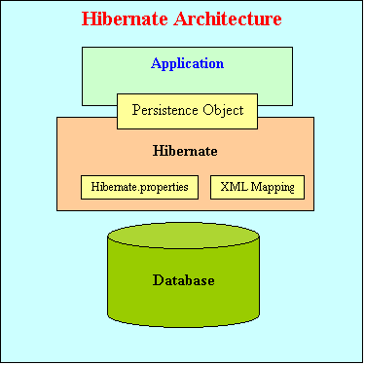
Hibernate Architecture

Slide 8
Components of architecture
Hibernate architecture has three main components:
Connection Management
Hibernate Connection management service provide efficient management of the database connections.
Database connection is the most expensive part of interacting with the database as it requires a lot of resources of open and close the database connection.
Transaction management:
Transaction management service provide the ability to the user to execute more than one database statements at a time.
Object relational mapping:
Object relational mapping is technique of mapping the data representation from an object model to a relational data model.
When we pass an object to a Session.save() method, Hibernate reads the state of the variables of that object and executes the necessary query.

Slide 9
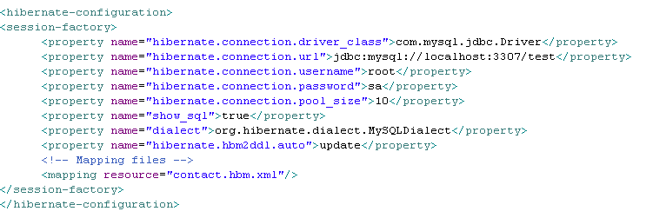
hibernate.cfg.xml
Hibernate uses the hibernate.cfg.xml to create the connection pool and setup required environment.

Slide 10
Database Dialect
DB2 | org.hibernate.dialect.DB2Dialect
Microsoft SQL Server | org.hibernate.dialect.SQLServerDialect
MySQL | org.hibernate.dialect.MySQLDialect
Oracle | org.hibernate.dialect.OracleDialect
Sybase | org.hibernate.dialect.SybaseDialect
PostgreSQL | org.hibernate.dialect.PostgreSQLDialect

Slide 11
Hibernate mapping file
<hibernate-mapping> element
The first or root element of hibernate mapping document is <hibernate-mapping> element.
<hibernate-mapping>
…….
…….
</hibernate-mapping>

Slide 12
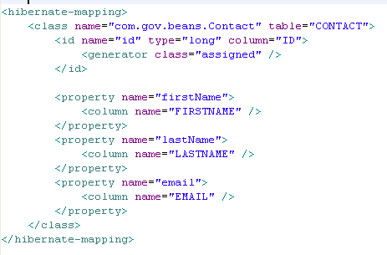
.hbm.xml
Hibernate mapping documents are simple xml documents. Here are important elements of the mapping file:.

Slide 13
<class> element
<class> element
The <Class> element maps the class object with corresponding entity in the database.
It also tells what table in the database has to access and what column in that table it should use.
Within one <hibernate-mapping> element, several <class> mappings are possible.
<class name="com.gov.beans.Contact" table="CONTACT">
Identifies the class name to map
Identifies the table name in database to map

Slide 14
<id> element
<id> element
The <id> element in unique identifier to identify and object.
In fact <id> element map with the primary key of the table.
In our code primary key maps to the ID field of the table CONTACT
<id name="id" type="long" column="ID">
<generator class="assigned" />
</id>
The property name used by the persistent class.
The Java data type used.
The column used to store the primary key value

Slide 15
<property> element
The property elements define standard Java attributes and their mapping into database schema.
The property element supports the column child element to specify additional properties, such as the index name on a column or a specific column type.
<property name="firstName">
<column name="FIRSTNAME" />
</property>
Identifies the column in a table
Identifies the setter and getter in a java class

Slide 16
<generator> element
The <generator> method is used to generate the primary key for the new record. Here is some of the commonly used generators :
* Increment - This is used to generate primary keys of type long, short or int that are unique only. It should not be used in the clustered deployment environment.
* Sequence - Hibernate can also use the sequences to generate the primary key. It can be used with DB2, PostgreSQL, Oracle, SAP DB databases.
* Assigned - Assigned method is used when application code generates the primary key.

Slide 17
Generator | Description
increment | It generates identifiers of type long, short or int that are unique only when no other process is inserting data into the same table. It should not be used in the clustered environment.
identity | It supports identity columns in DB2, MySQL, MS SQL Server, Sybase and HypersonicSQL. The returned identifier is of type long, short or int.
sequence | The sequence generator uses a sequence in DB2, PostgreSQL, Oracle, SAP DB, McKoi or a generator in Interbase. The returned identifier is of type long, short or int
hilo | The hilo generator uses a hi/lo algorithm to efficiently generate identifiers of type long, short or int, given a table and column (by default hibernate_unique_key and next_hi respectively) as a source of hi values. The hi/lo algorithm generates identifiers that are unique only for a particular database. Do not use this generator with connections enlisted with JTA or with a user-supplied connection.
seqhilo | The seqhilo generator uses a hi/lo algorithm to efficiently generate identifiers of type long, short or int, given a named database sequence.

Slide 18
uuid | The uuid generator uses a 128-bit UUID algorithm to generate identifiers of type string, unique within a network (the IP address is used). The UUID is encoded as a string of hexadecimal digits of length 32.
guid | It uses a database-generated GUID string on MS SQL Server and MySQL.
native | It picks identity, sequence or hilo depending upon the capabilities of the underlying database.
assigned | lets the application to assign an identifier to the object before save() is called. This is the default strategy if no <generator> element is specified.
select | retrieves a primary key assigned by a database trigger by selecting the row by some unique key and retrieving the primary key value.
foreign | uses the identifier of another associated object. Usually used in conjunction with a <one-to-one> primary key association.

Slide 19
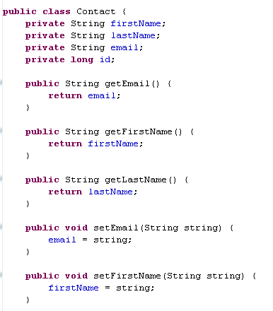
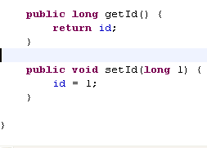
PoJo class
Encapsulate the fields
Plain Old Java Objects
Have getters and setters
Pojo is a plain class that does not have any call back method or implement interfaces or extending any class

Slide 20
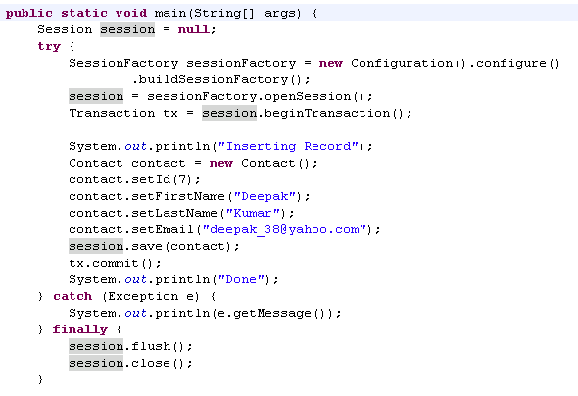
First Example
Start the transaction
Saves the instance
Commits the transaction

Slide 21
SessionFactory and session
Sessionfactory creates a session objects for a database connection data, caching and mappings
One Sessionfactory per database
Create a configuration Object and build a session factory by using it
SessionFactory sessionFactory = new Configuration().configure()
.buildSessionFactory();

Slide 22
Session
session = sessionFactory.openSession();
Session is created from Sessionfactory
It is common with Jdbc Connection
It is common to statement and Prepared stateement in JDBC
session.save(contact);
Session.get(id);

Slide 23
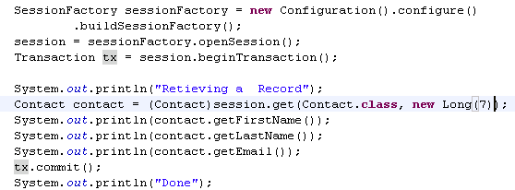
Retrieving a value
It returns an object whose primary key value is 7

Slide 24

Session.load
It retrieves an object whose primary key value is 7
Diff between Load and get
load() will throw an unrecoverable exception if there is no matching database row.
get() will return null if there is no matching database row.

Slide 25
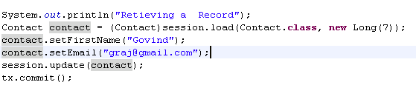
Updating a record
Retrieve a particular object and bind it to an instance
Using instance set the values and update it

Slide 26
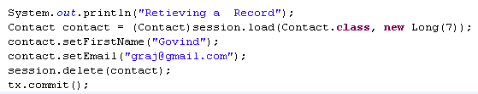
Deleting a record
Retrieve a particular instance and delete it , it deletes in the table

Slide 27
Hibernate Query Language
Hibernate Query Language or HQL for short is extremely powerful query language.
HQL is much like SQL and are case-insensitive, except for the names of the Java Classes and properties.
Hibernate Query Language is used to execute queries against database.
Hibernate automatically generates the sql query and execute it against underlying database if HQL is used in the application.
HQL is based on the relational object models and makes the SQL object oriented.
Hibernate Query Language uses Classes and properties instead of tables and columns.
Hibernate Query Language is extremely powerful and it supports Polymorphism, Associations, Much less verbose than SQL.

Slide 28
Why to use HQL?
Full support for relational operations: HQL allows representing SQL queries in the form of objects. Hibernate Query Language uses Classes and properties instead of tables and columns.
Return result as Object: The HQL queries return the query result(s) in the form of object(s), which is easy to use. This eleminates the need of creating the object and populate the data from result set.
Polymorphic Queries: HQL fully supports polymorphic queries. Polymorphic queries results the query results along with all the child objects if any.
Easy to Learn: Hibernate Queries are easy to learn and it can be easily implemented in the applications.
Support for Advance features: HQL contains many advance features such as pagination, fetch join with dynamic profiling, Inner/outer/full joins, Cartesian products. It also supports Projection, Aggregation (max, avg) and grouping, Ordering, Sub queries and SQL function calls.
Database independent: Queries written in HQL are database independent (If database supports the underlying feature).

