Slide 1
Collection framework

Slide 2
Collection
Collection
List
Set
Queue
ArrayList
Vector
Linked List
Hash set
Tree set
Queue
Priority Queue
Map
HashMap
TreeMap
Linkedhashmap
Collection: any collection of elements
All these interfaces and classes are part of the java.util package. Names of interfaces are in italics.

Slide 3
public interface List<E> extends Collection<E>
// Positional access
E get(int index);
E set(int index, E element); //optional
boolean add(E element); //optional
void add(int index, E element); //optional
E remove(int index); //optional
boolean addAll(int index,Collection<? extends E> c); //optional
// Search
int indexOf(Object o);
int lastIndexOf(Object o);
// Iteration
ListIterator<E> listIterator();
ListIterator<E> listIterator(int index);
// Range-view
List<E> subList(int from, int to);

Slide 4
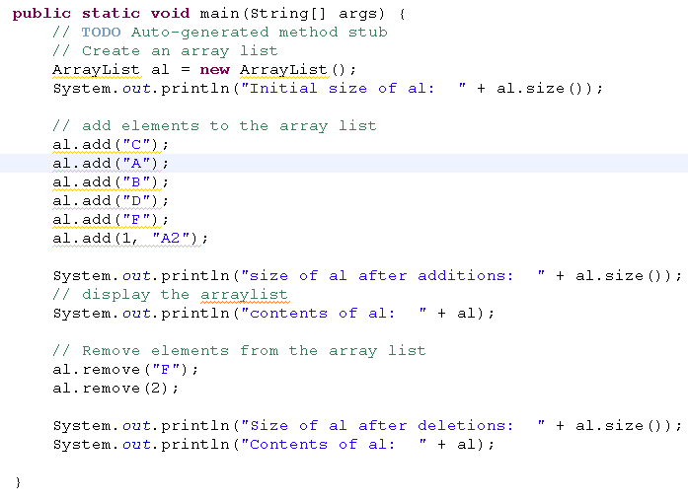
Arraylist demo
Adding objects to list
Adds object in specific index
Determines size of an list
Removes an item and also removes at specific index

Slide 5
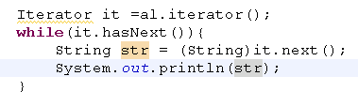
Collection, Iterator
«interface»
Iterator
«interface»
Collection
An iterator is an object that helps to traverse the collection (process all its elements in sequence).
Collection interface represents any collection.
A collection supplies its own iterator(s), (returned by collection’s iterator method); the traversal sequence depends on the collection.

Slide 6
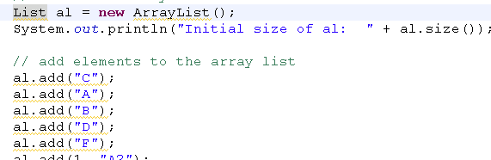


Enhanced For - Generics
Type safety warnings
Introduced from java 5
It is used to iterate the collection
Replaces Iterator object, effeciecy
List<String> al = new ArrayList<String>();
If we use Generics , no need of casting
Generics are executed at comple time

Slide 7
ArrayList ,Vector, Linked List
It is ordered, But not sorted
It is not a thread safety
Represents a list as a dynamic array (array that is resized when full)
Provides random access to the elements
It is used for traversing
It is Similar to array list
It is Thread safety
Vector
ArrayList
It is ordered
It is not a thread safety
No random Access
Generally for inserting and deleting
LinkedList

Slide 8
Set
Set is a collection of unique objects ,
it doesn't allow duplicate objects and modification of existing objects.
Set types also allow basic operations like adding /,removing/ accessing / iterating objects
There are two implementations of the Set interface they are HashSet and TreeSet.

Slide 9
// Basic operations
int size();
boolean isEmpty();
boolean contains(Object element);
boolean add(E element);
boolean remove(Object element);
Iterator<E> iterator();
// Bulk operations
boolean containsAll(Collection<?> c);
boolean addAll(Collection<? extends E> c);
boolean removeAll(Collection<?> c);
boolean retainAll(Collection<?> c);
void clear(); //optional

Slide 10
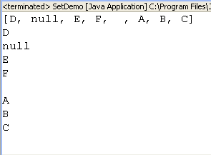
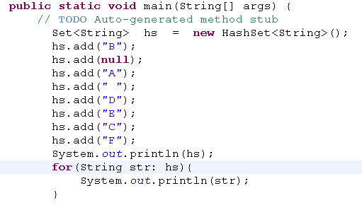
Set – Hash set
No ordered, no sorted
It adds unique items
It adds null

Slide 11
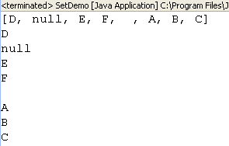
Unique elements
hs.add("B");
hs.add(null);
hs.add("A");
hs.add(" ");
hs.add("D");
hs.add("E");
hs.add("C");
hs.add("F");
hs.add("A");
No err is displayed
It ignores
Only first object is kept

Slide 12
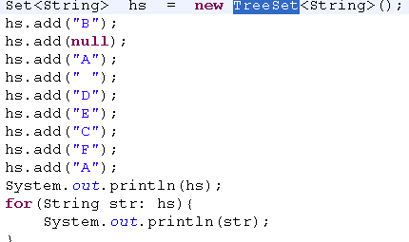
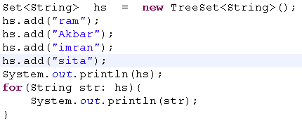
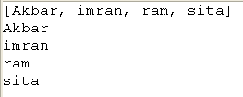

TreeSet
All the type must be same
It is ordered, sorted

Slide 13
Map
Map is a collection of key and value object associations.
There are four types of Map implementations they are HashMap, Hashtable, WeakHashMap and TreeMap.
Treemap is slower than other map

Slide 14
// Basic operations
V put(K key, V value);
V get(Object key);
V remove(Object key);
boolean containsKey(Object key);
boolean containsValue(Object value);
int size();
boolean isEmpty();
// Bulk operations
void putAll(Map<? extends K, ? extends V> m);
void clear();
// Collection Views
public Set<K> keySet();
public Collection<V> values();
public Set<Map.Entry<K,V>> entrySet();
// Interface for entrySet elements
public interface Entry {
K getKey();
V getValue();
V setValue(V value)

Slide 15
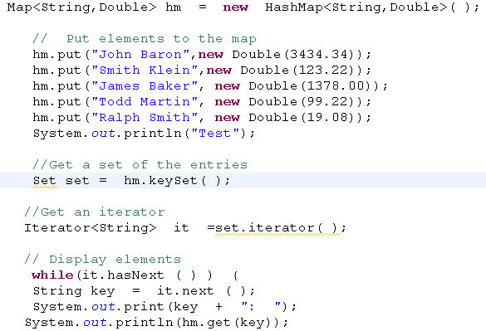
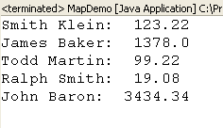
Traversing HashMap
Get all the keys in a set
Keys must be unique
Iterate the keyset
Get the key
Using key get values

Slide 16
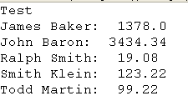
TreeMap
Hashmap are not ordered, no sorted
Allows null keys
Good performance
Map<String,Double> hm = new TreeMap<String,Double>( );
Keys are sorted
All key types must be same

