Slide 1
Exception Handling

Slide 2
Exceptions - Overview
Exception is an object that terminates the application abnormally
All exceptions are subclasses of java.lang.Throwable.
Exceptions are categorized in to two
        JVM exceptions
        Programmatic Exception
EXCEPTION TYPES
Errors are called JVM exception
Thrown by JVM
It cannot be handled
It is thrown by the application or API developers
They are checked and unchecked
Programmatic EXCEPTION
ERROR

Slide 3
HIREARCHY OF EXCEPTION CLASS
JAVA.LANG.OBJECT
JAVA.LANG.THROWABLE
EXCEPTION
ERROR
Checked Exception
Unchecked exception
RUNTIME EXCEPTION
IOEXCEPTION
EOFEXCEPTION
ARITHMETICEXCEPTION
FILENOTFOUND
EXCEPTION
NULL POINTER EXCEPTION

Slide 4
Runtime exceptions
describe program bugs.
Runtime exceptions generally arise from things like out-of-bounds array accesses, Arithmetic exception etc.
Because runtime exceptions should never arise in a correct program, you’re not required to handle them.
It is checked at run time
No compile time error but run time error
public static void main(String[] args) {
int noOfSubjects = 0;
int total = 500;
double avg = total/noOfSubjects;
}

Slide 5
Run time Exception
int noOfSubjects = 0;
int total = 500;
if (noOfSubjects > 0){
double avg = total/noOfSubjects;
}
They are called unchecked exception
It is legal to handle and declare but it is not recommended
Try to avoid unchecked exceptions as seen in the above code

Slide 6
Errors
Errors are called JVM exception
It is thrown by JVM
Errors generally describe problems that are sufficiently unusual, and sufficiently difficult to recover from, that you cannot handle them.
but more commonly they reflect environment problems, such as running out of memory.

Slide 7
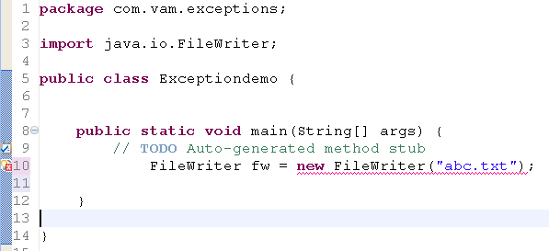
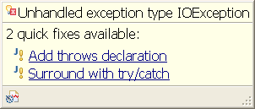
Checked exception
The checked exceptions describe problems that can arise in a correct program,
typically difficulties with the environment ex: I/O problems.
These exceptions are thrown at compile time
They must be handled or declare rule(throwing an exception)

Slide 8
Handling an exception
Checked exceptions are checked by compiler and returns an exception object if it is not handled or declared(thrown)
It can be handled using try,catch, finally blocks
codes that may throw exception(s)
try {
……….
FileWriter fw = new FileWriter("abc.txt");
} catch (IOException e) {
……….
e.printStackTrace();
}
finally{
………
}
The exception is thrown in try block and it is caught in catch block
how do you want to deal with this exeption
Catch block is accompanied with try block
There can be many catch blocks for a single try block

Slide 9
ADVANTAGES OF HANDLING EXCEPTION
ALLOWS US TO FIX THE ERROR.
PREVENTS THE PROGRAM FROM TERMINATING AUTOMATICALLY.

Slide 10
Handling multiple exceptions
try {
………..
FileWriter fw = new FileWriter("abc.txt");
} catch (FileNotFoundException e) {
e.printStackTrace();
} catch (IOExcetion ex1){
}catch(Exception ex2){
}
try {
………..
FileWriter fw = new FileWriter("abc.txt");
} catch (Exception e) {
e.printStackTrace();
}
No single exception handler can properly handle every exception

Slide 11
Exception matching
Exception
try {
………..
FileWriter fw = new FileWriter("abc.txt");
} catch (FileNotFoundException e) {
e.printStackTrace();
} catch (IOExcetion ex1){
}catch(Exception ex2){
}
IOException
FileNotFoundException
EndOfFileException
You can have multiple catch blocks for a single try block
Catch blocks must be ordered from most specific to general
otherwise super class exceptions will catch all of its subtypes
If an exception is not a subtype or supertype, then order does not manner

Slide 12
finally block
It gets executed under successful or unsuccessful conditions
try {
……….
FileWriter fw = new FileWriter("abc.txt");
} catch (IOException e) {
……….
e.printStackTrace();
}
finally{
………
}
try {
……….
FileWriter fw = new FileWriter("abc.txt");
} finally{
………
}
If any exception is thrown in try block , finally block gets executed and then it thrown to jvm

Slide 13
finally
When does the finally block not executed?
  the death of the thread
  the use of System.exit( )
  turning off the power to the CPU
  an exception arising in the finally block itself
What code is written in finally block?
Clean up resource code because finally block gets executed when there is an exception or no exception arises in try block

Slide 14
Declare rule (propagating an exception)
public static void writeFile() throws IOException{
FileWriter fw = new FileWriter("abc.txt");
}
To avoid this, please handle the exception at any one point
Throws to
main
jvm
method2
Throws to
Jvm stops abruptly
Method3

Slide 15
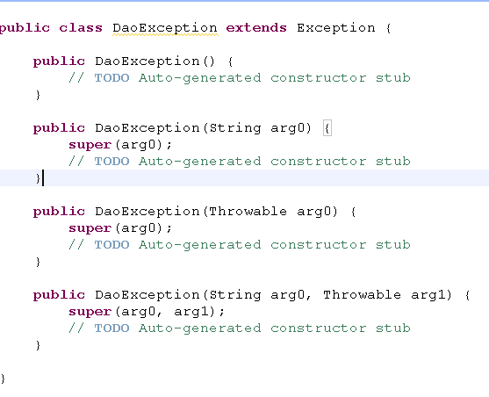
Userdefined exception
All user defined exceptions are the subclass of Exception
Constructor with no arg
Constructor with string arg
Constructor withThrowable arg
Constructor with String and Throwable arg

Slide 16
Why user defined exception
To identify where the exception is arised in which layer of code
Wrap the built-in exception to user defined exception and throw it
Ex If there is a problem in database connection then wrap the SQLException to DaoException
In real life scenario, Codes are constructed in layers. So if built-in exception is thrown, it is difficult to handle and identify the layer
Generally these exceptions are logged
Developer finds easy to fix the problems

Slide 17
throw
Declaring an exception is done by using throws clause
public static void getConnection() throws DaoException{
try{
Class.forName("com.jdbc.mysql.JdbcDriver");
}catch (ClassNotFoundException e) {
// TODO Auto-generated catch block
throw new DaoException();
}
}
If the method is throwing an exception from the body of the code or try/catch block then declare the exception

Slide 18
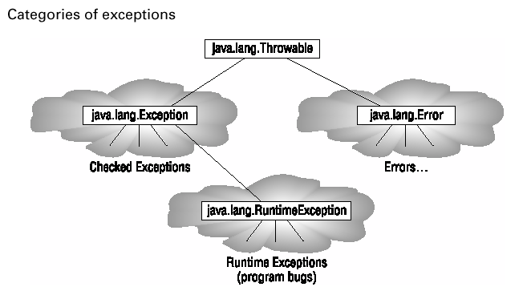
Exceptions - Categories

Slide 19
Exceptions - Subclass
When you override a method, Java insists that the new method cannot be declared as throwing checked exceptions of classes other than those that were declared by the original method.

