Slide 1
Io Streams
JAVA PERFORMS IO THROUGH STREAMS
STREAM IS AN ABSTRACTION THAT EITHER PRODUCES OR CONSUMES INFORMATION.
STREAMS BEHAVE IN THE SAME MANNER IRRESPECTIVE OF THE SOURCE OR DESTINATION.

Slide 2
Byte STREAM CLASSES WILL READ OR WRITE THE DATA IN THE FORM OF BYTES
READER AND WRITER CLASSES WILL WRITE THE DATA IN THE FORM OF CHARACTER.
READER/WRITER CLASSES ARE ALWAYS FASTER THAN STREAM CLASSES.

Slide 3
Java Stream Classes - Inputstream
A stream is a path along which data flows
It has a “source” of data and a “destination” for that data
  The source and the destination may be physical devices or programs or other streams in the same program.
  Java Streams are classified into two basic types,
Source
I / P Stream
Program
        It extracts (reads) data from the source (file) and sends it to the program.
        The program connects and opens an I / P stream on the data source and reads the data serially.

Slide 4
Java Stream Classes…- Outputstream
      It takes data from the program and sends (writes) it to the destination (file).
      The program connects and opens an O/P stream to the destination place of data and writes data out serially
Program
O/P Stream
Destination
Writes

Slide 5
Java Stream Classes…
    Input stream classes…
Object
InputStream
FileInputStream
SequenceInputStream
PipeInputStream
ObjectInputStream
StringBufferInputStream
ByteArrayInputStream
FilterInputStream
BufferedInputStream
PushbackInputStream
DataInputStream

Slide 6
Output Stream Methods
S.No | Method | Description
1 | write() | Writes a byte to the output stream
2 | write (byte b[ ]) | Writes all bytes in the array ‘b’ to the output stream.
3 | write(byte b[ ],int n, int m) | Writes ‘m’ bytes from the array ‘b’ starting from ‘n’ th byte.
4 | close( ) | Closes the output stream.
5 | flush ( ) | Flushes the output stream.

Slide 7
Java Stream Classes…
    Output stream classes…
Object
OutputStream
FileOutputStream
ObjectOutputStream
PipeOutputStream
ByteArrayOutputStream
FilterOutputStream
BufferedOutputStream
PushbackOutputStream
DataOutputStream

Slide 8
Java Stream classes – Character Stream
  Character stream class.
      These were not a part of the Java language when it was released in 1995.
      They were added in the version 1.1
      Character streams can be used to read and write 16-bit Unicode characters.
      It can be classified into two and they are,
        Reader stream classes
        Writer stream classes

Slide 9
Java Stream Classes…
    Reader stream classes…
Object
Reader
BufferedReader
StringReader
CharArrayReader
PipeReader
FilterReader
InputStreamReader
FileReader
PushbackReader

Slide 10
Java Stream Classes…
    Reader stream classes…
Object
Writer
BufferedWriter
PrintWriter
CharArrayWriter
PipeWriter
StringWriter
FilterWriter
OutputStreamWriter
FileWriter

Slide 11
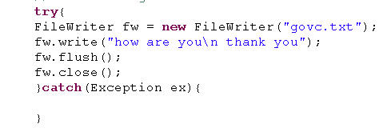
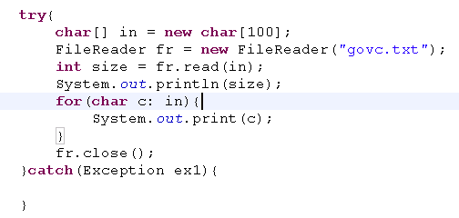
File reader & Writer
fileWriter cannot handle new line
Writes a char at a time
Allocating char array to max size
Reads a char at a time

Slide 12
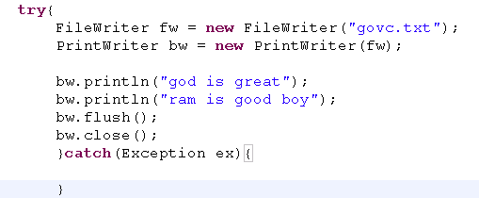
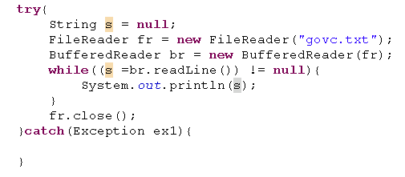
BufferedReader & writer
Buffered reader reads a line at a time(chunks of data)
printWriter writes a line inclusive of newline char
Whereas BufferedWriter writes new line char seperately
br.newLine()
BufferedReader & writer improves effeciency
Java 5 introduces Printwriter

Slide 13
Java Stream Classes…
S.No | Task to be performed | Character Stream class | Byte Stream class
1 | Input operations | Reader | InputStream
2 | Buffering input | BufferedReader | BufferedInputStream
3 | Reading from an array | CharArrayReader | ByteArrayInputStream
4 | Reading from files | FileReader | FileInputStream
5 | Filtering the input | FilterReader | FilterInputStream
6 | Reading from a string | StringReader | StringBufferInputStream
7 | Reading primitive types | -- | DataInputStream

Slide 14
Java Stream Classes…
S.No | Task to be performed | Character Stream class | Byte Stream class
8 | Output operations | Writer | OutputStream
9 | Buffering output | BufferedWriter | BufferedOutputStream
10 | Writing to an array | CharArrayWriter | ByteArrayOutputStream
11 | Writing to a file | FileWriter | FileOutputStream
12 | Filtering the output | FilterWriter | FilterOutputStream
13 | Writing to a string | StringWriter | -
14 | Writing primitive types | - | DataOutputStream
15 | Printing values and objects | PrintWriter | PrintStream

Slide 15
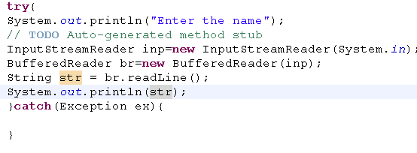
Console Input
InputStreamReader reads only a character
BufferedReader reads the line from keyboard

Slide 16
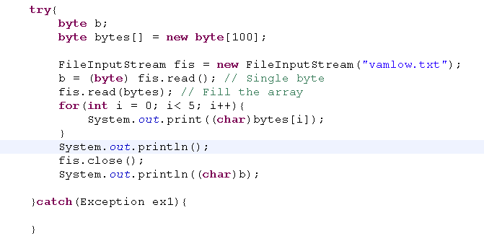
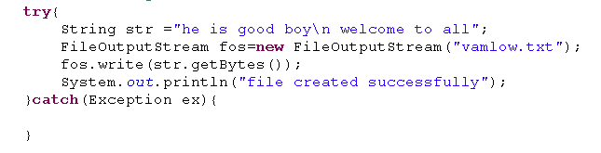
LowlevelStream – two types
Low-level input streams have methods that read input and return the input as bytes
FileOutputStream
FileInputStream

Slide 17
DataInputStream & DataOutputStream
DataOutputStream writes primitive data types into bytes
FileInputStream
DataInputStream
FileOutputStream
BYTES
DataOutputStream
Int,float,String,etc
BYTES
DataInputstream reads bytes into respected primitive data type
FILE
Int,float,String,etc

Slide 18
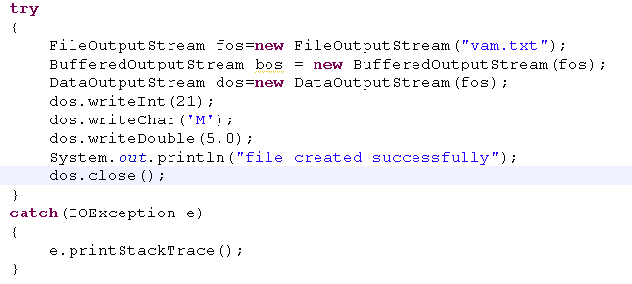
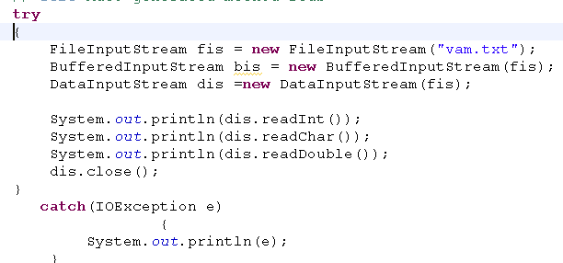

BufferedInputStream & BufferedOutputStream
o/p

Slide 19
, It reads and writes chunks of data and improves effeciency
BufferedInputStream
FileInputStream
DatainputStream
BYTES
Int,float,String,etc
FILE

Slide 20
Object Serialization
MAINTAINS THE PERSISTENCE OF THE OBJECT
USEFUL IS THE PROCESS OF TRANSPORTING OBJECTS
PLAYS AN ESSENTIAL ROLE IN REMOTE METHOD INVOCATION
ACHEIVED BY USING THE java.io.serializable INTERFACE
USING OBJECT SERIALIZATION WE CAN READ OR WRITE AN OBJECT

Slide 21
Serialization
Serialization
It stores the current state of an object to a file
It binds the current state of an object from a file
Deserialization
Object to be serialized must be implemented Serializable
ObjectoutputStream – writes an object as bytes to a file
ObjectInputstream – reads the bytes as an object from file

Slide 22
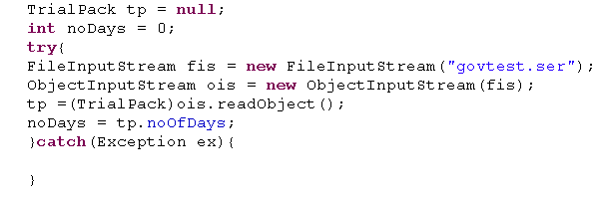
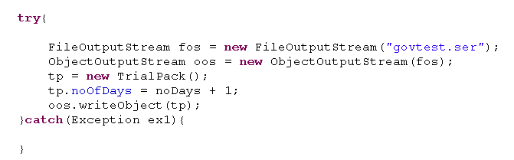
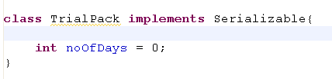
Serialization - Demo
Serialization
Deserialization
Object is implemented serializable

Slide 23
Criteria To Serialize A Class
THE CLASS OR ONE OF ITS SUPER CLASS MUST IMPLEMENT THE java.io.serializable INTERFACE.
THE CLASS MUST HAVE THE writeObject( ) METHOD TO APPEND THE NEW DATA TO THE EXISTING SAVED DATA
THE CLASS MUST HAVE THE readObject( ) METHOD TO READ THE DATA THAT IS AVAILABLE IN THE SOURCE.
VARIABLES THAT NEED NOT BE SERIALIZED SHOULD BE DECLARED AS transient.(KEY WORD)

Slide 24
Randomaccessfile
IS A CLASS USED FOR READING AND WRITING FROM AND TO THE FILE.
SUPPORTS FILE POINTER POSITIONING.
CAN OPEN THE FILE EITHER IN READ MODE OR READ/WRITE MODE or WRITE mode
Reads and writes the bytes in to a file
It has the capability of reading the bytes in to respected datatype and vice versa
Ex: If it is int – it read 4 bytes
if it is char – it reads 2 bytes

Slide 25
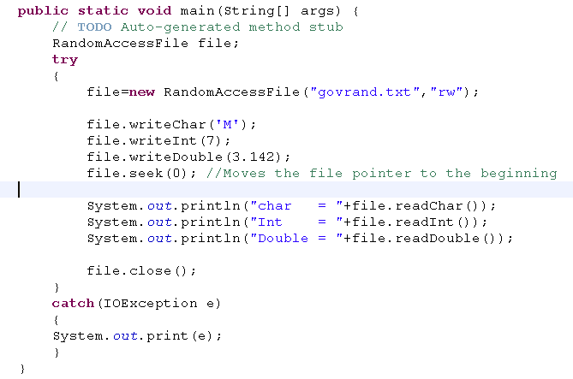
Random access
disadvantages in that you can't apply the same filters to RandomAccessFiles that you can to streams
RandomAccessFile is used for both reading and writing files

