Slide 1
Packages
interfaces

Slide 2


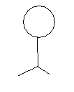
interface
Atm
bank
Interface hides all the bank details and provide him the service what the client need

Slide 3
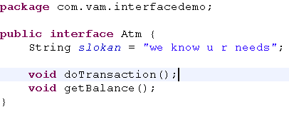
Interface - components
By default interface modifier is abstract
Access mofiers can be used for restriction
You can define constants, By default it is public static final
In interface only abstract methods are allowed, by default methods are declared public abstract

Slide 4
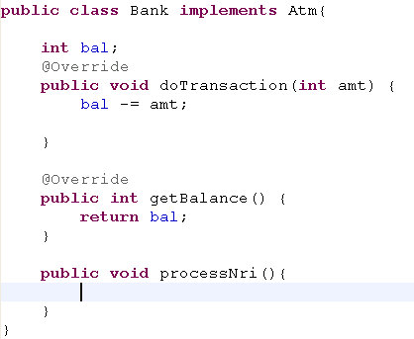
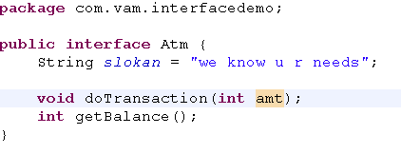

Interface – implementation
Implement keyword implements the interface
Client code
Interface provides tight contract to concrete classes
The methods that has the reference in interface, only those methods are accesible to client

Slide 5
Interface - inheritance
In java , you can extend only one super class
Interface achieves multiple inheritance by implementing many interfaces
Generally interface supports polymorphism
Why java don’t have multiple inheritance feature?
ex A man want to fly in the air
Human
Fly
man
Human
Flyable
In this case, is Man a fly ?
No
Man
In this case man can fly through an interface (aero vehicles)

Slide 6
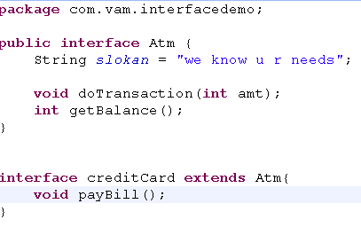
Interface extends interface
If a concrete class implements CreditCard interface then all the methods from atm + creditcard must be implemented

Slide 7
Packages
Packages are Java’s way of grouping a number of related classes and/or interfaces together into a single unit.
That means, packages act as “containers” for classes.
The benefits of organising classes into packages are:
  The classes contained in the packages of other programs/applications can be reused.
  That two classes in two different packages can have the same name. If there is a naming clash, then classes can be accessed with their fully qualified name.
  java.util.Date
  java.sql.Date
  Classes in packages can be hidden
  Packages also provide a way for separating “design” from coding.

Slide 8
Package Types
  Java API Package.
  User-Defined Package.
The six foundation Java API packages are:
  java.lang
    Contains classes for primitive types, strings, math functions, threads, and exception
  java.util
    Contains classes such as vectors, hash tables, date etc.
  java.io
    Stream classes for I/O
  java.awt
    Classes for implementing GUI – windows, buttons, menus etc.
  java.net
    Classes for networking
  java.applet
    Classes for creating and implementing applets

Slide 9
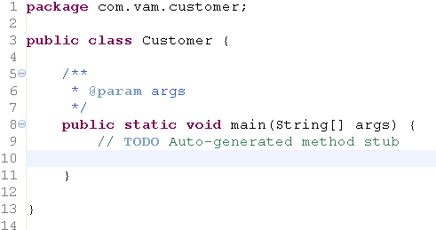
Packages
keyword called “package” for creating user-defined packages.
The package statement must be the first statement
MyProject
Source
Customer.java
classes
com
vam
customer
Customer.class
Comple java code
javac –d classes source/Customer.java

Slide 10
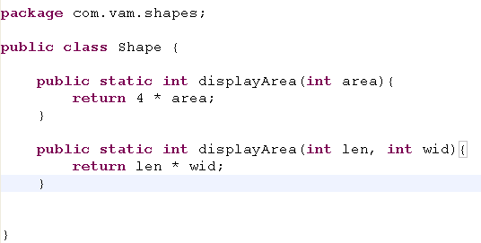
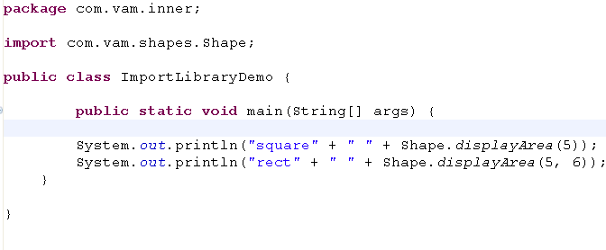
Accessing packages
Import the class name with fully qualified package name
Methods from the imported class can be reused

