Slide 1
Modifiers

Slide 2
Modifiers
Modifiers are Java keywords that give the compiler information about the nature of code, data, or classes.
Modifiers specify, for example, that a particular feature is static, final, or transient.
(A feature is a class, a method, or a variable.)
Modifiers
Access modifiers
Non access Modifiers
can be used in combination to describe the attributes of a feature.
dictates which classes are allowed to use a feature.

Slide 3
Access Modifiers Overviews
Access modifiers control which classes may use the following feature: the class itself, its class variables, its methods and constructors.
Access modifiers are: public, protected and private.
You can have only ONE access modifier to apply to a feature.
If NO access modifier is used, then default access level is assigned.

Slide 4
Access modifiers
There are 3 access modifiers but there are 4 access control levels
Static / instance Method access
Top level Class Access
public
protected
default
private
Static / instance Variable access

Slide 5
public
The most generous access modifier is public
Public access modifier is applied at class, method and variable level
Class, method and variable level are accessed in all the classes of any package within the application
Package A
Package B
Class A
classB
Class E
Class F
Class C
Class D
Class G
Class H

Slide 6
private
The least generous access modifier is private .
Top-level (that is, not inner) classes may not be declared private.
A private variable or method is accessed only within that class.
Package A
Package B
Class A
classB
Class E
Class F
Class C
Class D
Class G
Class H

Slide 7
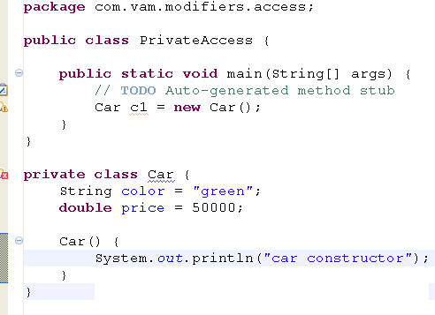
Class modifiers
Class access modifiers can be public or default access
Non – access modifiers can be final and abstract

Slide 8
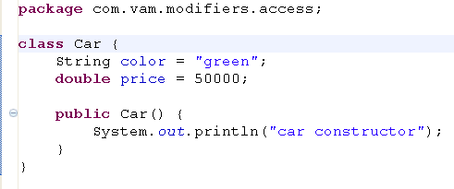
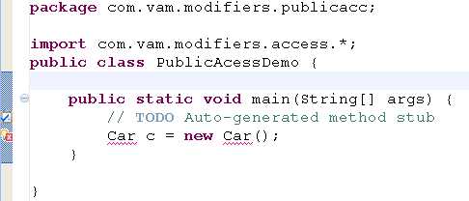
narrowing class access modifier

Slide 9
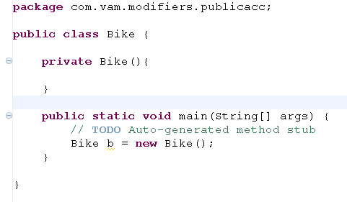
Constructor modifier
Acceesed by same class
If your constructor is private, Who can access
All 4 access level modifier is applicable
Non-accessmodifiers are not applicable
If you try to create an instance outside the class, it results compile time error

Slide 10
Default accesss modifier is used at class, method and variable level
It can be accessed in all the classes with in the package
Package A
Package B
Class A
classB
Class E
Class F
Class C
Class D
Class G
Class H

Slide 11
protected
Protected modifier is applied to method and variable level
Members can be accessed by all the classes with in the package + subclasses resided in other packages.
Package A
Package B
Class A
classB
Class E
Class F
Class C
Class D
Class G
Class H

Slide 12
Access modifiers - visibility
Visibility | Public | protected | default | private
From the same class | yes | yes | yes | yes
From any class in the same Package | Yes | Yes | Yes | no
From a subclass outside the same package | Yes | Yes | no | no
From a subclass in the same package | Yes | Yes (inheritance | Yes | no
From any non-subclass class outside the package | Yes | no | no | no

Slide 13

Subclasses and Method Privacy
Java specifies that methods may not be overridden to be more private.
legal overridden method access

Slide 14
Final – final class
It applies to classes, methods, and variables.
Final features cannot be changed.
A final class cannot be subclassed.
If a final variable is a reference to an object, it is the reference that must stay the same, not the object.
Common usage: declaring constants
final class Car{
void engine(){
System.out.println("engine started");
}
}
class Hyundai extends Car{
void engine(){
System.out.println("engine started");
}
}

Slide 15
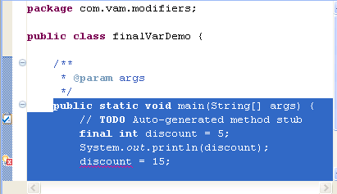
Final variables
It is used to declare the constant
It can be used with instance, static and local variables
syntax
final int a= 5;
A final variable cannot be modified once it has been assigned a value.

Slide 16
final method
It cannot be overridden
It is applicable only to instance methods
class Car{
final void engine(){
System.out.println("engine started");
}
}
class Hyundai extends Car{
void engine(){
System.out.println("engine started");
}
}

Slide 17
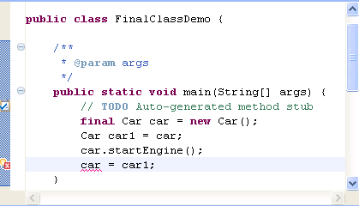
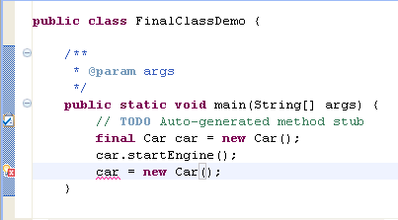
final object
If a final variable is a reference to an object,
it is the reference cannot be assigned to any object /object reference.
class Car{
void startEngine(){
System.out.println("engine started");
}
}
class Hyundai extends Car{
void startEngine(){
System.out.println("engine started");
}
}

Slide 18
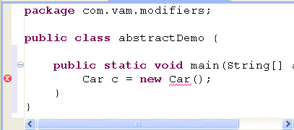
abstract modifier
abstract class Car{
String carColor;
double carPrice;
int noOfPassengers;
abstract void controlFuel();
void startEngine(){
System.out.println("engine started");
}
}
It is applicable to class and methods
An abstract class cannot be instantiated
abstract is the opposite of final:

Slide 19
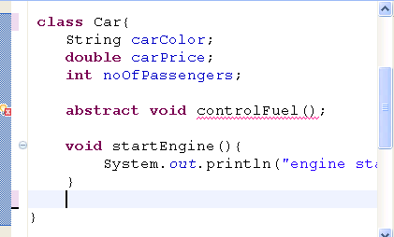
abstract modifier
If a class contains at least one abstract method, the compiler insists that the class must be declared abstract.

Slide 20
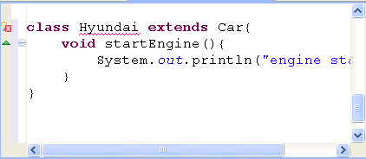
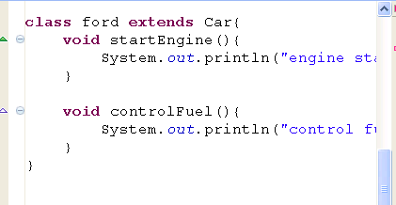
abstract modifier
Any subclass of abstract classes must provide an implementation of abstract method or declare itself to be abstract

Slide 21
Static modifier
It applies to variables, methods, static initializer.
A static feature belongs to a class
not an instance of the class.(One copy per class)
Static member is allocated once when class is loaded, the initialization also happens at class-load time.
two ways to reference a static variable:
    via a reference to any instance of the class (bad)
    via the class name (good)
Car car = new Car();
int p = car.price;
class Car{
static int price = 5;
}
Int p = Car.price

Slide 22

Static variables
They are not declared inside any methods or constructors
Class variables (belong to a class)
class Car{
static double price = 50000;
int noOfPass = 3;
}
Car c1 = new Car();
Car.price = 6000;
c1.noOfPass = 2;
System.out.println(c1.noOfPass + “” + Car.price);
Car c2 = new Car();
Car.price = 7000;
c2.noOfPass = 5;
System.out.println(c2.noOfPass + “” + Car.price);
System.out.println(Car.price);

Slide 23
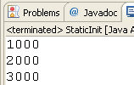
Static variable
SalesPerson p1 = new SalesPerson(1000);
System.out.println(SalesPerson.sales);
SalesPerson p2 = new SalesPerson(1000);
System.out.println(SalesPerson.sales);
SalesPerson p3 = new SalesPerson(1000);
System.out.println(SalesPerson.sales);
They are shared to all instances of that class
class SalesPerson{
static int sales;
SalesPerson(int tmpSales){
sales += tmpSales;
}
}

Slide 24
static block/initializer
The main purpose to use static initializer is to ensure some codes are loaded before the instance of class is constructed, one common usage of this feature is to load the JDBC driver in client code.
The compiler supports multiple initializer blocks within a class, but there is never a good reason for having more than one such block
Use static initialize should be used with caution, because it can easily be confusing and unclear.

Slide 25
static block/initializer
This block is loaded once during class load
Instance init Invoked when the instance are created
Static init Invoked only once
static{
System.out.println ("static block gets initialized");
}
{
System.out.println("instance block gets initialized");
}
ins1
loads
Constructors Invoked when the instance are created
create
staticInitBlock(){
System.out.println("constructor invoked");
}
Class staticInitBlock
ins2
create

Slide 26
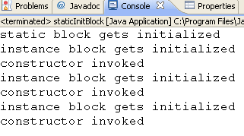
Static block
public static void main(String[] args) {
staticInitBlock ins1 = new staticInitBlock();
staticInitBlock ins2 = new staticInitBlock();
staticInitBlock ins3 = new staticInitBlock();
}
It is legal for a class to contain static code that does not exist within a method body.
A static initializer is a block of code that is simply surrounded by curly braces and labeled static.
The code inside the static initializer is executed exactly once, at the time the class is loaded.

Slide 27
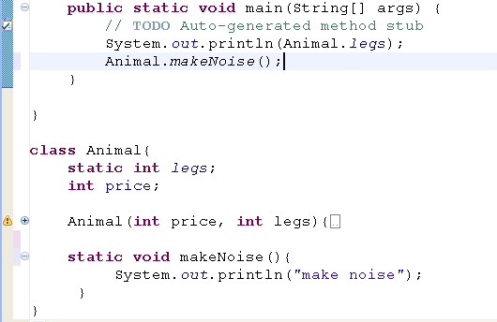
static Method
There is no guarantee that an instance exists when the static method is invoked. They may be invoked before even a single instance of the class is constructed. (example: main method)
Static variables and methods are accessed before any instance is created

Slide 28
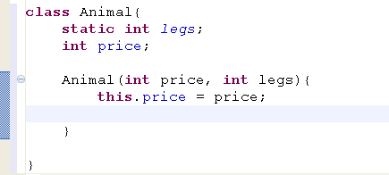
static Method
You have this keyword to reference instance variable whereas for static?
Animal(int price, int legs){
this.price = price;
Animal.legs = legs;
legs = legs;
}
Use class name to reference static variable
Refers to local variable

Slide 29
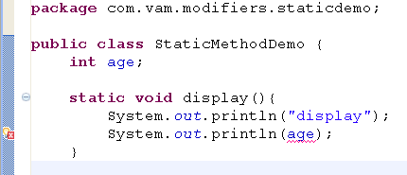
Static method access
If a static method needs to access a non-static variable or call a non-static method,
it must specify which instance of its class owns the variable or executes the method
StaticMethodDemo sd = new StaticMethodDemo
System.out.println(sd.age);

Slide 30
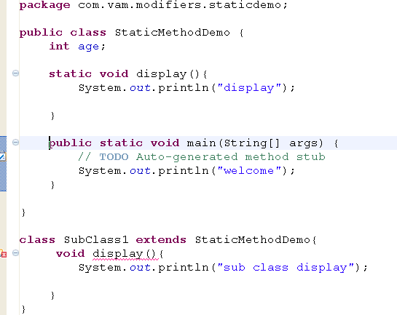
Static method - overriding
A static method may not be overridden to be non-static.
It can be override to another static method
static void display()

Slide 31
Synchronized method
The keyword indicates that a method can be accessed by only one thread at a time.
It applies to method only.
public synchronized User getUserInfo(int id) {
}

Slide 32
native
It applies to methods only.
With native methods, the body lies entirely outside the Java Virtual Machine, in a library written in non-Java language such as C, C++.
Try to avoid using native method, because it violates one of key feature of Java - platform-independent.
class NativeExample {
native void doSomethingLocal(int i);
static {
System.loadLibrary("MyNativeLib");
}
}
The librabry is loaded by calling System.loadLibrary(“library_name”); and you can use static initializer to load the library.

Slide 33
transient variable
It applies to instance variables only.
A transient variable will not be serialized
Transient variables must not be final or static
class car{
int wheel;
double price = 50000;
transient String color = "green";
}

Slide 34
Modifiers for different scopes
Local modifier
The only modifier for local variable is final
Instance Variable modifier
The access modifiers are – all 4 access level
Non access modifier – final, transient, volatile
Static variable modifiers
The access modifiers are – all 4 access level
Non access modifier – final

Slide 35
Method modifiers
Instance method modifier
The access modifiers are – all 4 access level
Non access modifier – final, abstract, native, strictfp, synchronized
Static variable modifiers
The access modifiers are – all 4 access level
Non access modifier – final, native, strictfp,synchronized

Slide 36
Restrictions on modifier
private and abstract cannot come together
abstract and final cannot come together
static and transient cannot come together
None of the non – access modifier come together with abstract

Slide 37
Scopes of a variable
There are 3 scopes of a variable
static
local
instance
They are declared inside the method
They die when the method completes its execution
They are declared in the general area of the class
They live until the jvm shuts down
They are declared in the general area of the class
They live until the instance is alive

Slide 38
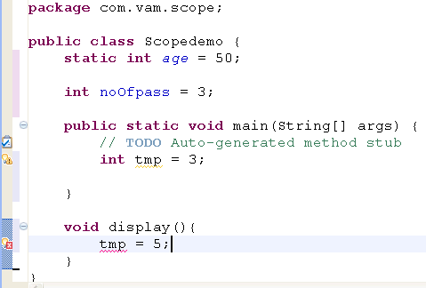
Scope of a local variable

Slide 39
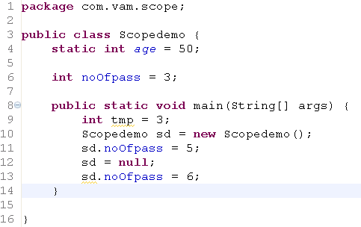

Scope of a instance variable

