Slide 1
OOC

Slide 2
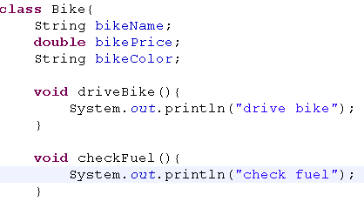
Class
A class is a template for an object.
Classes are user-defined data types.
It is a blueprint from which individual objects are created.
Once a class has been defined,
we can create any number of objects belonging to that class.
state
behaviour

Slide 3
Objects
An object is an instance of a class.
  Everything in Java is an object.
  “State” of an object is called an “instance variable”.
  “Behavior” of an object is known as “method”.
Heap space
Car car = new Car();
Car()
x1022
car
x1022
stack
New operator creates a new object dynamically at run time

Slide 4
Class components
State are the instance variable
Constructor special way of initializing instance variable
      Without it, none of the objects are created
Method behaviour of an object

Slide 5
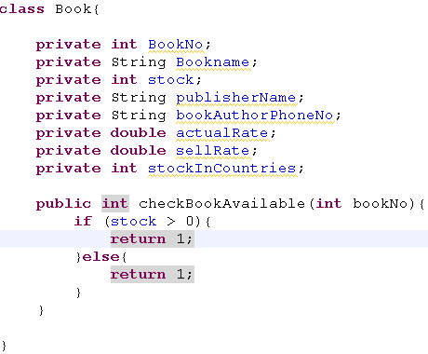

Data hiding
Generally client bothers to drive a car.
but he is not bothered about car mechanism
Client code does not know the book details,
0
Book book = new Book();
int bookNo = 1234;
book.checkBookAvailable(bookNo);

Slide 6
Diff between DataHiding and Encapsulation
It completely hides the data to the client
Forces the user to use an interface to access data

Slide 7
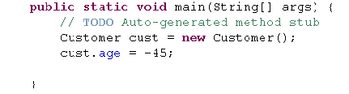
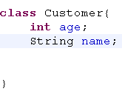
Why Encapsulation – case 1
Client code
If the fields are accessed directly by other classes, Data handling will be tedious
Age field cannot be negative in this case
Owner code should be able to handle these cases
Owner code

Slide 8
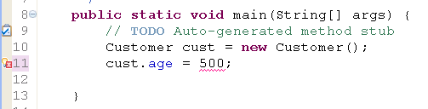
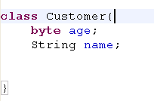
Why Encapsulation – case 2
When the owner tries to change the characteristics of a field in his code, client codes are all affected
In this case age value 500 cannot fit in to byte value

Slide 9
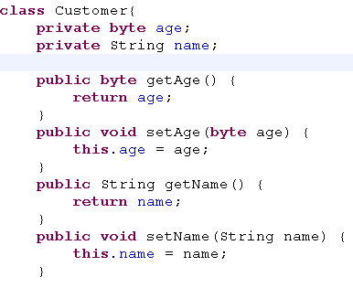
How to avoid these cases?
Encapsulation - Encapsulate the fields, is the better way
Achieving Encapsulation
How will you do the encapsulation?
Make all the fields private
Client should access these fields through getter and setter method

Slide 10
What is encapsulation
Owner code
Client code
cust.getAge();
setAge()
getAge()
age
Means wraps the data and code together as a single unit
Generally setters are called mutuators, getters are called accessors
Tight encapsulation is the good encapsulation(client should able to use accessors but not mutuators)
Encapsulation makes code maintaiable

Slide 11
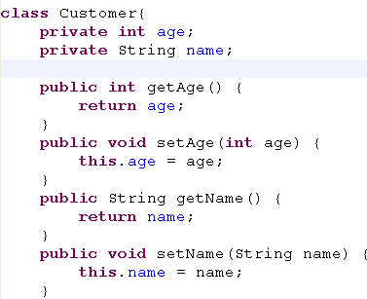

Encapsulation – the solution
In some situations, client need to use mutuators to assign fields
Consider the previous cases,
If a owner tries to change the characteristics as byte, then client code affects
What is the solution?
If the customer age is set to maximum of 30 years for a particluar loan scheme then the owner can provide the mutuators like this to assign to a byte field

Slide 12

Overloading
Java supports method overloading
More than one method name having same name with different parameters
JVM decides to call the method based on signatures
When to use overloading Overloading ?
Use it when you actually do need multiple methods with different parameters,
but the methods do the same thing.
In java , wait method is overloaded

Slide 13
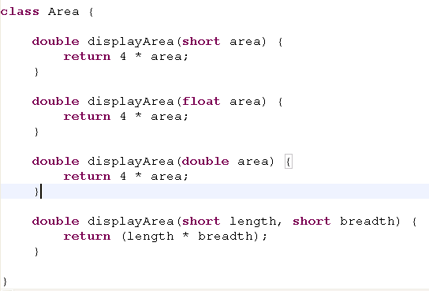
Overloading - Scenario
Area of a rectangle
Area of a square
In this case, single parameter- area of a square
Two parameter – area of a rectangle
Owner provides the client to access method displayArea() with different parameter type as input
Overloading involves in both single class or inheritance

Slide 14
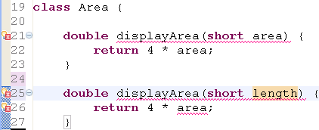
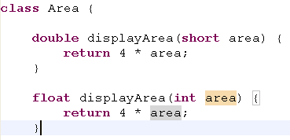
Overloading – legal and illegal
Eventhough argument names are different but they are same type
Illegal
Even if return types are different , they are legal
Overloading takes care for method names and its parameters, but not return types

Slide 15
Has – a - relationship
class Car{
Wheel wheel = new Wheel();
}
has
class Wheel {
}

Slide 16



Is-a-Relation ship
Object
Inheritance achieves is-a-relationship
99% polymorphism in java because all the built-in objects and user objects are inherited from Object class
Vehicle
Car
Bike

Slide 17
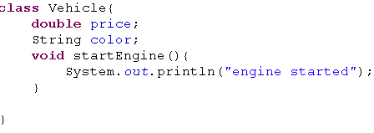
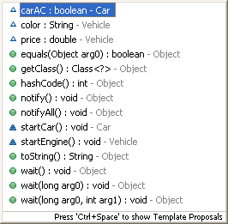
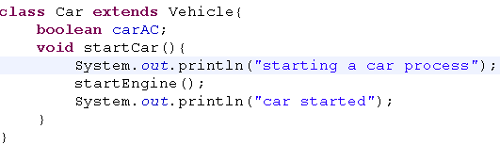
Code reuse
Two most common reasons to use inheritance are
To promote code reuse
To use polymorphism

Slide 18
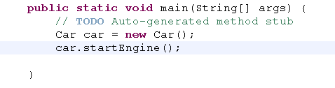
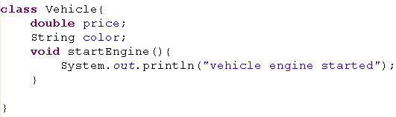
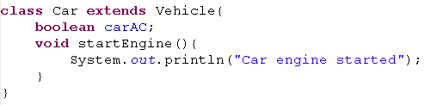

Overriding
Client code
startEngine() of car method overrides startEngine() of vehicle
Overridden mehod
output

Slide 19
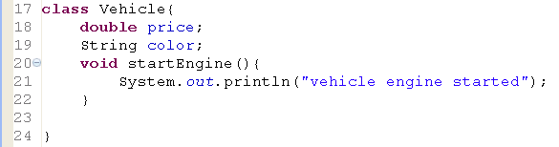

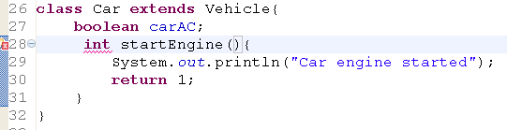
Overridden - restrictions
Overriding takes place when the methods in superclass and subclass having same signature and same return type
Return type can be different , if only a return type is covariant
Legal, because it is not overriding,
It is overloading
Cannot override because return types are different

Slide 20
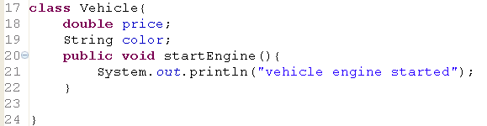
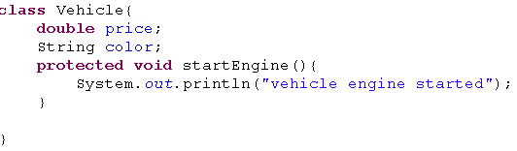
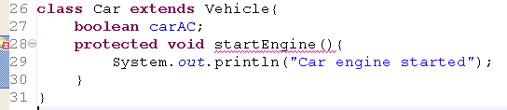
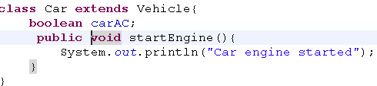
Access modifiers - overriding
Illegal
legal
Less restrictive
Overridden method access modifier must not be less restrictive
More restrictive

Slide 21
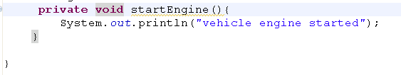
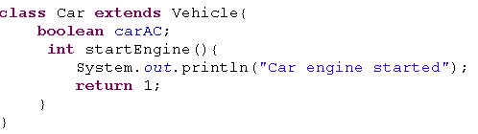
Overriding – private method
Why there is no error
Actually , Overriding does not takes place
Because super class method is private

Slide 22
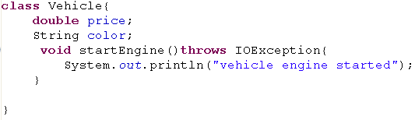
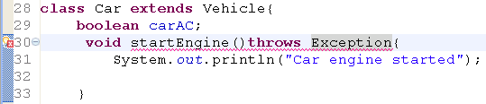
Exceptions in Overriding
Exception
IOException
Overridden method must throw narrowing exception , not widening exception

Slide 23
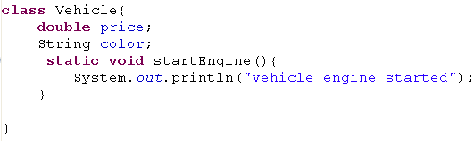
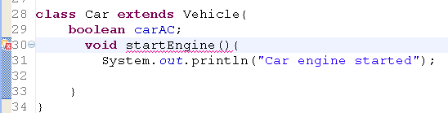
Override – static method
Static methods cannot override instance method
But it can override a static method

Slide 24
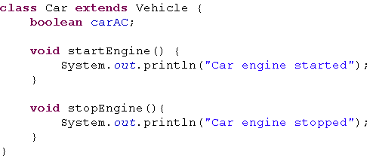

Run time Polymorphism in inheritance
class Vehicle {
double price;
String color;
void startEngine() {
System.out.println("vehicle engine started");
}
}
Vehicle reference references the method in vehicle class at compile time
but executes car version at run time.
This approach is called dynamic dispatching
public static void main(String[] args) {
// TODO Auto-generated method stub
Vehicle vc = new Car();
vc.startEngine();
}

Slide 25
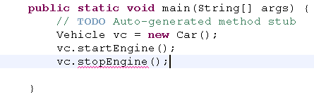
Run time polymorphism
Results compile time error
There is no method named stopEngine defined in vehicle class
Vehicle reference cannot reference the method at compile time

Slide 26
Default constructor
class Car{
int modelId = 1224;
String ModelName = "hyndai accent";
String color = "green";
}
If no constructor is defined,
Jvm defines the default constructor with no args
If you define a constructor with no args explicitly then it is called ?
A constructor is a set of instructions designed to initialize an instance.
The name of the constructor must always be the same as the class name.
Constructors are not methods. They do not have return values and are not inherited.
By default class modifier will be the constructor modifier

Slide 27
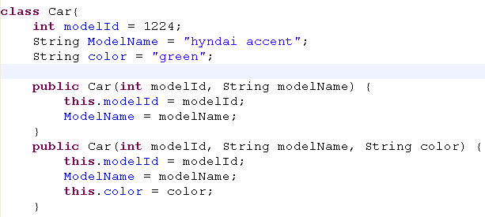

Default constructor
Default constructor is stopped supplied by your JVM
IF you explicitly define the constructor
In this case , you should define the constructor with no args
Generally defining a constructor with no args explicitly is a best practice

Slide 28
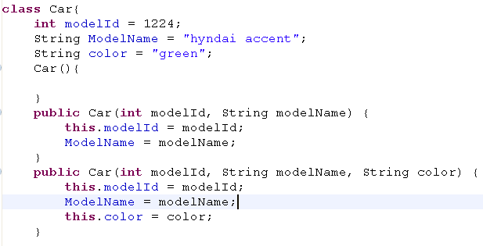
Constructor overloading
3 constructors
It calls the constructor with no args
Car car = new Car();

Slide 29

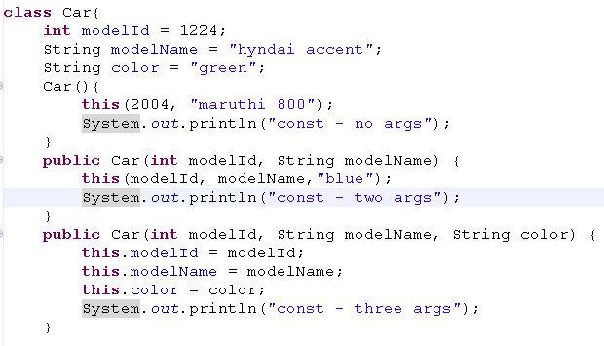
Constrctor chaining
this keyword must be as first statement
this() constructor calls the another constructor with in the class
Car()
Car(int modelId, String modelName)
Car(int modelId, String modelName, String color)

Slide 30
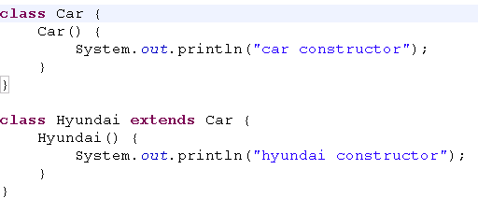


Constructor - inheritance
Client code
object
Car calls object constructor
Hyundai call car constructor

Slide 31
Constructor - What happens?
Jvm implicitly adds super() keyword as the first line, if this() or super() keyword is not given explicitly
If explicitly defined, this() or super() can be defined, but not both
Car() {
super();
System.out.println("car constructor");
}
Hyundai() {
super();
System.out.println("hyundai constructor");
}

Slide 32
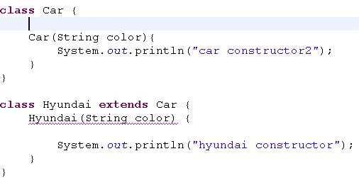
Constructor – super()
Car(String color){
super();
System.out.println("car constructor2");
}
Jvm rewrires the constructor
Hyundai(String color) {
super();
System.out.println("hyundai constructor");
}
When hyundai constructor tries to invoke super class constructor but fails, due to constructor’s absence
Best practice – always define a constructor with no args

Slide 33


Constructor – super()
How will you invoke the constructor with arguments in super class?
        Use super() keyword
Calls the super class constructor having one arg

